Slide 1
Verifying Neural Networks ReluPlex
Verifying cyberphysical systems
Sayan Mitra
mitras@illinois.edu
Reference : Introduction to Neural Network Verification by Aws Albarghouthi

Slide 2
Outline
Modeling neural networks
Requirements of neural networks
Reluplex algorithm

Slide 3
References
Reluplex: An Efficient SMT Solver for Verifying Deep Neural Networks by Guy Katz, Clark Barrett, David Dill, Kyle Julian, Mykel Kochenderfer, CAV 2017
Book: Introduction to Neural Network Verification by Aws Albarghouthi, 2021
Further exploration: Neural Network Verification competition: https://sites.google.com/view/vnn20/
Neural Networks and Deep Learning

Slide 4
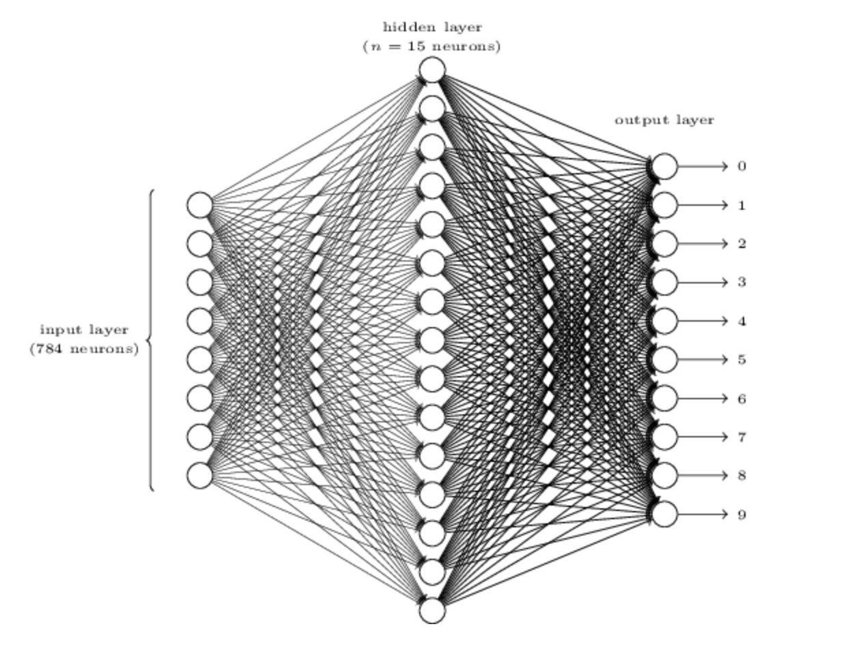
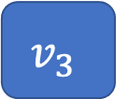
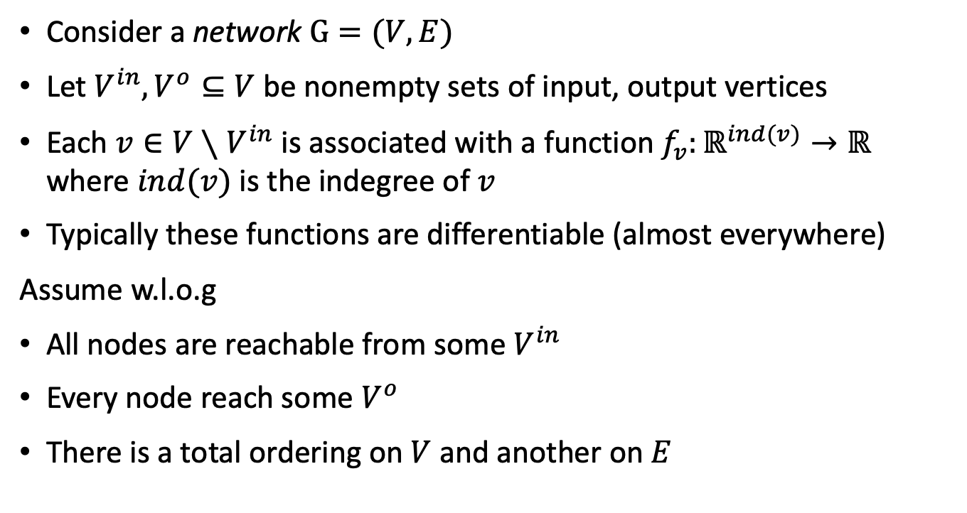

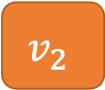
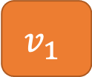
Neural networks as graphs
Consider a network $G=(V,E)$
Let $V^{in}, V^{o}⊆V$ be nonempty sets of input, output vertices
Each ${v∈V∖V}^{in}$ is associated with a function $f_{v}:ℝ^{ind(v)}→ℝ$ where $ind(v)$ is the indegree of $v$
Typically these functions are differentiable (almost everywhere)
Assume w.l.o.g
All nodes are reachable from some $V^{in}$
Every node reach some $V^{o}$
There is a total ordering on $V$ and another on $E$
http://neuralnetworksanddeeplearning.com/chap1.html
$$v_{1}$$
$$f_{v}$$
$$v_{3}$$
$$v_{2}$$

Slide 5
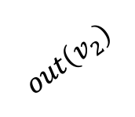
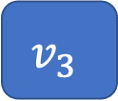
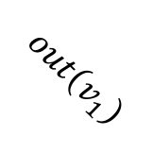
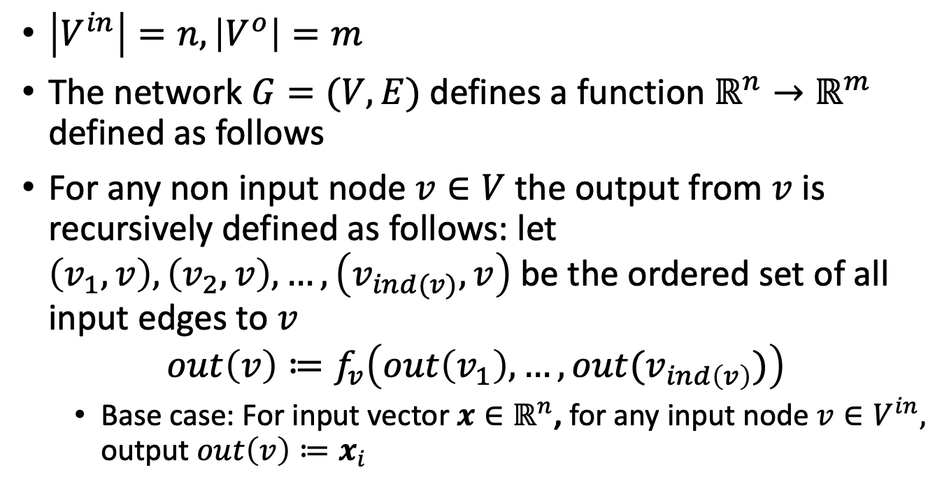

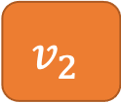
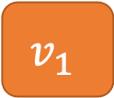
Computation performed by a Network
$\left|V^{in}\right|=n, \left|V^{o}\right|=m$
The network $G=(V,E)$ defines a function $ℝ^{n}→ℝ^{m}$ defined as follows
For any non input node $v∈V$ the output from $v$ is recursively defined as follows: let $\left(v_{1},v\right), \left(v_{2},v\right),…,\left(v_{ind(v)},v\right)$ be the ordered set of all input edges to $v$
$$out\left(v\right)≔f_{v}\left(out\left(v_{1}\right),…,out(v_{ind\left(v\right)})\right)$$
Base case: For input vector $x∈ℝ^{n}$, for any input node $v∈V^{in},$ output $out\left(v\right)≔x_{i}$
$$v_{1}$$
$$out\left(v_{1}\right)$$
$$f_{v}$$
$$v_{3}$$
$$out\left(v_{2}\right)$$
$$v_{2}$$

Slide 6
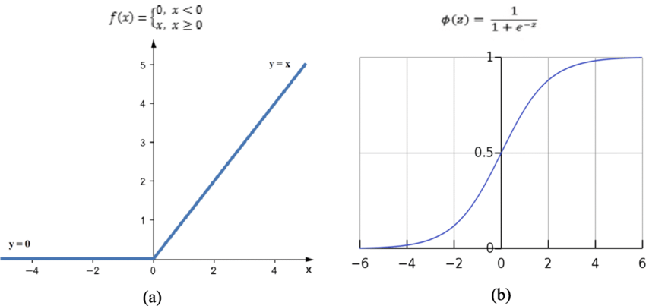
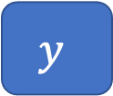
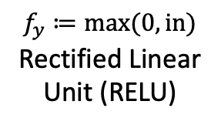


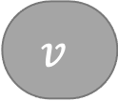
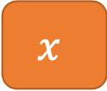
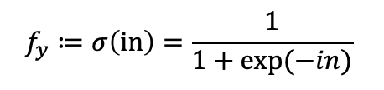
Example functions
$$f_{v}≔2in+1$$
$$out\left(y\right)=f_{y}\left(f_{v}\left(out\left(x\right)\right)\right)$$
$=f_{y}\left(f_{v}\left(x\right)\right)$
$=f_{y}\left(2x+1\right)$
$=max⁡(0,2x+1)$
$$x$$
$$v$$
$$y$$
$$f_{y}≔max(0,in)$$
Rectified Linear Unit (RELU)
RELU
Sigmoid
$$f_{y}≔σ\left(in\right)=\frac{1}{1+exp⁡(−in)}$$

Slide 7
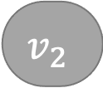
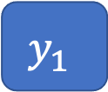
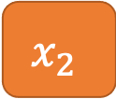
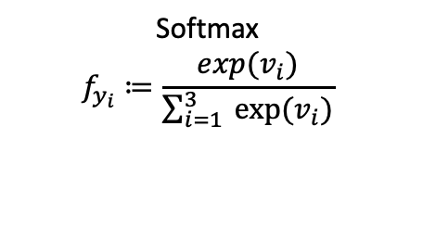
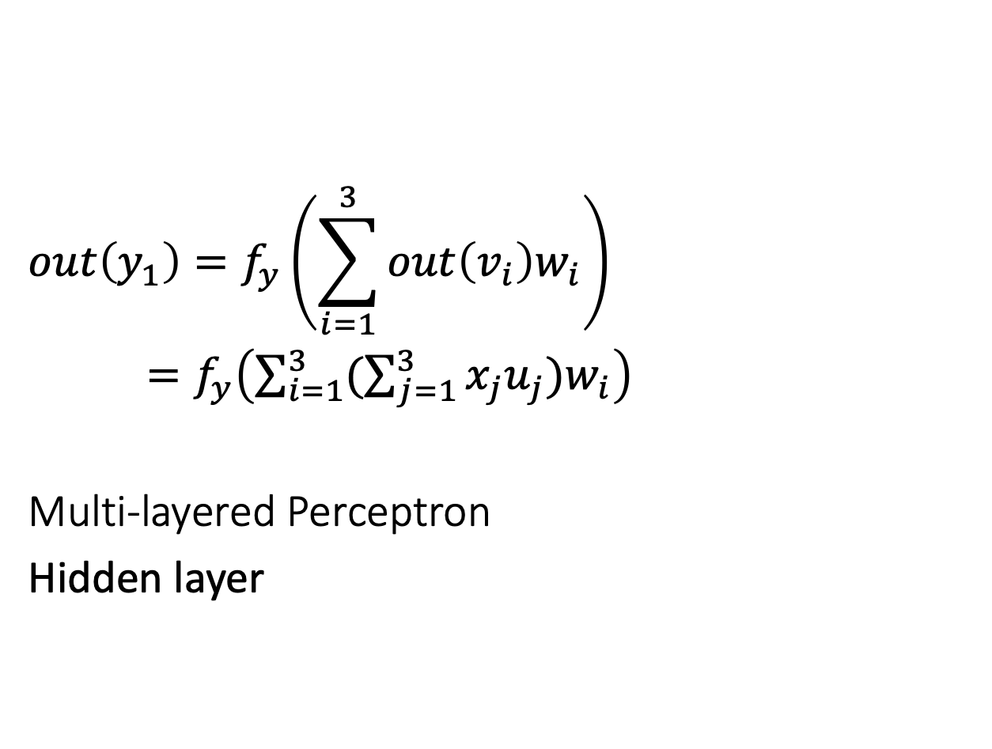
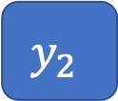
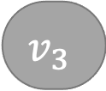
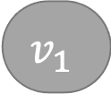
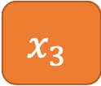
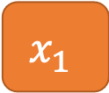
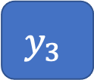
Example functions
$$x_{1}$$
$$v_{1}$$
$$y_{1}$$
$$x_{2}$$
$$v_{2}$$
$$y_{2}$$
$$out\left(y_{1}\right)=f_{y}\left(\sum_{i=1}^{3}{out\left(v_{i}\right)w_{i}}\right)$$
$=f_{y}\left(\sum_{i=1}^{3 }{(\sum_{j=1}^{3 }{x_{j}u_{j}})w_{i}}\right)$
Multi-layered Perceptron
Hidden layer
$$x_{3}$$
$$v_{3}$$
$$y_{3}$$
Softmax
$$f_{y_{i}}≔\frac{exp(v_{i})}{\sum_{i=1}^{3}{ exp⁡(v_{i})}}$$

Slide 8




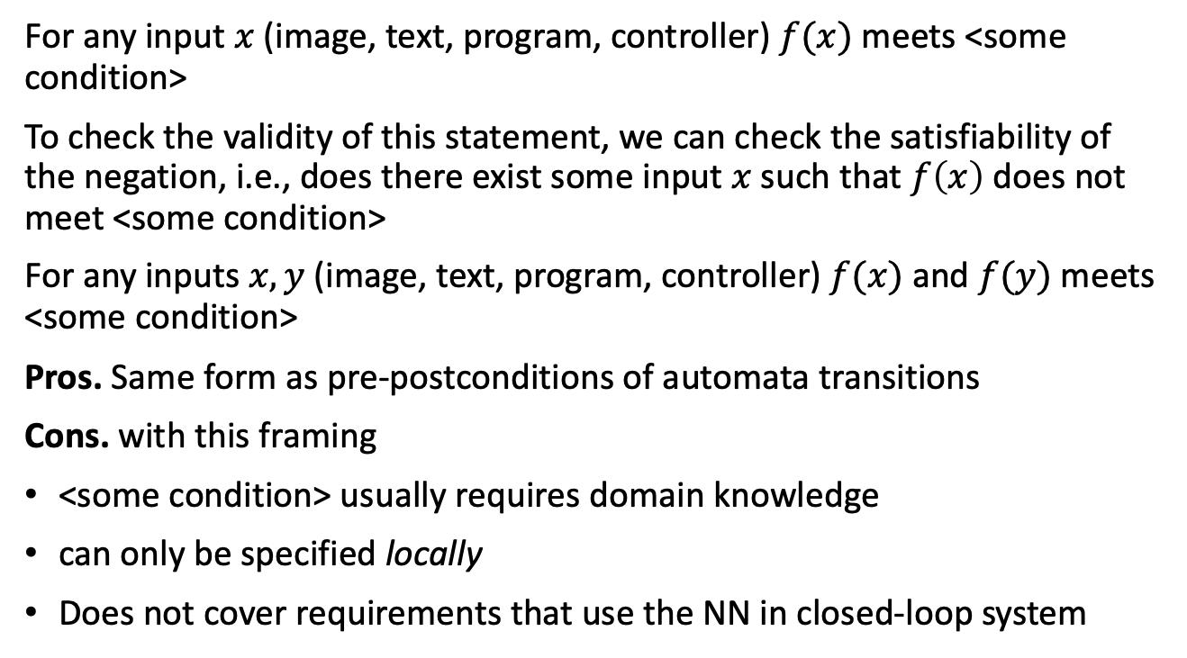






Typical requirements studied for neural networks
For any input $x$ (image, text, program, controller) $f(x)$ meets <some condition>
To check the validity of this statement, we can check the satisfiability of the negation, i.e., does there exist some input $x$ such that $f\left(x\right)$ does not meet <some condition>
For any inputs $x,y$ (image, text, program, controller) $f(x)$ and $f(y)$meets <some condition>
Pros. Same form as pre-postconditions of automata transitions
Cons. with this framing
<some condition> usually requires domain knowledge
can only be specified locally
Does not cover requirements that use the NN in closed-loop system
$$x_{1}$$
$$v_{1}$$
$$y_{1}$$
$$x_{2}$$
$$v_{2}$$
$$y_{2}$$
$$x_{3}$$
$$v_{3}$$
$$y_{3}$$
$$g$$

Slide 9
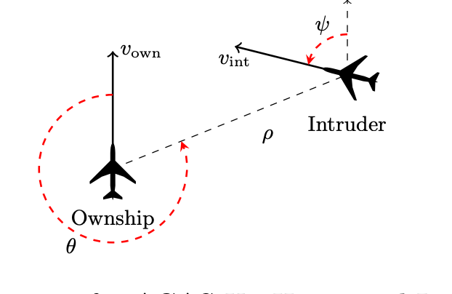
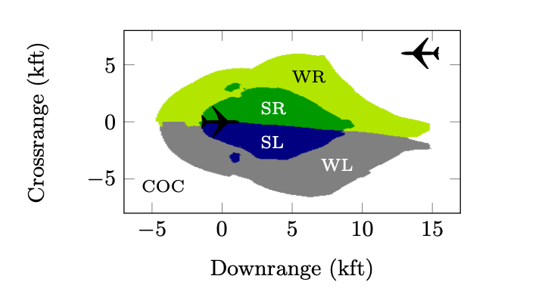
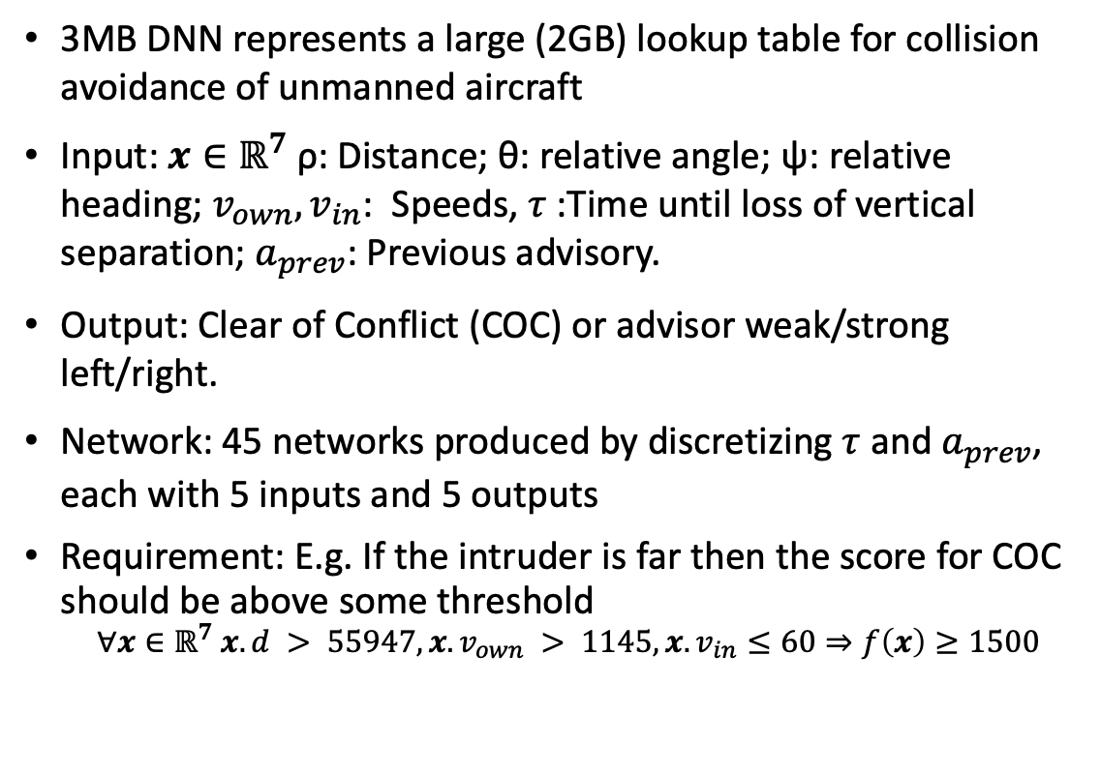
Application: ACAS Xu system
3MB DNN represents a large (2GB) lookup table for collision avoidance of unmanned aircraft
Input: $x∈ℝ^{7}$ ρ: Distance; θ: relative angle; ψ: relative heading; $v_{own},v_{in}$: Speeds, $τ$:Time until loss of vertical separation; $a_{prev}$: Previous advisory.
Output: Clear of Conflict (COC) or advisor weak/strong left/right.
Network: 45 networks produced by discretizing $τ$ and $a_{prev}$, each with 5 inputs and 5 outputs
Requirement: E.g. If the intruder is far then the score for COC should be above some threshold
$$∀x∈ℝ^{7} x.d > 55947, {x.v}_{own} > 1145, {x.v}_{in}≤60⇒f\left(x\right)≥1500$$

Slide 10
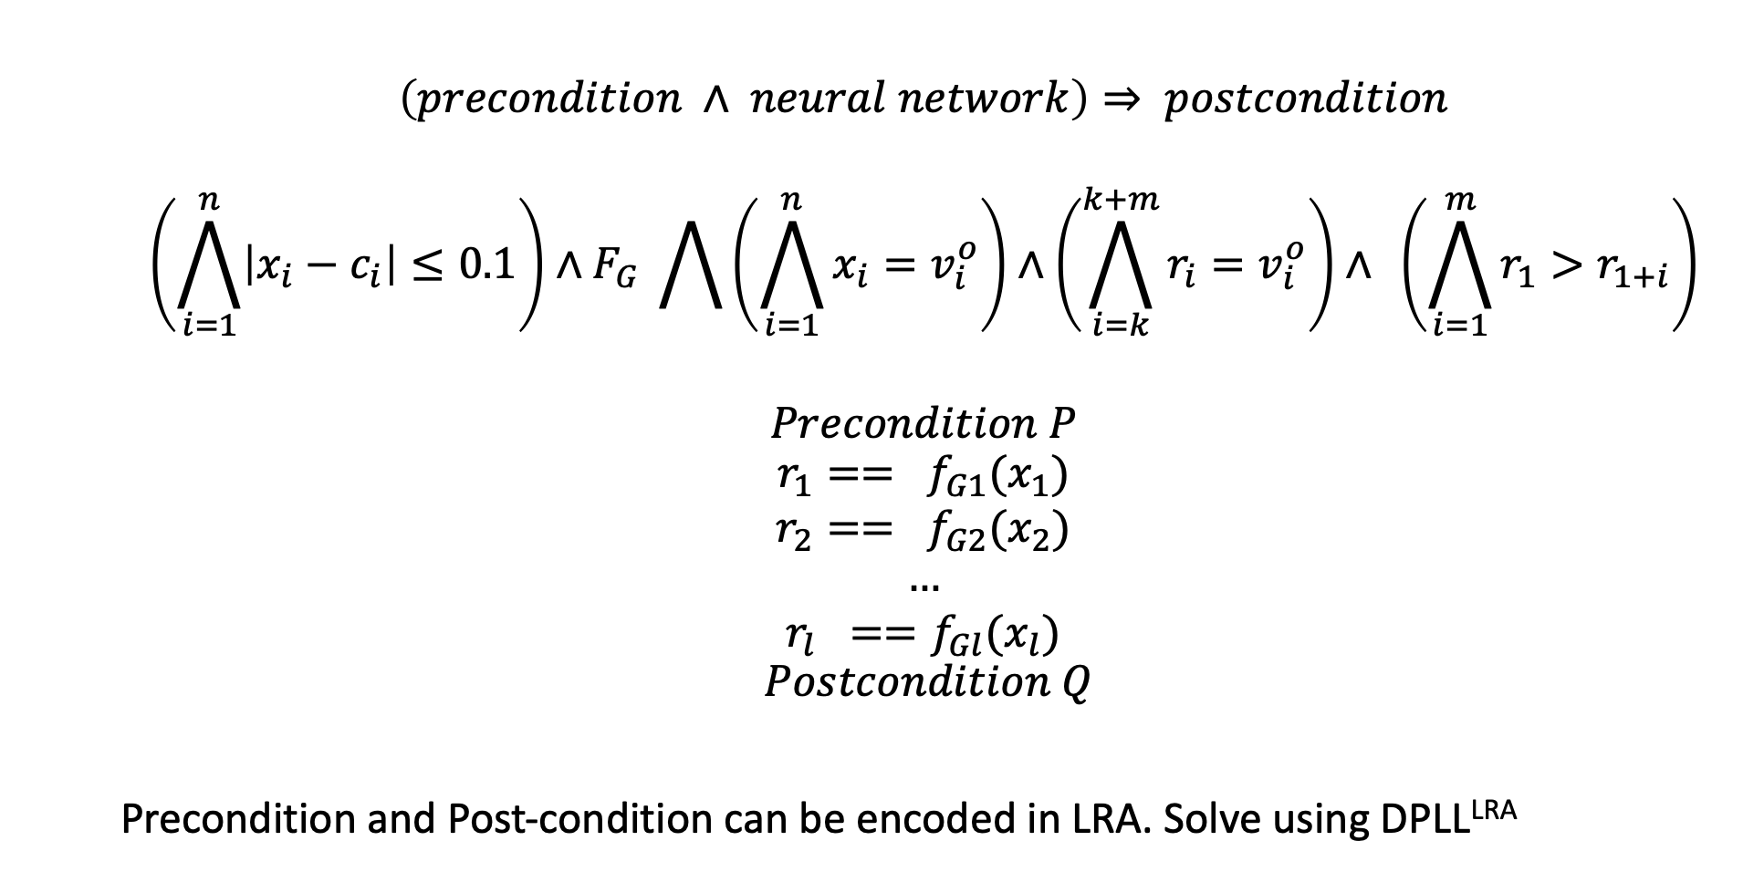
General formulation of correctness
$$\left(precondition ∧ neural network\right)⇒ postcondition$$
$$\left(\bigwedge_{i=1}^{n}{\left|x_{i}−c_{i}\right|≤0.1}\right)∧F_{G} \bigwedge{\left(\bigwedge_{i=1}^{n}{x_{i}=v_{i}^{o}}\right)∧\left(\bigwedge_{i=k}^{k+m}{r_{i}=v_{i}^{o}}\right)}∧ \left(\bigwedge_{i=1}^{m}{r_{1}>r_{1+i}}\right)$$
$$Precondition P$$
$$r_{1}== f_{G1}(x_{1})$$
$$r_{2}== f_{G2}(x_{2})$$
$$…$$
$$r_{l} ==f_{Gl}(x_{l})$$
$$Postcondition Q$$
Precondition and Post-condition can be encoded in LRA. Solve using DPLL^{LRA}

Slide 11

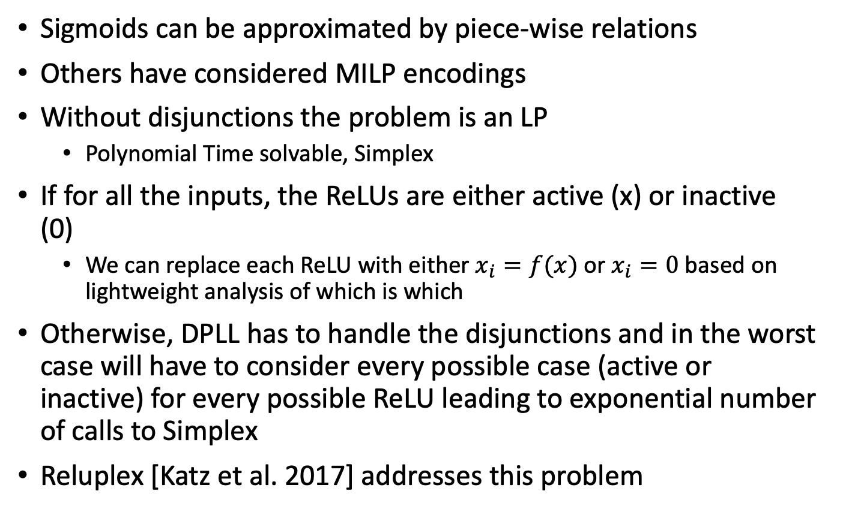



Sigmoids and ReLUs and exponential blow-up
Sigmoids can be approximated by piece-wise relations
Others have considered MILP encodings
Without disjunctions the problem is an LP
Polynomial Time solvable, Simplex
If for all the inputs, the ReLUs are either active (x) or inactive (0)
We can replace each ReLU with either $x_{i}=f(x)$ or $x_{i}=0$ based on lightweight analysis of which is which
Otherwise, DPLL has to handle the disjunctions and in the worst case will have to consider every possible case (active or inactive) for every possible ReLU leading to exponential number of calls to Simplex
Reluplex [Katz et al. 2017] addresses this problem
$$y_{i+1}$$
$$y_{i}$$
$$x_{i}$$
$$x_{i+1}$$

Slide 12
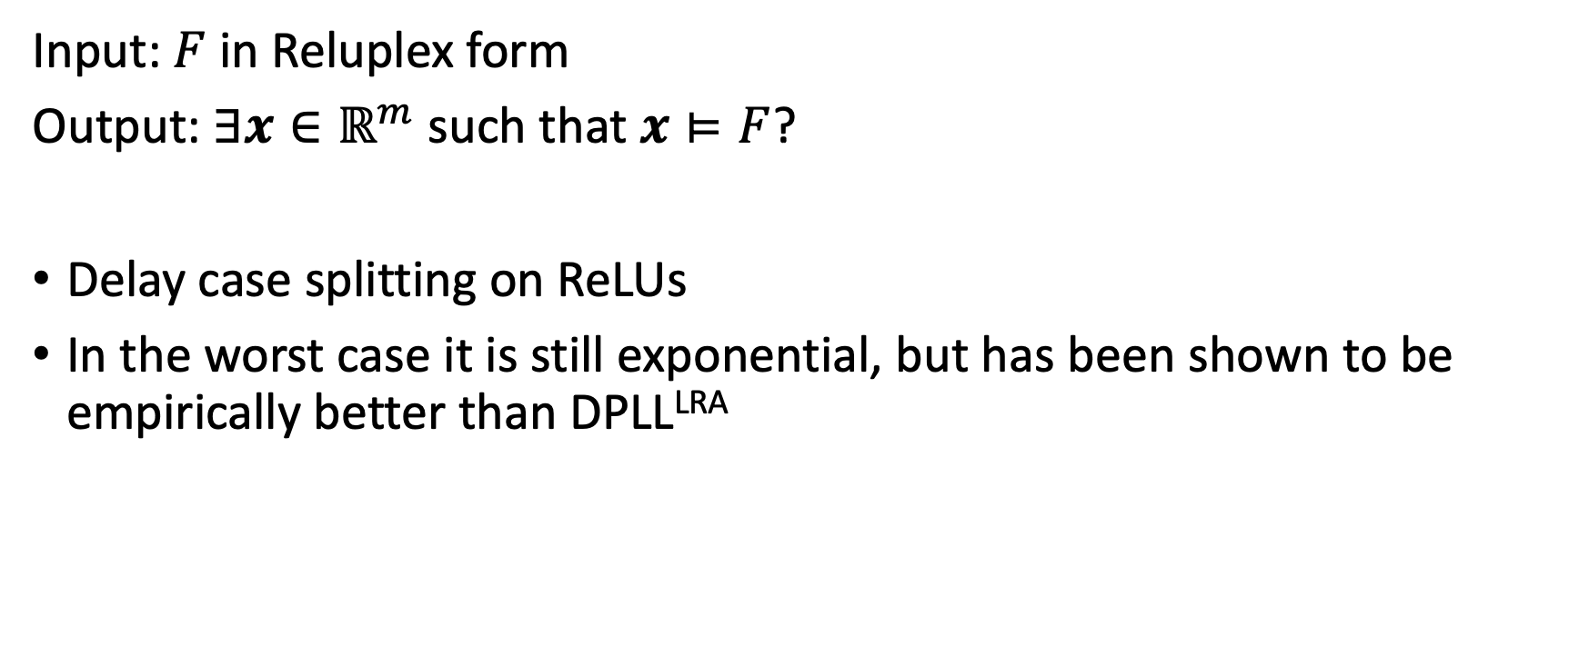
Reluplex Decision Procedure for ReLU NNs
Input: $F$ in Reluplex form
Output: $∃x∈ℝ^{m}$such that $x⊨F$?
Delay case splitting on ReLUs
In the worst case it is still exponential, but has been shown to be empirically better than DPLL^{LRA}
Notes:
Dantzig realized that one of the unsolved problems that he had mistaken as homework in his professor Jerzy Neyman's class (and actually later solved), was applicable to finding an algorithm for linear programs.
From: https://en.wikipedia.org/wiki/George_Dantzig#Mathematical_statistics
In 1939, a misunderstanding brought about surprising results. Near the beginning of a class, Professor Neyman wrote two problems on the blackboard. Dantzig arrived late and assumed that they were a homework assignment. According to Dantzig, they "seemed to be a little harder than usual", but a few days later he handed in completed solutions for both problems, still believing that they were an assignment that was overdue.^{[4][6]} Six weeks later, an excited Neyman eagerly told him that the "homework" problems he had solved were two of the most famous unsolved problems in statistics.
story persisted in the form of an urban legend and as an introductory scene in the movie Good Will Hunting.^{[6]}

Slide 13
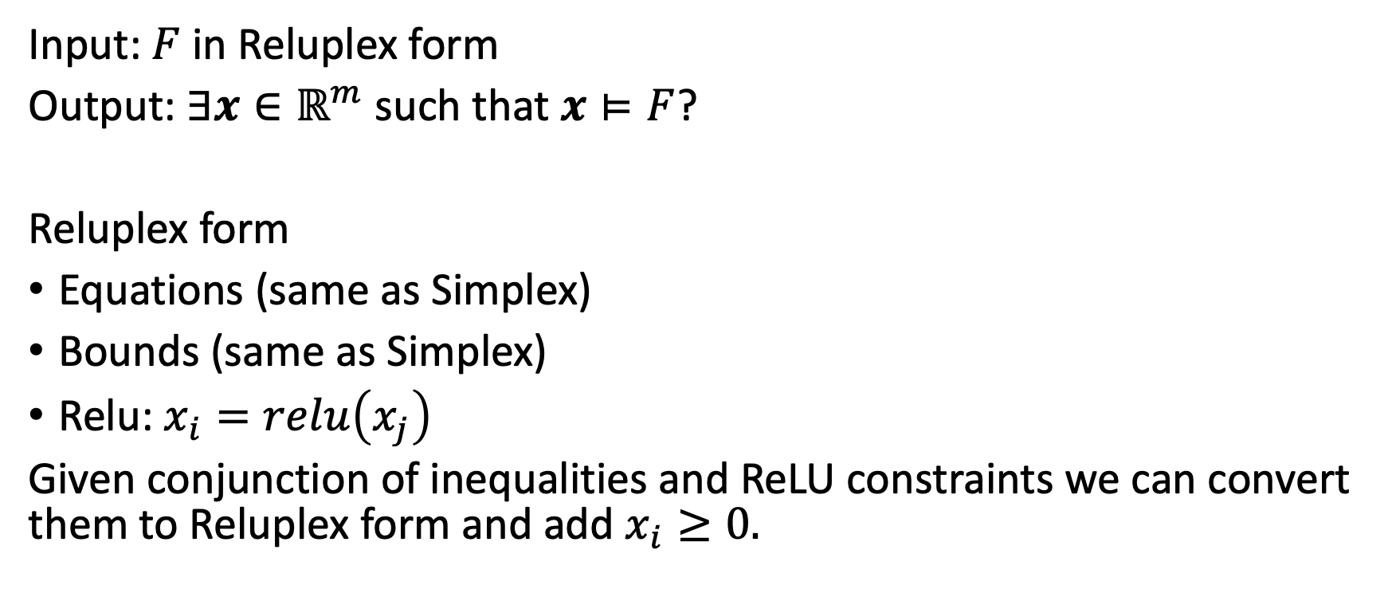
Reluplex Decision Procedure for ReLU NNs
Input: $F$ in Reluplex form
Output: $∃x∈ℝ^{m}$such that $x⊨F$?
Reluplex form
Equations (same as Simplex)
Bounds (same as Simplex)
Relu: $x_{i}=relu\left(x_{j}\right)$
Given conjunction of inequalities and ReLU constraints we can convert them to Reluplex form and add $x_{i}≥0.$
Notes:
Dantzig realized that one of the unsolved problems that he had mistaken as homework in his professor Jerzy Neyman's class (and actually later solved), was applicable to finding an algorithm for linear programs.
From: https://en.wikipedia.org/wiki/George_Dantzig#Mathematical_statistics
In 1939, a misunderstanding brought about surprising results. Near the beginning of a class, Professor Neyman wrote two problems on the blackboard. Dantzig arrived late and assumed that they were a homework assignment. According to Dantzig, they "seemed to be a little harder than usual", but a few days later he handed in completed solutions for both problems, still believing that they were an assignment that was overdue.^{[4][6]} Six weeks later, an excited Neyman eagerly told him that the "homework" problems he had solved were two of the most famous unsolved problems in statistics.
story persisted in the form of an urban legend and as an introductory scene in the movie Good Will Hunting.^{[6]}

Slide 14
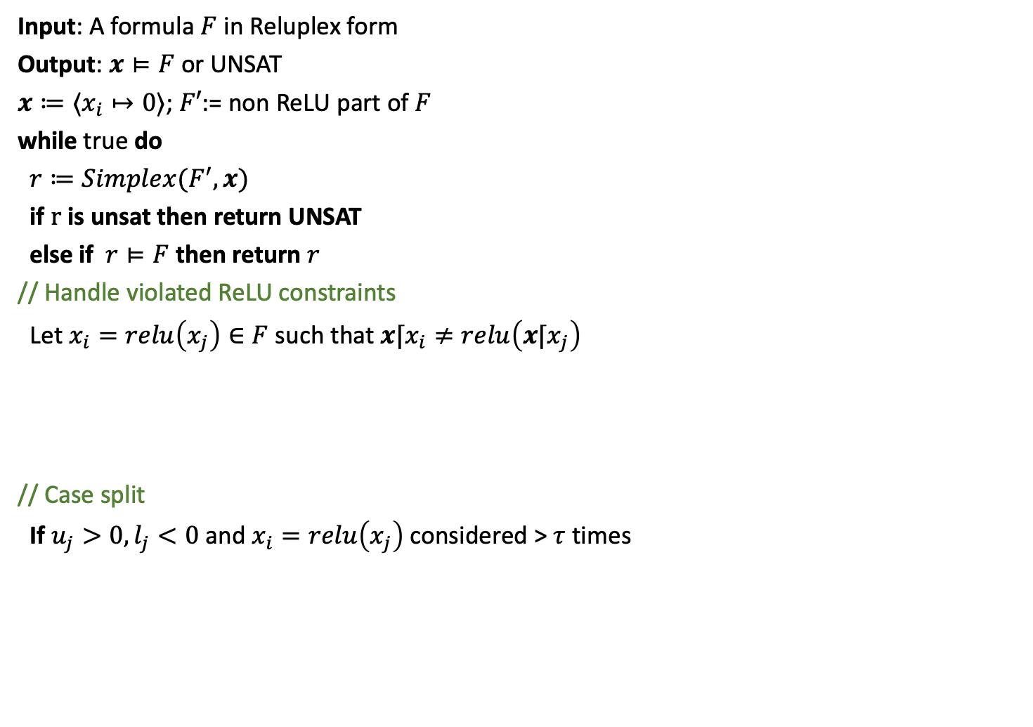
Reluplex
Input: A formula $F$ in Reluplex form
Output: $x⊨F$ or UNSAT
$x≔⟨x_{i}↦0⟩$; $F′$:= non ReLU part of $F$
while true do
$r≔Simplex(F^{′},x)$
if $r$ is unsat then return UNSAT
else if $r⊨F$ then return $r$
// Handle violated ReLU constraints
Let $x_{i}=relu\left(x_{j}\right)∈F$ such that ${x⌈x}_{i}≠relu\left(x⌈x_{j}\right)$
if $x_{i}$ is basic then pivot $x_{i}$ with non-basic variable $x_{k}$ where $k≠j$ and $c_{ik}≠0$
if $x_{j}$ is basic then pivot $x_{j}$ with non-basic variable $x_{k}$ where $k≠i$ and $c_{jk}≠0$
${x⌈x}_{i}≔relu(x⌈x_{j})$ OR ${x⌈x}_{j}≔x⌈x_{i}$
// Case split
If $u_{j}>0, l_{j}<0$ and $x_{i}=relu\left(x_{j}\right)$ considered > $τ$ times
$r_{1}=Reluplex(F∧x_{j}≥0∧x_{j}=x_{j})$
$r_{2}=Reluplex(F∧x_{j}≤0∧x_{i}=0)$
if $r_{1}=r_{2}=$ unsat then return UNSAT
else if $r_{1}=unsat$ then return $r_{1}$ else return $r_{2}$

Slide 15
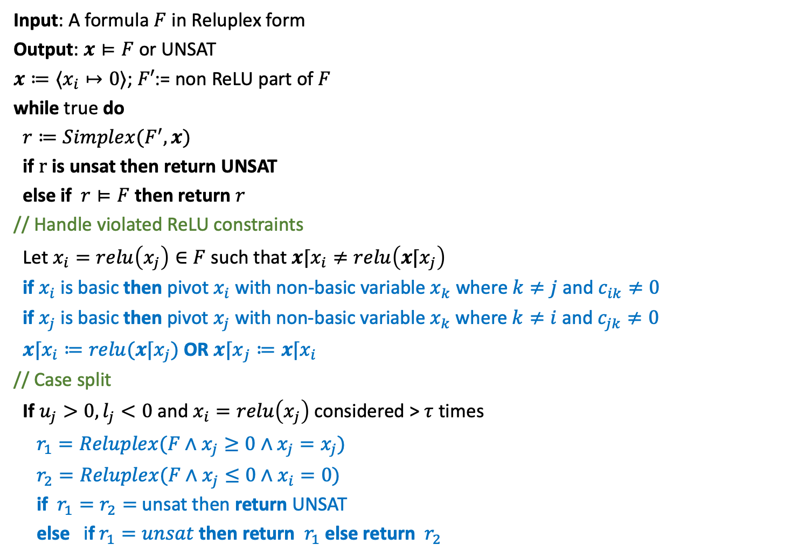
Reluplex
Input: A formula $F$ in Reluplex form
Output: $x⊨F$ or UNSAT
$x≔⟨x_{i}↦0⟩$; $F′$:= non ReLU part of $F$
while true do
$r≔Simplex(F^{′},x)$
if $r$ is unsat then return UNSAT
else if $r⊨F$ then return $r$
// Handle violated ReLU constraints
Let $x_{i}=relu\left(x_{j}\right)∈F$ such that ${x⌈x}_{i}≠relu\left(x⌈x_{j}\right)$
if $x_{i}$ is basic then pivot $x_{i}$ with non-basic variable $x_{k}$ where $k≠j$ and $c_{ik}≠0$
if $x_{j}$ is basic then pivot $x_{j}$ with non-basic variable $x_{k}$ where $k≠i$ and $c_{jk}≠0$
${x⌈x}_{i}≔relu(x⌈x_{j})$ OR ${x⌈x}_{j}≔x⌈x_{i}$
// Case split
If $u_{j}>0, l_{j}<0$ and $x_{i}=relu\left(x_{j}\right)$ considered > $τ$ times
$r_{1}=Reluplex(F∧x_{j}≥0∧x_{j}=x_{j})$
$r_{2}=Reluplex(F∧x_{j}≤0∧x_{i}=0)$
if $r_{1}=r_{2}=$ unsat then return UNSAT
else if $r_{1}=unsat$ then return $r_{1}$ else return $r_{2}$

Slide 16
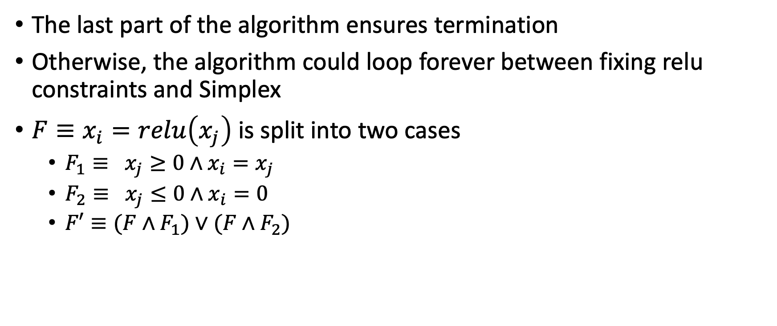
Termination
The last part of the algorithm ensures termination
Otherwise, the algorithm could loop forever between fixing relu constraints and Simplex
$F≡x_{i}=relu\left(x_{j}\right)$ is split into two cases
$F_{1}≡ x_{j}≥0∧x_{i}=x_{j}$
$F_{2}≡ x_{j}≤0∧x_{i}=0$
$F′≡{(F∧F}_{1})∨(F∧F_{2})$

Slide 17
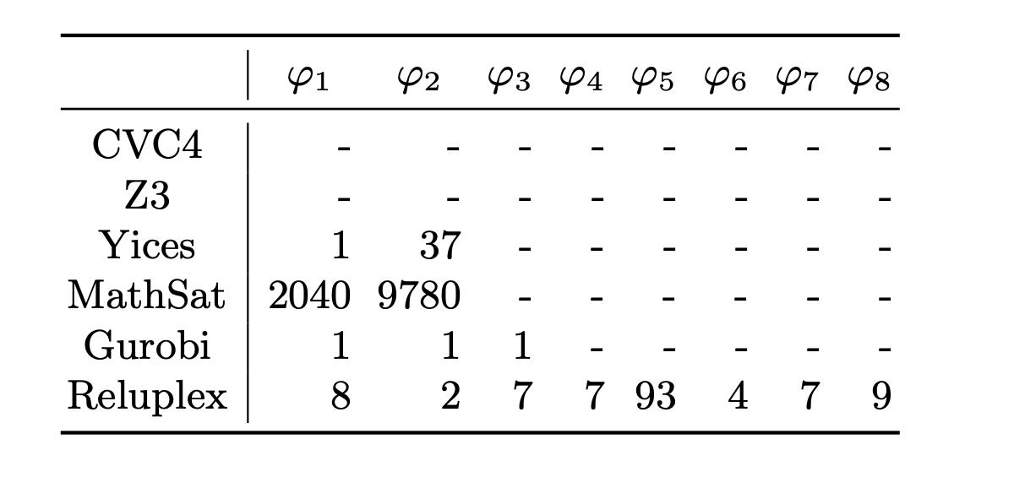
Performance of Reluplex on ACAS

Slide 18
Summary
Input-output and robustness requirements of neural networks can be expressed as satisfiability queries
Without ReLU and disjunctions the requirements can be checked efficiently, e.g., Simplex
Reluplex implements smarter case splitting

