Slide 1
Verifying Neural Networks ReluPlex
Verifying cyberphysical systems
Sayan Mitra
mitras@illinois.edu
Reference : Introduction to Neural Network Verification by Aws Albarghouthi

Slide 2
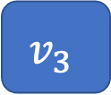
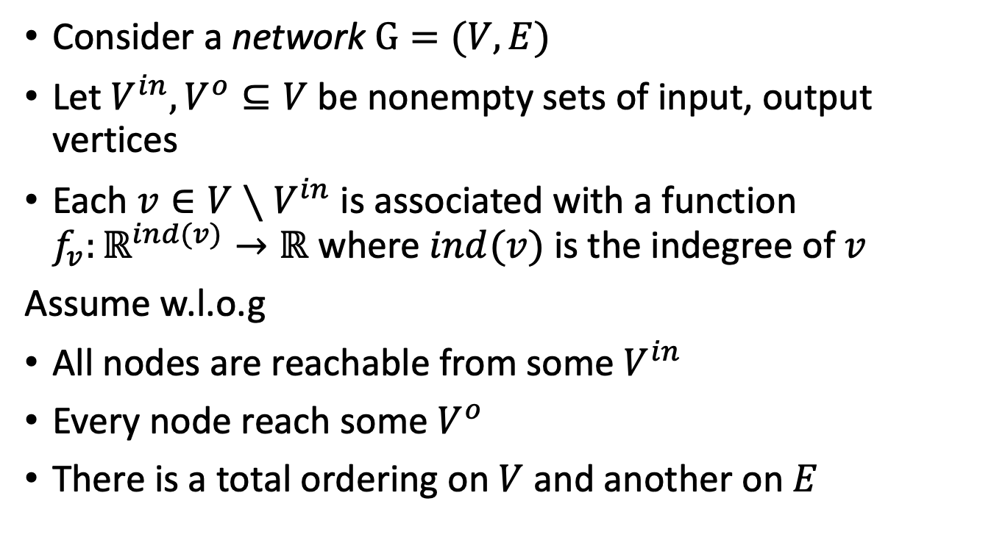

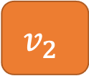
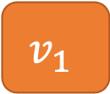
Neural networks as graphs
Consider a network $G=(V,E)$
Let $V^{in}, V^{o}⊆V$ be nonempty sets of input, output vertices
Each ${v∈V∖V}^{in}$ is associated with a function $f_{v}:ℝ^{ind(v)}→ℝ$ where $ind(v)$ is the indegree of $v$
Assume w.l.o.g
All nodes are reachable from some $V^{in}$
Every node reach some $V^{o}$
There is a total ordering on $V$ and another on $E$
$$v_{1}$$
$$f_{v}$$
$$v_{3}$$
$$v_{2}$$

Slide 3
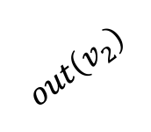
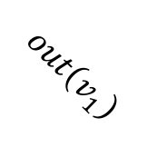
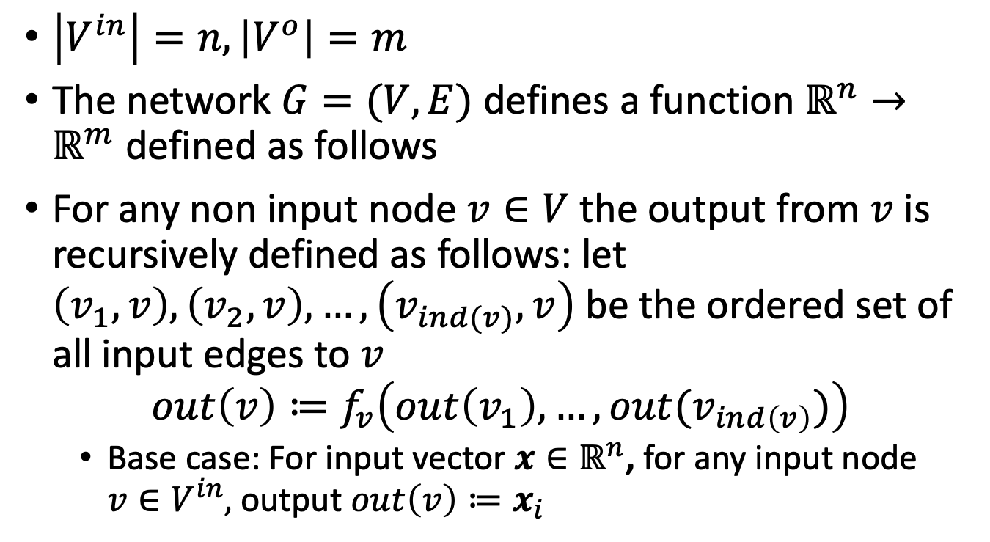

Computation performed by a Network
$\left|V^{in}\right|=n, \left|V^{o}\right|=m$
The network $G=(V,E)$ defines a function $ℝ^{n}→ℝ^{m}$ defined as follows
For any non input node $v∈V$ the output from $v$ is recursively defined as follows: let $\left(v_{1},v\right), \left(v_{2},v\right),…,\left(v_{ind(v)},v\right)$ be the ordered set of all input edges to $v$
$$out\left(v\right)≔f_{v}\left(out\left(v_{1}\right),…,out(v_{ind\left(v\right)})\right)$$
Base case: For input vector $x∈ℝ^{n}$, for any input node $v∈V^{in},$ output $out\left(v\right)≔x_{i}$
$$v_{1}$$
$$out\left(v_{1}\right)$$
$$f_{v}$$
$$v_{3}$$
$$out\left(v_{2}\right)$$
$$v_{2}$$

Slide 4
Example functions

Slide 5
Properties on NNs

Slide 6
ReluPlex

