Slide 1
ECE/CS 584: Verification of Embedded Computing Systems Model Checking Timed Automata
Sayan Mitra
Lecture 09

Slide 2
Reachability analysis: Integer Timed Automaton
Sayan Mitra
Verifying cyberphysical systems
mitras@illinois.edu

Slide 3
This course so far
A modeling framework
Discrete and continuous dynamics
Compositional (modular) modeling
General proof techniques for proving invariants

Slide 4
Next
Focus on specific classes of Hybrid Automata for which safety properties (invariants) can be verified completely automatically
Alur-Dill’s Timed Automata[1] (Today)
Rectangular initializaed hybrid automata
Linear hybrid automata
…
Later we will look at other types of properties like stability, liveness, etc.
We will introduce notions of abstractions and invariance are still going to be important
[1] Rajeev Alur et al. The Algorithmic Analysis ofHybrid Systems. Theoretical Computer Science, colume 138, pages 3-34, 1995.

Slide 5
Today
Algorithmic analysis of (Alur-Dill’s) Timed Automata[1]
A restricted class of what we call hybrid automata in this course with only clock variables
[1] Rajeev Alur and David L. Dill. A theory of timed automata. Theoretical Computer Science, 126:183-235, 1994.

Slide 6
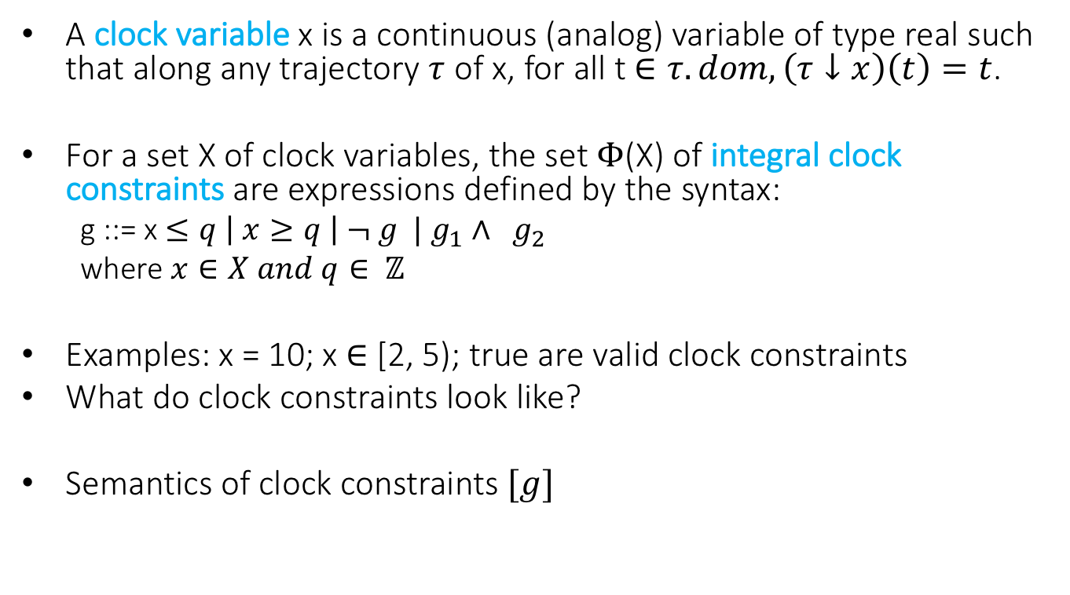
Clocks and Clock Constraints
A clock variable x is a continuous (analog) variable of type real such that along any trajectory $τ$ of x, for all t $∈τ.dom, \left(τ↓x\right)\left(t\right)=t$.
For a set X of clock variables, the set $Φ$(X) of integral clock constraints are expressions defined by the syntax:
g ::= x $≤q \left| x≥q \right| ¬ g | g_{1}∧ g_{2}$
where $x∈X and q∈ ℤ$
Examples: x = 10; x $∈$ [2, 5); true are valid clock constraints
What do clock constraints look like?
Semantics of clock constraints $[g]$

Slide 7
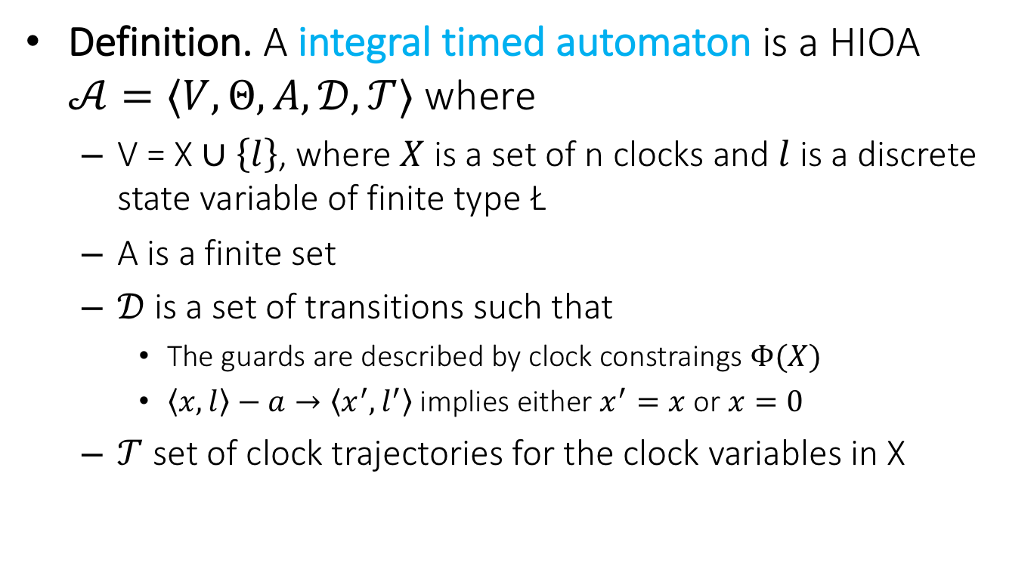
Integral Timed Automata
Definition. A integral timed automaton is a HIOA $𝒜=〈V, Θ, A, 𝒟, 𝒯〉$ where
V = X $∪\left\{l\right\}$, where $X$ is a set of n clocks and $l$ is a discrete state variable of finite type Ł
A is a finite set
$𝒟$is a set of transitions such that
The guards are described by clock constraings $Φ(X)$
$〈x,l〉−a→〈x^{′},l^{′}〉$ implies either $x^{′}=x$ or $x=0$
$𝒯$ set of clock trajectories for the clock variables in X

Slide 8
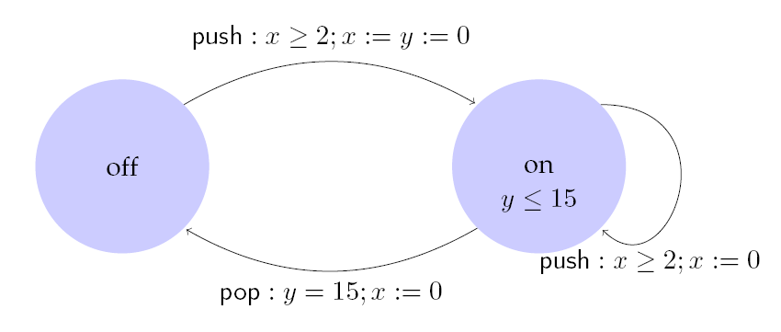
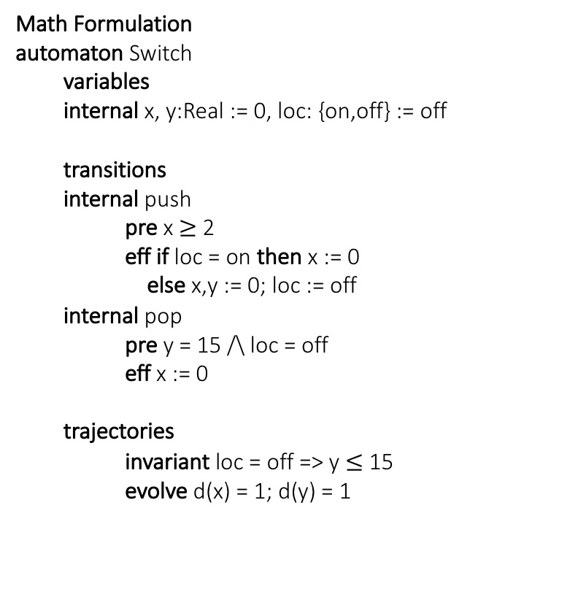
Example: Light switch
Math Formulation
automaton Switch
variables
internal x, y:Real := 0, loc: {on,off} := off
transitions
internal push
pre x $≥$ 2
eff if loc = on then x := 0
else x,y := 0; loc := off
internal pop
pre y = 15 /\ loc = off
eff x := 0
trajectories
invariant loc = off => y $≤$ 15
evolve d(x) = 1; d(y) = 1
Description
Switch can be turned on whenever at least 2 time units have elapsed since the last turn on. Switches off automatically 15 time units after the last on.

Slide 9
Control State (Location) Reachability Problem
Given an ITA, check if a particular (discrete) control state is reachable from the initial states
Why is control state reachability (CSR) good enough?
This problem is decidable [Alur Dill]
Key idea:
Construct a finite automaton that is a time-abstract bisimilar to the ITA (behaves identically with respect to control state reachability)
Check reachability of FSM

Slide 10
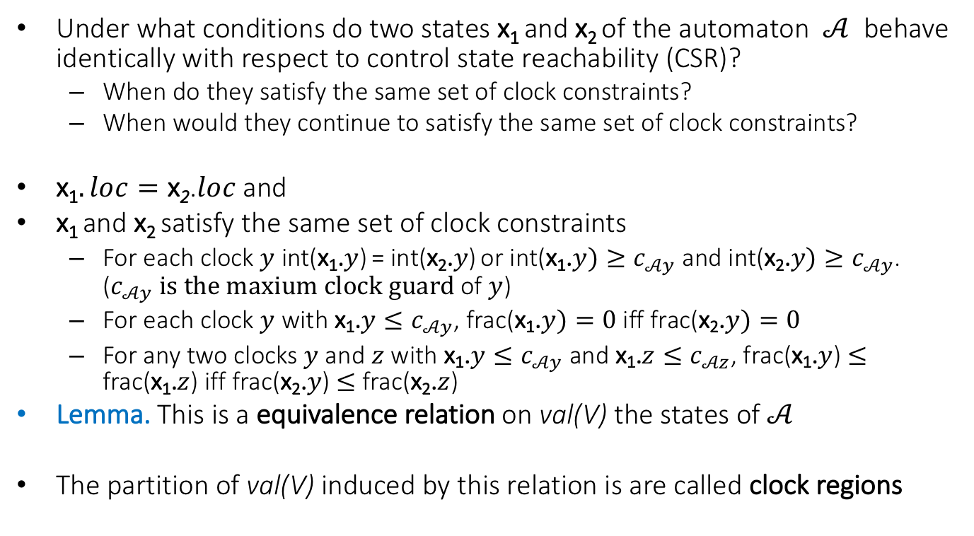
An equivalence relation with a finite quotient
Under what conditions do two states x₁ and x₂ of the automaton $𝒜$ behave identically with respect to control state reachability (CSR)?
When do they satisfy the same set of clock constraints?
When would they continue to satisfy the same set of clock constraints?
x₁$. loc=\text{x}\text{2}$.$loc$and
x₁ and x₂ satisfy the same set of clock constraints
For each clock $y$ int(x₁.$y$) = int(x₂.$y$) or int(x₁.$y)≥c_{𝒜y}$and int(x₂.$y)≥c_{𝒜y}$. ($c_{𝒜y} is the maxium clock guard$ of $y$)
For each clock $y$ with x₁.$y≤c_{𝒜y}$, frac(x₁.$y)=0$iff frac(x₂.$y)=0$
For any two clocks $y$ and $z$ with x₁.$y≤c_{𝒜y}$ and x₁.$z≤c_{𝒜z}$, frac(x₁.$y$) $≤$ frac(x₁.$z$) iff frac(x₂.$y$) $≤$ frac(x₂.$z$)
Lemma. This is a equivalence relation on val(V) the states of $𝒜$
The partition of val(V) induced by this relation is are called clock regions

Slide 11
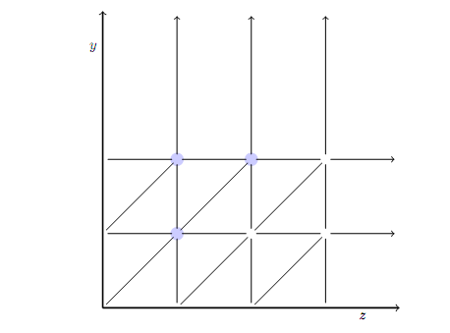
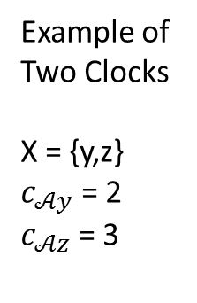
What do the clock regions look like?
Example of Two Clocks
X = {y,z}
$c_{𝒜y}$ = 2
$c_{𝒜z}$ = 3

Slide 12

Complexity
Lemma. The number of clock regions is bounded by |X|! 2^{|X|}$\prod_{z∈X}{(2c_{𝒜z}+2)}$.

Slide 13
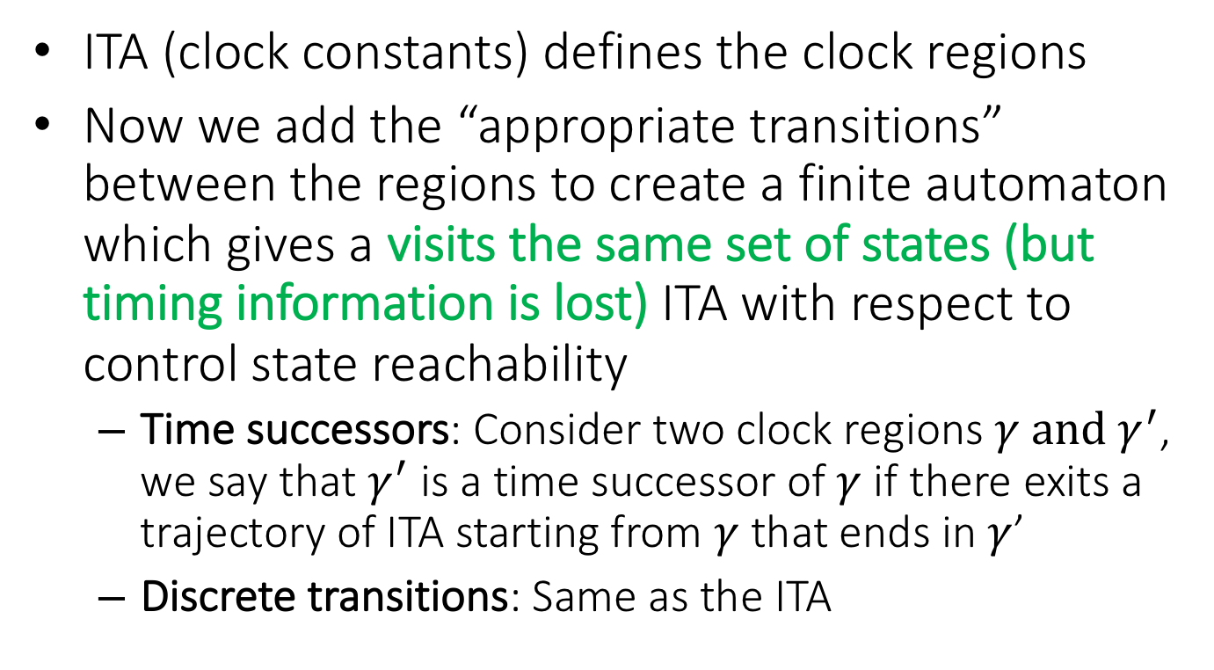
Region Automaton
ITA (clock constants) defines the clock regions
Now we add the “appropriate transitions” between the regions to create a finite automaton which gives a visits the same set of states (but timing information is lost) ITA with respect to control state reachability
Time successors: Consider two clock regions $γ and γ^{′}$, we say that $γ^{′}$ is a time successor of $γ$ if there exits a trajectory of ITA starting from $γ$ that ends in $γ$’
Discrete transitions: Same as the ITA

Slide 14
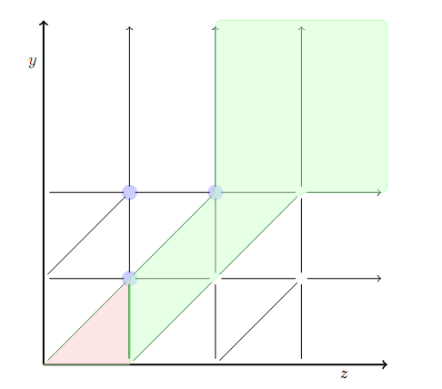
Time Successors
The clock regions in blue are time successors of the clock region in red.

Slide 15

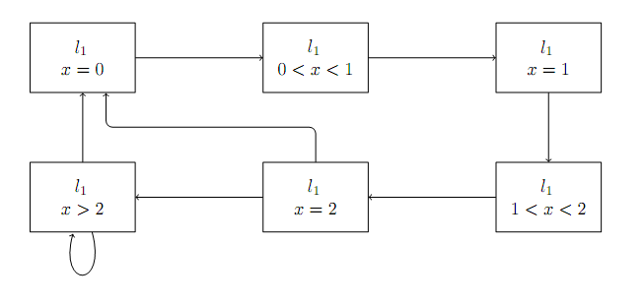
Example 1: Region Automata
ITA
Corresponding FA

Slide 16
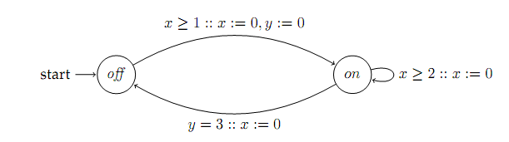
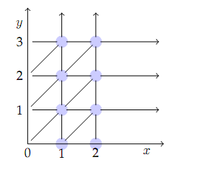
Example 2
ITA
Clock Regions

Slide 17
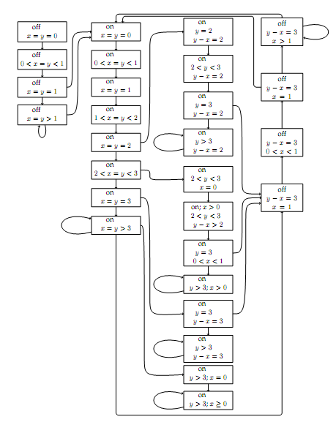
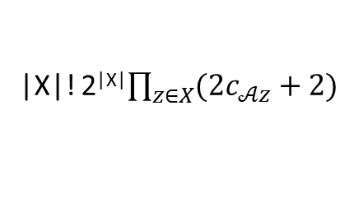
Corresponding FA
|X|! 2^{|X|}$\prod_{z∈X}{(2c_{𝒜z}+2)}$
Drastically increasing with the number of clocks

Slide 18
Summary
ITA: (very) Restricted class of hybrid automata
Clocks, integer constraints
No clock comparison, linear
Control state reachability
Alur-Dill’s algorithm
Construct finite bisimulation (region automaton)
Idea is to lump together states that behave similarly and reduce the size of the model
UPPAAL model checker based on similar model of timed automata

