Slide 1
Satisfiability modulo theories Part 2 Neural Theory Solvers
Verifying cyberphysical systems
Sayan Mitra
mitras@illinois.edu

Slide 2
Today
SMT
Decision procedure for Linear Real Arithmetic
Simplex Algorithm [Dantzig 1947]
Next week: Verification of Neural Networks
Reluplex [Katz et al 2017]

Slide 3
References
Lectures on SMT from Clark Barrett
Book: Introduction to Neural Network Verification by Aws Albarghouthi
Book: Decision Procedures by Daniel Kroening and Ofer Strichman

Slide 4
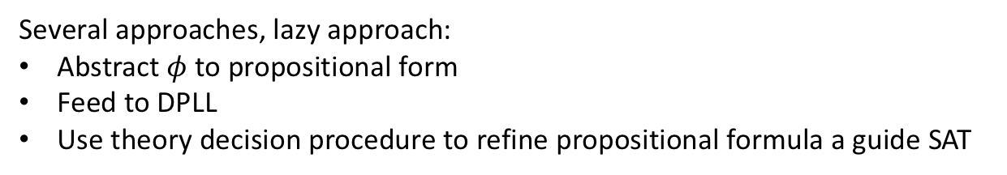
SMT
$$φ≡g\left(a\right)=c∧f\left(g\left(a\right)\right)≠f\left(c\right)∨g\left(a\right)=d∧c≠d$$
Several approaches, lazy approach:
Abstract $φ$ to propositional form
Feed to DPLL
Use theory decision procedure to refine propositional formula a guide SAT
Theory solvers/decision procedures
literals/formula in
real arithmetic
boolean skeleton of problem
Arithmetic
Bitvectors
Core
DPLL
Difference logic
…
Uninterpreted functions
assertions
solution or
counterexample

Slide 5
DPLL^{T:} DPLL modulo theories
How can we extend DPLL to handle formulas over other theories like
Difference Logic (DL)
Linear Real Arithmetic (LRA)
Uninterpreted functions (UF)
Idea: Start with a Boolean abstraction (or skeleton) and
incrementally add more theory information
until we can conclusively say SAT or UNSAT

Slide 6
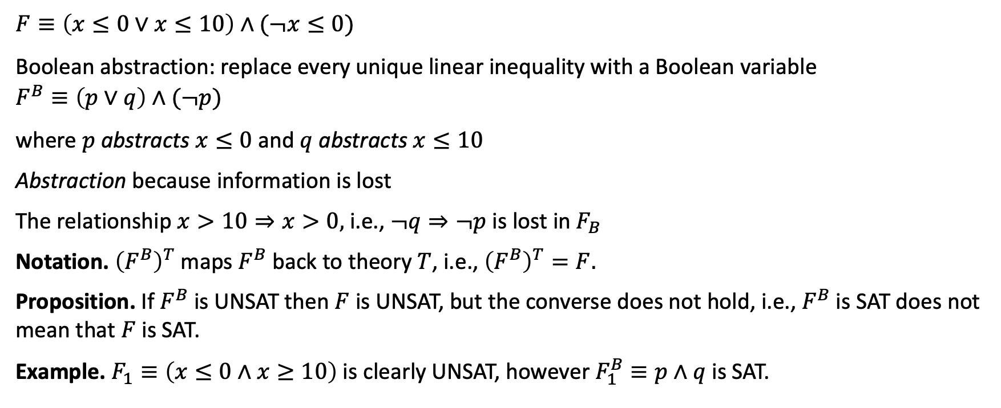
Example: DPLL^{LRA}
$$F≡\left(x≤0∨x≤10\right)∧(¬x≤0)$$
Boolean abstraction: replace every unique linear inequality with a Boolean variable
$$F^{B}≡\left(p∨q\right)∧(¬p)$$
where $p$ abstracts $x≤0$ and $q$ abstracts $x≤10$
Abstraction because information is lost
The relationship $x>10⇒x>0,$ i.e., $¬q⇒¬p$ is lost in $F_{B}$
Notation. ${\left(F^{B}\right)}^{T}$ maps $F^{B}$ back to theory $T$, i.e., ${\left(F^{B}\right)}^{T}=F.$
Proposition. If $F^{B}$ is UNSAT then $F$ is UNSAT, but the converse does not hold, i.e., $F^{B}$ is SAT does not mean that $F$ is SAT.
Example. $F_{1}≡\left(x≤0∧x≥10\right)$ is clearly UNSAT, however $F_{1}^{B}≡p∧q$ is SAT.

Slide 7





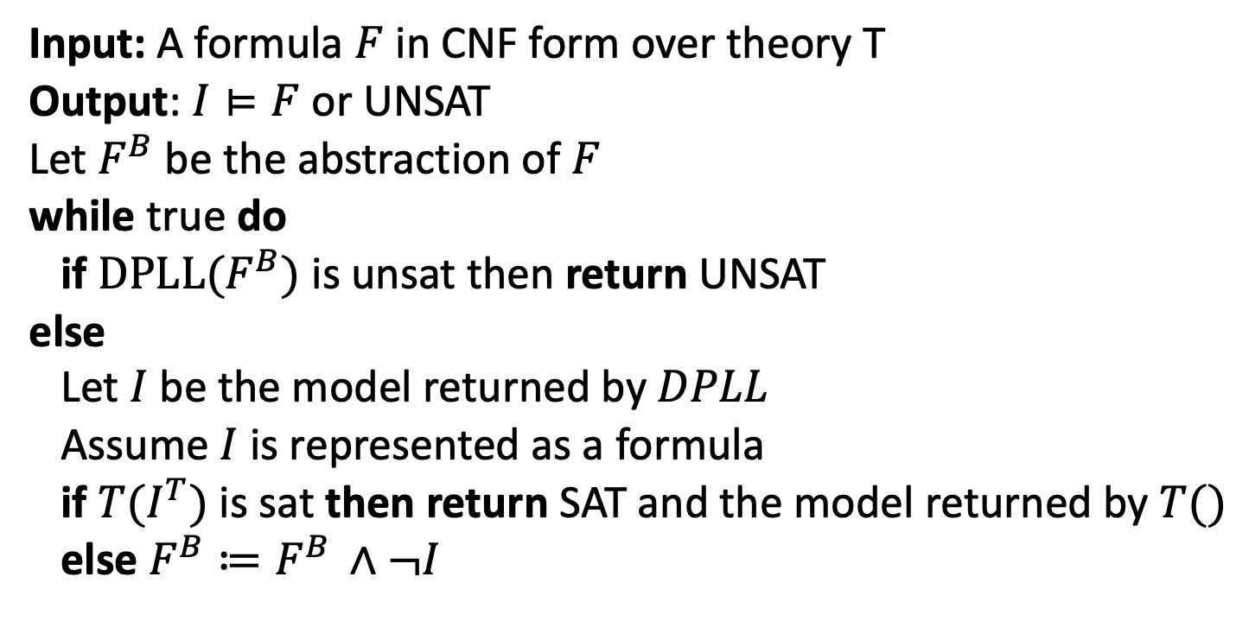

Lazy DPLL^{T} Algorithm using a Decision Procedure $T()$
Input: A formula $F$ in CNF form over theory T
Output: $I⊨F$or UNSAT
Let $F^{B}$ be the abstraction of $F$
while true do
if $DPLL(F^{B})$ is unsat then return UNSAT
else
Let $I$ be the model returned by $DPLL$
Assume $I$ is represented as a formula
if $T(I^{T})$ is sat then return SAT and the model returned by $T()$
else $F^{B}≔F^{B }∧¬I$
Theory solvers/decision procedures $T()$
$$I^{T}$$
Arithmetic
Bitvectors
Core
$$F^{B}$$
DPLL
Difference logic
…
UNSAT
SAT, $m$
Uninterpreted functions
UNSAT
SAT, $I$
Notes:
Theory solver takes care of conjunctions and DPLL takes care of disjunctions
DPLL Lazily learns more facts about the theory, refining the abstraction until it can decide STA or UNSAT

Slide 8

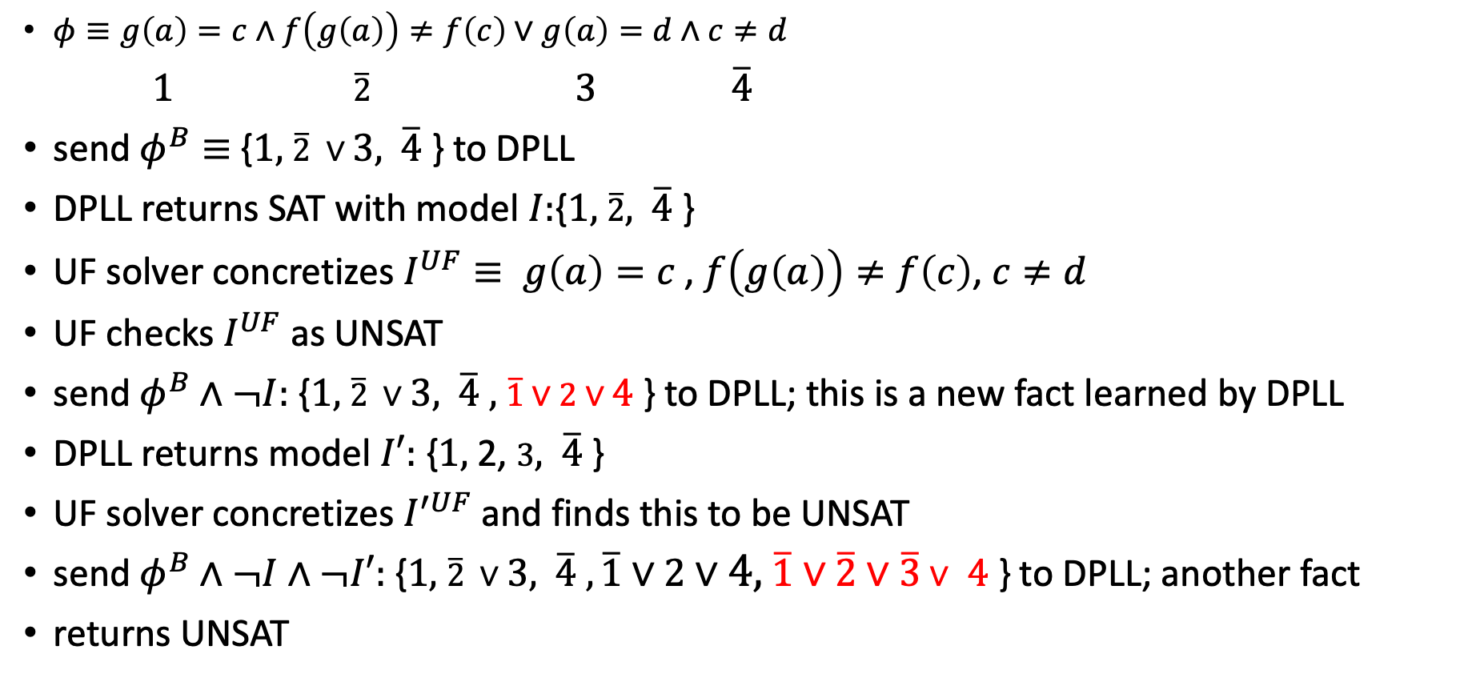



Theory solvers/decision procedures $T()$
$$I^{T}$$
$φ≡g\left(a\right)=c∧f\left(g\left(a\right)\right)≠f\left(c\right)∨g\left(a\right)=d∧c≠d$
$1$ $\overline{2}$ $3$ $\overline{4}$
send $φ^{B}≡${$1,$ $\overline{2} ∨3,$ $\overline{4}$} to DPLL
DPLL returns SAT with model $I:${$1,$ $\overline{2},$ $\overline{4}$}
UF solver concretizes $I^{UF}≡ g\left(a\right)=c$, $f\left(g\left(a\right)\right)≠f\left(c\right)$, $c≠d$
UF checks $I^{UF}$as UNSAT
send $φ^{B}∧¬I:$ {$1,$ $\overline{2} ∨3,$ $\overline{4} ,$ $\overline{1}∨2∨4$} to DPLL; this is a new fact learned by DPLL
DPLL returns model $I′:$ {$1,$ 2, $3,$ $\overline{4}$}
UF solver concretizes $I^{′UF}$and finds this to be UNSAT
send $φ^{B}∧¬I∧¬I′:$ {$1,$ $\overline{2} ∨3,$ $\overline{4} ,\overline{1}∨2∨4,$ $\overline{1}∨\overline{2}∨\overline{3}∨$ $4$ } to DPLL; another fact
returns UNSAT
Arithmetic
Bitvectors
Core
$$F^{B}$$
DPLL
Difference logic
…
Uninterpreted functions
UNSAT
SAT, $I$

Slide 9
Linear Real Arithmetic
Reference : Introduction to Neural Network Verification by Aws Albarghouthi

Slide 10
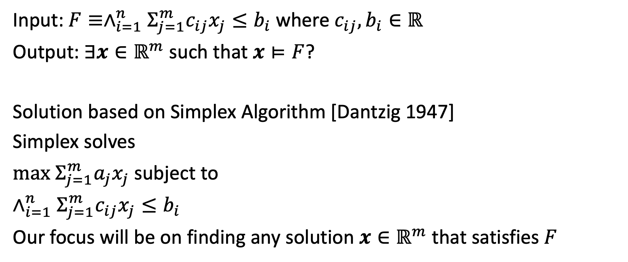
Decision Procedure for Linear Real Arithmetic
Input: $F≡∧_{i=1}^{n}Σ_{j=1}^{m}c_{ij}x_{j}≤b_{i}$ where $c_{ij},b_{i}∈ℝ$
Output: $∃x∈ℝ^{m}$such that $x⊨F$?
Solution based on Simplex Algorithm [Dantzig 1947]
Simplex solves
$max Σ_{j=1}^{m}a_{j}x_{j}$ subject to
$∧_{i=1}^{n}Σ_{j=1}^{m}c_{ij}x_{j}≤b_{i}$
Our focus will be on finding any solution $x∈ℝ^{m}$ that satisfies $F$
Notes:
Dantzig realized that one of the unsolved problems that he had mistaken as homework in his professor Jerzy Neyman's class (and actually later solved), was applicable to finding an algorithm for linear programs.
From: https://en.wikipedia.org/wiki/George_Dantzig#Mathematical_statistics
In 1939, a misunderstanding brought about surprising results. Near the beginning of a class, Professor Neyman wrote two problems on the blackboard. Dantzig arrived late and assumed that they were a homework assignment. According to Dantzig, they "seemed to be a little harder than usual", but a few days later he handed in completed solutions for both problems, still believing that they were an assignment that was overdue.^{[4][6]} Six weeks later, an excited Neyman eagerly told him that the "homework" problems he had solved were two of the most famous unsolved problems in statistics.
story persisted in the form of an urban legend and as an introductory scene in the movie Good Will Hunting.^{[6]}

Slide 11
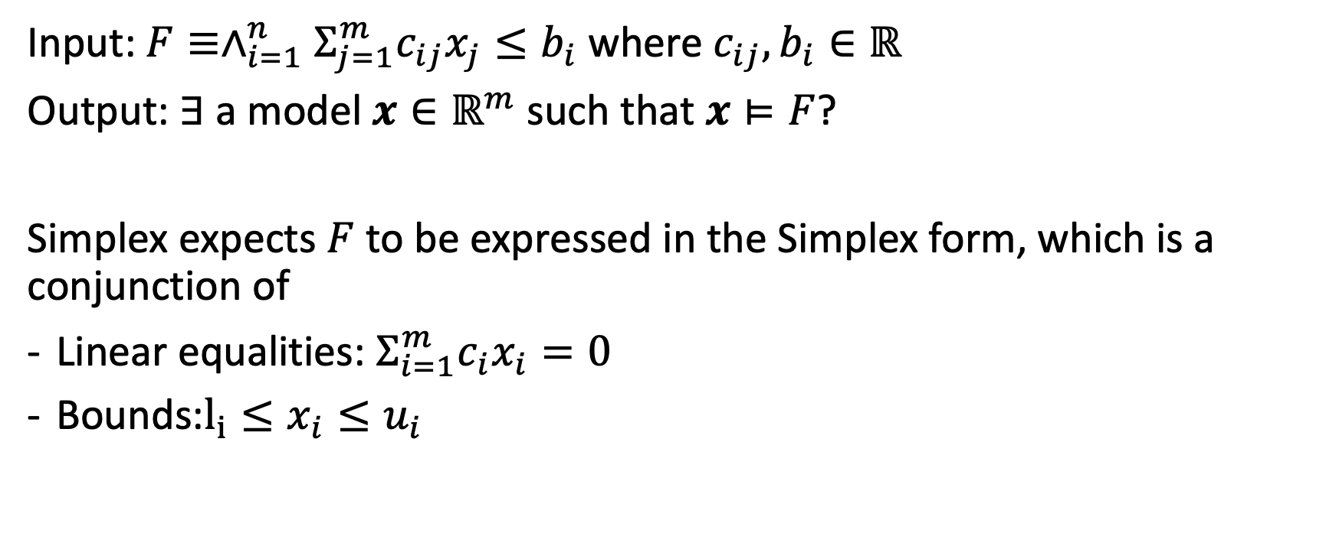
Decision Procedure for Linear Real Arithmetic
Input: $F≡∧_{i=1}^{n}Σ_{j=1}^{m}c_{ij}x_{j}≤b_{i}$ where $c_{ij},b_{i}∈ℝ$
Output: $∃ \text{a} \text{model} x∈ℝ^{m}$such that $x⊨F$?
Simplex expects $F$ to be expressed in the Simplex form, which is a conjunction of
Linear equalities: $Σ_{i=1}^{m}c_{i}x_{i}=0$
Bounds:$l_{i}≤x_{i}≤u_{i}$

Slide 12
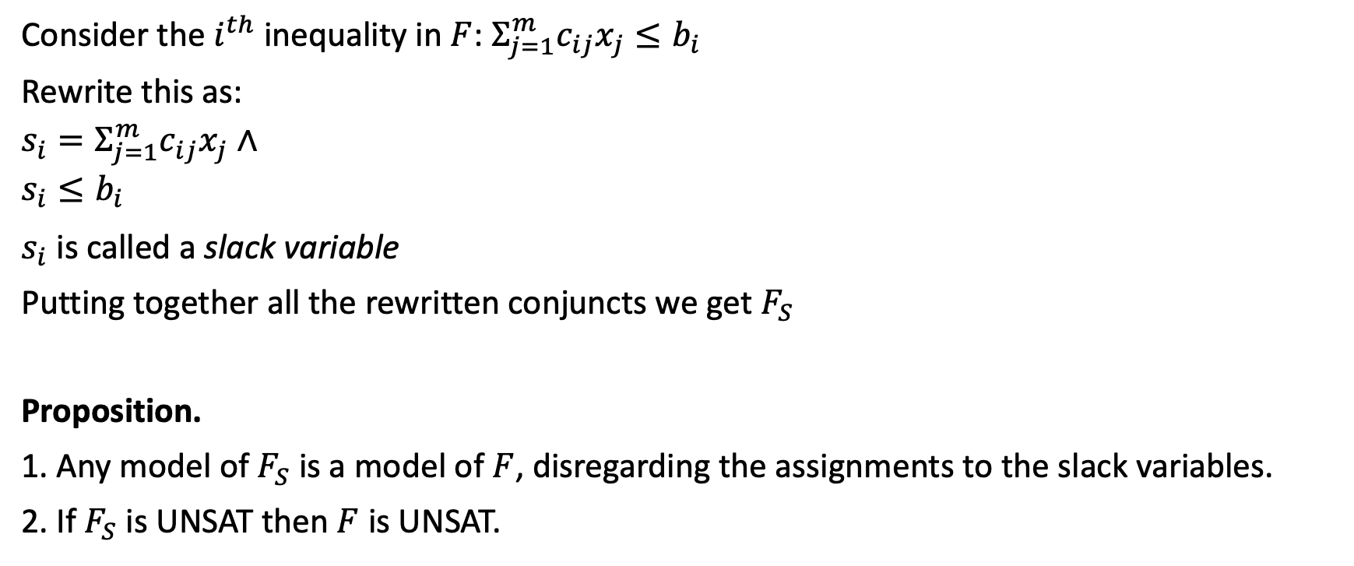
Transforming to Simplex Form
Consider the $i^{th}$ inequality in $F$: $Σ_{j=1}^{m}c_{ij}x_{j}≤b_{i}$
Rewrite this as:
$$s_{i}=Σ_{j=1}^{m}c_{ij}x_{j}∧$$
$$s_{i}≤b_{i}$$
$s_{i}$ is called a slack variable
Putting together all the rewritten conjuncts we get $F_{S}$
Proposition.
1. Any model of $F_{S}$ is a model of $F$, disregarding the assignments to the slack variables.
2. If $F_{S}$ is UNSAT then $F$ is UNSAT.

Slide 13
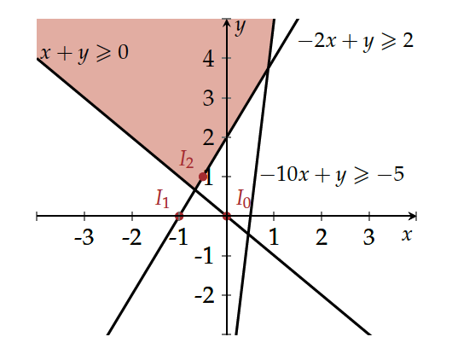
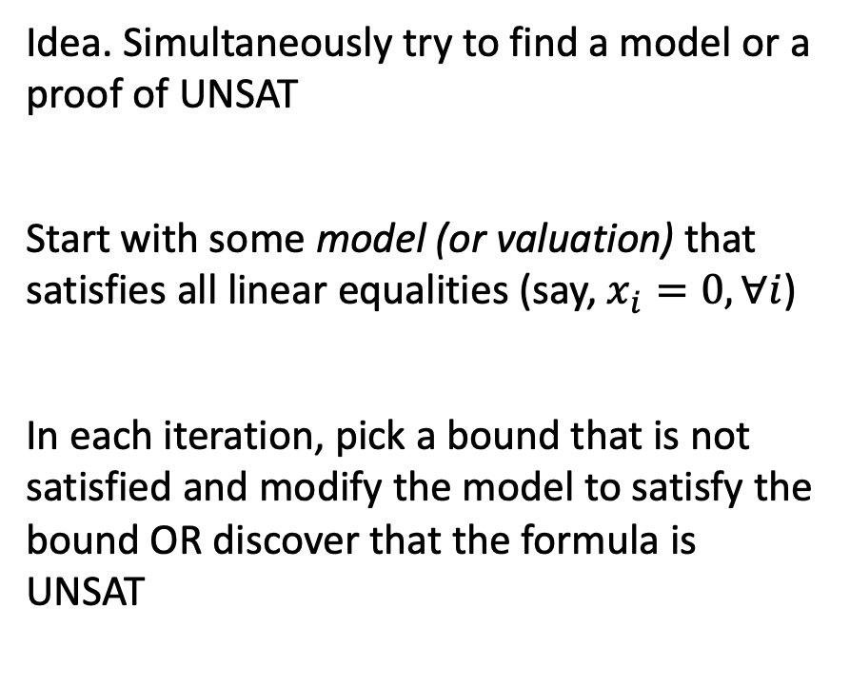

Simplex (Informal)
Idea. Simultaneously try to find a model or a proof of UNSAT
Start with some model (or valuation) that satisfies all linear equalities (say, $x_{i}=0, ∀i$)
In each iteration, pick a bound that is not satisfied and modify the model to satisfy the bound OR discover that the formula is UNSAT
$$x_{0}=⟨x↦0, y↦0⟩$$
$$x_{0}\backslash unsat −2x+y≥2$$
$$x_{1}=⟨x↦−1, y↦0⟩$$
$$x_{1}\backslash unsat x+y≥0$$
$x_{2}= \left\langle x↦−\frac{1}{2}, y↦1\right\rangle ⊨F$

Slide 14
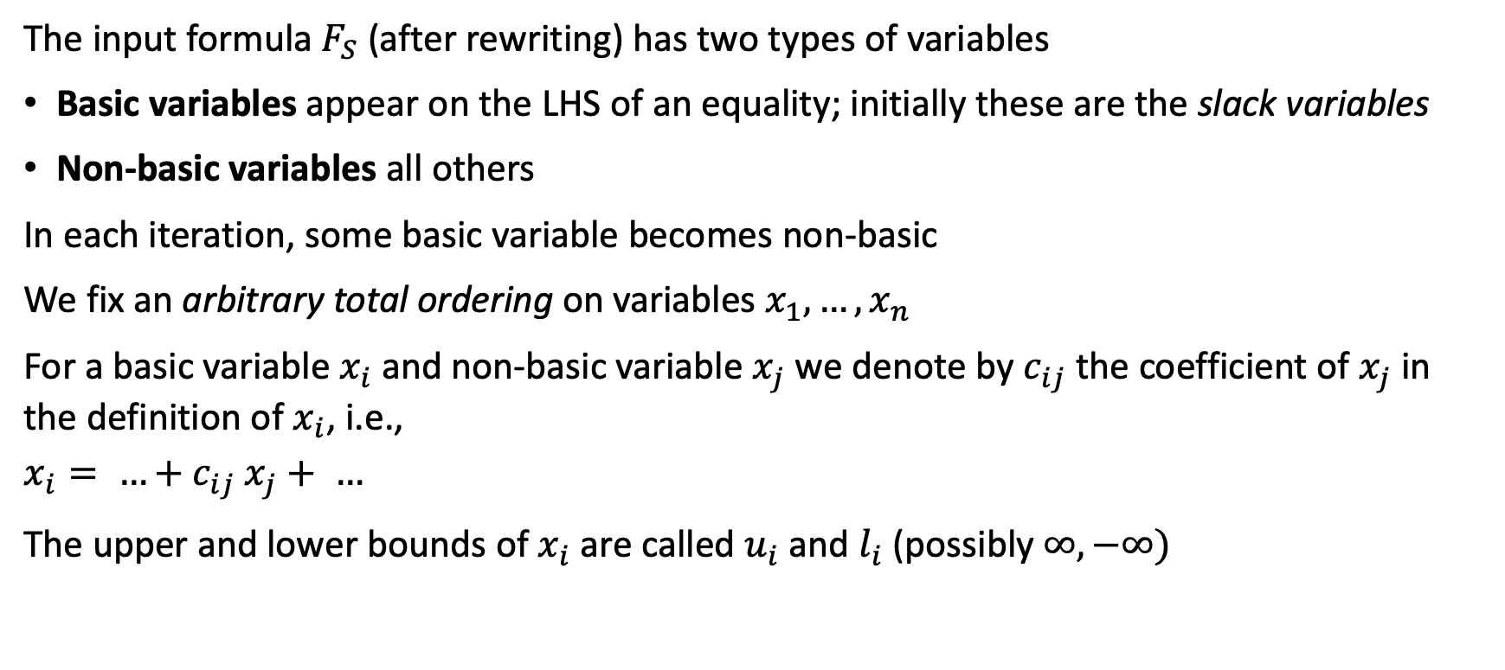
Variable naming and ordering for Simplex
The input formula $F_{S}$ (after rewriting) has two types of variables
Basic variables appear on the LHS of an equality; initially these are the slack variables
Non-basic variables all others
In each iteration, some basic variable becomes non-basic
We fix an arbitrary total ordering on variables $x_{1},…,x_{n}$
For a basic variable $x_{i}$ and non-basic variable $x_{j}$ we denote by $c_{ij}$ the coefficient of $x_{j}$ in the definition of $x_{i}$, i.e.,
$$x_{i}= …+c_{ij} x_{j}+ …$$
The upper and lower bounds of $x_{i}$ are called $u_{i}$ and $l_{i}$ (possibly $∞, −∞)$

Slide 15
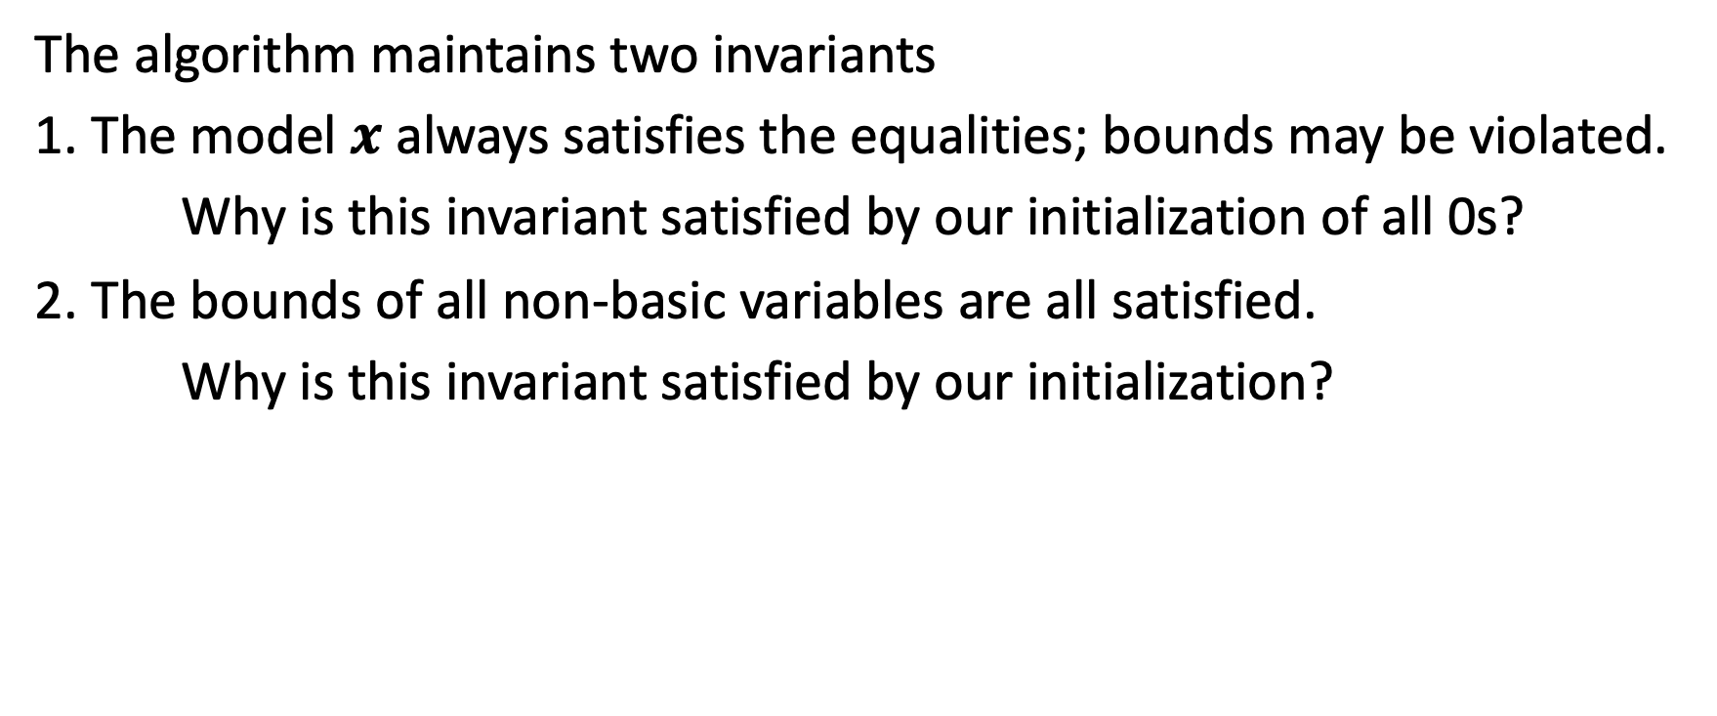
Simplex (Formal) 1
The algorithm maintains two invariants
1. The model $x$ always satisfies the equalities; bounds may be violated.
Why is this invariant satisfied by our initialization of all 0s?
2. The bounds of all non-basic variables are all satisfied.
Why is this invariant satisfied by our initialization?

Slide 16
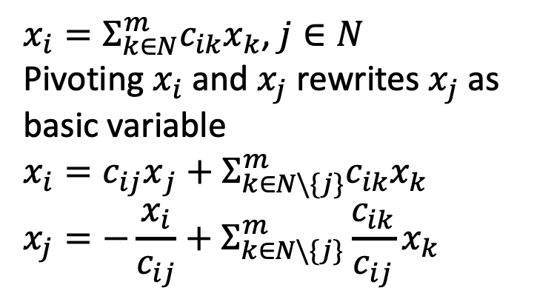
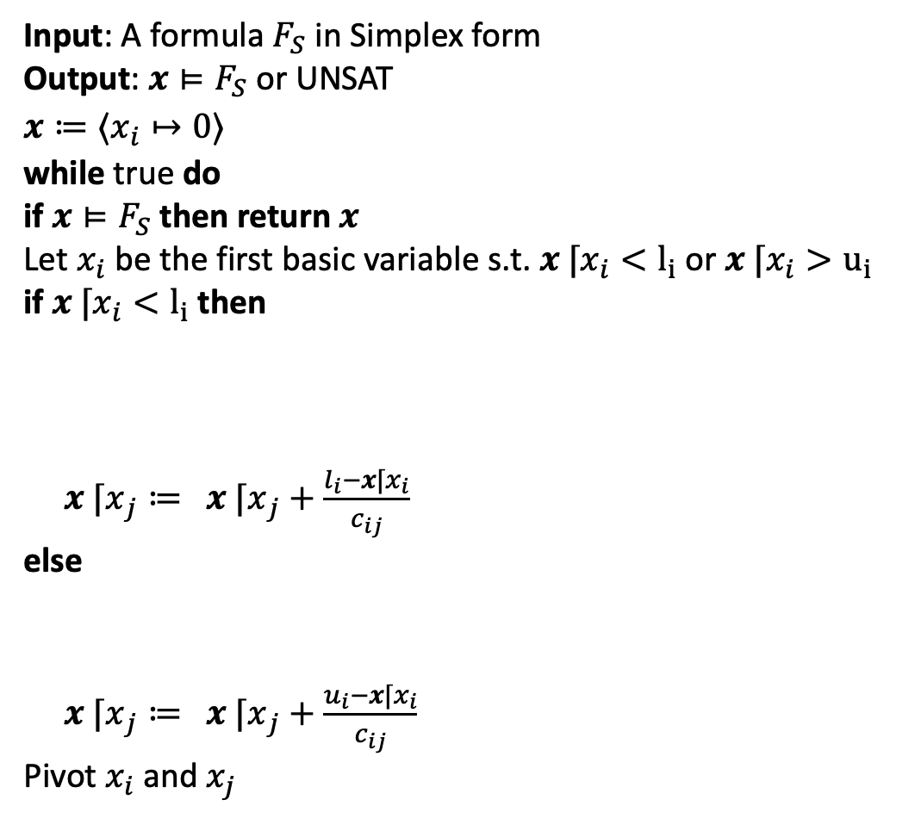
Simplex Algorithm: DP for LRA
$x_{i}=Σ_{k∈N}^{m}c_{ik}x_{k}$, $j∈N$
Pivoting $x_{i}$ and $x_{j}$ rewrites $x_{j}$ as basic variable
$$x_{i}={c_{ij}x}_{j}+Σ_{k∈N\backslash \{j\}}^{m}c_{ik}x_{k}$$
$$x_{j}=−\frac{x_{i}}{c_{ij}}+Σ_{k∈N\backslash \{j\}}^{m}\frac{c_{ik}}{c_{ij}}x_{k}$$
Input: A formula $F_{S}$ in Simplex form
Output: $x⊨F_{S}$ or UNSAT
$$x≔⟨x_{i}↦0⟩$$
while true do
if $x⊨F_{S}$ then return $x$
Let $x_{i}$be the first basic variable s.t. ${x ⌈x}_{i}<l_{i}$ or ${x ⌈x}_{i}>u_{i}$
if ${x ⌈x}_{i}<l_{i}$ then
Let $x_{j}$ be the first non-basic variable s.t.
$(x\left\lceil x_{j} < u_{j}∧ c_{ij} > 0\right)∨(x⌈x_{j} > l_{j}∧ c_{ij} < 0)$
If no such $x_{j}$ exists then return UNSAT
${x ⌈x}_{j}≔$ ${x ⌈x}_{j}+\frac{l_{i}−x⌈x_{i}}{c_{ij}}$
else Let $x_{j}$ be the first non-basic variable s.t.
$(x\left\lceil x_{j}> l_{j}∧ c_{ij} > 0\right)∨(x⌈x_{j}< u_{j}∧ c_{ij} < 0)$
If no such $x_{j}$ exists then return UNSAT
${x ⌈x}_{j}≔$ ${x ⌈x}_{j}+\frac{u_{i}−x⌈x_{i}}{c_{ij}}$
Pivot$x_{i}$ and $x_{j}$

Slide 17
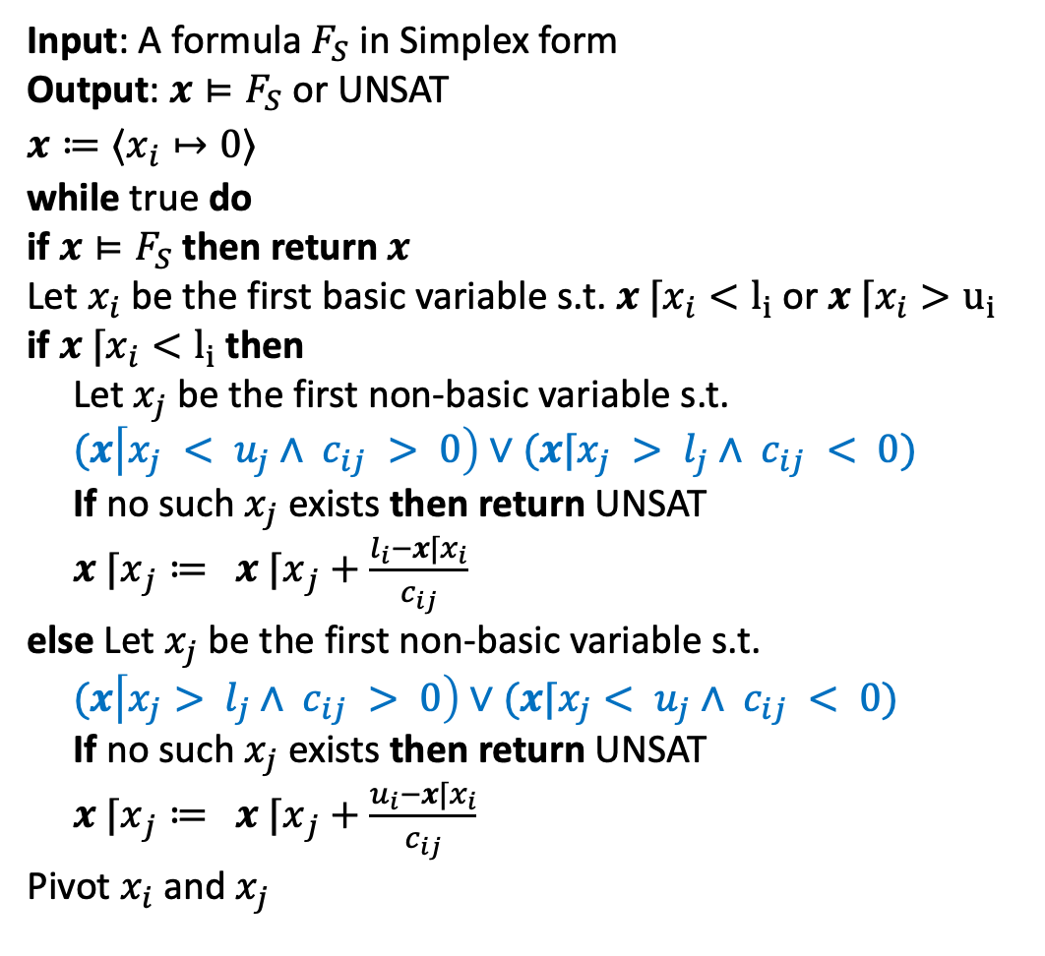
Simplex Algorithm: DP for LRA
$x_{i}=Σ_{k∈N}^{m}c_{ik}x_{k}$, $j∈N$
Pivoting $x_{i}$ and $x_{j}$ rewrites $x_{j}$ as basic variable
$$x_{i}={c_{ij}x}_{j}+Σ_{k∈N\backslash \{j\}}^{m}c_{ik}x_{k}$$
$$x_{j}=−\frac{x_{i}}{c_{ij}}+Σ_{k∈N\backslash \{j\}}^{m}\frac{c_{ik}}{c_{ij}}x_{k}$$
Input: A formula $F_{S}$ in Simplex form
Output: $x⊨F_{S}$ or UNSAT
$$x≔⟨x_{i}↦0⟩$$
while true do
if $x⊨F_{S}$ then return $x$
Let $x_{i}$be the first basic variable s.t. ${x ⌈x}_{i}<l_{i}$ or ${x ⌈x}_{i}>u_{i}$
if ${x ⌈x}_{i}<l_{i}$ then
Let $x_{j}$ be the first non-basic variable s.t.
$(x\left\lceil x_{j} < u_{j}∧ c_{ij} > 0\right)∨(x⌈x_{j} > l_{j}∧ c_{ij} < 0)$
If no such $x_{j}$ exists then return UNSAT
${x ⌈x}_{j}≔$ ${x ⌈x}_{j}+\frac{l_{i}−x⌈x_{i}}{c_{ij}}$
else Let $x_{j}$ be the first non-basic variable s.t.
$(x\left\lceil x_{j}> l_{j}∧ c_{ij} > 0\right)∨(x⌈x_{j}< u_{j}∧ c_{ij} < 0)$
If no such $x_{j}$ exists then return UNSAT
${x ⌈x}_{j}≔$ ${x ⌈x}_{j}+\frac{u_{i}−x⌈x_{i}}{c_{ij}}$
Pivot$x_{i}$ and $x_{j}$

Slide 18

Example
$$x+y≥0$$
$$−2x+y≥2$$
$$−10x+y≥−5$$
Rewritten in Simplex form
$$s_{1}= x+y$$
$$s_{2}=−2x+y$$
$$s_{3}= −10x+y$$
$$s_{1}≥0$$
$$s_{2}≥2$$
$$s_{3}≥−5$$

Slide 19
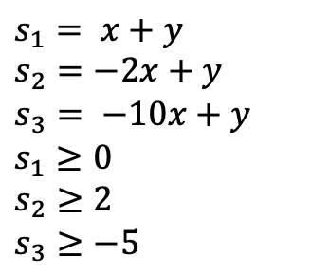
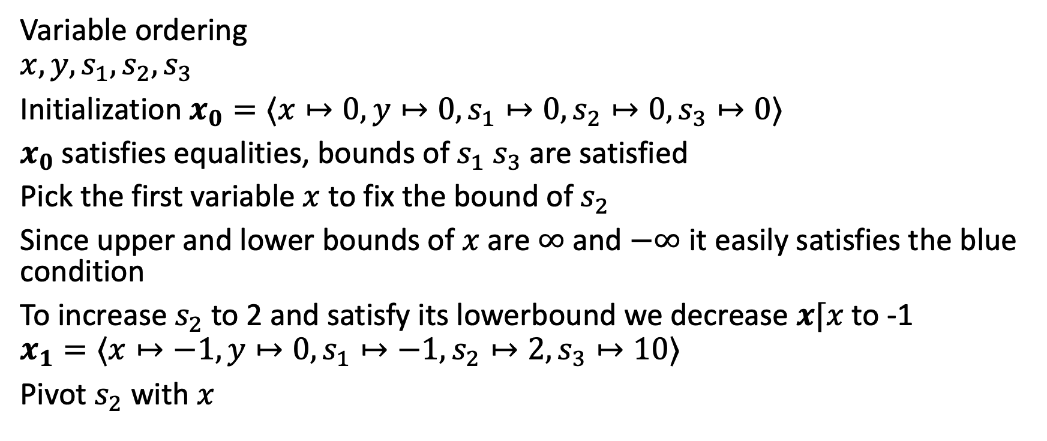
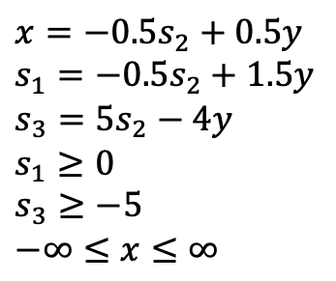
Example continued
$$s_{1}= x+y$$
$$s_{2}=−2x+y$$
$$s_{3}= −10x+y$$
$$s_{1}≥0$$
$$s_{2}≥2$$
$$s_{3}≥−5$$
Variable ordering
$$x,y,s_{1},s_{2},s_{3}$$
Initialization $x_{0}=⟨x↦0,y↦0,s_{1}↦0,s_{2}↦0,s_{3}↦0⟩$
$x_{0}$ satisfies equalities, bounds of $s_{1}$ $s_{3}$ are satisfied
Pick the first variable $x$to fix the bound of $s_{2}$
Since upper and lower bounds of $x$ are $∞$ and $−∞$ it easily satisfies the blue condition
To increase $s_{2}$to 2 and satisfy its lowerbound we decrease $x⌈x$to -1
$$x_{1}=⟨x↦−1,y↦0,s_{1}↦−1,s_{2}↦2,s_{3}↦10⟩$$
Pivot $s_{2}$with $x$
$$x=−0.5s_{2}+0.5y$$
$$s_{1}=−0.5s_{2}+1.5y$$
$$s_{3}=5s_{2}−4y$$
$$s_{1}≥0$$
$$s_{3}≥−5$$
$$−∞≤x≤∞$$

Slide 20

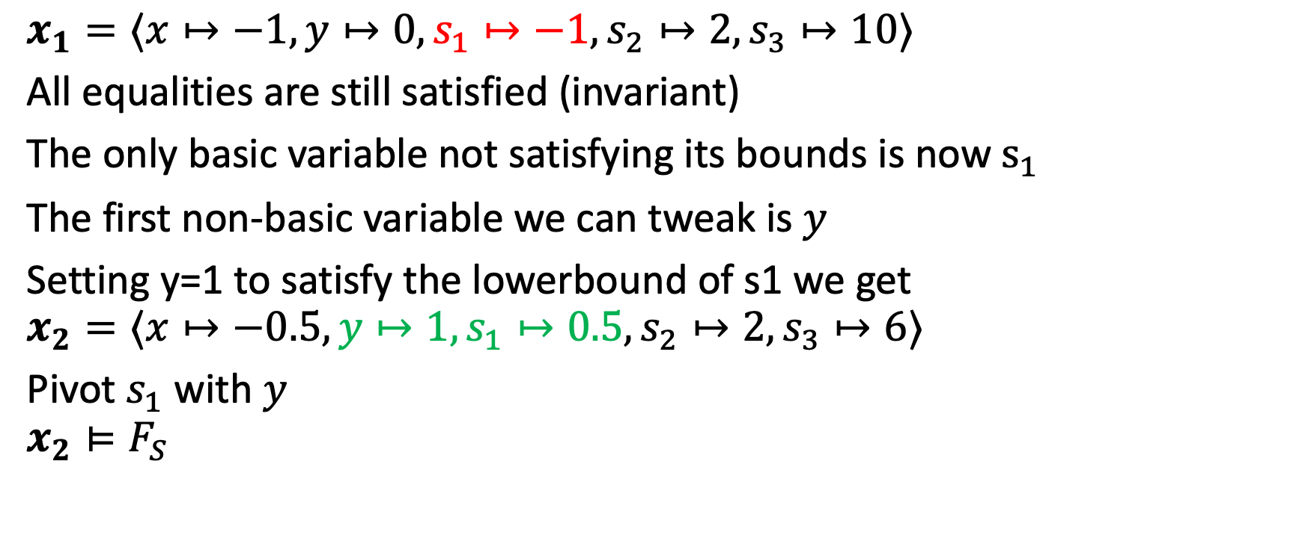

Example continued 2
$$x=−0.5s_{2}+0.5y$$
$$s_{1}=−0.5s_{2}+1.5y$$
$$s_{3}=5s_{2}−4y$$
$$s_{1}≥0$$
$$s_{3}≥−5$$
$$−∞≤x≤∞$$
$$x_{1}=⟨x↦−1,y↦0,s_{1}↦−1,s_{2}↦2,s_{3}↦10⟩$$
All equalities are still satisfied (invariant)
The only basic variable not satisfying its bounds is now$s_{1}$
The first non-basic variable we can tweak is $y$
Setting y=1 to satisfy the lowerbound of s1 we get
$$x_{2}=⟨x↦−0.5,y↦1,s_{1}↦0.5,s_{2}↦2,s_{3}↦6⟩$$
Pivot $s_{1}$ with $y$
$$x_{2}⊨F_{S}$$
$$y= \frac{2}{3}s_{1}+\frac{1}{3}s_{2}$$
$$x=+\frac{1}{3}s_{1}−\frac{1}{3}s_{2}$$
$$s_{2}≥2$$
$$s_{1}≥0$$
$$s_{3}≥−5$$
$$−∞≤x≤∞$$

Slide 21
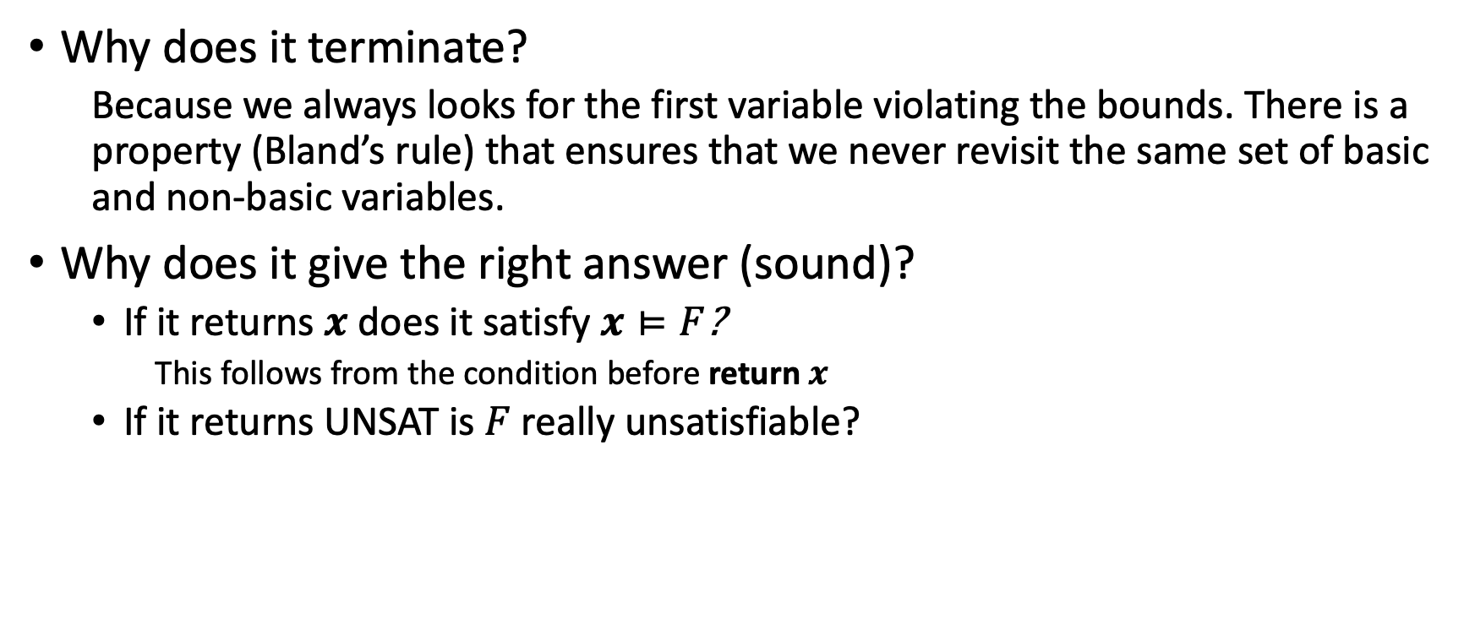
Why is simplex correct?
Why does it terminate?
Because we always looks for the first variable violating the bounds. There is a property (Bland’s rule) that ensures that we never revisit the same set of basic and non-basic variables.
Why does it give the right answer (sound)?
If it returns $x$ does it satisfy $x⊨F$?
This follows from the condition before return $x$
If it returns UNSAT is $F$ really unsatisfiable?

Slide 22
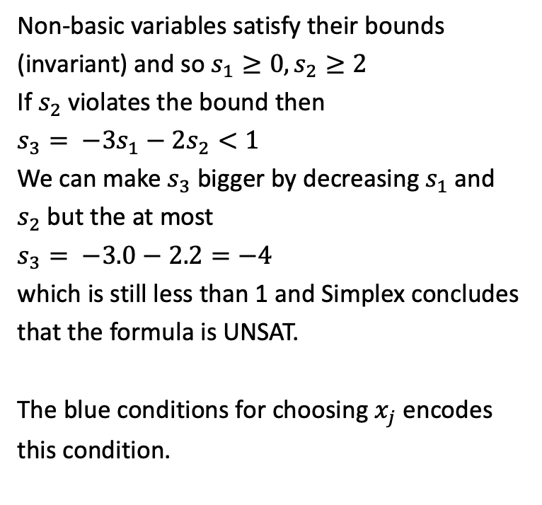
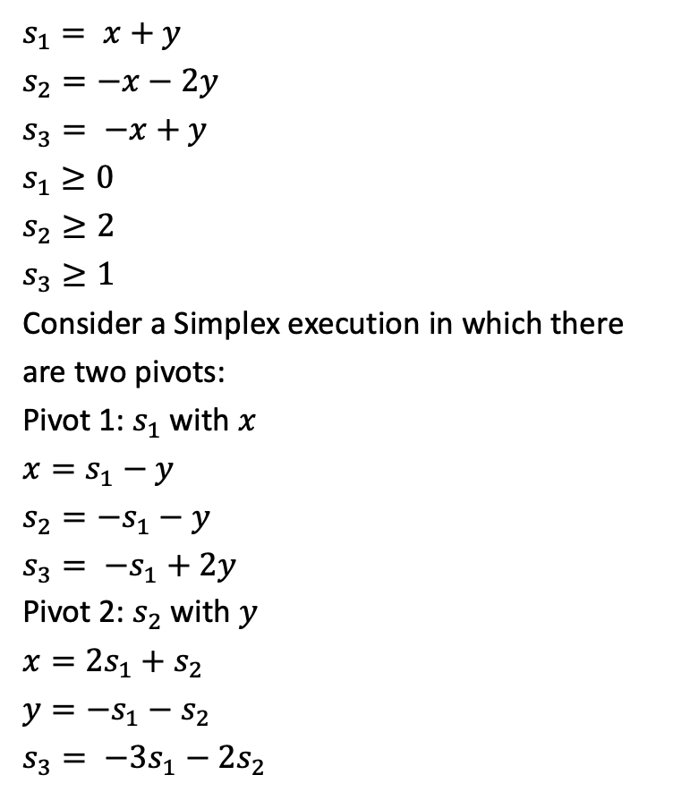
Unsatisfiable example
$$s_{1}= x+y$$
$$s_{2}=−x−2y$$
$$s_{3}= −x+y$$
$$s_{1}≥0$$
$$s_{2}≥2$$
$$s_{3}≥1$$
Consider a Simplex execution in which there are two pivots:
Pivot 1: $s_{1}$with $x$
$$x=s_{1}−y$$
$$s_{2}=−s_{1}−y$$
$$s_{3}= −s_{1}+2y$$
Pivot 2: $s_{2}$with $y$
$$x={2s}_{1}+s_{2}$$
$$y=−s_{1}−s_{2}$$
$$s_{3}= −{3s}_{1}−2s_{2}$$
Non-basic variables satisfy their bounds (invariant) and so $s_{1}≥0,s_{2}≥2$
If $s_{2}$violates the bound then
$$s_{3}= −{3s}_{1}−2s_{2}<1$$
We can make $s_{3}$bigger by decreasing $s_{1}$and $s_{2}$ but the at most
$s_{3}= −3.0−2.2=−4$
which is still less than 1 and Simplex concludes that the formula is UNSAT.
The blue conditions for choosing $x_{j}$ encodes this condition.

Slide 23
Summary and Takeaways
Satisfiability modulo theory solvers use theory solvers and DPLL to check satisfiability of formulas in other theories
DPLL takes care of disjunctions
Theory solvers take care of conjunctions
Simplex or more generally Linear programming (LP) solvers is a theory solver for linear real arithmetic
Simplex algorithm solves LP by incrementally fixing the bounds of basic variables
Next time Reluplex

