Slide 1
Satisfiability modulo theories
Verifying cyberphysical systems
Sayan Mitra
mitras@illinois.edu
Some of the slides and examples for this lecture are from Clark Barrett

Slide 2
Today
Satisfiability modulo theories (SMT)
Theories, models, decision procedures
Uninterpreted Functions
Difference Logic
Brief z3 tutorial (see notebook)

Slide 3
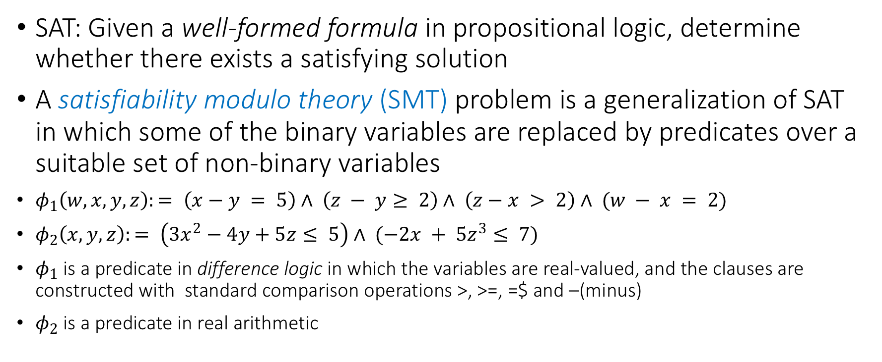
Satisfiability modulo theories
SAT: Given a well-formed formula in propositional logic, determine whether there exists a satisfying solution
A satisfiability modulo theory (SMT) problem is a generalization of SAT in which some of the binary variables are replaced by predicates over a suitable set of non-binary variables
$φ_{1}\left(w,x,y,z\right):= \left(x−y = 5\right)∧ \left(z − y≥ 2\right)∧ \left(z−x > 2\right)∧ (w − x = 2)$
$φ_{2}\left(x,y,z\right):= \left(3x^{2}−4y+5z≤ 5\right)∧ (−2x + 5z^{3}≤ 7)$
$φ_{1}$ is a predicate in difference logic in which the variables are real-valued, and the clauses are constructed with standard comparison operations >, >=, =$ and –(minus)
$φ_{2}$ is a predicate in real arithmetic

Slide 4
Architecture of an SMT solver
Theory solvers/decision procedures
CNF formula in
real arithmetic
boolean skeleton of problem
Arithmetic
Bitvectors
Core
DPLL
Difference logic
…
Uninterpreted functions
assertions
solution or
counterexample

Slide 5
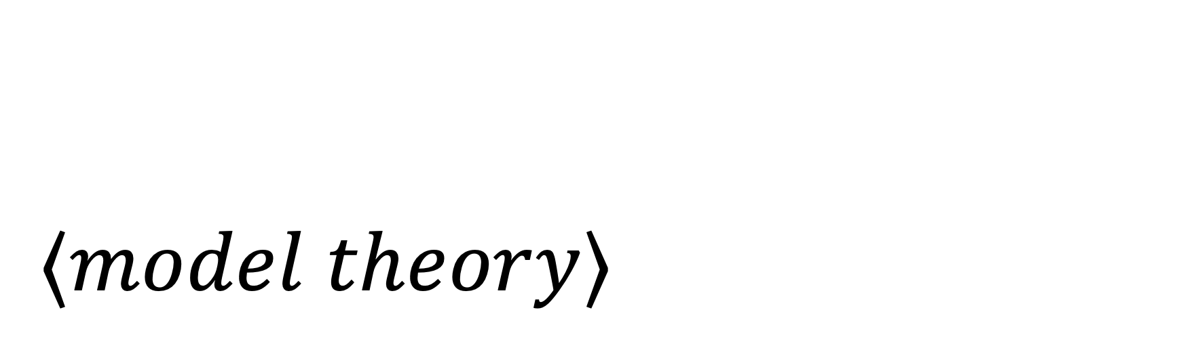
$$⟨model theory⟩$$
A short overview of theories, models, decision procedures

Slide 6
What is a theory in mathematical logic?
When we talk about well-formed formulas with non-binary variables, we have to say exactly what type of formulas are allowed
and, what it means for assignments to satisfy such formulas
This brings us to some basic notions in mathematical logic
theory --- what does a well-formed formula look like ?
models --- what does it mean to satisfy a formula?

Slide 7
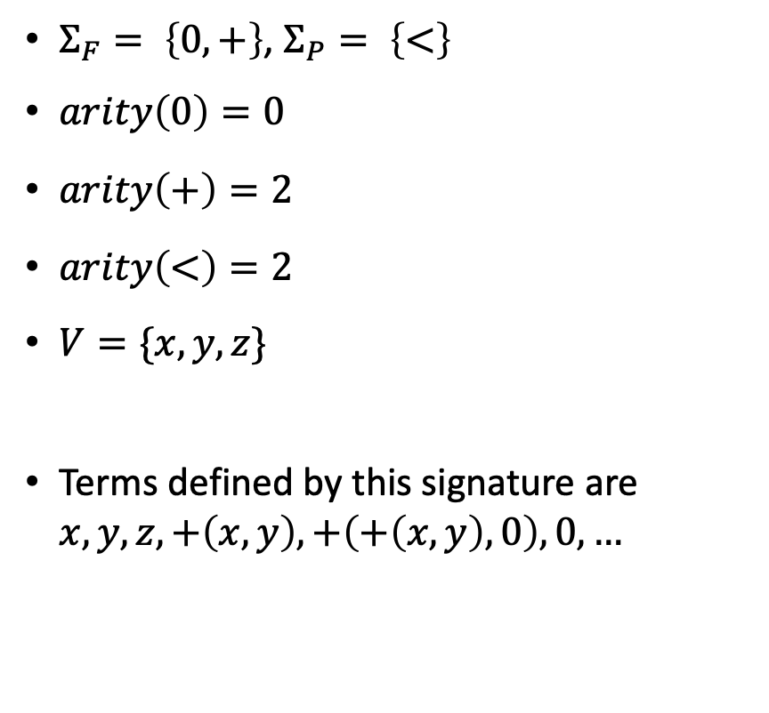
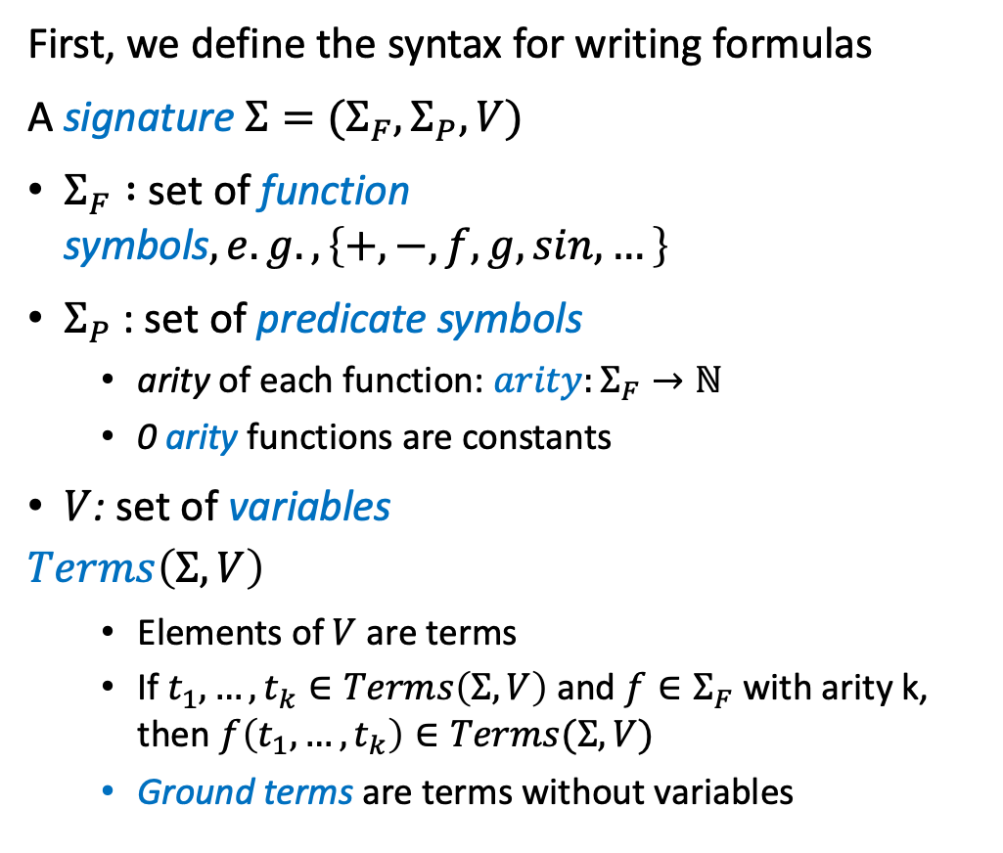

Building up a theory
First, we define the syntax for writing formulas
A signature $Σ=(Σ_{F},Σ_{P},V)$
$Σ_{F} :$ set of function symbols$, e.g., \left\{+,−,f,g,sin,…\right\}$
$Σ_{P}$: set of predicate symbols
arity of each function: $arity:Σ_{F}→ℕ$
0 arity functions are constants
$V$: set of variables
$$Terms\left(Σ,V\right)$$
Elements of $V$ are terms
If $t_{1},…,t_{k}∈Terms\left(Σ,V\right)$ and $f∈Σ_{F}$ with arity k, then $f\left(t_{1},…,t_{k}\right)∈Terms(Σ,V)$
Ground terms are terms without variables
$Σ_{F}= \left\{0,+\right\}$, $Σ_{P}= \left\{<\right\}$
$arity\left(0\right)=0$
$arity\left(+\right)=2$
$arity\left(<\right)=2$
$V=\{x,y,z\}$
Terms defined by this signature are $x,y,z, +\left(x,y\right), +\left(+\left(x,y\right),0\right),0,…$

Slide 8
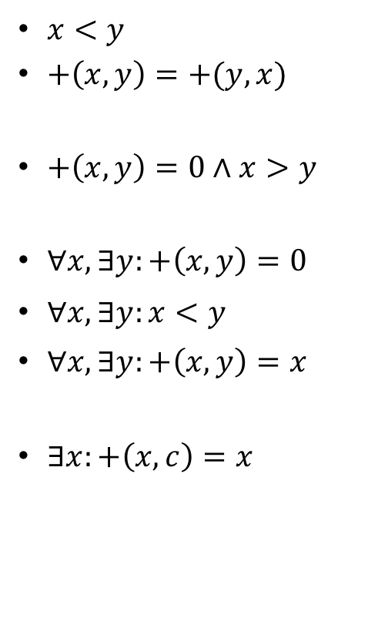
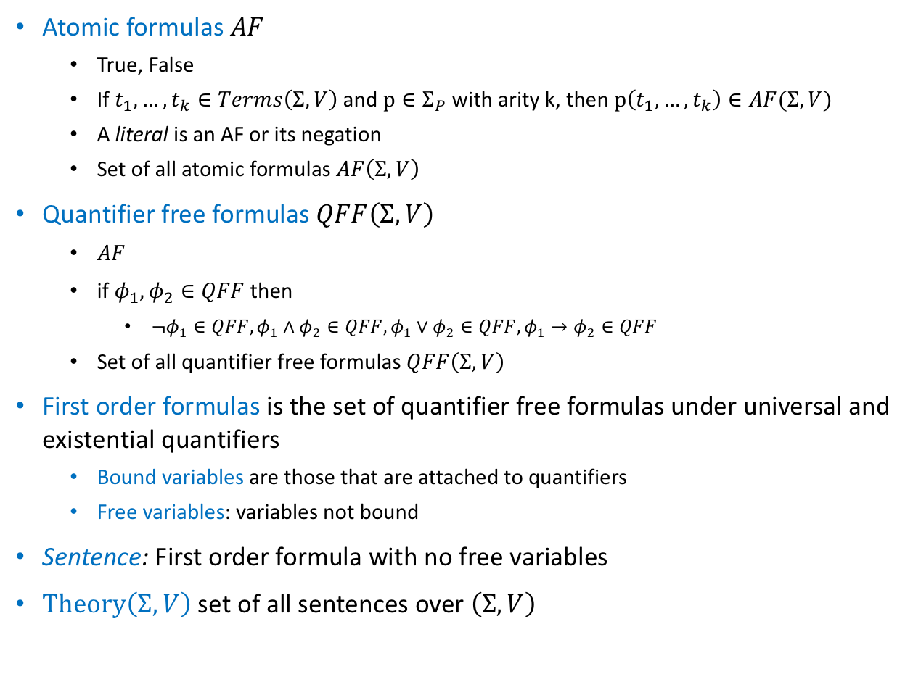
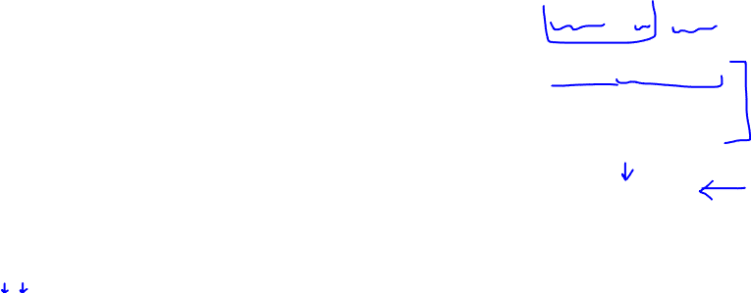
Terms to Formulas
Atomic formulas $AF$
True, False
If $t_{1},…,t_{k}∈Terms\left(Σ,V\right)$ and $p∈Σ_{P}$ with arity k, then $p\left(t_{1},…,t_{k}\right)∈AF(Σ,V)$
A literal is an AF or its negation
Set of all atomic formulas $AF\left(Σ,V\right)$
Quantifier free formulas $QFF\left(Σ,V\right)$
$AF$
if $φ_{1}, φ_{2}∈QFF$ then
$¬φ_{1}∈QFF, φ_{1}∧φ_{2}∈QFF,φ_{1}∨φ_{2}∈QFF, φ_{1}→φ_{2}∈QFF$
Set of all quantifier free formulas $QFF\left(Σ,V\right)$
First order formulas is the set of quantifier free formulas under universal and existential quantifiers
Bound variables are those that are attached to quantifiers
Free variables: variables not bound
Sentence: First order formula with no free variables
$Theory\left(Σ,V\right)$ set of all sentences over $\left(Σ,V\right)$
$x<y$
$+\left(x,y\right)=+(y,x)$
$+\left(x,y\right)=0∧x>y$
$∀x, ∃y:+\left(x,y\right)=0$
$∀x, ∃y:x<y$
$∀x, ∃y:+\left(x,y\right)=x$
$∃x:+\left(x,c\right)=x$

Slide 9
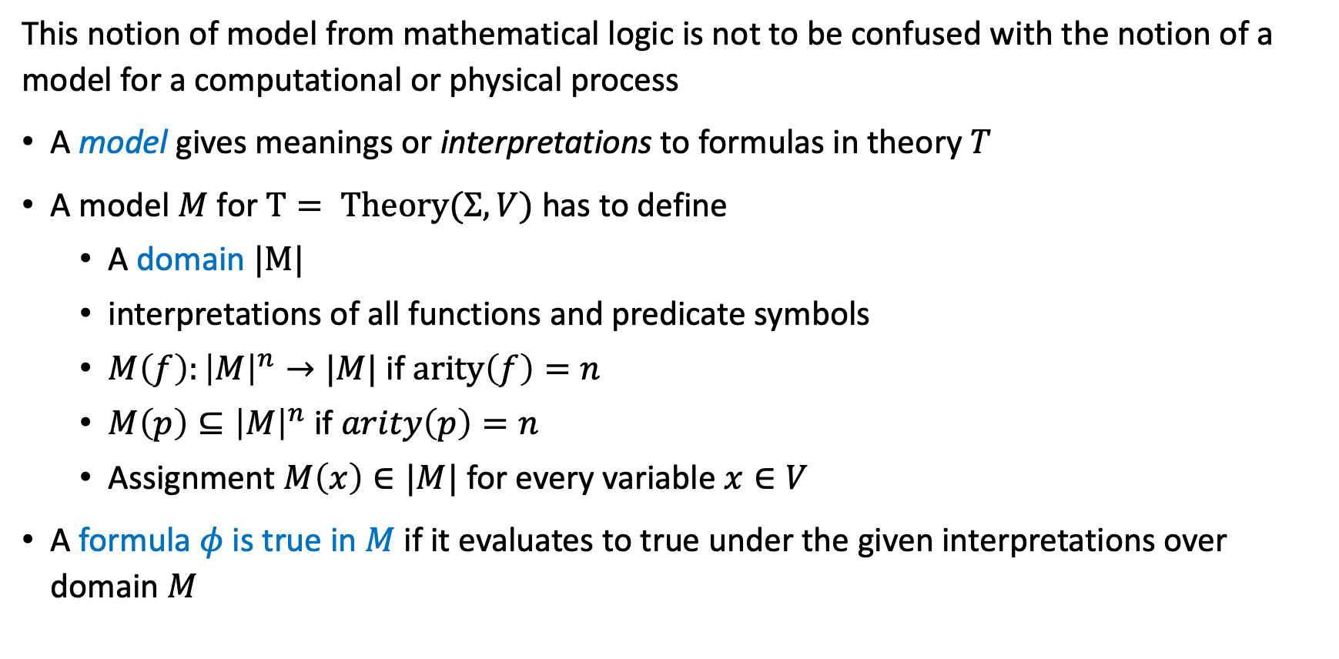

Models for theories
This notion of model from mathematical logic is not to be confused with the notion of a model for a computational or physical process
A model gives meanings or interpretations to formulas in theory $T$
A model $M$ for $T= Theory(Σ,V)$ has to define
A domain $|M|$
interpretations of all functions and predicate symbols
$M\left(f\right):{\left|M\right|}^{n}→|M|$ if $arity\left(f\right)=n$
$M\left(p\right)⊆{\left|M\right|}^{n}$ if $arity\left(p\right)=n$
Assignment $M\left(x\right)∈|M|$ for every variable $x∈V$
A formula $φ$ is true in $M$ if it evaluates to true under the given interpretations over domain $M$

Slide 10
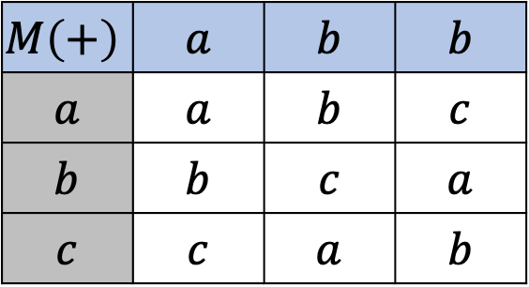
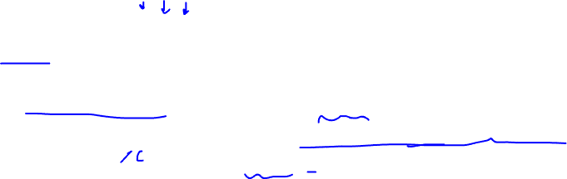
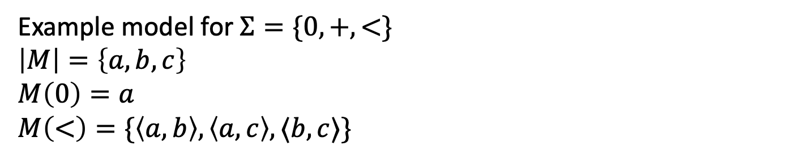

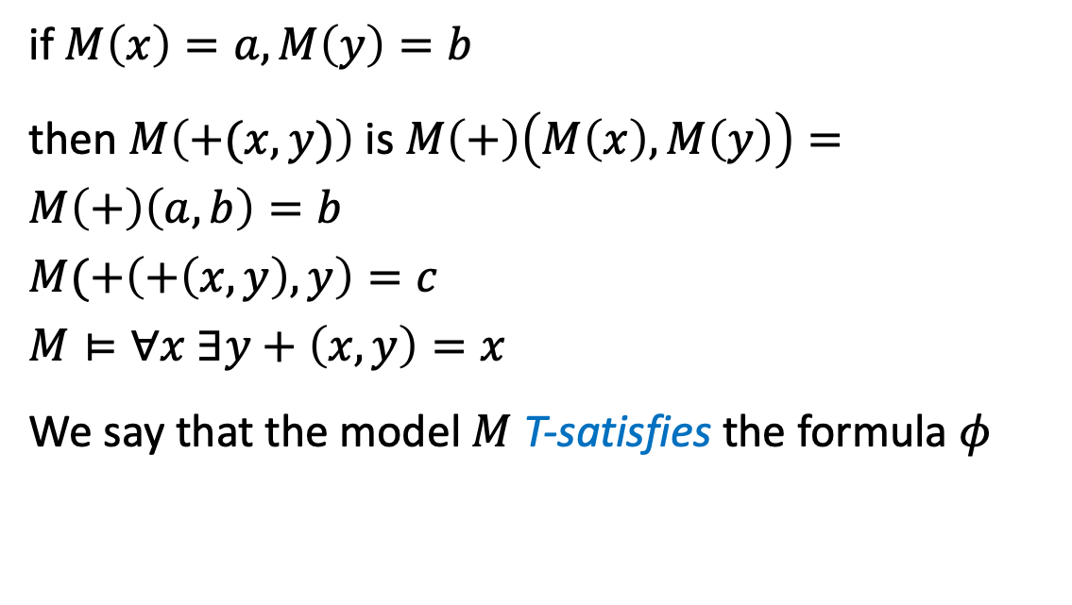
Example
A model gives meanings or interpretations to formulas in theory $T$
Example model for $Σ=\{0,+,<\}$
$$\left|M\right|=\left\{a,b,c\right\}$$
$$M\left(0\right)=a$$
$$M\left(<\right)=\{\left\langle a,b\right\rangle ,\left\langle a,c\right\rangle ,⟨b,c⟩\}$$
if $M\left(x\right)=a, M\left(y\right)=b$
then $M\left(+(x,y)\right)$ is $M\left(+\right)\left(M\left(x\right),M\left(y\right)\right)=M\left(+\right)\left(a,b\right)=b$
$$M(+\left(+\left(x,y\right),y\right)=c$$
$$M⊨∀x ∃y+\left(x,y\right)=x$$
We say that the model $M$ T-satisfies the formula $φ$
$$M\left(+\right)$$ | $$a$$ | $$b$$ | $$b$$
$$a$$ | $$a$$ | $$b$$ | $$c$$
$$b$$ | $$b$$ | $$c$$ | $$a$$
$$c$$ | $$c$$ | $$a$$ | $$b$$

Slide 11

Decision procedures
Given a theory $T$ a theory solver or a decision procedure for $T$ takes as input a set of literals $φ$ (atomic propositions) and determines whether $φ$ is $T$-satisfiable, that is,
$∃$ a model $M$ such that $M⊨φ?$

Slide 12

$$⟨\backslash model theory⟩$$
A short overview of theories and models in mathematical logic

Slide 13
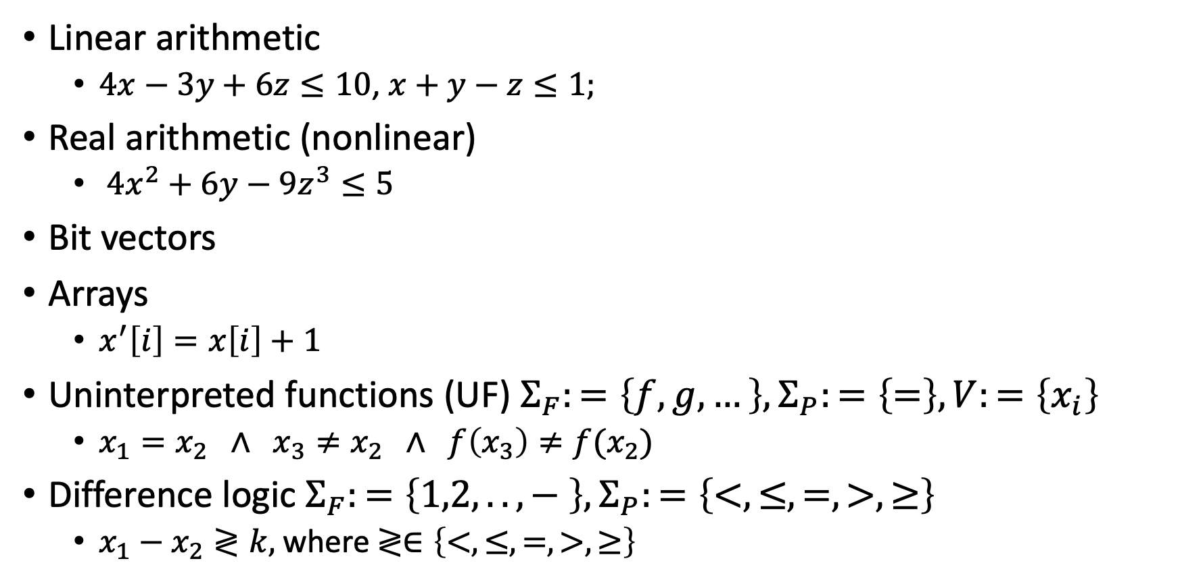

Example theories
Linear arithmetic
$4x−3y+6z≤10$, $x+y−z≤1;$
Real arithmetic (nonlinear)
$4x^{2}+6y−9z^{3}≤5$
Bit vectors
Arrays
$x^{′}\left[i\right]=x\left[i\right]+1$
Uninterpreted functions (UF) $Σ_{F}:=\left\{f,g,…\right\}, Σ_{P}:=\left\{=\right\}, V:=\left\{x_{i}\right\}$
$x_{1}=x_{2} ∧ x_{3}≠x_{2} ∧ f\left(x_{3}\right)≠f(x_{2})$
Difference logic $Σ_{F}:=\left\{1,2,..,− \right\},Σ_{P}:=\left\{<,≤, =,>,≥\right\}$
$x_{1}−x_{2}≷k,$ where $≷∈\left\{<,≤, =,>,≥\right\}$

Slide 14

Uninterpreted functions
Useful for abstractly reasoning about programs
$Σ_{F}:=\left\{f,g,…\right\}, Σ_{P}:=\left\{=\right\}, V:=\left\{x_{i}\right\}$
Literals are of the form $x_{1}=x_{2} ∧ x_{3}≠x_{2} ∧ f\left(x_{3}\right)≠f(x_{2})$

Slide 15
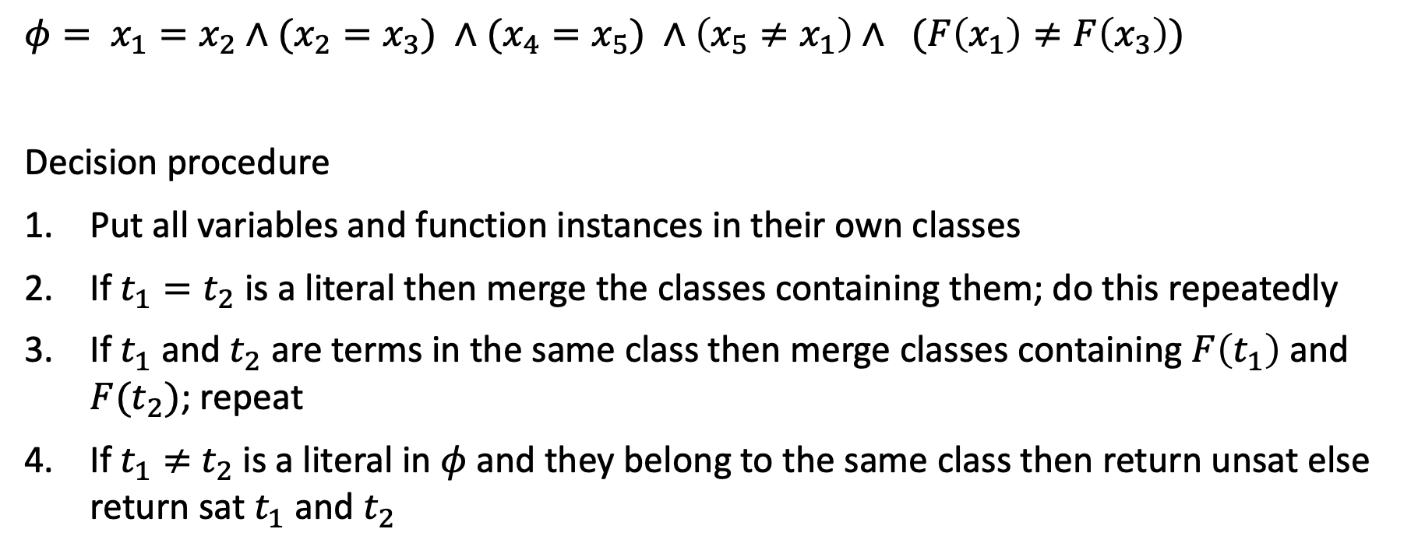
Decision procedure for Uninterpreted functions (UF)
$$φ= x_{1}=x_{2}∧(x_{2}=x_{3}) ∧(x_{4}=x_{5}) ∧\left(x_{5}≠x_{1}\right)∧ (F\left(x_{1}\right)≠F\left(x_{3}\right))$$
Decision procedure
Put all variables and function instances in their own classes
If $t_{1}=t_{2}$ is a literal then merge the classes containing them; do this repeatedly
If $t_{1}$ and $t_{2}$ are terms in the same class then merge classes containing $F\left(t_{1}\right)$ and $F(t_{2})$; repeat
If $t_{1}≠$ $t_{2}$ is a literal in $φ$ and they belong to the same class then return unsat else return sat $t_{1}$ and $t_{2}$

Slide 16
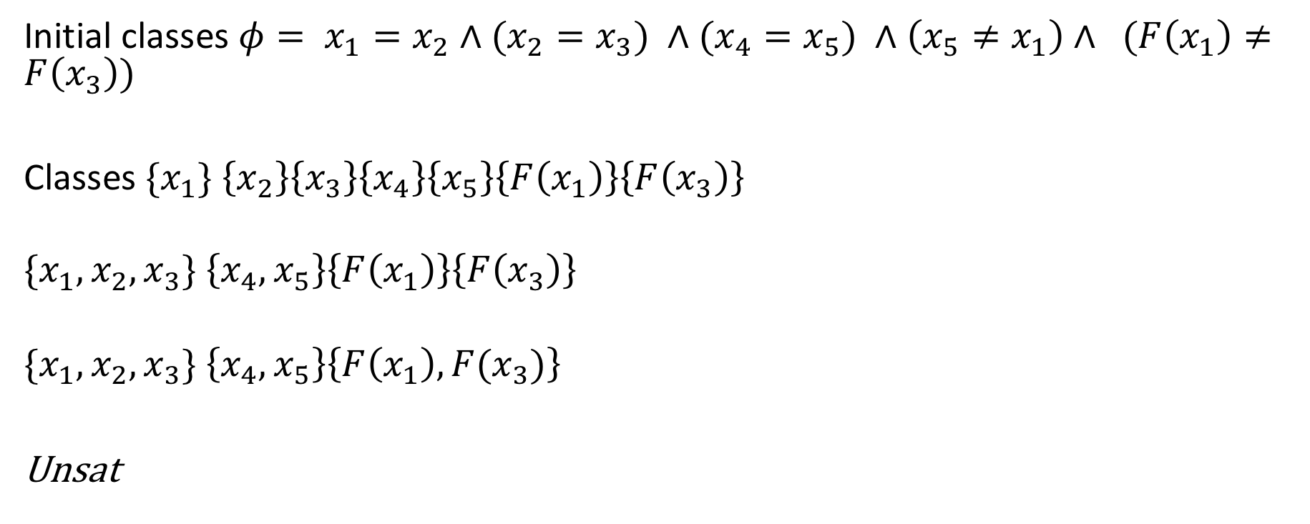
Decision procedure for Uninterpreted functions (UF)
Initial classes $φ= x_{1}=x_{2}∧(x_{2}=x_{3}) ∧(x_{4}=x_{5}) ∧\left(x_{5}≠x_{1}\right)∧ (F\left(x_{1}\right)≠F\left(x_{3}\right))$
Classes ${\{x}_{1}\} \left\{x_{2}\right\}\left\{x_{3}\right\}\left\{x_{4}\right\}\left\{x_{5}\right\}\left\{F\left(x_{1}\right)\right\}\left\{F\left(x_{3}\right)\right\}$
$${\{x}_{1},x_{2},x_{3}\} \left\{x_{4},x_{5}\right\}\left\{F\left(x_{1}\right)\right\}\left\{F\left(x_{3}\right)\right\}$$
$${\{x}_{1},x_{2},x_{3}\} \left\{x_{4},x_{5}\right\}\left\{F\left(x_{1}\right),F(x_{3})\right\}$$
Unsat

Slide 17
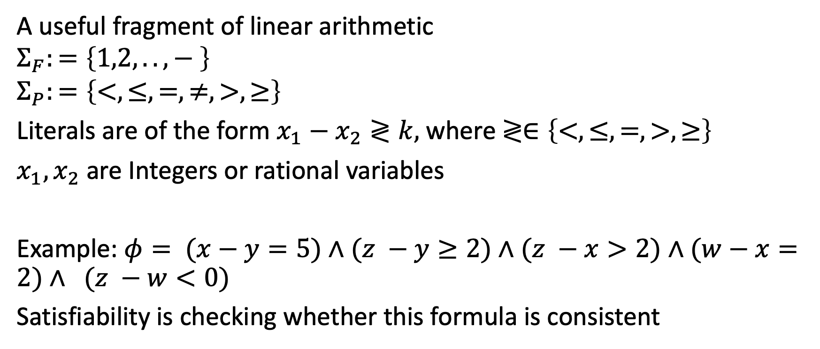
Difference Logic (conjunctive fragment)
A useful fragment of linear arithmetic
$$Σ_{F}:=\left\{1,2,..,− \right\}$$
$$Σ_{P}:=\left\{<,≤, =,≠,>,≥\right\}$$
Literals are of the form $x_{1}−x_{2}≷k,$ where $≷∈\left\{<,≤, =,>,≥\right\}$
$x_{1},x_{2}$are Integers or rational variables
Example: $φ= (x−y=5)∧(z −y≥2)∧(z −x>2)∧(w−x=2)∧ (z −w<0)$
Satisfiability is checking whether this formula is consistent

Slide 18
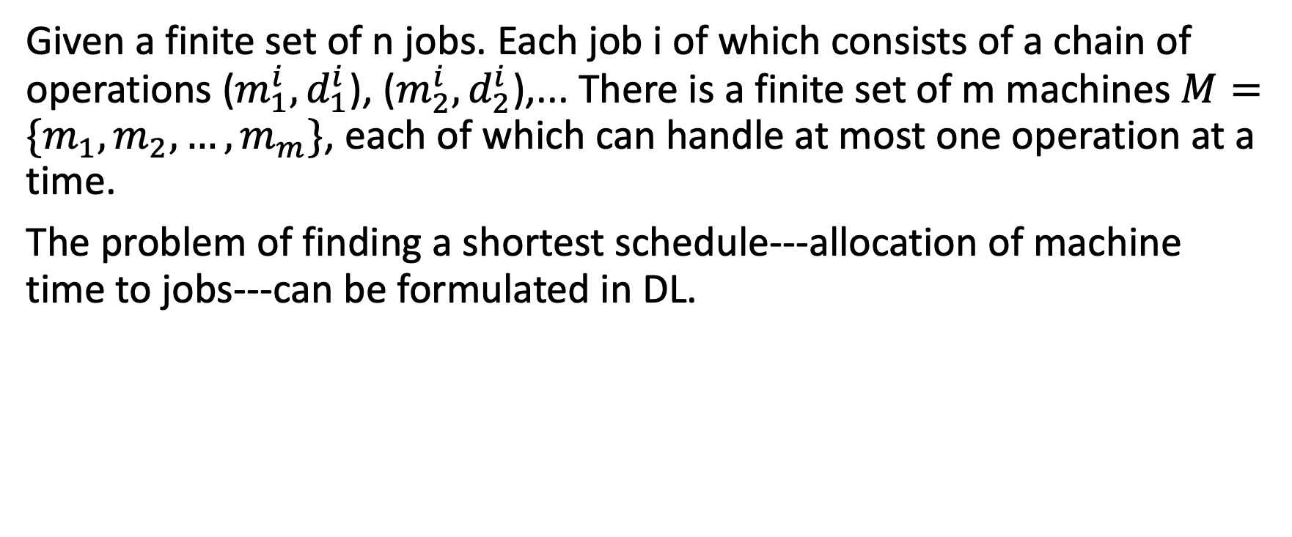
An Application: Job shop scheduling problem
Given a finite set of n jobs. Each job i of which consists of a chain of operations ($m_{1}^{i},d_{1}^{i}$), ($m_{2}^{i},d_{2}^{i}$),... There is a finite set of m machines $M=\{m_{1},m_{2},…,m_{m}\}$, each of which can handle at most one operation at a time.
The problem of finding a shortest schedule---allocation of machine time to jobs---can be formulated in DL.

Slide 19
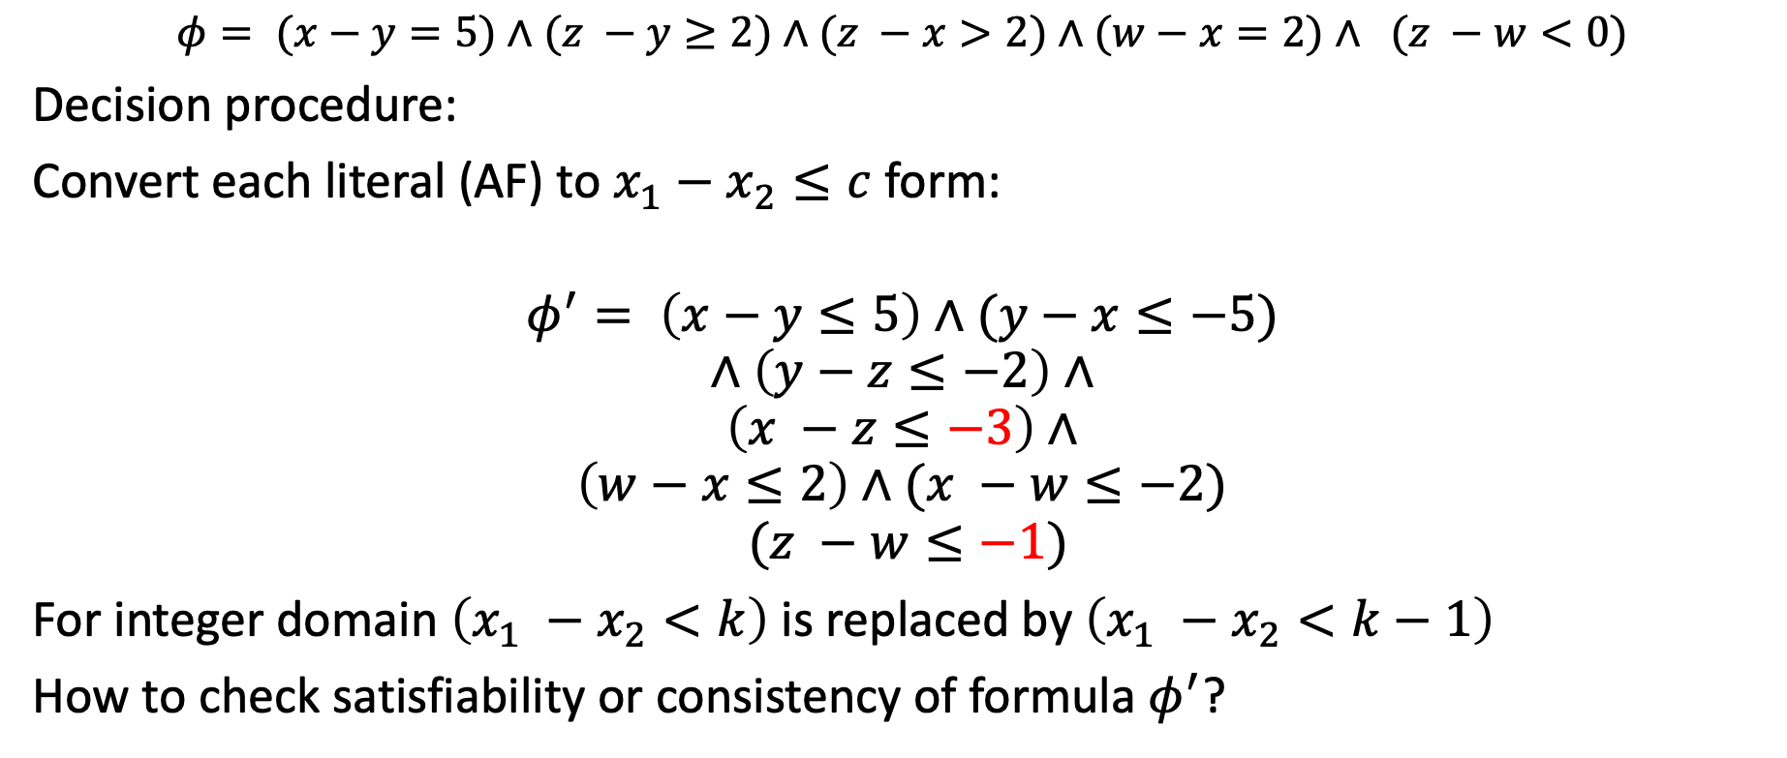
Decision procedure for Difference logic
$$φ= (x−y=5)∧(z −y≥2)∧(z −x>2)∧(w−x=2)∧ (z −w<0)$$
Decision procedure:
Convert each literal (AF) to $x_{1}−x_{2}≤c$ form:
$$φ^{′}= \left(x−y≤5\right)∧(y−x≤−5)$$
$$∧\left(y−z≤−2\right)∧$$
$$\left(x −z≤−3\right)∧$$
$$\left(w−x≤2\right)∧(x −w≤−2)$$
$$(z −w≤−1)$$
For integer domain $\left(x_{1} −x_{2}<k\right)$ is replaced by $\left(x_{1} −x_{2}<k−1\right)$
How to check satisfiability or consistency of formula $φ^{′}$?

Slide 20


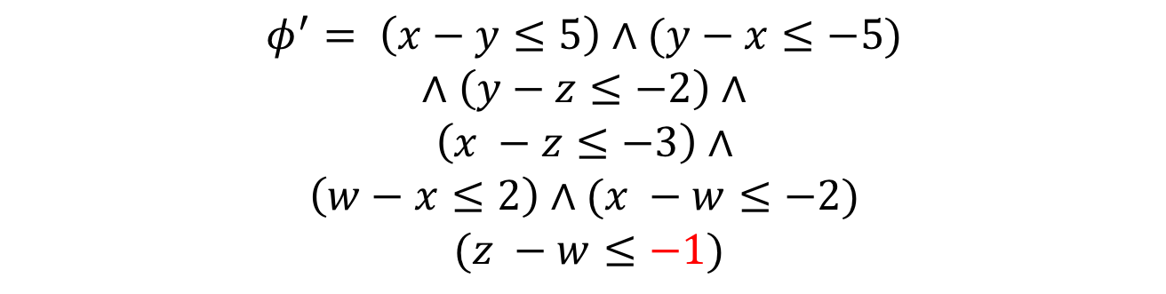









$$φ^{′}= \left(x−y≤5\right)∧(y−x≤−5)$$
$$∧\left(y−z≤−2\right)∧$$
$$\left(x −z≤−3\right)∧$$
$$\left(w−x≤2\right)∧(x −w≤−2)$$
$$(z −w≤−1)$$
Construct a graph with edge from $x→^{c}y$ for each literal $x−y≤c$ in $φ′$
$$y$$
$$5$$
$$−2$$
$$x$$
$$−5$$
$$z$$
$$−3$$
$$−2$$
$$2$$
$$w$$
$$−1$$

Slide 21
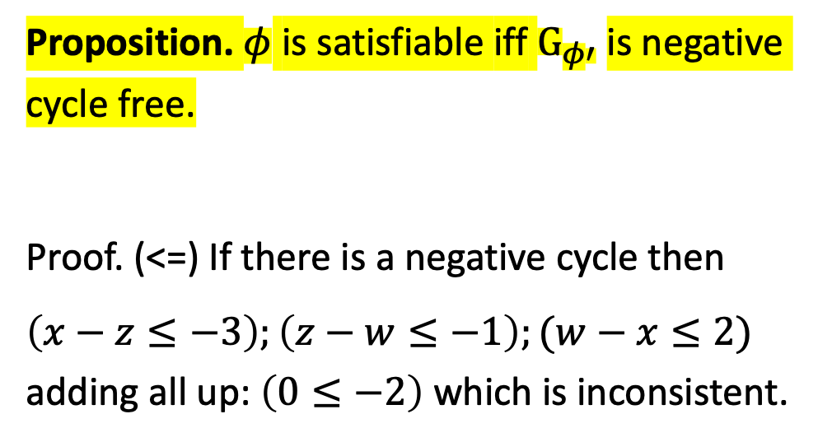
$$φ^{′}= \left(x−y≤5\right)∧(y−x≤−5)$$
$$∧\left(y−z≤−2\right)∧$$
$$\left(x −z≤−3\right)∧$$
$$\left(w−x≤2\right)∧(x −w≤−2)$$
$$(z −w≤−1)$$
Construct a graph $G_{φ′}$ with edge from $x→^{c}y$ for each literal $φ′$
$$y$$
$$5$$
$$−2$$
Proposition. $φ$ is satisfiable iff $G_{φ′}$is negative cycle free.
Proof. (<=) If there is a negative cycle then
$\left(x−z≤−3\right);\left(z−w≤−1\right);(w−x≤2)$ adding all up: $\left(0≤−2\right)$ which is inconsistent.
$$x$$
$$−5$$
$$z$$
$$−3$$
$$−2$$
$$2$$
$$w$$
$$−1$$

Slide 22

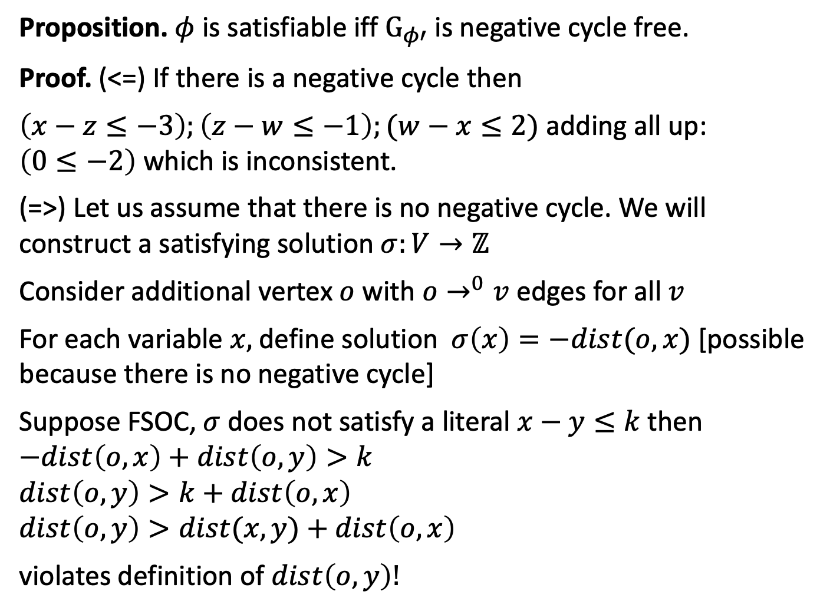


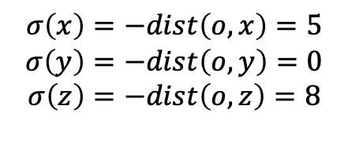















$$y$$
Proposition. $φ$ is satisfiable iff $G_{φ′}$is negative cycle free.
Proof. (<=) If there is a negative cycle then
$\left(x−z≤−3\right);\left(z−w≤−1\right);(w−x≤2)$ adding all up: $\left(0≤−2\right)$ which is inconsistent.
(=>) Let us assume that there is no negative cycle. We will construct a satisfying solution $σ:V→ℤ$
Consider additional vertex $o$ with $o→^{0}v$ edges for all $v$
For each variable $x,$define solution $σ\left(x\right)=−dist(o,x)$ [possible because there is no negative cycle]
Suppose FSOC, $σ$ does not satisfy a literal $x−y≤k$ then
$$−dist\left(o,x\right)+dist\left(o,y\right)>k$$
$$dist\left(o,y\right)>k+dist\left(o,x\right)$$
$$dist\left(o,y\right)>dist(x,y)+dist\left(o,x\right)$$
violates definition of $dist\left(o,y\right)!$
$$5$$
$$−2$$
$$x$$
$$−5$$
$$z$$
$$−3$$
$$−2$$
$$2$$
$$w$$
$$−1$$
$$y$$
$$5$$
$$−2$$
$$x$$
$$−5$$
$$−3$$
$$z$$
$$o$$
$$σ\left(x\right)=−dist\left(o,x\right)=5$$
$$σ\left(y\right)=−dist\left(o,y\right)=0$$
$$σ\left(z\right)=−dist\left(o,z\right)=8$$

Slide 23
Summary of DP for Difference Logic
Satisfiability check for conjunctive fragment of DL can be performed using Bellman-Ford algorithm in time O(|V|.|E|)
Inconsistency/unsatisfiability explanations are negative cycles
Amenable to incremental checks

Slide 24
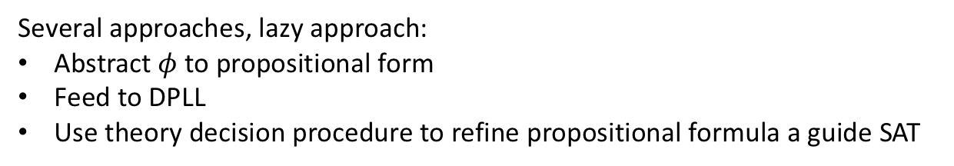
Return to SMT
$$φ≡g\left(a\right)=c∧f\left(g\left(a\right)\right)≠f\left(c\right)∨g\left(a\right)=d∧c≠d$$
Several approaches, lazy approach:
Abstract $φ$ to propositional form
Feed to DPLL
Use theory decision procedure to refine propositional formula a guide SAT
Theory solvers/decision procedures
literals/formula in
real arithmetic
boolean skeleton of problem
Arithmetic
Bitvectors
Core
DPLL
Difference logic
…
Uninterpreted functions
assertions
solution or
counterexample

Slide 25
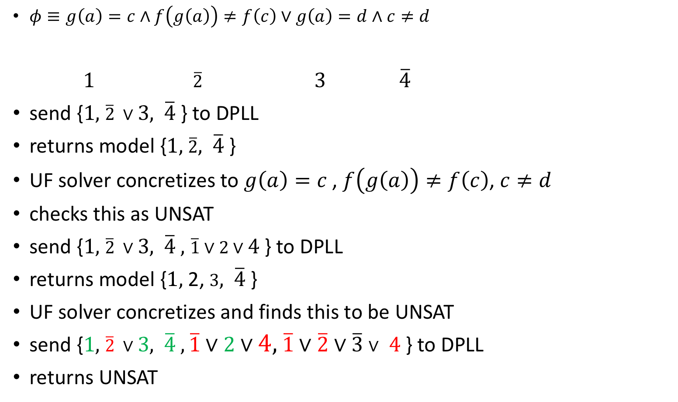
Theory solvers/decision procedures
literals/formula in
real arithmetic
boolean skeleton of problem
Arithmetic
Bitvectors
Core
DPLL
Difference logic
$φ≡g\left(a\right)=c∧f\left(g\left(a\right)\right)≠f\left(c\right)∨g\left(a\right)=d∧c≠d$
$1$ $\overline{2}$ $3$ $\overline{4}$
send {$1,$ $\overline{2} ∨3,$ $\overline{4}$} to DPLL
returns model {$1,$ $\overline{2},$ $\overline{4}$}
UF solver concretizes to $g\left(a\right)=c$, $f\left(g\left(a\right)\right)≠f\left(c\right)$, $c≠d$
checks this as UNSAT
send {$1,$ $\overline{2} ∨3,$ $\overline{4} ,$ $\overline{1}∨2∨4$} to DPLL
returns model {$1,$ 2, $3,$ $\overline{4}$}
UF solver concretizes and finds this to be UNSAT
send {$1,$ $\overline{2} ∨3,$ $\overline{4} ,\overline{1}∨2∨4,$ $\overline{1}∨\overline{2}∨\overline{3}∨$ $4$ } to DPLL
returns UNSAT
…
Uninterpreted functions
assertions
solution or
counterexample

Slide 26
Assignments
Learn z3
https://ericpony.github.io/z3py-tutorial/guide-examples.htm
Readings
Read chapter 4 for next week
Reading more about decision procedures

