Slide 1
Abstractions
Sayan Mitra
Verifying cyberphysical systems
mitras@illinois.edu

Slide 2
Outline
Abstractions
Simulation relations
Composition and substitutivity

Slide 3
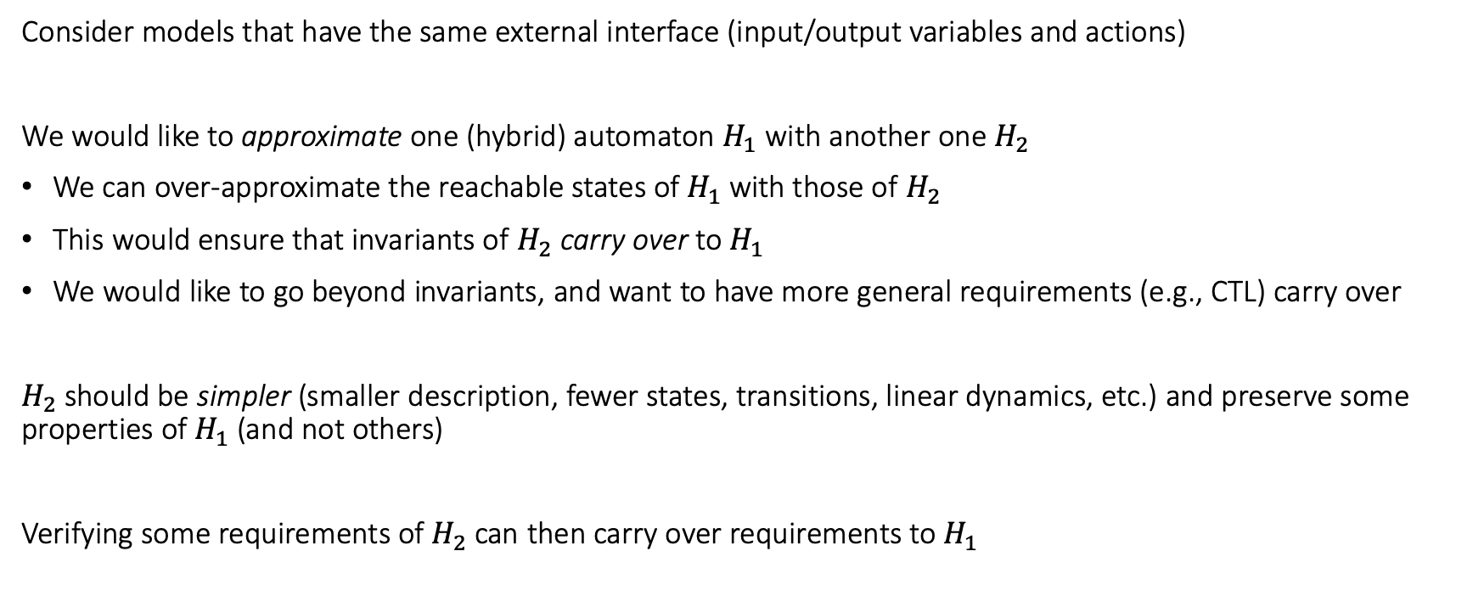
Abstractions and Simulations
Consider models that have the same external interface (input/output variables and actions)
We would like to approximate one (hybrid) automaton $H_{1}$ with another one $H_{2}$
We can over-approximate the reachable states of $H_{1}$ with those of $H_{2}$
This would ensure that invariants of $H_{2}$ carry over to $H_{1}$
We would like to go beyond invariants, and want to have more general requirements (e.g., CTL) carry over
$H_{2}$ should be simpler (smaller description, fewer states, transitions, linear dynamics, etc.) and preserve some properties of $H_{1}$ (and not others)
Verifying some requirements of $H_{2}$ can then carry over requirements to $H_{1}$

Slide 4
Finite state examples
0
1
0
A0
A1
A2
A3
Traces_{A}= (01)*
A
1
0
1
0
B02
B13
B
Traces_{B}= 01*
1
C03
Traces_{C}= {0,1}*
C
0,1

Slide 5
Finite state examples
0
1
0
A0
A1
A2
A3
A
1
0
1
0
B simulates A and vice versa.
A and B are bisimilar.
B02
B13
B
1
C simulates both A and B.
C is an abstraction of both A and B.
C03
C
0,1

Slide 6
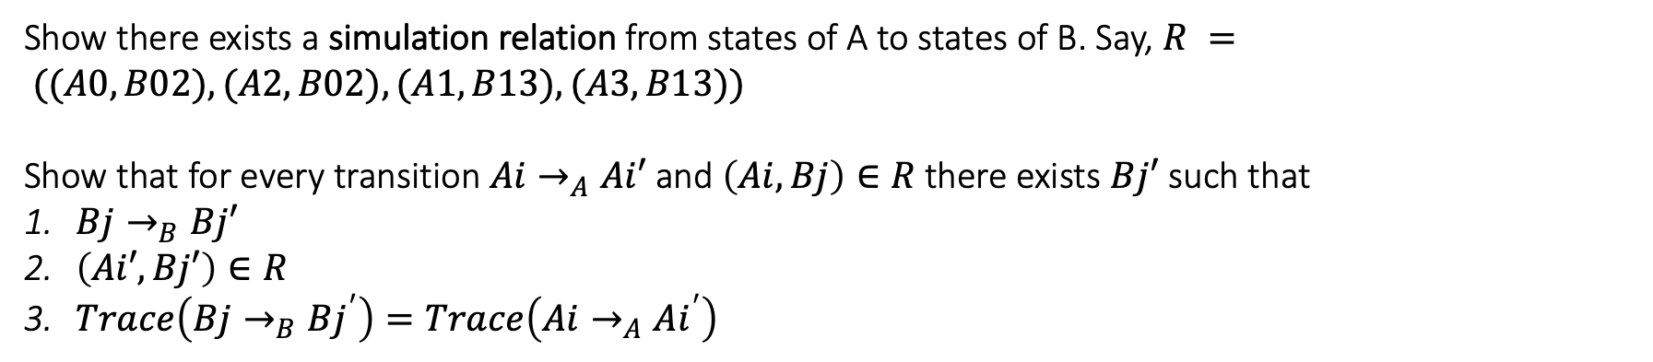

How to prove B simulates A?
0
1
0
A0
A1
A2
A3
A
1
0
1
0
B
B02
B13
1
Show there exists a simulation relation from states of A to states of B. Say, $R = ((A0,B02), (A2,B02), (A1, B13), (A3, B13))$
Show that for every transition $Ai→_{A}Ai′$ and $\left(Ai,Bj\right)∈R$ there exists $Bj′$ such that
$Bj→_{B}Bj′$
$\left(Ai′,Bj′\right)∈R$
$Trace\left(Bj→_{B}Bj^{′}\right)=Trace\left(Ai→_{A}Ai^{′}\right)$

Slide 7
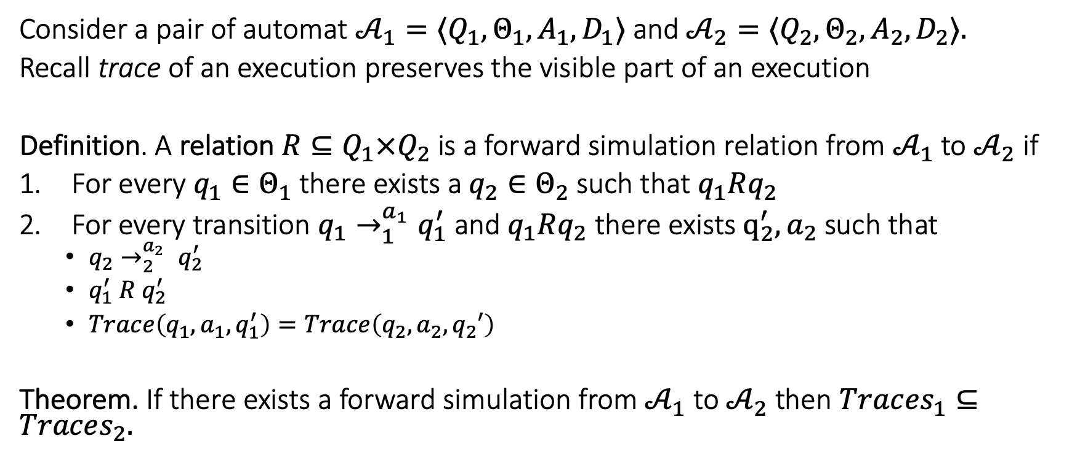
Forward simulation relation
Consider a pair of automat ${𝒜_{1}=⟨Q}_{1}, Θ_{1},A_{1},D_{1}⟩$and ${𝒜_{2}=⟨Q}_{2}, Θ_{2},A_{2},D_{2}⟩.$
Recall trace of an execution preserves the visible part of an execution
Definition. A relation $R⊆Q_{1}×Q_{2}$ is a forward simulation relation from $𝒜_{1}$to $𝒜_{2}$if
For every $q_{1}∈Θ_{1}$there exists a $q_{2}∈Θ_{2}$ such that $q_{1}Rq_{2}$
For every transition $q_{1}→_{1}^{a_{1}}q_{1}^{′}$ and $q_{1}Rq_{2}$ there exists $q_{2}^{′},a_{2}$ such that
$q_{2}→_{2}^{a_{2}} q_{2}^{′}$
$q_{1}^{′} R q_{2}^{′}$
$Trace\left(q_{1},a_{1},q_{1}^{′}\right)=Trace\left(q_{2},a_{2},q_{2}′\right)$
Theorem. If there exists a forward simulation from $𝒜_{1}$ to $𝒜_{2}$ then $Trac{es}_{1}⊆Traces_{2}.$

Slide 8

Theorem. If there exists a forward simulation from $𝒜_{1}$ to $𝒜_{2}$ then $Trac{es}_{1}⊆Traces_{2}.$

Slide 9
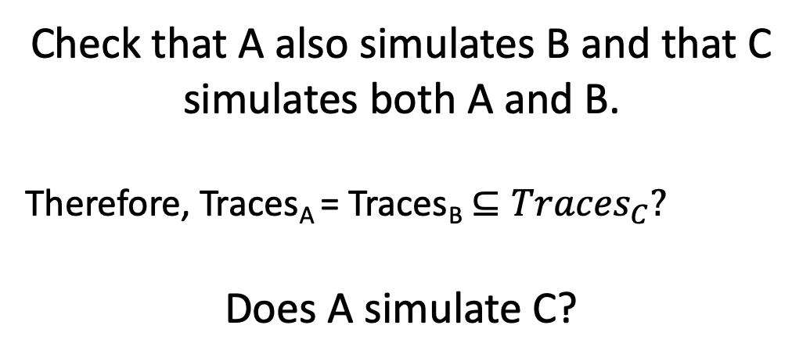
Finite state examples
0
1
0
A0
A1
A2
A3
A
1
0
1
0
Check that A also simulates B and that C simulates both A and B.
Therefore, Traces_{A} = Traces_{B} $⊆Traces_{C}?$
Does A simulate C?
B02
B13
B
1
0
C03
1
C

Slide 10

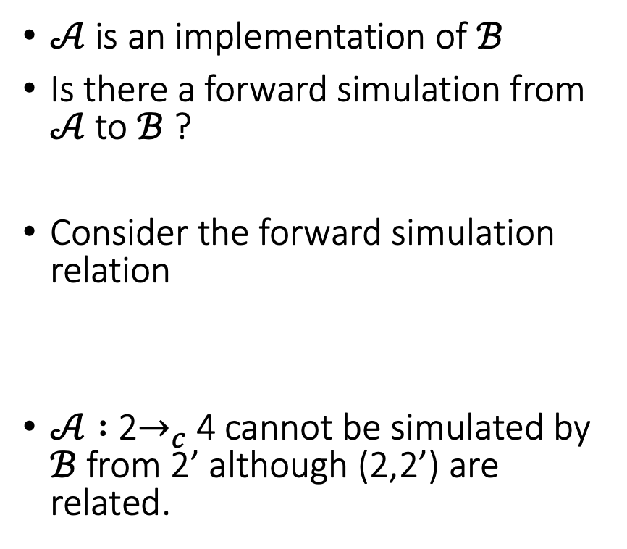
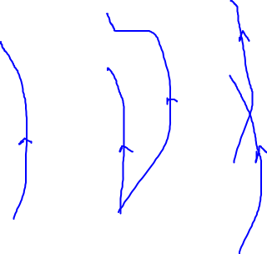

A Simulation Example
$$ℬ$$
$𝒜$ is an implementation of $ℬ$
Is there a forward simulation from $𝒜$ to $ℬ$ ?
Consider the forward simulation relation
$𝒜 :$ 2$→_{c}$4 cannot be simulated by $ℬ$ from 2’ although (2,2’) are related.
a
3
2’
b
1
a
c
2
4
$$𝒜$$
3
b
a
1
2
c
4

Slide 11
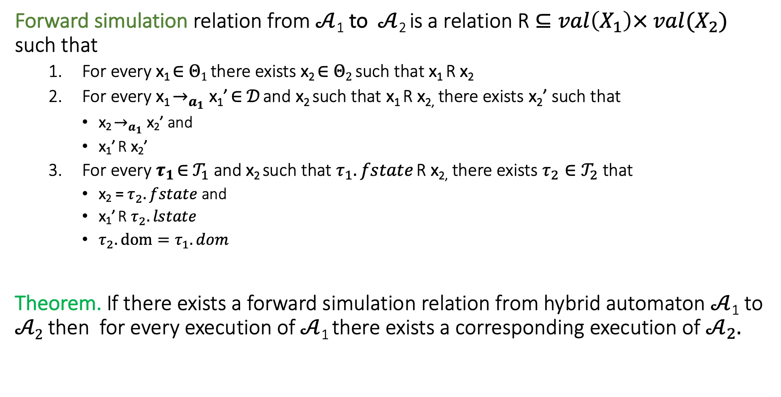
Simulations for hybrid systems
Forward simulation relation from $𝒜$₁ to $𝒜$₂ is a relation R $⊆val\left(X_{1}\right)× {val(X_{2})}_{}$ such that
For every x₁ ∈ $Θ1$ there exists x₂ ∈ $Θ2$ such that x₁ R x₂
For every x₁ $→_{a_{1}}$ x₁’ ∈ $𝒟$ and x₂ such that x₁ R x_{2,} there exists x₂’ such that
x₂ $→_{a_{1}}$ x₂’ and
x₁’ R x₂’
For every $τ_{1}$ ∈ $𝒯_{1}$ and x₂ such that $τ_{1}.fstate$ R x_{2,} there exists $τ_{2}∈𝒯_{2}$ that
x₂ = $τ_{2}.fstate$ and
x₁’ R $τ_{2}.lstate$
$τ_{2}.dom=τ_{1}.dom$
Theorem. If there exists a forward simulation relation from hybrid automaton $𝒜$₁ to $𝒜2$ then for every execution of $𝒜$₁ there exists a corresponding execution of $𝒜_{2}.$

Slide 12
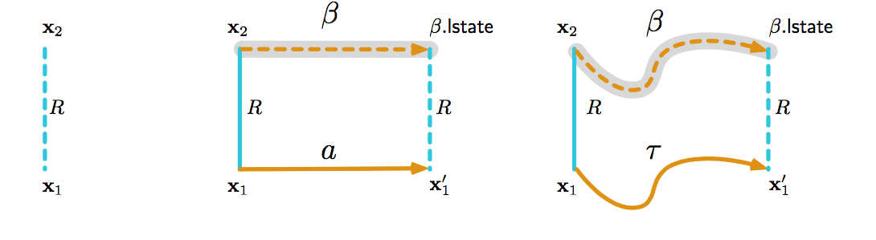
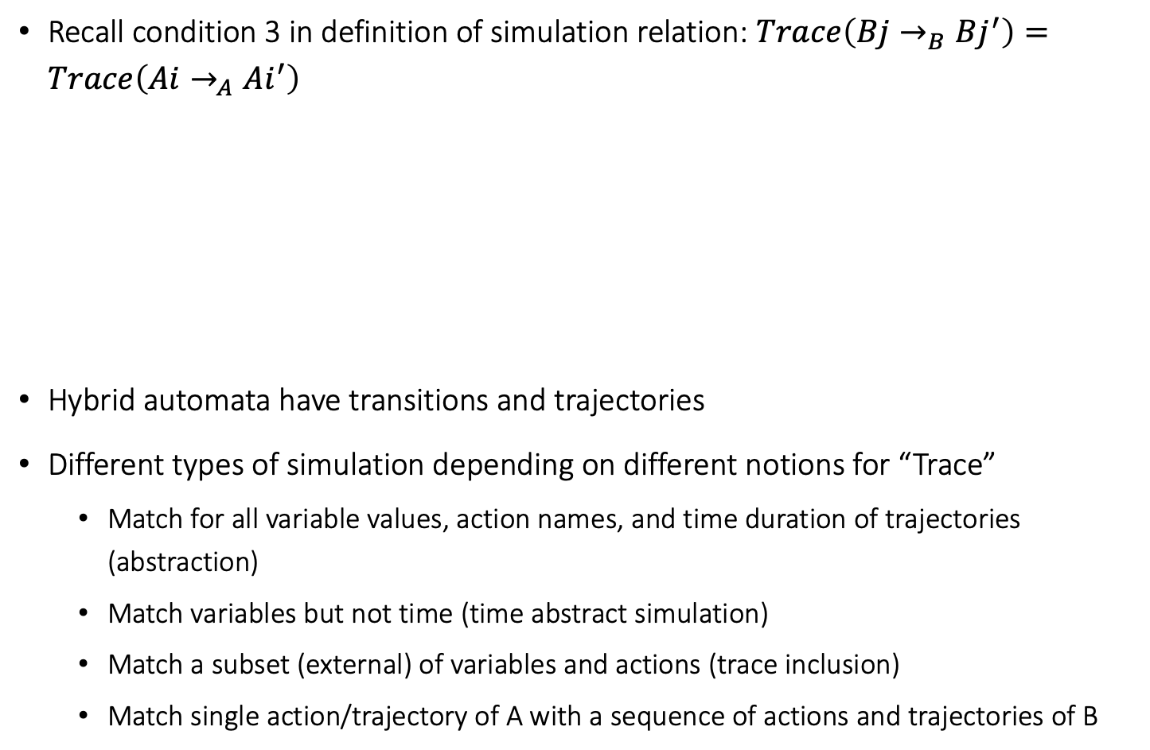
Simulation relations for hybrid automata
Recall condition 3 in definition of simulation relation: $Trace\left(Bj→_{B}Bj^{′}\right)=Trace\left(Ai→_{A}Ai^{′}\right)$
Hybrid automata have transitions and trajectories
Different types of simulation depending on different notions for “Trace”
Match for all variable values, action names, and time duration of trajectories (abstraction)
Match variables but not time (time abstract simulation)
Match a subset (external) of variables and actions (trace inclusion)
Match single action/trajectory of A with a sequence of actions and trajectories of B

Slide 13
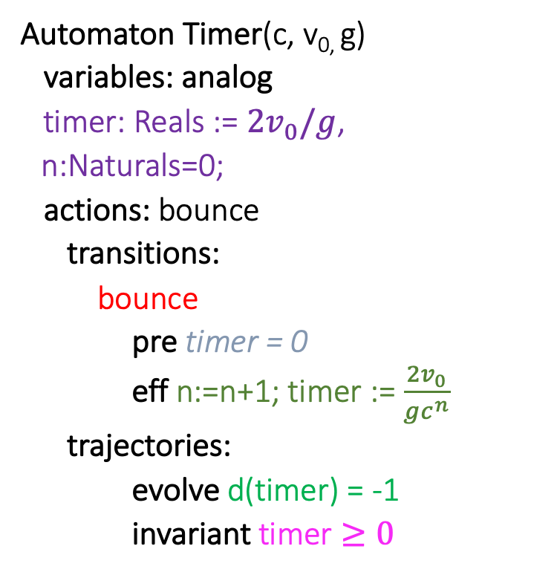

Timer simulates Ball (w.r.t. timing of bounce actions)
Automaton Timer(c, v_{0,} g)
variables: analog
timer: Reals := $2v_{0}/g$,
n:Naturals=0;
actions: bounce
transitions:
bounce
pre timer = 0
eff n:=n+1; timer := $\frac{2v_{0}}{gc^{n}}$
trajectories:
evolve d(timer) = -1
invariant timer $≥0$
Automaton Ball(c,v₀,g)
variables:
x: Reals := 0
v: Reals := v₀
actions: bounce
transitions:
bounce
pre x = 0 /\ v < 0
eff v := -cv
trajectories:
evolve d(x) = v; d(v) = -g
invariant $x≥0$

Slide 14
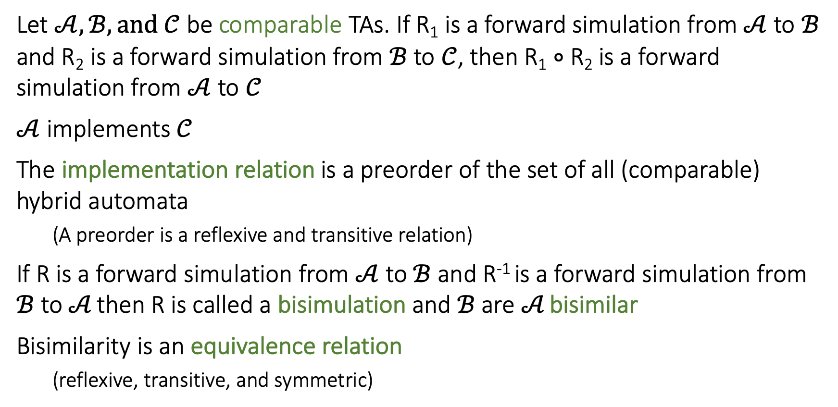
Some nice properties of Forward Simulation
Let $𝒜, ℬ, and 𝒞$ be comparable TAs. If R₁ is a forward simulation from $𝒜$ to $ℬ$ and R₂ is a forward simulation from $ℬ$ to $𝒞$, then R₁ $∘$ R₂ is a forward simulation from $𝒜$ to $𝒞$
$𝒜$ implements $𝒞$
The implementation relation is a preorder of the set of all (comparable) hybrid automata
(A preorder is a reflexive and transitive relation)
If R is a forward simulation from $𝒜$ to $ℬ$ and R⁻¹ is a forward simulation from $ℬ$ to $𝒜$ then R is called a bisimulation and $ℬ$ are $𝒜$ bisimilar
Bisimilarity is an equivalence relation
(reflexive, transitive, and symmetric)
Notes:
Relational composition

Slide 15
Remark on Simulations and Stability
Stability not preserved by ordinary simulations and bisimulations [Prabhakar, et. al 15]
time
time
Stability Preserving Simulations and Bisimulations for Hybrid Systems, Prabhakar, Dullerud, Viswanathan IEEE Trans. Automatic Control 2015

Slide 16
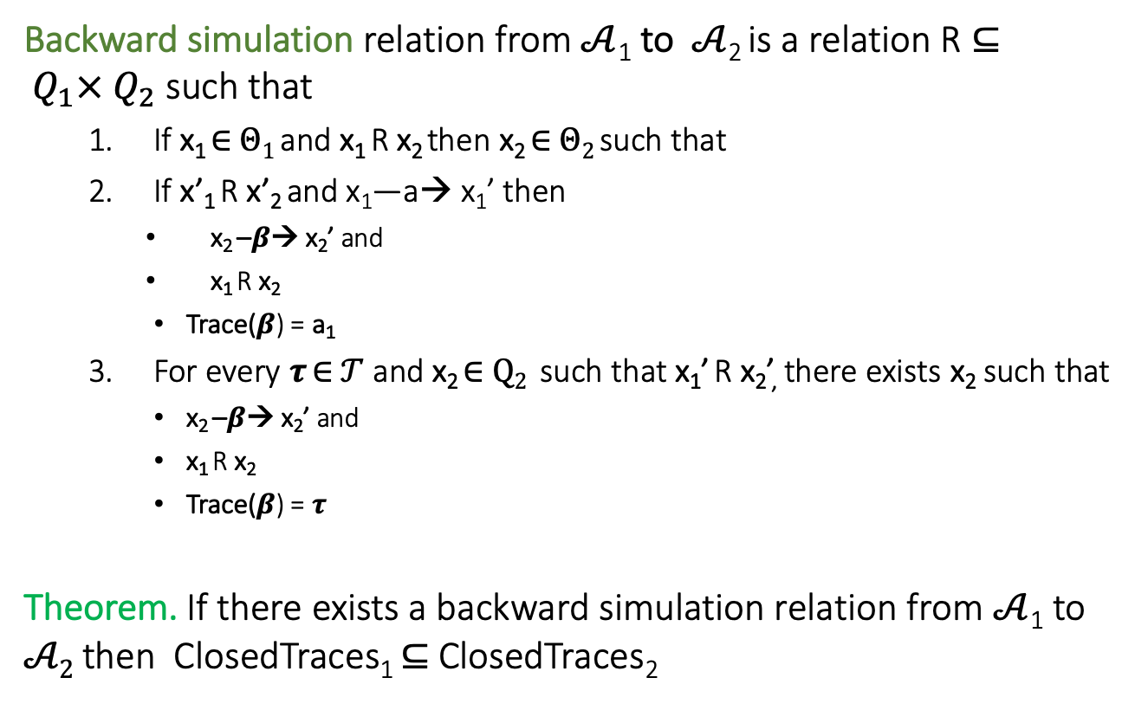
Backward Simulations
Backward simulation relation from $𝒜$₁ to $𝒜$₂ is a relation R $⊆ Q_{1}× Q_{2}$ such that
If x₁ ∈ $Θ1$ and x₁ R x₂ then x₂ ∈ $Θ2$ such that
If x’₁ R x’₂ and x₁—a→ x₁’ then
x₂ –$β$→ x₂’ and
x₁ R x₂
Trace($β$) = a₁
For every $τ$ ∈ $𝒯$ and x₂ ∈ $Q2$ such that x₁’ R x₂’, there exists x₂ such that
x₂ –$β$→ x₂’ and
x₁ R x₂
Trace($β$) = $τ$
Theorem. If there exists a backward simulation relation from $𝒜$₁ to $𝒜2$ then ClosedTraces₁ $⊆$ ClosedTraces₂
Notes:
skip this maybe

Slide 17
Abstractions II

Slide 18

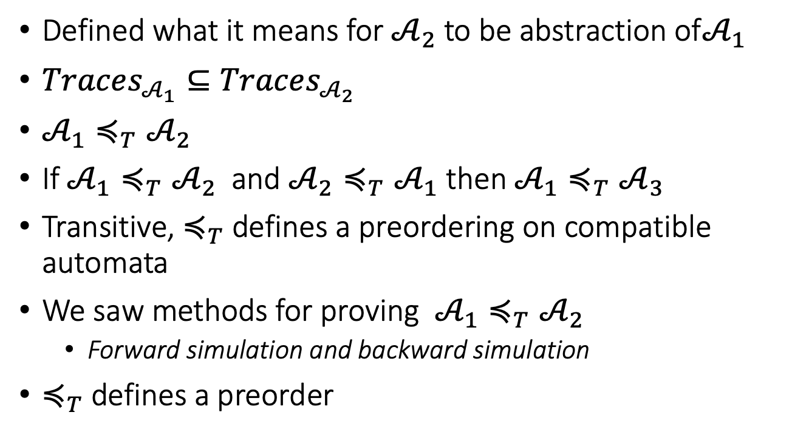


Abstraction recap
Defined what it means for $𝒜_{2}$ to be abstraction of$𝒜_{1}$
$Traces_{𝒜_{1}}⊆Traces_{𝒜_{2}}$
$𝒜_{1}≼_{T}𝒜_{2}$
If $𝒜_{1}≼_{T}𝒜_{2}$ and $𝒜_{2}≼_{T}𝒜_{1}$ then $𝒜_{1}≼_{T}𝒜_{3}$
Transitive, $≼_{T}$ defines a preordering on compatible automata
We saw methods for proving $𝒜_{1}≼_{T}𝒜_{2}$
Forward simulation and backward simulation
$≼_{T}$ defines a preorder
$$𝒜_{1}$$
$$𝒜_{2}$$
$$≼$$

Slide 19
Outline
Abstractions and composition
CEGAR

Slide 20
Substituting an automaton with its abstraction
Concrete system
Plant
Controller

Slide 21
Substituting an automaton with its abstraction
Abstract system
Plant
Abstract Controller
Controller

Slide 22


How is the abstract system related to the concrete system?
Controller
Abstract Controller
Does
$$≼$$
imply
Concrete system
Abstract system
Plant
Controller
$$≼$$
Plant
Abstract Controller
?

Slide 23
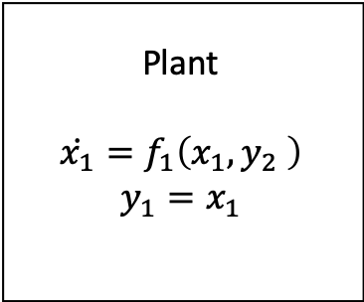
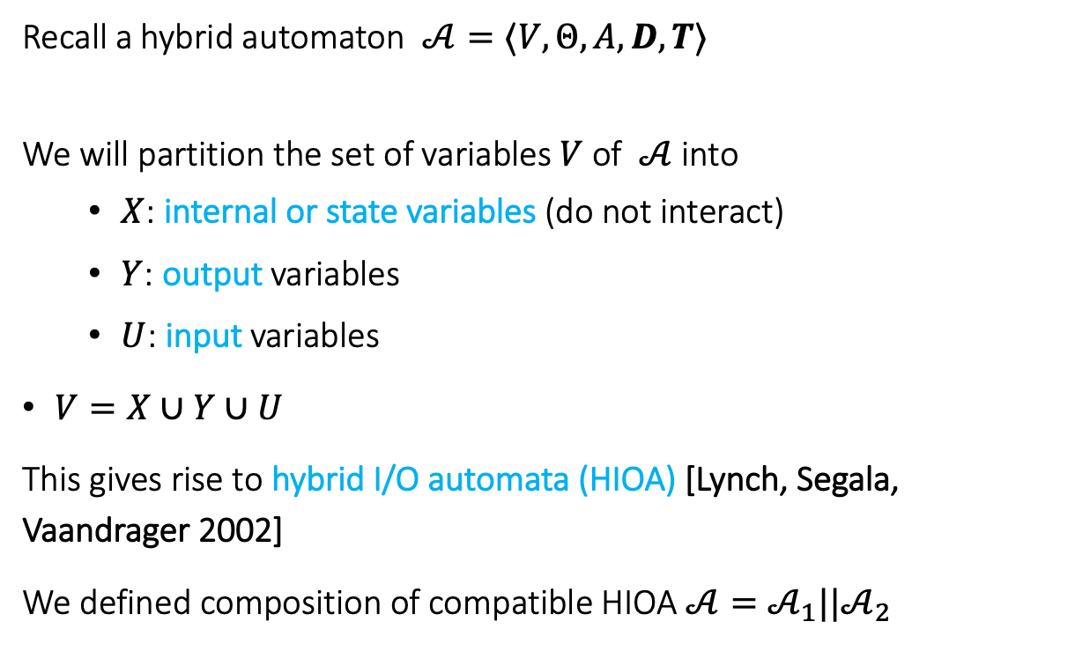


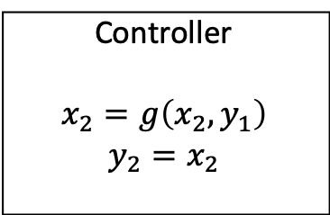
Hybrid IO Automaton
Recall a hybrid automaton $𝒜=⟨V,Θ,A, D,T⟩$
We will partition the set of variables $V$of $𝒜$ into
$X$: internal or state variables (do not interact)
$Y$: output variables
$U$: input variables
$V=X∪Y∪U$
This gives rise to hybrid I/O automata (HIOA) [Lynch, Segala, Vaandrager 2002]
We defined composition of compatible HIOA $𝒜=𝒜_{1}||𝒜_{2}$
Plant
$$\dot{x_{1}}=f_{1}\left(x_{1},y_{2} \right)$$
$$y_{1}=x_{1}$$
$$y_{2}$$
$$y_{1}$$
Controller
$$x_{2}=g\left(x_{2},y_{1}\right)$$
$$y_{2}=x_{2}$$

Slide 24
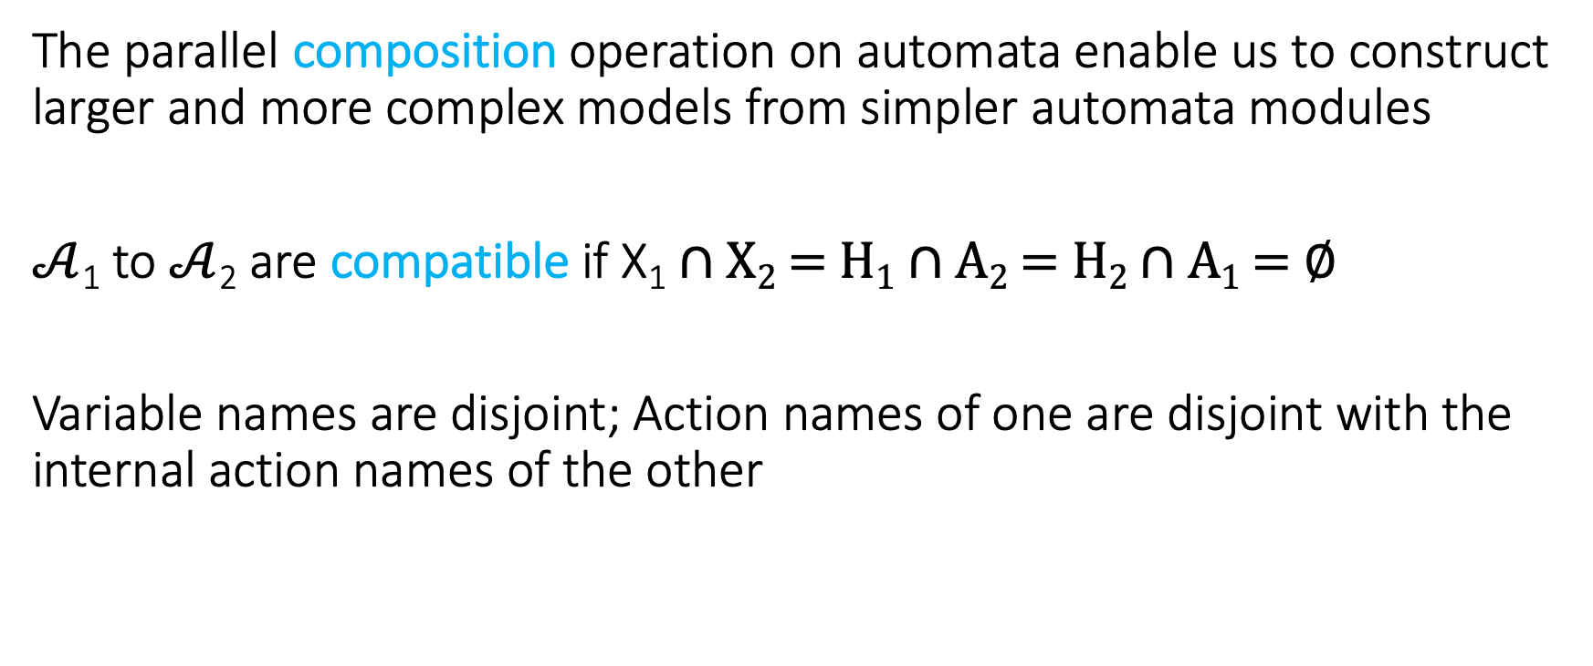
Composition of Hybrid Automata
The parallel composition operation on automata enable us to construct larger and more complex models from simpler automata modules
$𝒜$₁ to $𝒜$₂ are compatible if X₁ ∩ X₂ = H₁ ∩ A₂ = H₂ ∩ A₁ = ∅
Variable names are disjoint; Action names of one are disjoint with the internal action names of the other

Slide 25
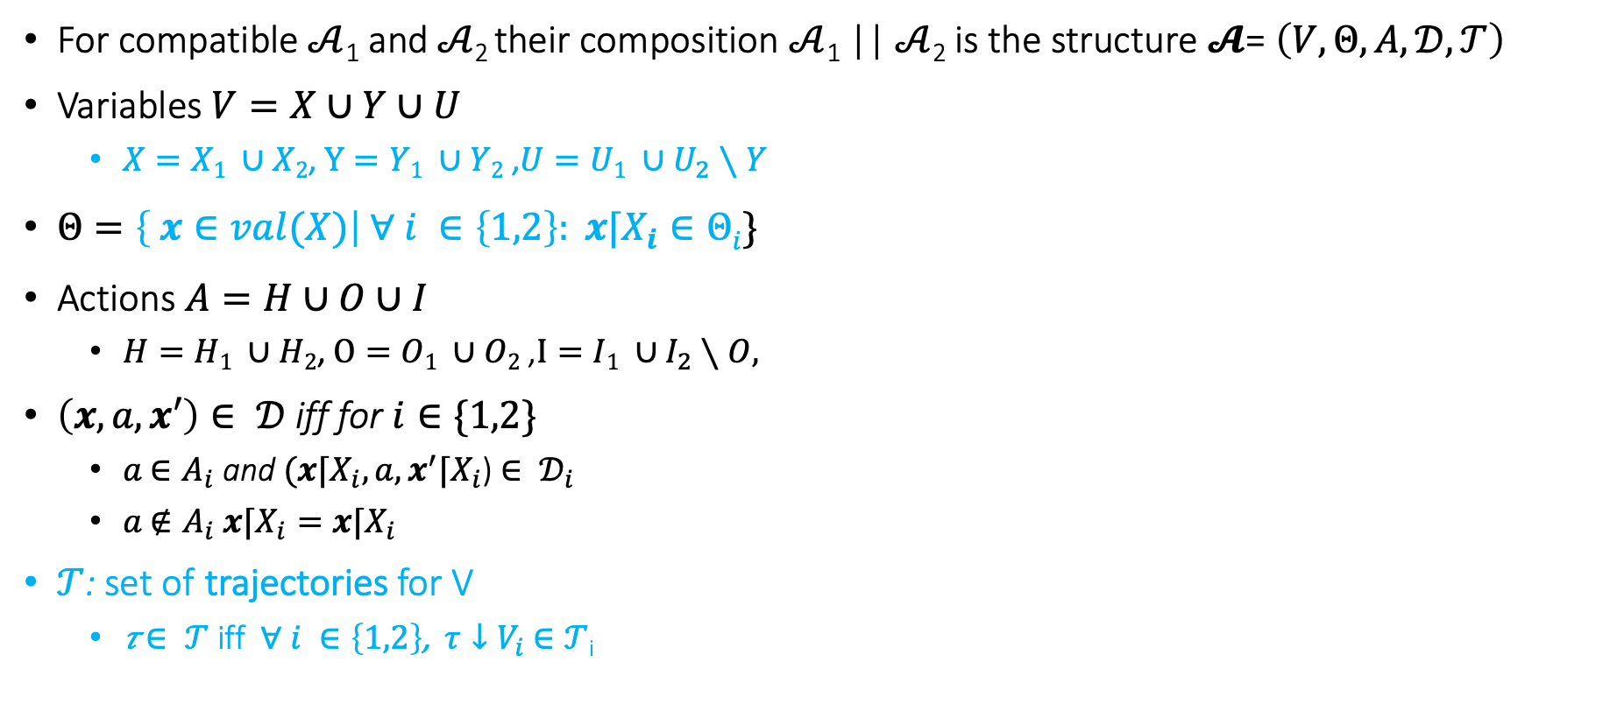
Composition
For compatible $𝒜$₁ and $𝒜$₂ their composition $𝒜$₁ || $𝒜$₂ is the structure $𝓐$= $\left(V,Θ,A,𝒟,𝒯\right)$
Variables $V=X∪Y∪U$
$X=X1 ∪X2$, $Y=Y1 ∪Y2$ ,$U=U1 ∪U_{2}∖Y$
$Θ=\left\{ x∈val(X)\right| ∀ i ∈\left\{1,2\right\}: x⌈X_{i}∈Θi\}$
Actions $A=H∪O∪I$
$H=H1 ∪H2$, $O=O1 ∪O2$ ,$I=I1 ∪I_{2}∖O,$
$\left(x,a,x′\right)∈ 𝒟$ iff for $i∈\{1,2\}$
$a$ $∈A_{i}$ and $(x⌈X_{i},a,x^{′}⌈X_{i}$) $∈ 𝒟_{i}$
$a$ $∉A_{i}$ $x⌈X_{i}=x⌈X_{i}$
$𝒯$: set of trajectories for V
𝜏 $∈ 𝒯$ iff $∀ i ∈\left\{1,2\right\}$, $τ↓V_{i}$ $∈𝒯$_{i}

Slide 26

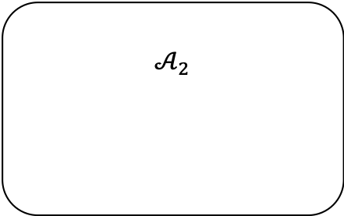
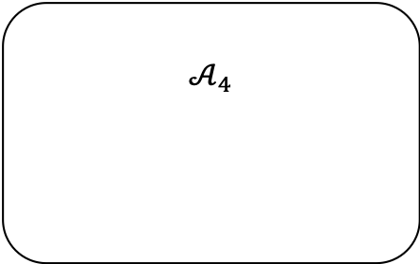

$$𝒜_{2}$$
u₂
u₂
$${\dot{x}}_{1}=f(x_{1},u_{2})$$
a₁
a₁
$$𝒜_{3}$$
a₁
e
e
f
f
a₁
$$𝒜_{4}$$

Slide 27
Modeling a Simple Failure Detector System
Periodic send
Channel
Timeout
Send
Send(m)
Channel
recv(m)
Failure Detector
fail
detect

Slide 28
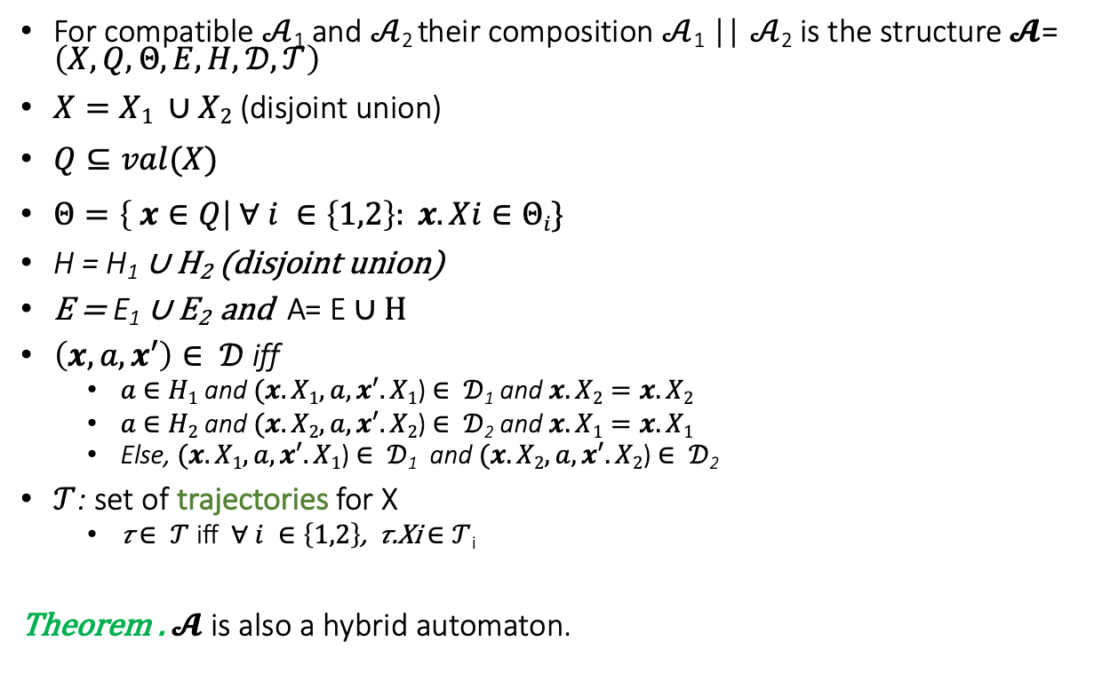
Composition
For compatible $𝒜$₁ and $𝒜$₂ their composition $𝒜$₁ || $𝒜$₂ is the structure $𝓐$= $\left(X,Q,Θ,E,H,𝒟,𝒯\right)$
$X=X1 ∪X2$ (disjoint union)
$Q⊆val(X)$
$Θ=\left\{ x∈Q\right| ∀ i ∈\left\{1,2\right\}: x.Xi∈Θi\}$
H = H₁ ∪ H₂ (disjoint union)
E = E₁ ∪ E₂ and A= E ∪ H
$\left(x,a,x′\right)∈ 𝒟$ iff
$a$ $∈H1$ and $(x.X1,a,x′.X1$) $∈ 𝒟$₁ and $x.X2=x.X2$
$a$ $∈H2$ and $(x.X2,a,x′.X2$) $∈ 𝒟$₂ and $x.X1=x.X1$
Else, $(x.X1,a,x′.X1$) $∈ 𝒟$₁ and $(x.X2,a,x′.X2$) $∈ 𝒟$₂
$𝒯$: set of trajectories for X
𝜏 $∈ 𝒯$ iff $∀ i ∈\left\{1,2\right\}$, 𝜏.Xi $∈𝒯$_{i}
Theorem . $𝓐$ is also a hybrid automaton.

Slide 29
Example: Send || TimedChannel
Automaton Channel(b,M)
variables: internal
queue: Queue[M,Reals] := {}
clock1: Reals := 0
actions: external send(m:M), receive(m:M)
transitions:
send(m)
pre true
eff queue := append(<m, clock1+b>, queue)
receive(m)
pre head(queue)[1] = m
eff queue := queue.tail
trajectories:
evolve d(clock1) = 1
stop when ∃ m, d, <m,d> ∈ queue
/\ clock=d
Automaton PeriodicSend(u, M)
variables: internal clock: Reals := 0
actions: external send(m:M)
transitions:
send(m)
pre clock = u
eff clock := 0
trajectories:
evolve d(clock) = 1
stop when clock=u

Slide 30
Composed Automaton
Automaton SC(b,u)
variables: internal queue: Queue[M,Reals] := {}
clock_s, clock_c: Reals := 0
actions: external send(m:M), receive(m:M)
transitions:
send(m)
pre clock_s = u
eff queue := append(<m, clock_c+b>, queue); clock_s := 0
receive(m)
pre head(queue)[1] = m
eff queue := queue.tail
trajectories:
evolve d(clock_c) = 1; d(clock_s) = 1
stop when
(∃ m, d, <m,d> ∈ queue /\ clock_c=d)
\/ (clock_s=u)

Slide 31
Modeling a Simple Failure Detector System
Periodic send || Channel
Periodic send || Channel || Timeout
Send
Send(m)
Channel
recv(m)
Failure Detector
fail
detect

Slide 32
Time bounded channel & Simple Failure Detector
Automaton Timeout(u,M)
variables: internal suspected: Boolean := F,
clock: Reals := 0
actions: external receive(m:M), timeout
transitions:
receive(m)
pre true
eff clock := 0; suspected := false;
timeout
pre ~suspected /\ clock = u
eff suspected := true
trajectories:
evolve d(clock) = 1
stop when clock = u /\ ~suspected

Slide 33


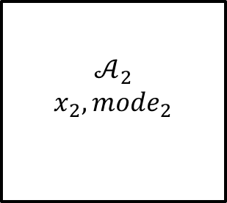


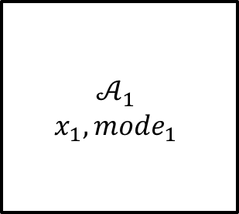





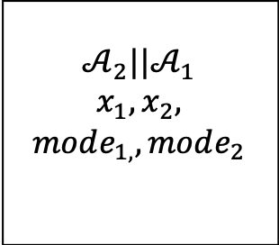

General composition
$$u_{1}$$
$${input}_{1}$$
$$a_{1}$$
$$𝒜_{1}$$
$$x_{1},mode_{1}$$
$$𝒜_{2}$$
$$x_{2},mode_{2}$$
$$var_{1}$$
$$y_{2}$$
$$a_{2}$$
$$u_{1},u_{2}$$
$$𝒜_{2}||𝒜_{1}$$
$$x_{1},x_{2},$$
$$mode_{1,},mode_{2}$$
$$var_{1},y_{2}$$
$${input}_{1}$$
$$a_{1},a_{2}$$

Slide 34
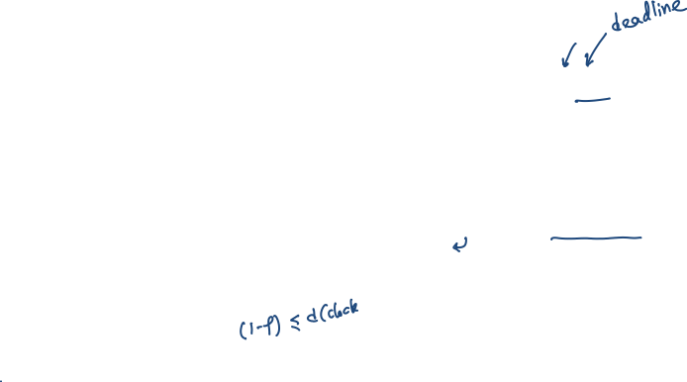
Time bounded channel & Simple Failure Detector
Automaton Timeout(u,M)
variables: suspected: Boolean := F,
clock: Reals := 0
actions: external receive(m:M), timeout
transitions:
receive(m)
pre true
eff clock := 0; suspected := false;
timeout
pre ~suspected /\ clock = u
eff suspected := true
trajectories:
evolve d(clock) = 1
stop when clock = u /\ ~suspected
Automaton Channel(b,M)
variables: queue: Queue[M,Reals] := {}
clock: Reals := 0
actions: external send(m:M), receive(m:M)
transitions:
send(m)
pre true
eff queue := append(<m, clock+b>, queue)
receive(m)
pre head(queue)[1] = m
eff queue := queue.tail
trajectories:
evolve d(clock) = 1
stop when ∃ m, d, <m,d> ∈ queue
/\ clock=d

Slide 35
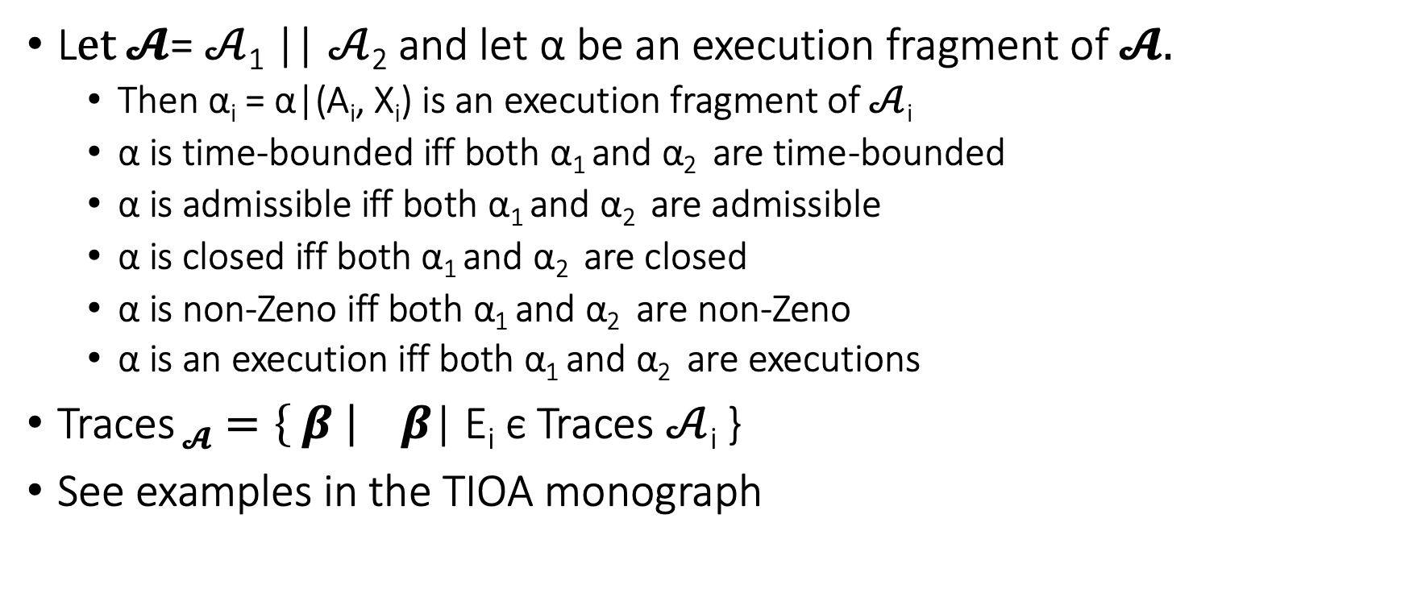
Some properties about composed automata
L$et 𝓐$= $𝒜$₁ || $𝒜$₂ and let α be an execution fragment of $𝓐.$
Then α_{i} = α|(A_{i}, X_{i}) is an execution fragment of $𝒜$_{i}
α is time-bounded iff both α₁ and α₂ are time-bounded
α is admissible iff both α₁ and α₂ are admissible
α is closed iff both α₁ and α₂ are closed
α is non-Zeno iff both α₁ and α₂ are non-Zeno
α is an execution iff both α₁ and α₂ are executions
Traces $𝓐=\left\{ β \right|$ $β$| E_{i} ϵ Traces $𝒜$_{i} }
See examples in the TIOA monograph

Slide 36
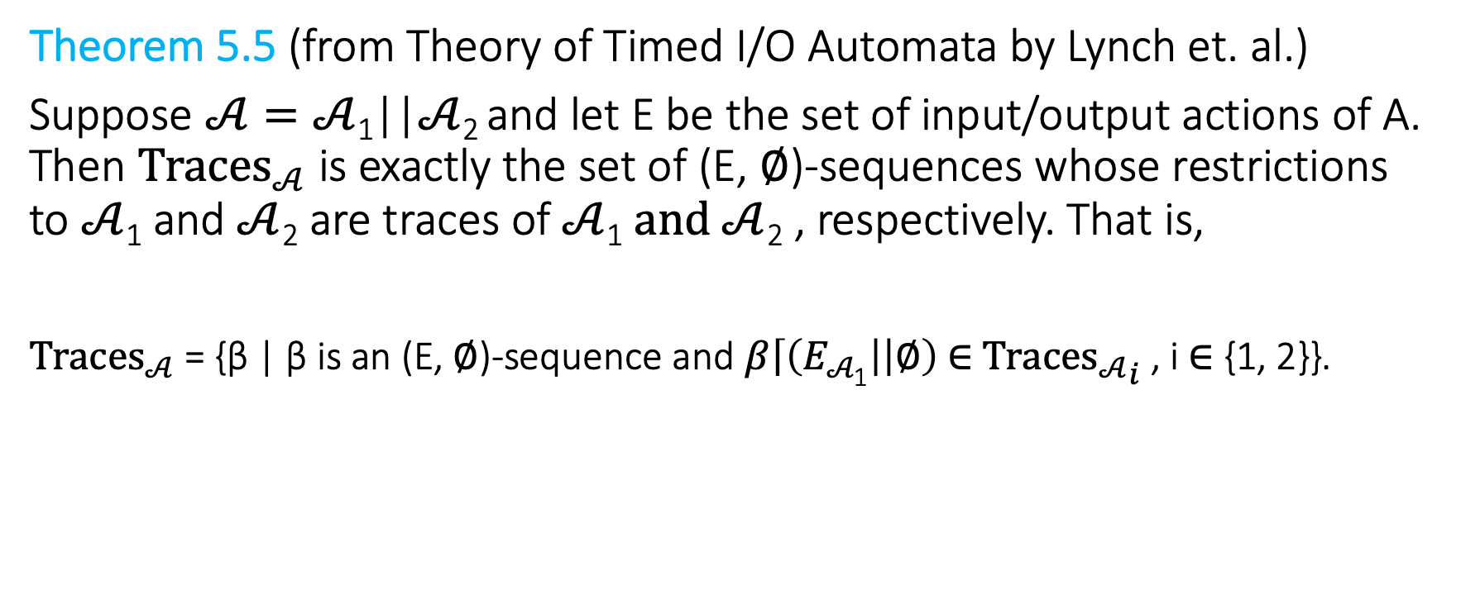
A trace theorem restriction from composition of I/O automata
Theorem 5.5 (from Theory of Timed I/O Automata by Lynch et. al.)
Suppose $𝒜=𝒜$₁||$𝒜$₂ and let E be the set of input/output actions of A. Then ${Traces}_{𝒜}$ is exactly the set of (E, ∅)-sequences whose restrictions to $𝒜$₁ and $𝒜$₂ are traces of $𝒜$₁ $and 𝒜$₂ , respectively. That is,
${Traces}_{𝒜}$ = {β | β is an (E, ∅)-sequence and $β\left\lceil \left(E_{𝒜\text{1}}\right| | ∅\right)$∈ ${{Traces}_{𝒜}}_{i}$ , i ∈ {1, 2}}.

Slide 37

Substitutivity
Theorem 1. Suppose $𝒜$₁ , $𝒜$₂ and $ℬ$ have the same external interface and $𝒜$₁ , $𝒜$₂ are compatible with $ℬ$. If $𝒜_{1}≼$ $𝒜$₂ then $𝒜$₁|| $ℬ≼$ $𝒜$₂ || $ℬ$

Slide 38
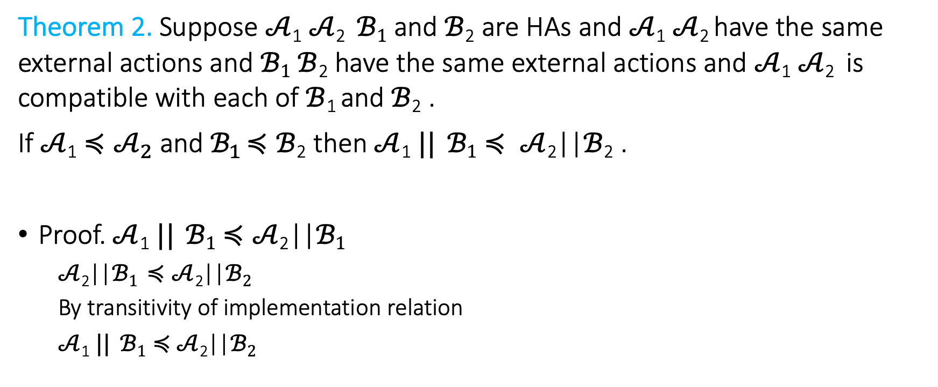
Substutivity
Theorem 2. Suppose $𝒜$₁ $𝒜$₂ $ℬ1$ and $ℬ$₂ are HAs and $𝒜$₁ $𝒜$₂ have the same external actions and $ℬ1$ $ℬ$₂ have the same external actions and $𝒜$₁ $𝒜$₂ is compatible with each of$ℬ$₁ and $ℬ$₂ .
If $𝒜$₁ $≼𝒜_{2}$ and$ℬ_{1}$ $≼ℬ$₂ then $𝒜$₁ $||$ $ℬ1$ $≼ 𝒜$₂||$ℬ$₂ .
Proof. $𝒜$₁ $||$ $ℬ1$ $≼𝒜$₂||$ℬ1$
$𝒜$₂||$ℬ1$ $≼𝒜$₂||$ℬ2$
By transitivity of implementation relation
$𝒜$₁ $||$ $ℬ1≼$ $𝒜$₂||$ℬ2$

Slide 39

A stronger substitutivity result
Theorem 3. $𝒜$₁ $||$ $ℬ2≼𝒜$₂||$ℬ$₂ and $ℬ1≼ℬ2$ then $𝒜$₁ $||$ $ℬ1$ $≼𝒜$₂||$ℬ$₂.

Slide 40
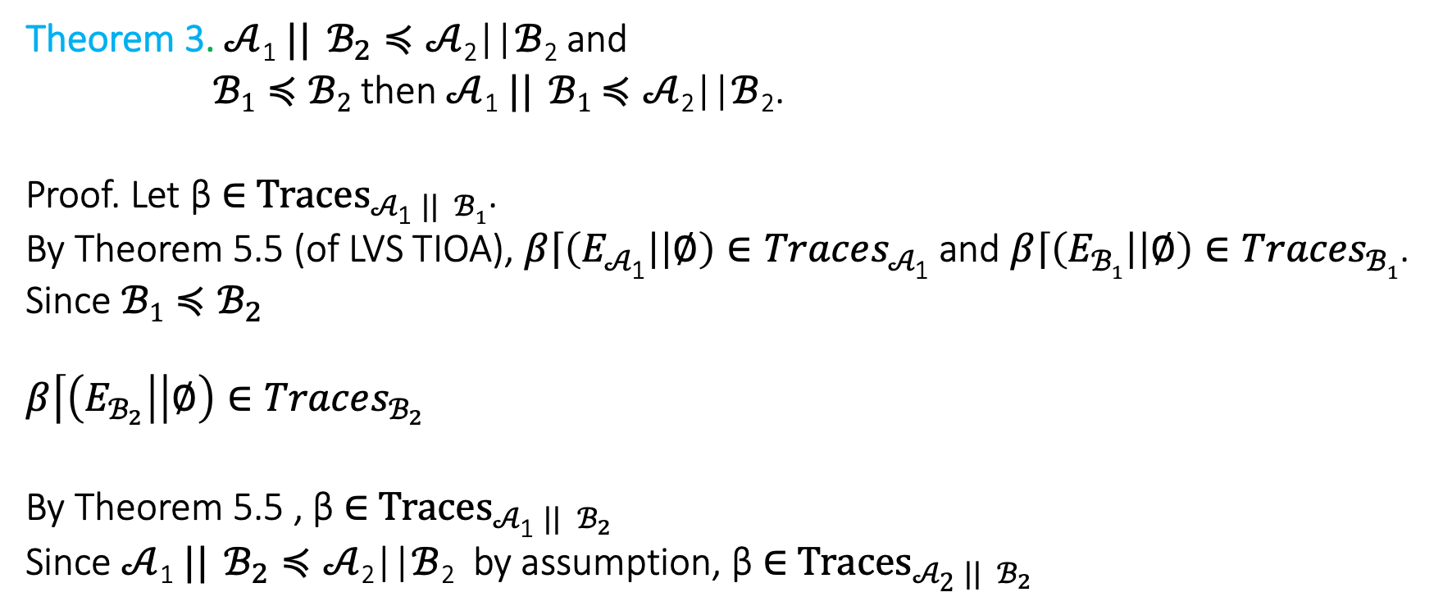
A stronger substitutivity result
Theorem 3. $𝒜$₁ $||$ $ℬ_{2}≼𝒜$₂||$ℬ$₂ and
$ℬ1≼ℬ2$ then $𝒜$₁ $||$ $ℬ1$ $≼𝒜$₂||$ℬ$₂.
Proof. Let β ∈ ${Traces}_{𝒜\text{1} || ℬ1}$.
By Theorem 5.5 (of LVS TIOA), $β\left\lceil \left(E_{𝒜\text{1}}\right| | ∅\right)∈Traces_{𝒜\text{1}}$ and $β\left\lceil \left(E_{ℬ1}\right| | ∅\right)∈Traces_{ℬ1}$.
Since $ℬ1≼ℬ_{2}$
$$β\left\lceil \left(E_{ℬ_{2}}\right| | ∅\right)∈Traces_{ℬ_{2}}$$
By Theorem 5.5 , β ∈ ${Traces}_{𝒜\text{1} || ℬ_{2}}$
Since $𝒜$₁ $||$ $ℬ_{2}≼𝒜$₂||$ℬ$₂ by assumption, β ∈ ${Traces}_{𝒜\text{2} || ℬ_{2}}$

Slide 41
Counter-example guided abstraction-refinement

Slide 42
Counterexample guided abstraction refinement (CEGAR)
A general algorithmic framework for automatically constructing and verifying property-specific abstractions [Clarke:2000]
CEGAR has been applied to discrete automata, software, and hybrid systems [Holzman 00,Ball 01, Alur 2006,Clarke 2003, Fehnker2005, Prabhakar 15, Roohi 17]
We will discuss the basic idea of the CEGAR and the key design choices, and their implications.

Slide 43
Start with coarse abstraction B₀
Check B_{i} satisfies S ?
Idea of CEGAR
Yes
A is safe
No
β = q₀ q₁ q₂ … q_{n}
β counter-example for A?
Yes
A unsafe
No
Refine B_{i} to get B_{i+1}

Slide 44
Key design choices
Space of the abstract automata (finite, timed, linear)
Model checker for abstract automaton
Counter-example validation procedure
Refinement strategy

Slide 45




$$Unsafe$$
$$q_{0}$$
$$Θ$$
$$(0,0)$$

Slide 46


$$Unsafe$$
$$q_{0}$$
$$Θ$$
$$(0,0)$$

Slide 47










$$Unsafe$$
$$q_{5}$$
$$S_{4}= Pre_{A}\left(S_{5}\right)∩ R^{−1 }\left(q_{4}\right)≠∅$$
$$S_{3}= Pr{e_{A}(S_{4})}_{}∩R^{−1 }\left(q_{3}\right)≠ ∅$$
$$S_{2}= Pre_{A} \left(S_{3}\right)∩ R^{−1}\left(q_{2}\right)≠∅$$
$$S_{1}= Pre_{A} \left(S_{2}\right)∩ R^{−1} \left(q_{1}\right) =∅$$
$$q_{2}$$
$$q_{3}$$
$$q_{4}$$
$$q_{1}$$
$$q_{0}$$
$$Θ$$
$$(0,0)$$

