Slide 1
Progress verification
Sayan Mitra
Verifying cyberphysical systems
mitras@illinois.edu

Slide 2
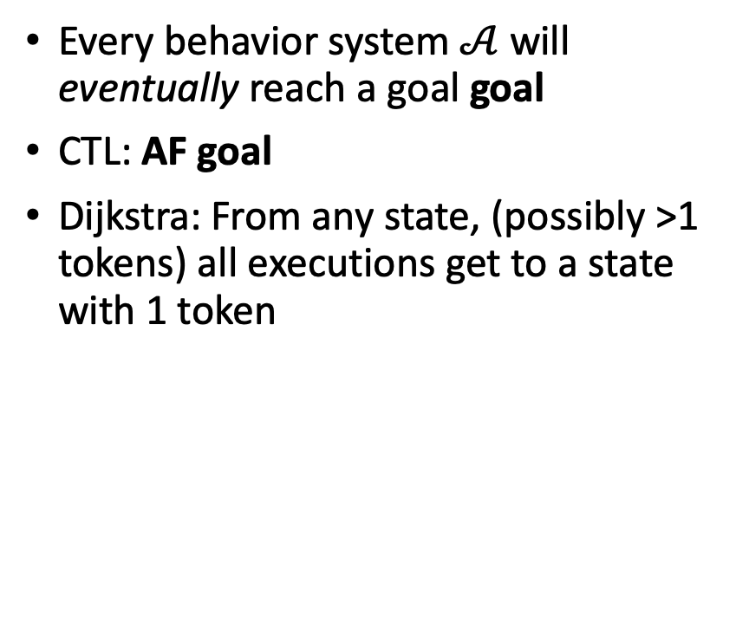
Progress properties Invariance/safety
Every behavior system $𝒜$ will eventually reach a goal goal
CTL: AF goal
Dijkstra: From any state, (possibly >1 tokens) all executions get to a state with 1 token
No behavior of A goes outside of unsafe
CTL: AG unsafe
Dijkstra: Starting a state with a 1 token, all executions have 1 token
Finding a counterexample to safety does not prove progress

Slide 3
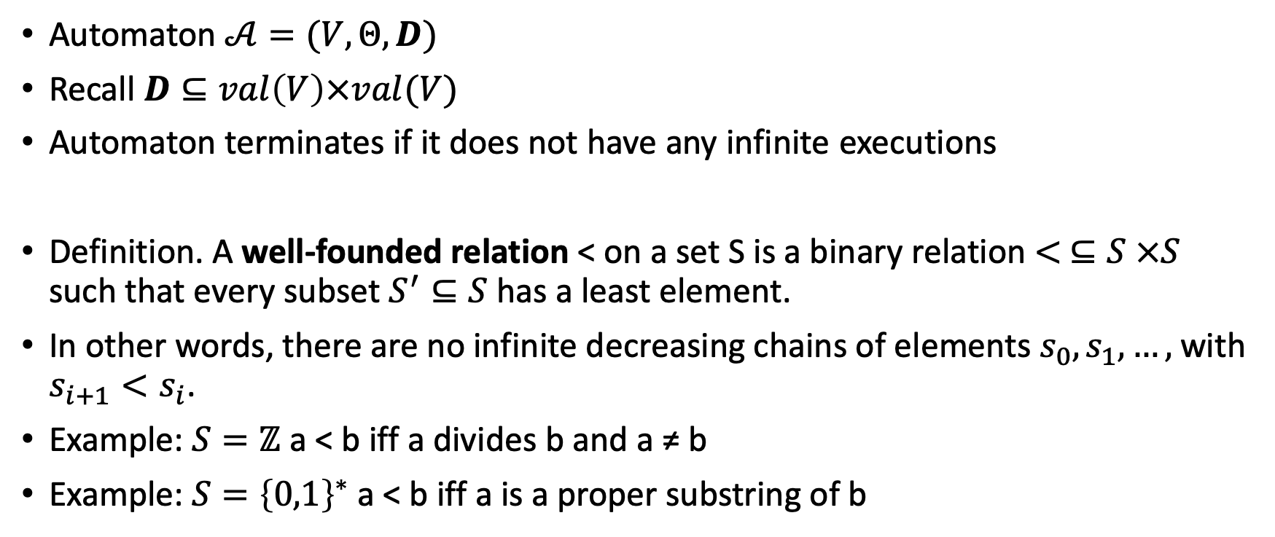
Proving termination for automata
Automaton $𝒜=(V,Θ, D)$
Recall $D⊆val\left(V\right)×val(V)$
Automaton terminates if it does not have any infinite executions
Definition. A well-founded relation < on a set S is a binary relation $< ⊆S ×S$ such that every subset$S^{′}⊆S$ has a least element.
In other words, there are no infinite decreasing chains of elements $s_{0},s_{1},…,$with $s_{i+1}<s_{i}$.
Example: $S=ℤ$ a < b iff a divides b and a ≠ b
Example: $S={\left\{0,1\right\}}^{∗}$ a < b iff a is a proper substring of b

Slide 4
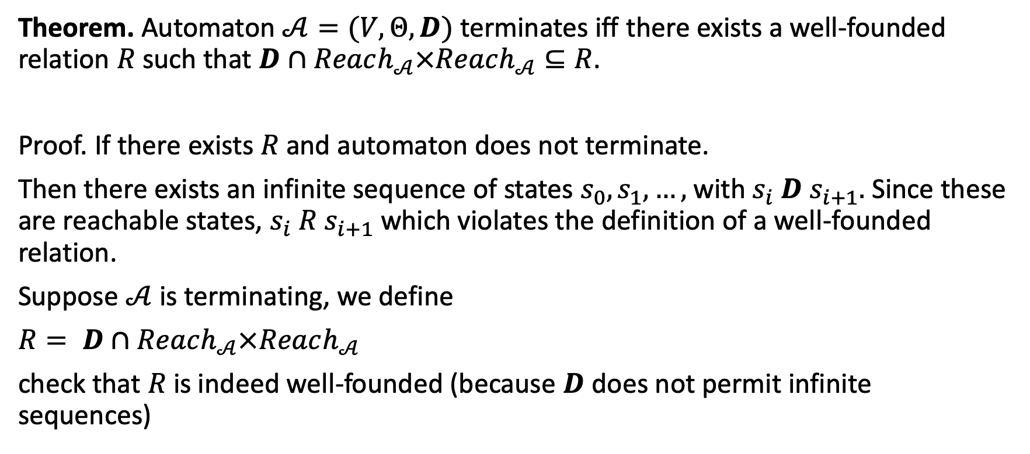
Proving termination for automata
Theorem. Automaton $𝒜=(V,Θ, D)$ terminates iff there exists a well-founded relation $R$ such that $D∩Reach_{𝒜}×Reach_{𝒜}⊆R$.
Proof. If there exists $R$ and automaton does not terminate.
Then there exists an infinite sequence of states $s_{0},s_{1},…,$with $s_{i} D s_{i+1}.$ Since these are reachable states, $s_{i} R s_{i+1}$ which violates the definition of a well-founded relation.
Suppose $𝒜$ is terminating, we define
$R= D∩Reach_{𝒜}×Reach_{𝒜}$
check that $R$ is indeed well-founded (because $D$ does not permit infinite sequences)

Slide 5
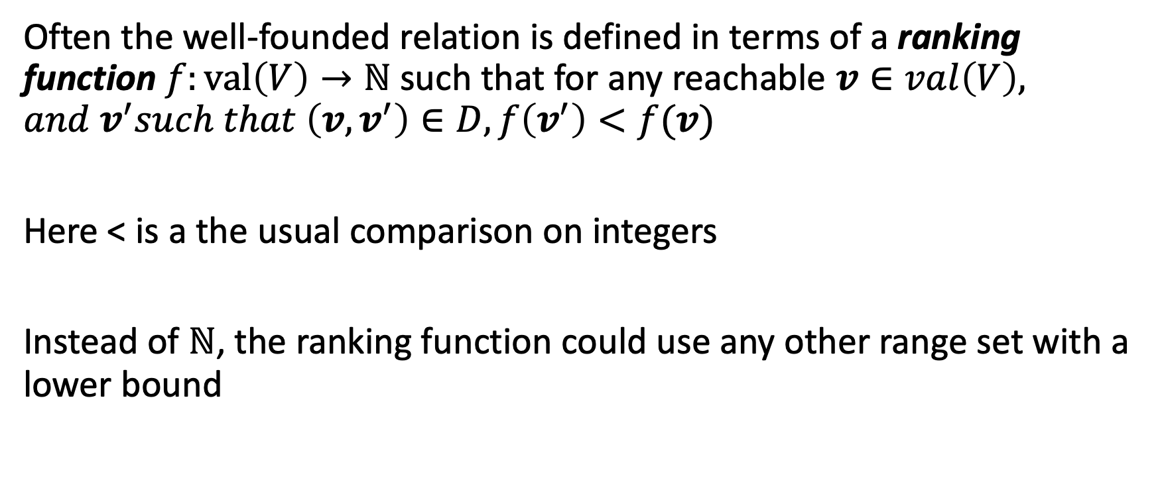
Ranking functions
Often the well-founded relation is defined in terms of a ranking function $f:val\left(V\right)→ℕ$ such that for any reachable $v∈val\left(V\right), and v^{′}such that \left(v,v^{′}\right)∈D, f\left(v^{′}\right)<f(v)$
Here < is a the usual comparison on integers
Instead of $ℕ$, the ranking function could use any other range set with a lower bound

Slide 6
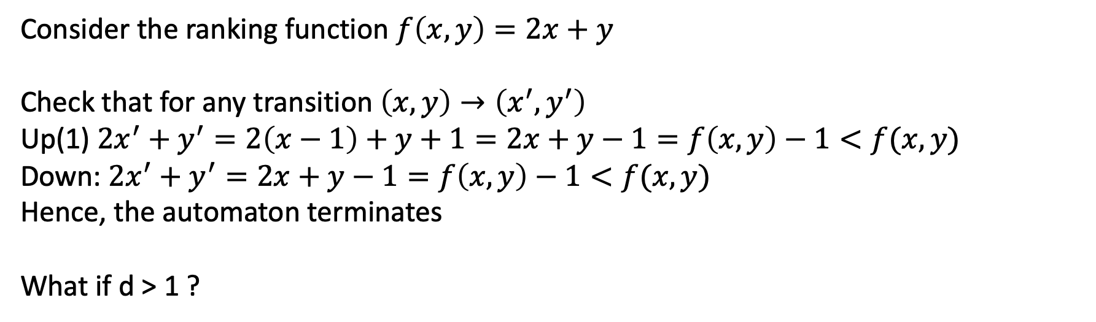
Example
Consider the ranking function $f\left(x,y\right)=2x+y$
Check that for any transition $\left(x,y\right)→\left(x^{′},y^{′}\right)$
Up(1) $2x^{′}+y^{′}=2\left(x−1\right)+y+1=2x+y−1=f\left(x,y\right)−1<f(x,y)$
Down: $2x^{′}+y^{′}=2x+y−1=f\left(x,y\right)−1<f(x,y)$
Hence, the automaton terminates
What if d > 1 ?

Slide 7
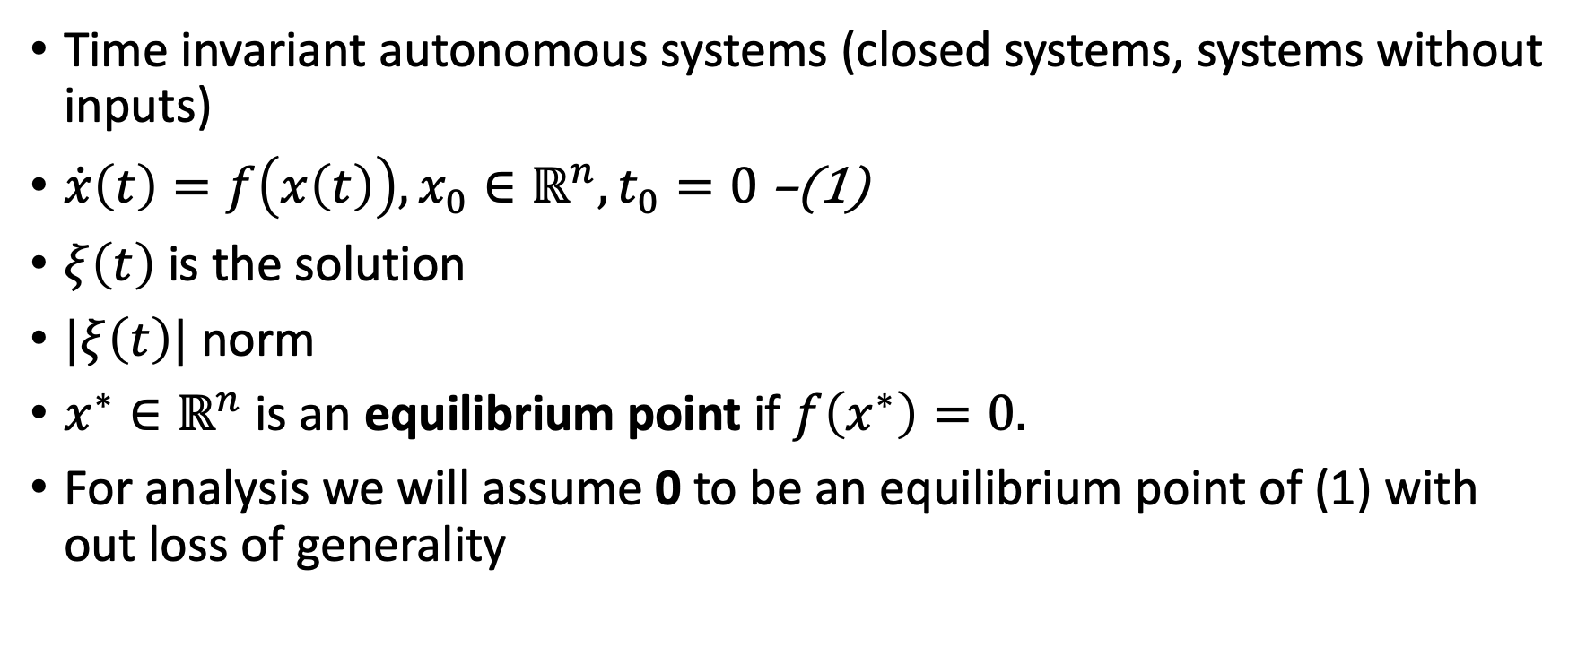
Recall Stability
Time invariant autonomous systems (closed systems, systems without inputs)
$\dot{x}\left(t\right)=f\left(x\left(t\right)\right), x_{0}∈ℝ^{n}, t_{0}=0$ –(1)
$ξ\left(t\right)$ is the solution
$|ξ\left(t\right)|$ norm
$x^{∗}∈ℝ^{n}$ is an equilibrium point if $f\left(x^{∗}\right)=0.$
For analysis we will assume 0 to be an equilibrium point of (1) with out loss of generality

Slide 8



Lyapunov stability
Lyapunov stability: The system (1) is said to be Lyapunov stable (at the origin) if for every $ε>0$there exists $δ_{ε}>0$such that for every if $\left|ξ\left(0\right)\right|≤δ_{ε}$ then for all $t≥0, \left|ξ\left(t\right)\right|≤ε.$
$$δ_{ε}$$
$$ε$$

Slide 9
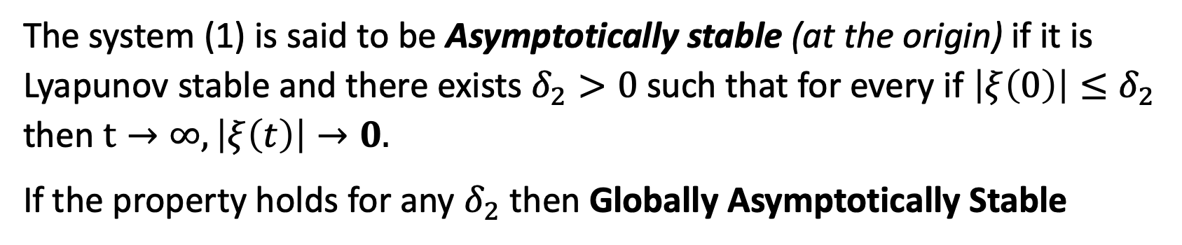
Asymptotically stability
The system (1) is said to be Asymptotically stable (at the origin) if it is Lyapunov stable and there exists $δ_{2}>0$such that for every if $\left|ξ\left(0\right)\right|≤δ_{2}$ then $t→∞, \left|ξ\left(t\right)\right|→0.$
If the property holds for any $δ_{2}$ then Globally Asymptotically Stable

Slide 10

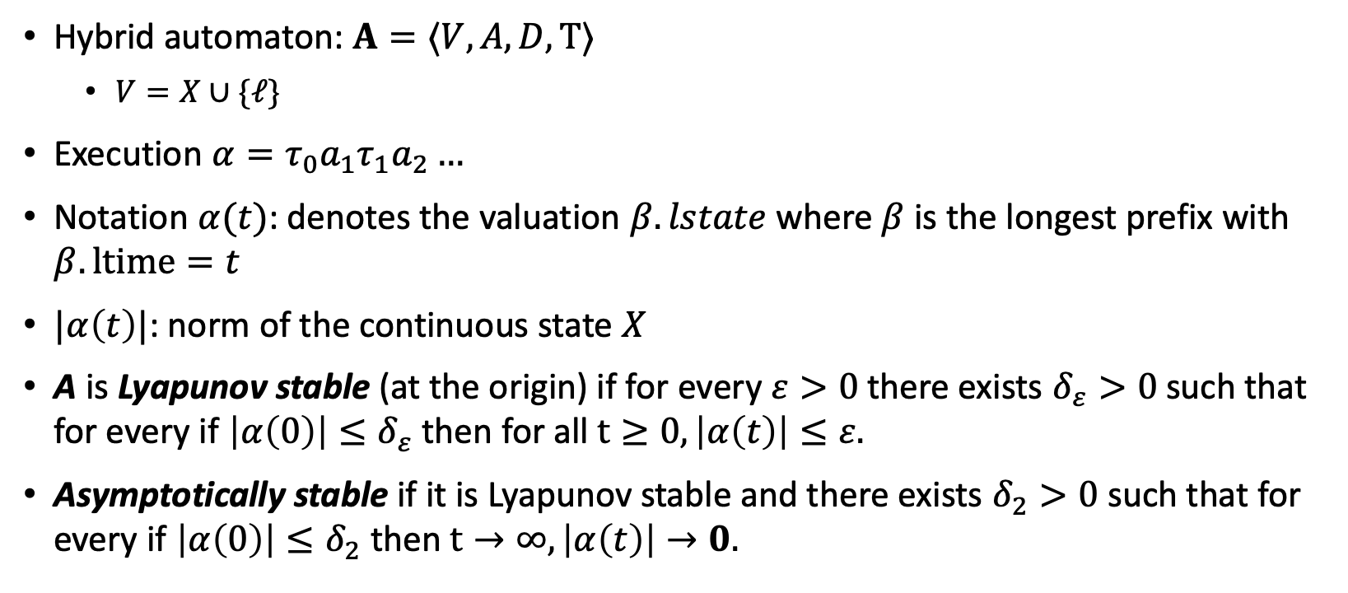


Defining stability of hybrid systems
Pre $G_{12}$Eff $x≔R_{12}(x)$
mode 1
$$d\left(x\right)=f_{1}(x)$$
mode 2
$$d\left(x\right)=f_{2}(x)$$
Hybrid automaton: $A=⟨V,A, D,Τ⟩$
$V=X∪\{ℓ\}$
Execution $α=τ_{0}a_{1}τ_{1}a_{2}…$
Notation $α(t)$: denotes the valuation $β.lstate$where $β$ is the longest prefix with $β.ltime=t$
$|α\left(t\right)|$: norm of the continuous state $X$
A is Lyapunov stable (at the origin) if for every $ε>0$there exists $δ_{ε}>0$such that for every if $\left|α\left(0\right)\right|≤δ_{ε}$ then for all $t≥0, \left|α\left(t\right)\right|≤ε.$
Asymptotically stable if it is Lyapunov stable and there exists $δ_{2}>0$such that for every if $\left|α\left(0\right)\right|≤δ_{2}$ then $t→∞, \left|α\left(t\right)\right|→0.$

Slide 11
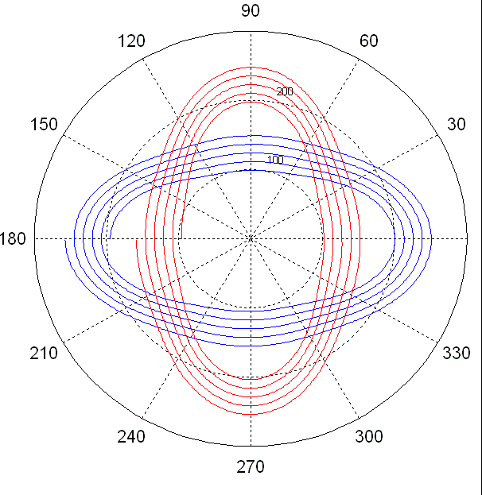
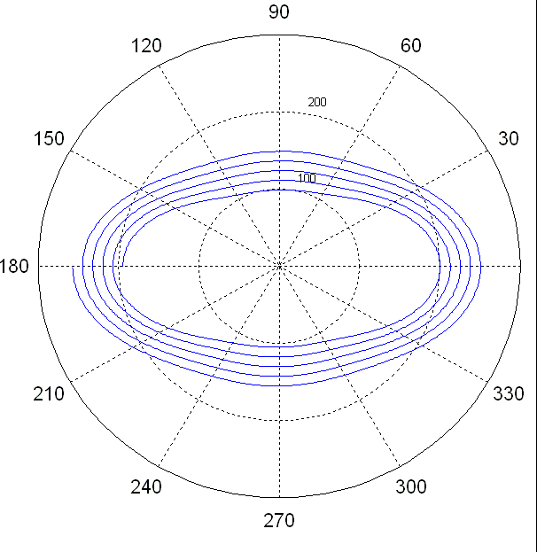
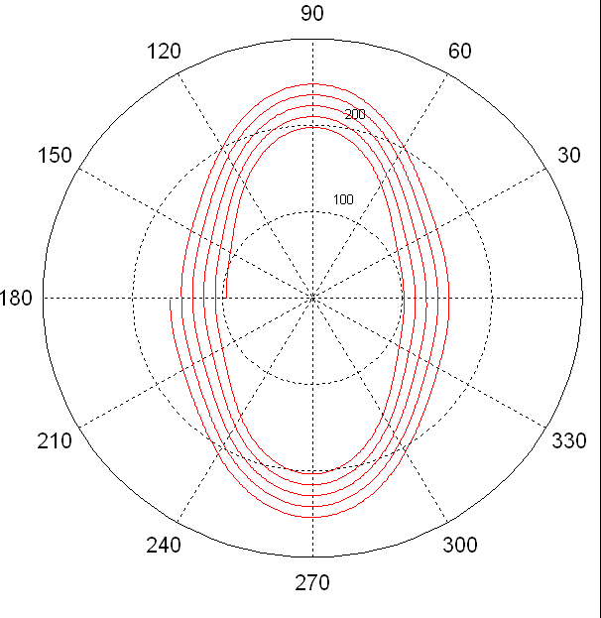
Question:Stability Verification
Proof Techniques: Stability
If each mode is asymptotically stable then is A also asymptotically stable?
No
Notes:
A SHA H is stable if for every positive epsilon, there exists a positive delta, such that for every execution starting within the delta ball around the origin then it stays within the epsilon ball.
“Within the epsilon ball” means that the norm of the continuous valued variables is less than \epsilon
Stability properties are important in many hybrid systems e.g., in switched control system.
Mobile robot coordination problems can also be formulated as stability properties.
Throughout this talk we will assume that our Has finite number of modes and that each mode of is stable
(in the usual sense of stability of continuous time systems)
% and w.l.o.g we assume that the origin as a stable equilibrium point.
This does not guarantee the stability H. Here is an example to illustrate this: Suppose the trajectories allowed by mode 1 are shown by the blue spiral.
Now this is a spiral going inwards (that’s why it is stable), (missed the arrow heads in matlab).
And suppose the trajectories allowed by mode 2 are as shown by the red spiral.
Both these modes are stable, yet it is possible to switch between them, through discrete transitions, in such a way that
the overall system is spirals outwards.
Q Why this assumption ?
Our verification techniques build up on theorems that give sufficient conditions for stability for the SS mode, and use this assumption.
So, we inherit their assumptions. However, there are other analogous results that give sufficient conditions for stabilizing unstable modes. And we conjecture that the techniques we have developed here will carry over to the other case, when we use the appropriate theorems.
If we do not make this assumption, i.e., if a state model is unstable then we can construct an SHA which is also unstable. E.g, an SHA which never switches out of that unstable state model will be unstable.

Slide 12
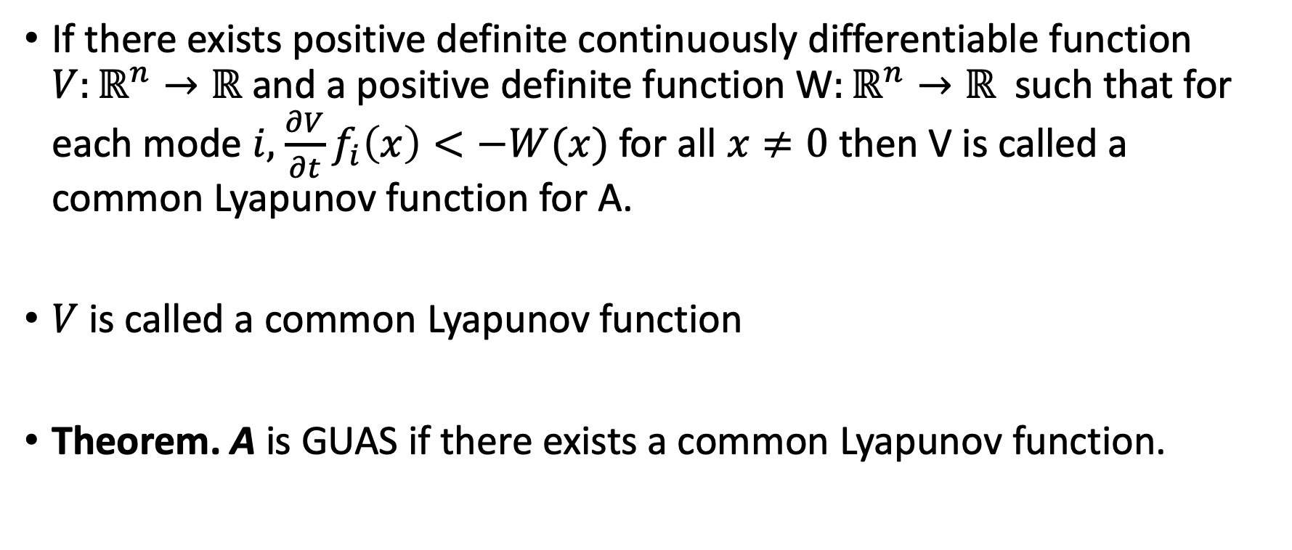
Common Lyapunov Function
If there exists positive definite continuously differentiable function $V:ℝ^{n}→ℝ$ and a positive definite function W$:ℝ^{n}→ℝ$ such that for each mode $i,$ $\frac{∂V}{∂t}f_{i}\left(x\right)<−W(x)$ for all $x≠0$ then V is called a common Lyapunov function for A.
$V$ is called a common Lyapunov function
Theorem. A is GUAS if there exists a common Lyapunov function.

Slide 13
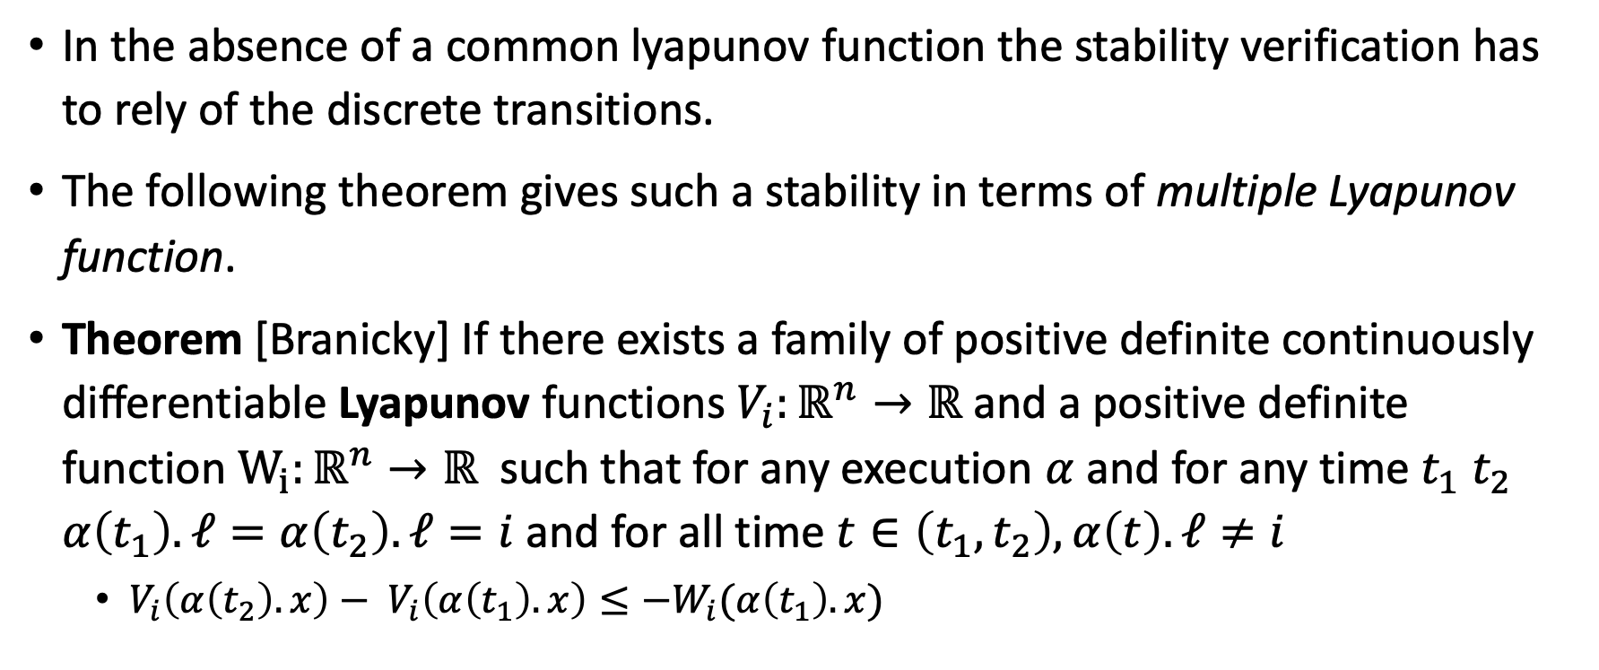
Multiple Lyapunov Functions
In the absence of a common lyapunov function the stability verification has to rely of the discrete transitions.
The following theorem gives such a stability in terms of multiple Lyapunov function.
Theorem [Branicky] If there exists a family of positive definite continuously differentiable Lyapunov functions $V_{i}:ℝ^{n}→ℝ$ and a positive definite function $W_{i}:ℝ^{n}→ℝ$ such that for any execution $α$and for any time $t_{1} t_{2}$ $α\left(t_{1}\right).ℓ=α\left(t_{2}\right).ℓ=i$ and for all time $t∈\left(t_{1},t_{2}\right),α\left(t\right).ℓ≠i$
$V_{i}\left(α\left(t_{2}\right).x\right)− V_{i}\left(α\left(t_{1}\right).x\right)≤−W_{i}(α\left(t_{1}\right).x)$

Slide 14
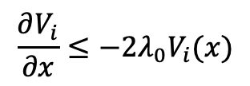
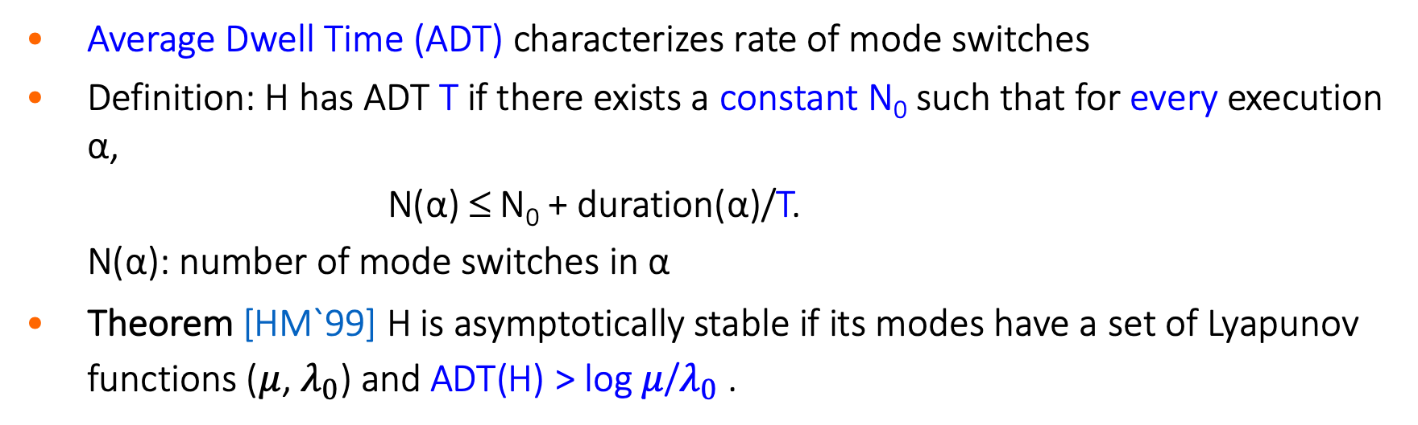
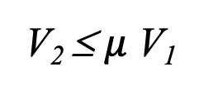
Stability Under Slow Switching
Proof Techniques: Stability
[Hespanha and Morse`99]
$$\frac{∂V_{i}}{∂x}≤{−2λ_{0}V}_{i}(x)$$
V₂ ≤ $μ$ V₁
time
mode 1
mode 2
mode 1
mode 2
Average Dwell Time (ADT) characterizes rate of mode switches
Definition: H has ADT T if there exists a constant N₀ such that for every execution α,
N(α) ≤ N₀ + duration(α)/T.
N(α): number of mode switches in α
Theorem [HM`99] H is asymptotically stable if its modes have a set of Lyapunov functions ($μ$, $λ_{0}$) and ADT(H) > log $μ$/$λ_{0}$ .
Notes:
Our verification method combines these results (for SSs),
in particular a theorem by H & M with analysis of the discrete transitions.
Explain lyapunov functions
Here is the intuition behind M & H ADT theoem:
Consider a system with 2 modes, and each mode has Lyapunov function V₁ V₂:
Suppose, along each trajectory in mode i Lyapunov function V_{i} decays at an exponential rate of \lambda,
and whenever there is a switch more mode i to j, the new Lyapunov function V_{j} may be higher than V_{i} but only by a factor of \mu.
E.g., here is a jump from 1 to 2, and V2 is greater than V1, but less then \mu times V1.
If these conditions hold and the rate of mode switches between 1 and 2 is not too high then the system is stable.
The intuition is that the energy gained through switching should be dissipated by staying in the same mode for long enough.
I said that the rate of mode switches is not too high, this is characterized by the ADT property:
The ADT of an automaton is the average amount of time that it stays in each mode.
Formally, a HA has ADT T, if in any execution, it performs mode switches at a rate of 1/T plus
it performs a constant number N₀ of extra switches.
N₀ is like the burst rate.
But note that N₀ has to be a constant over all executions.
….
The notion of ADT was introduced by M and H to characterize the rate of mode switches using which they give a sufficient condition for stability of switched systems. The proof of this theorem is based on the intuition I described in the previous slide,
the theorem says that : A a SS is stable if its individual modes have Ly functions characterized by the parameters \lambda and \mu,
and the rate of switches is such that ADT is greater than some constant, log \mu over \lambda.
[c]
We will use this result to verify stability of hybrid systems.
We assume that the individual modes are stable, and that thei Lyp functions are known (derived using techniques from control theory).
Then it suffices to check if the discrete transitions of the HA produce mode switches that have ADT greater than a certain constant, say T.
[c]
In this CDC2004 paper we presented a method for accomplishing this verification task.
The approach was to transform H to a new automaton H’ such that an ADT property (which is a property of whole executions mind you) of H becomes an invariant property of H’.
and then we prove the invariant for H’ using one of the many techniques that are available.
Q 1 / \lambda * (log \mu) over

Slide 15
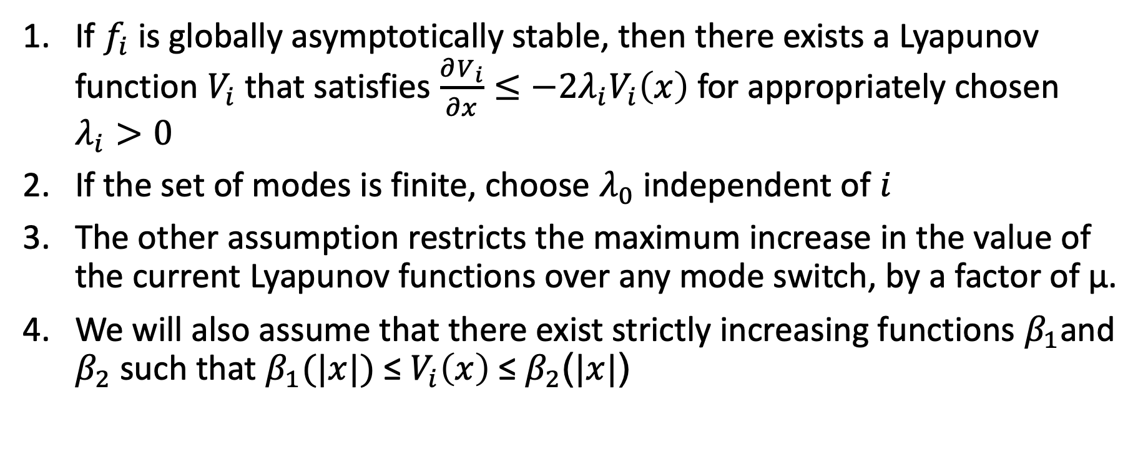
Remarks about ADT theorem assumptions
If $f_{i}$ is globally asymptotically stable, then there exists a Lyapunov function $V_{i}$ that satisfies $\frac{∂V_{i}}{∂x}≤{−2λ_{i}V}_{i}\left(x\right)$ for appropriately chosen $λ_{i}>0$
If the set of modes is finite, choose $λ_{0}$ independent of $i$
The other assumption restricts the maximum increase in the value of the current Lyapunov functions over any mode switch, by a factor of μ.
We will also assume that there exist strictly increasing functions $β_{1}$and $β_{2}$ such that $β_{1}(|x|)$ ≤ $V_{i}\left(x\right)$ ≤ $β_{2}$($|x|$)

Slide 16
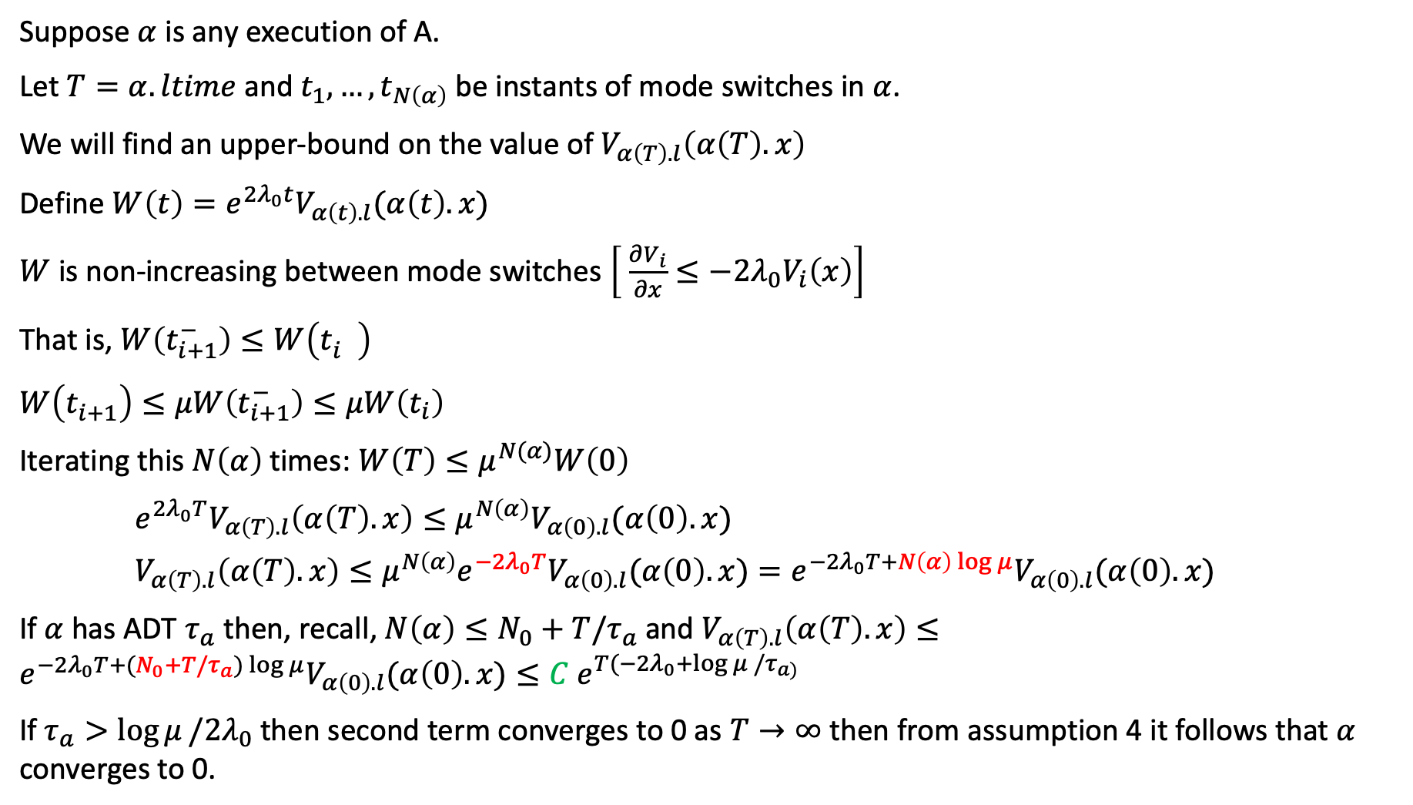
Proof sketch
Suppose $α$ is any execution of A.
Let $T=α.ltime$and $t_{1}, …,t_{N\left(α\right)}$be instants of mode switches in $α$.
We will find an upper-bound on the value of $V_{α\left(T\right).l}\left(α\left(T\right).x\right)$
Define $W\left(t\right)=e^{2λ_{0}t}V_{α\left(t\right).l}(α\left(t\right).x)$
$W$ is non-increasing between mode switches $\left[ \frac{∂V_{i}}{∂x}≤{−2λ_{0}V}_{i}\left(x\right)\right]$
That is, $W\left(t_{i+1}^{−}\right)≤W\left(t_{i}^{}\right)$
$W\left(t_{i+1}^{}\right)≤μW\left(t_{i+1}^{−}\right)≤μW\left(t_{i}\right)$
Iterating this $N\left(α\right)$times: $W\left(T\right)≤μ^{N(α)}W\left(0\right)$
$e^{2λ_{0}T}V_{α\left(T\right).l}\left(α\left(T\right).x\right)≤{μ^{N\left(α\right)}V}_{α\left(0\right).l}(α\left(0\right).x)$
$V_{α\left(T\right).l}\left(α\left(T\right).x\right)≤{μ^{N\left(α\right)}e}^{−2λ_{0}T}V_{α\left(0\right).l}(α\left(0\right).x)=e^{−2λ_{0}T+N\left(α\right)\log{μ}}V_{α\left(0\right).l}(α\left(0\right).x)$
If $α$ has ADT $τ_{a}$ then, recall, $N\left(α\right)≤N_{0}+T/τ_{a}$ and $V_{α\left(T\right).l}\left(α\left(T\right).x\right)≤e^{−2λ_{0}T+(N_{0}+T/τ_{a})\log{μ}}V_{α\left(0\right).l}(α\left(0\right).x)≤C{ e}^{T(−2λ_{0}+log μ /τ_{a) }}$
If $τ_{a}>\log{μ}/2λ_{0}$ then second term converges to 0 as $T→∞$ then from assumption 4 it follows that $α$ converges to 0.

Slide 17
Further reading
More general conditions for termination proofs of automata (Disjunctive unions of well-founded relations) [Podelski and Rybalchenko]
Verification of dwell time [Mitra and Liberzon]
Abstractions for stability proofs [Prabhakar et al., Duggirala et al.]

