Slide 1
Reachability analysis
Sayan Mitra
Verifying cyberphysical systems
mitras@illinois.edu

Slide 2
Next few lectures
Focus on specific classes of hybrid automata for which safety properties (invariants) can be verified completely automatically
Finite state machines
Alur-Dill’s Timed Automata[1] (Today)
Rectangular initializaed hybrid automata
Linear hybrid automata
…
We will introduce abstractions: Simplifying or approximating one automaton A with another automaton B
[1] Rajeev Alur et al. The Algorithmic Analysis ofHybrid Systems. Theoretical Computer Science, volume 138, pages 3-34, 1995.

Slide 3
Today
Finite state machines
Algorithmic analysis of (Alur-Dill’s) Timed Automata[1]
A restricted class of what we call hybrid automata in this course with only clock variables
[1] Rajeev Alur and David L. Dill. A theory of timed automata. Theoretical Computer Science, 126:183-235, 1994.

Slide 4
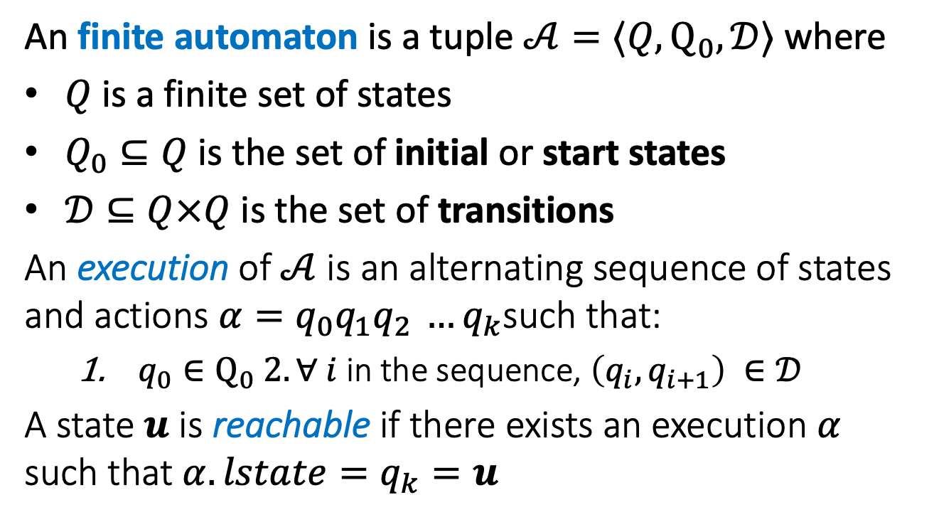
Reachability of Finite Automata
An finite automaton is a tuple $𝒜=〈Q,Q_{0}, 𝒟〉$ where
$Q$ is a finite set of states
$Q_{0}⊆Q$ is the set of initial or start states
$𝒟⊆Q×Q$ is the set of transitions
An execution of $𝒜$ is an alternating sequence of states and actions $α=q_{0}q_{1}q_{2 }…q_{k}$such that:
$q_{0}∈Q_{0} 2. ∀ i$in the sequence, $\left(q_{i},q_{i+1}\right) ∈𝒟$
A state $u$ is reachable if there exists an execution $α$ such that $α.lstate=q_{k}=u$

Slide 5





Reachability in finite state machines
$Reach_{𝒜}\left(Θ\right):$ set of states reachable from $Θ$ by automaton $𝒜$
An invariant is a set of states I such that $Reach_{𝒜}⊆I$
How to check whether $u$ is reachable ?
Q: All states e.g. $I_{3}$
Invariant e.g. $I_{1}$
$${Reach}_{𝒜}(Q_{0})$$
$$Q_{0}$$

Slide 6
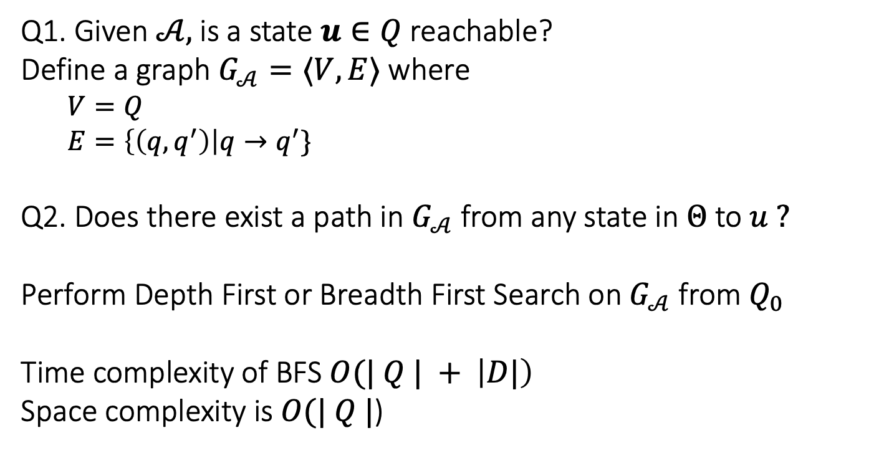
Reachability as graph search
Q1. Given $𝒜,$is a state $u∈Q$ reachable?
Define a graph $G_{𝒜}=〈V,E〉$ where
$V=Q$
$E=\left\{\left(q,q^{′}\right)\right|q→q^{′}\}$
Q2. Does there exist a path in $G_{𝒜}$ from any state in $Θ$ to $u ?$
Perform Depth First or Breadth First Search on $G_{𝒜}$ from $Q_{0}$
Time complexity of BFS $O(| Q | + \left|D|\right)$
Space complexity is $O(| Q |$)

Slide 7
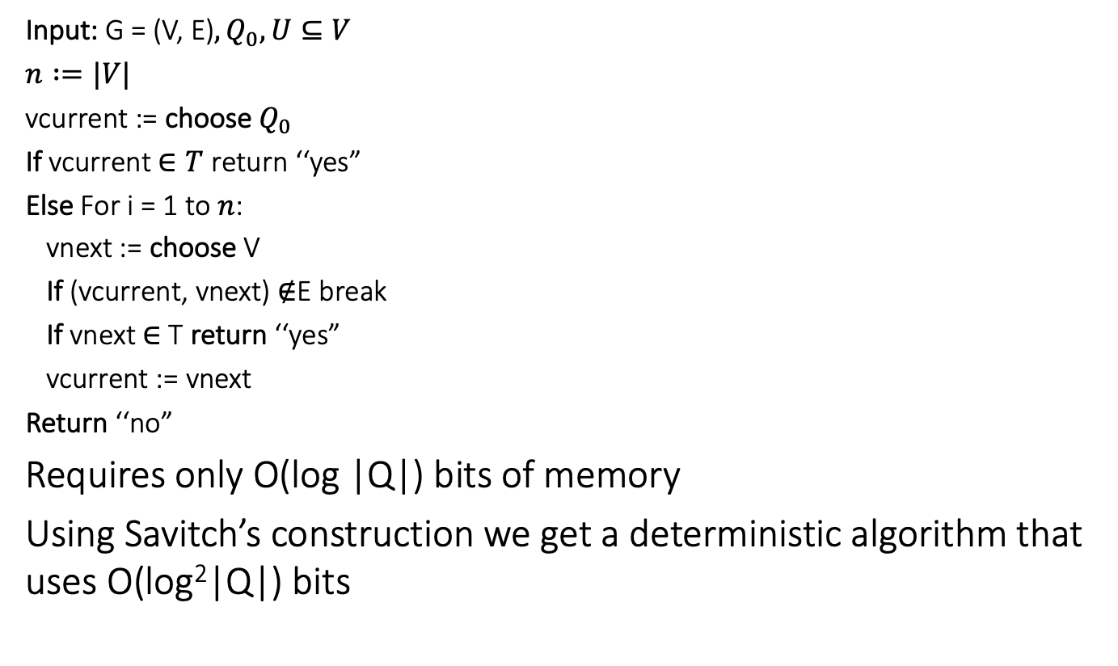
Nondeterministic reachability
Input: G = (V, E)$,Q_{0}, U⊆V$
$n :=|V|$
vcurrent := choose $Q_{0}$
If vcurrent $∈T$ return ‘‘yes”
Else For i = 1 to $n$:
vnext := choose V
If (vcurrent, vnext) $∉$E break
If vnext $∈$ T return ‘‘yes”
vcurrent := vnext
Return ‘‘no”
Requires only O(log |Q|) bits of memory
Using Savitch’s construction we get a deterministic algorithm that uses O(log²|Q|) bits

Slide 8
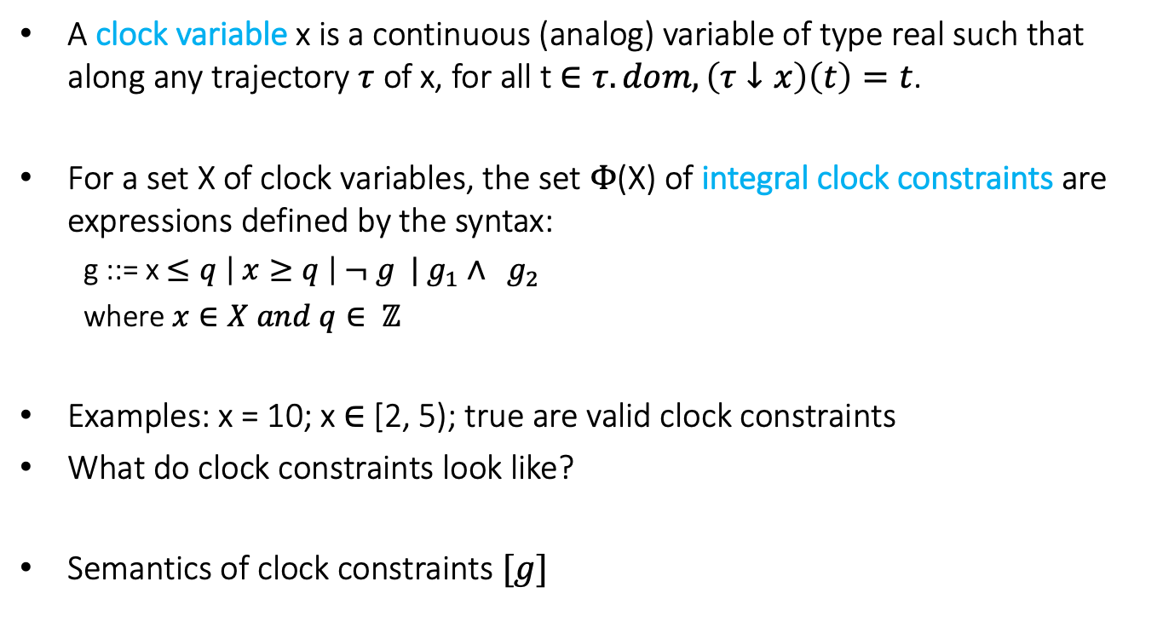
Adding Clocks and Clock Constraints
A clock variable x is a continuous (analog) variable of type real such that along any trajectory $τ$ of x, for all t $∈τ.dom, \left(τ↓x\right)\left(t\right)=t$.
For a set X of clock variables, the set $Φ$(X) of integral clock constraints are expressions defined by the syntax:
g ::= x $≤q \left| x≥q \right| ¬ g | g_{1}∧ g_{2}$
where $x∈X and q∈ ℤ$
Examples: x = 10; x $∈$ [2, 5); true are valid clock constraints
What do clock constraints look like?
Semantics of clock constraints $[g]$

Slide 9
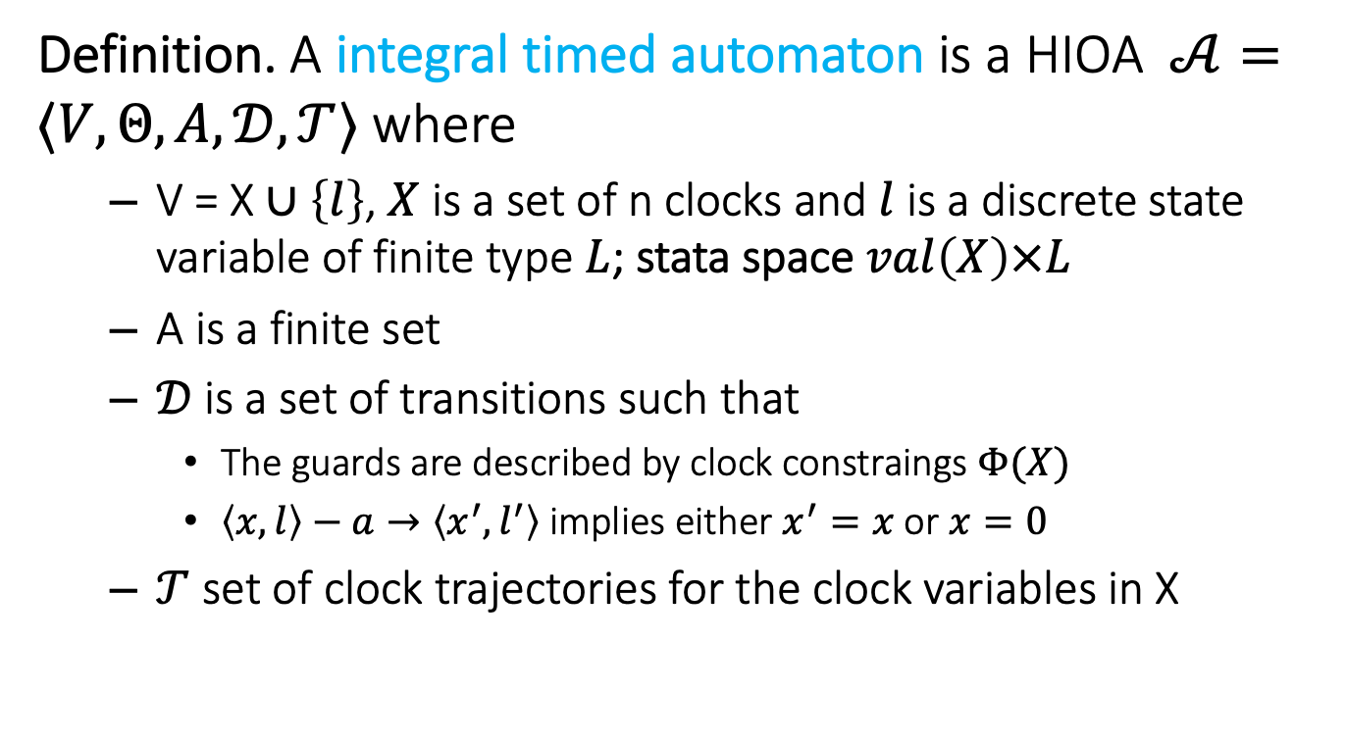
Integral Timed Automata
Definition. A integral timed automaton is a HIOA $𝒜=〈V, Θ, A, 𝒟, 𝒯〉$ where
V = X $∪\left\{l\right\}$, $X$ is a set of n clocks and $l$ is a discrete state variable of finite type $L$; stata space $val\left(X\right)×L$
A is a finite set
$𝒟$is a set of transitions such that
The guards are described by clock constraings $Φ(X)$
$〈x,l〉−a→〈x^{′},l^{′}〉$ implies either $x^{′}=x$ or $x=0$
$𝒯$ set of clock trajectories for the clock variables in X

Slide 10
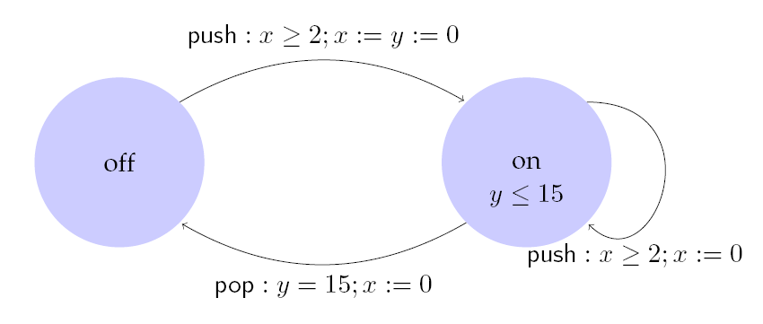
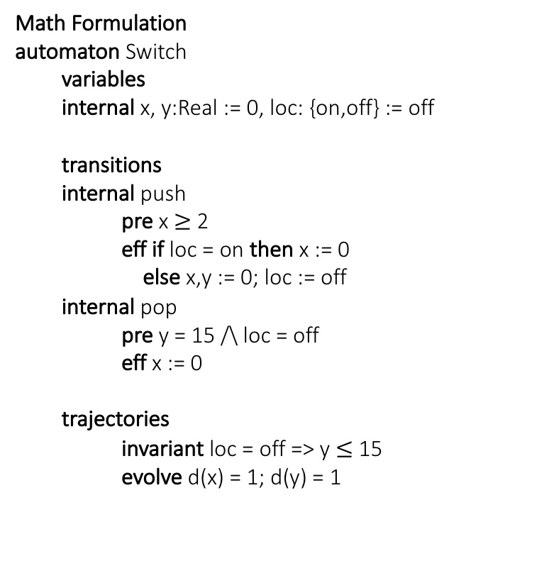
Example: Light switch
Math Formulation
automaton Switch
variables
internal x, y:Real := 0, loc: {on,off} := off
transitions
internal push
pre x $≥$ 2
eff if loc = on then x := 0
else x,y := 0; loc := off
internal pop
pre y = 15 /\ loc = off
eff x := 0
trajectories
invariant loc = off => y $≤$ 15
evolve d(x) = 1; d(y) = 1
Description
Switch can be turned on whenever at least 2 time units have elapsed since the last turn on. Switches off automatically 15 time units after the last on.

Slide 11
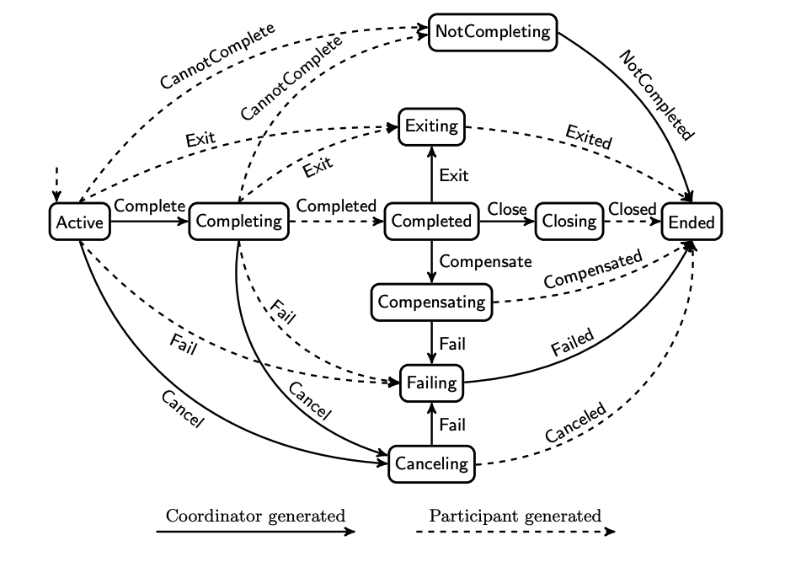
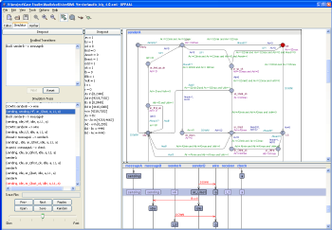
Timed Automaton application in Web Services (WS)
WS-Coordination describes a framework for coordinating transactional web services
Network protocol described in state tables
600+ lines of C-like code in the protocol model
Modeled and Verified using the UPPAAL tool
Analysis considers different channel models
The main safety property: protocol does not enter invalid state
Property violated in all but the FIFO channel model
Modelling and Verification of Web Services Business Activity Protocol Anders P. Ravn, Jiri Srba, and Saleem Vighio, RV 2010

Slide 12
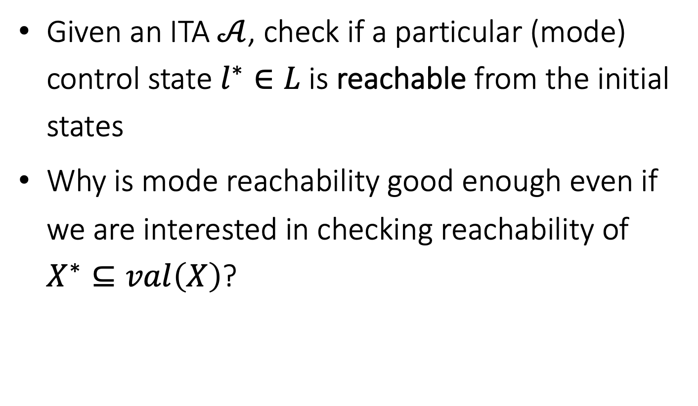
Control State (mode) Reachability Problem
Given an ITA $𝒜$, check if a particular (mode) control state $l^{∗}∈L$is reachable from the initial states
Why is mode reachability good enough even if we are interested in checking reachability of $X^{∗}⊆val\left(X\right)$?

Slide 13
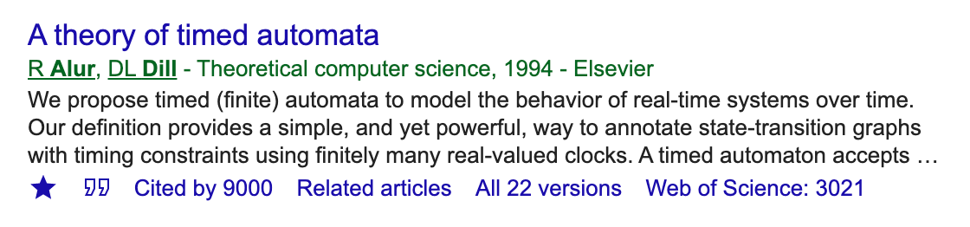
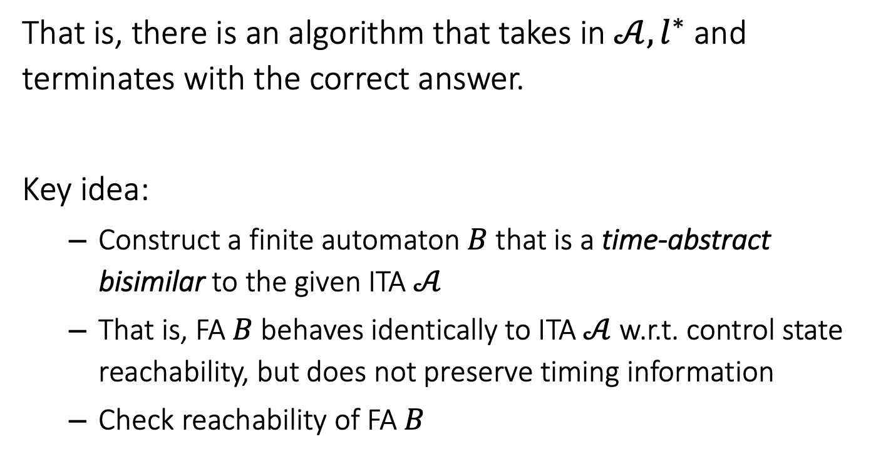
Model Reachability of Integral Timed Automata is Decidable [Alur Dill 94]
That is, there is an algorithm that takes in $𝒜, l^{∗}$ and terminates with the correct answer.
Key idea:
Construct a finite automaton $B$ that is a time-abstract bisimilar to the given ITA $𝒜$
That is, FA $B$behaves identically to ITA $𝒜$ w.r.t. control state reachability, but does not preserve timing information
Check reachability of FA $B$

Slide 14
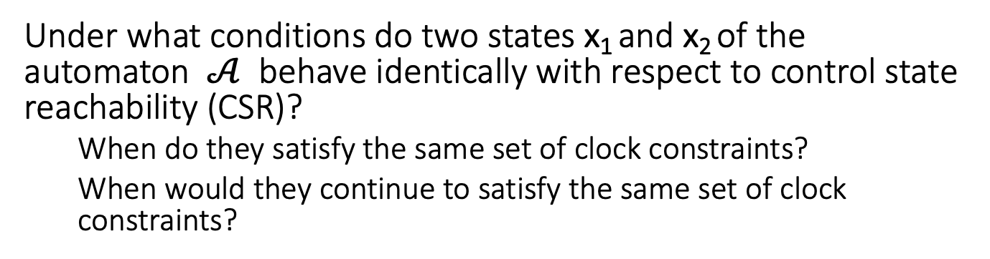
An equivalence relation with a finite quotient
Under what conditions do two states x₁ and x₂ of the automaton $𝒜$ behave identically with respect to control state reachability (CSR)?
When do they satisfy the same set of clock constraints?
When would they continue to satisfy the same set of clock constraints?

Slide 15
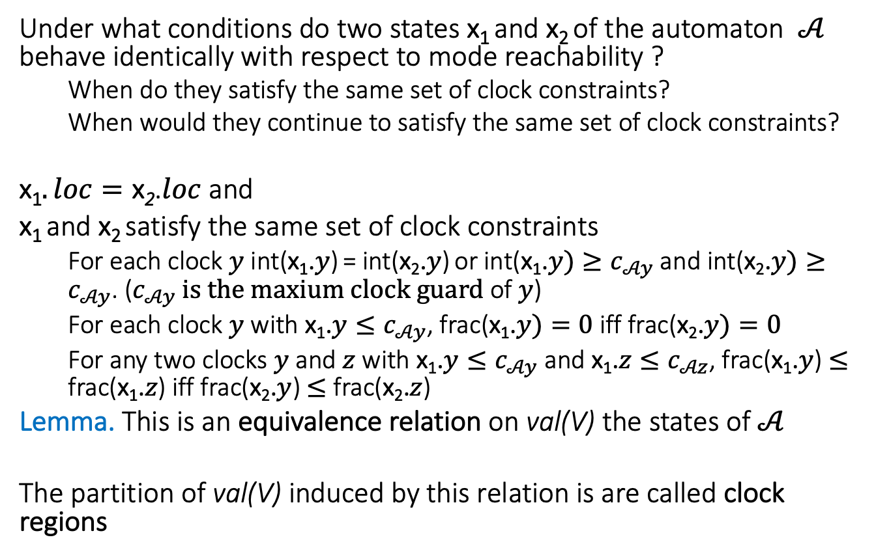
An equivalence relation with a finite quotient
Under what conditions do two states x₁ and x₂ of the automaton $𝒜$ behave identically with respect to mode reachability ?
When do they satisfy the same set of clock constraints?
When would they continue to satisfy the same set of clock constraints?
x₁$. loc=\text{x}\text{2}$.$loc$and
x₁ and x₂ satisfy the same set of clock constraints
For each clock $y$ int(x₁.$y$) = int(x₂.$y$) or int(x₁.$y)≥c_{𝒜y}$and int(x₂.$y)≥c_{𝒜y}$. ($c_{𝒜y} is the maxium clock guard$ of $y$)
For each clock $y$ with x₁.$y≤c_{𝒜y}$, frac(x₁.$y)=0$iff frac(x₂.$y)=0$
For any two clocks $y$ and $z$ with x₁.$y≤c_{𝒜y}$ and x₁.$z≤c_{𝒜z}$, frac(x₁.$y$) $≤$ frac(x₁.$z$) iff frac(x₂.$y$) $≤$ frac(x₂.$z$)
Lemma. This is an equivalence relation on val(V) the states of $𝒜$
The partition of val(V) induced by this relation is are called clock regions

Slide 16
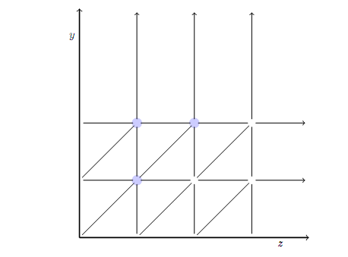
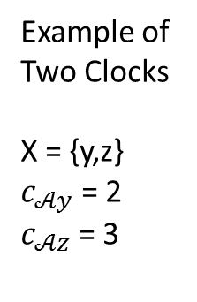
What do the clock regions look like?
Example of Two Clocks
X = {y,z}
$c_{𝒜y}$ = 2
$c_{𝒜z}$ = 3

Slide 17
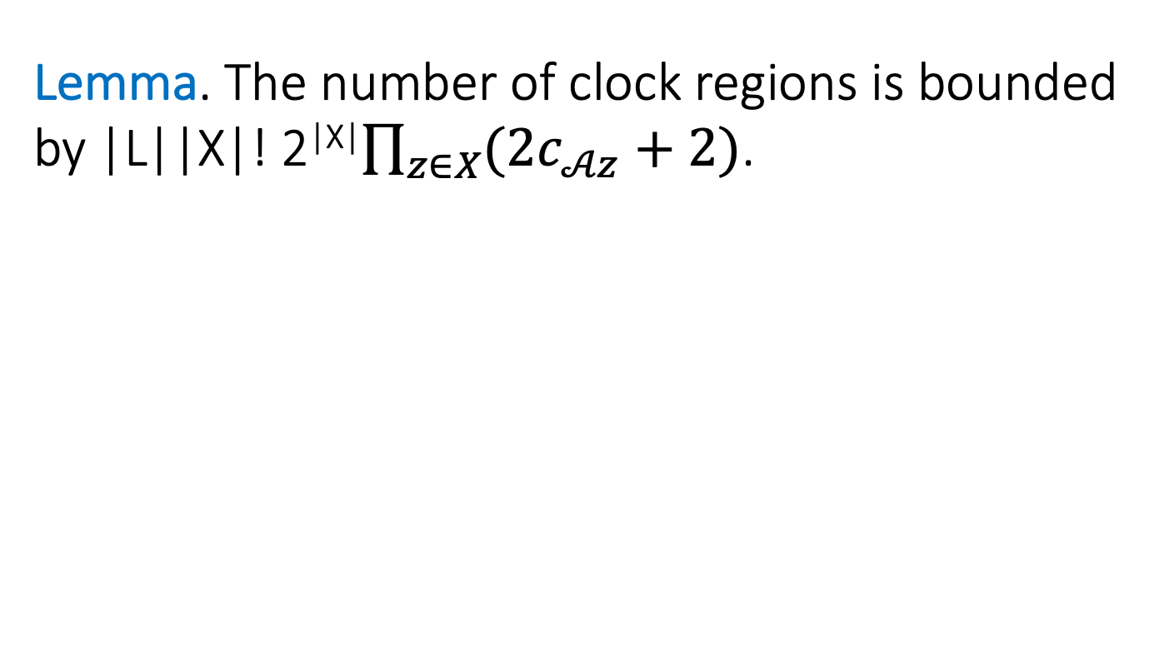
Complexity
Lemma. The number of clock regions is bounded by |L||X|! 2^{|X|}$\prod_{z∈X}{(2c_{𝒜z}+2)}$.

Slide 18
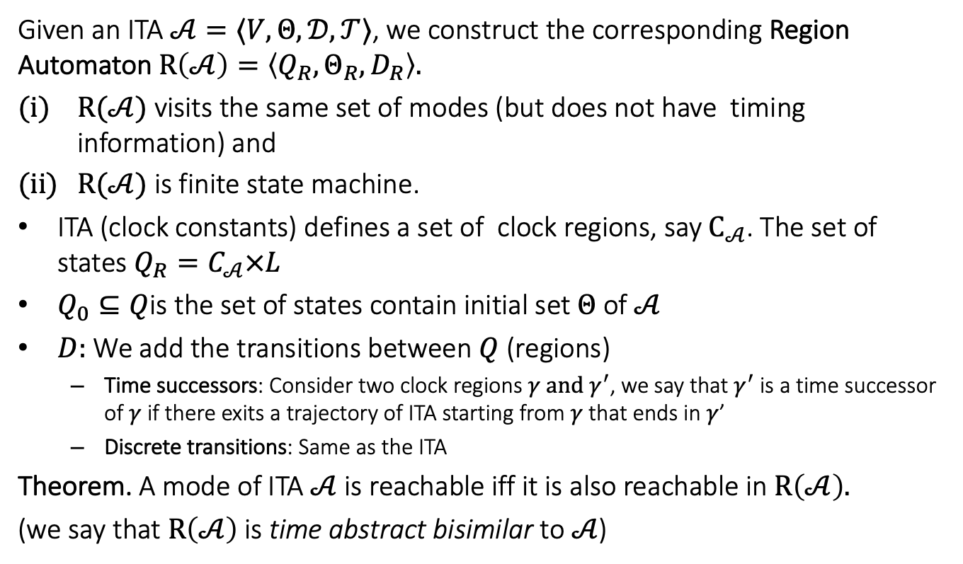

Region automaton $R(𝒜)$
Given an ITA $𝒜=〈V, Θ, 𝒟, 𝒯〉$, we construct the corresponding Region Automaton $R\left(𝒜\right)=\left\langle Q_{R},Θ_{R},D_{R}\right\rangle .$
$R(𝒜)$ visits the same set of modes (but does not have timing information) and
$R(𝒜)$ is finite state machine.
ITA (clock constants) defines a set of clock regions, say $C_{𝒜}$. The set of states $Q_{R}=C_{𝒜}×L$
$Q_{0}⊆Q$is the set of states contain initial set $Θ$of $𝒜$
$D:$We add the transitions between $Q$ (regions)
Time successors: Consider two clock regions $γ and γ^{′}$, we say that $γ^{′}$ is a time successor of $γ$ if there exits a trajectory of ITA starting from $γ$ that ends in $γ$’
Discrete transitions: Same as the ITA
Theorem. A mode of ITA $𝒜$is reachable iff it is also reachable in $R\left(𝒜\right).$
(we say that $R\left(𝒜\right)$ is time abstract bisimilar to $𝒜$)

Slide 19
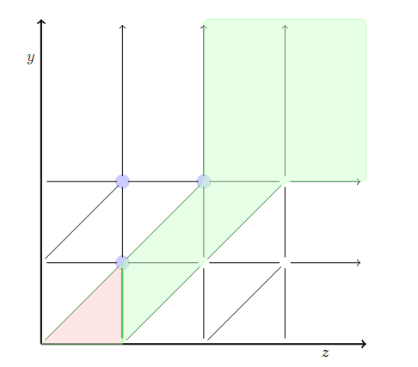
Time successors
The clock regions in blue are time successors of the clock region in red.

Slide 20

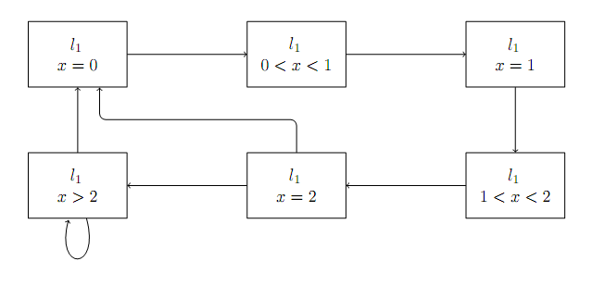
Example 1: Region Automata
ITA
Corresponding FA

Slide 21
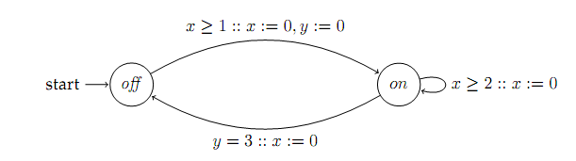
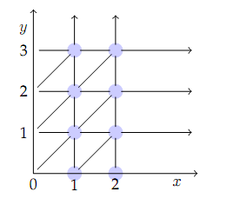
Example 2
ITA
Clock Regions

Slide 22
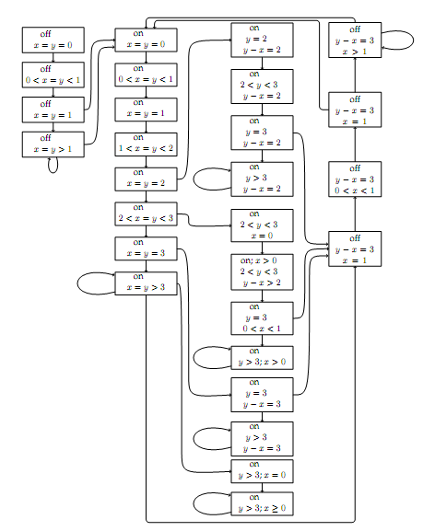
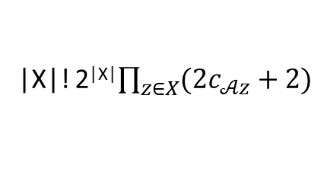
Corresponding FA
|X|! 2^{|X|}$\prod_{z∈X}{(2c_{𝒜z}+2)}$
Drastically increasing with the number of clocks

Slide 23
Special Classes of Hybrid Automata
Finite Automata
Integral Timed Automata ←
Rational time automata
Multirate automata
Rectangular Initialized HA
Rectangular HA
Linear HA
Nonlinear HA

Slide 24

ACM NEWS: In Space, No One Can Fix Your Sign Errors--- Paul Cheng & Peter Carian
15,000 satellite launches planned for the decade
5.3% satellites are lost in the first year, 42% of those in first 2 months
Most common cause sign errors: SW/HW parameter used the wrong way
fitting acceleration sensors the wrong way
wrong usage of negative instead of positive parameters
switching current in wrong direction in a circuit
inverting the orientation of the electromagnets used for positioning
Genesis (2001) for capturing particles from the solar wind, pounded into the Utah desert unbraked because a pencil-eraser-sized deceleration sensor was mounted upside-down.

Slide 25
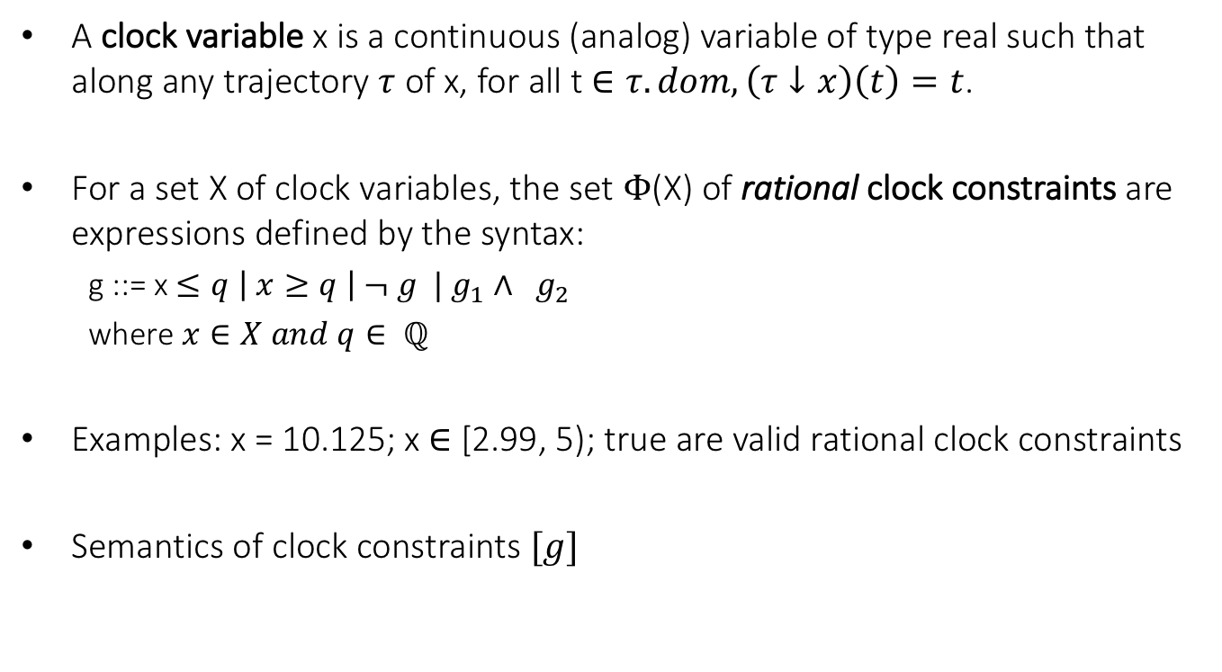
Clocks and Rational Clock Constraints
A clock variable x is a continuous (analog) variable of type real such that along any trajectory $τ$ of x, for all t $∈τ.dom, \left(τ↓x\right)\left(t\right)=t$.
For a set X of clock variables, the set $Φ$(X) of rational clock constraints are expressions defined by the syntax:
g ::= x $≤q \left| x≥q \right| ¬ g | g_{1}∧ g_{2}$
where $x∈X and q∈ ℚ$
Examples: x = 10.125; x $∈$ [2.99, 5); true are valid rational clock constraints
Semantics of clock constraints $[g]$

Slide 26
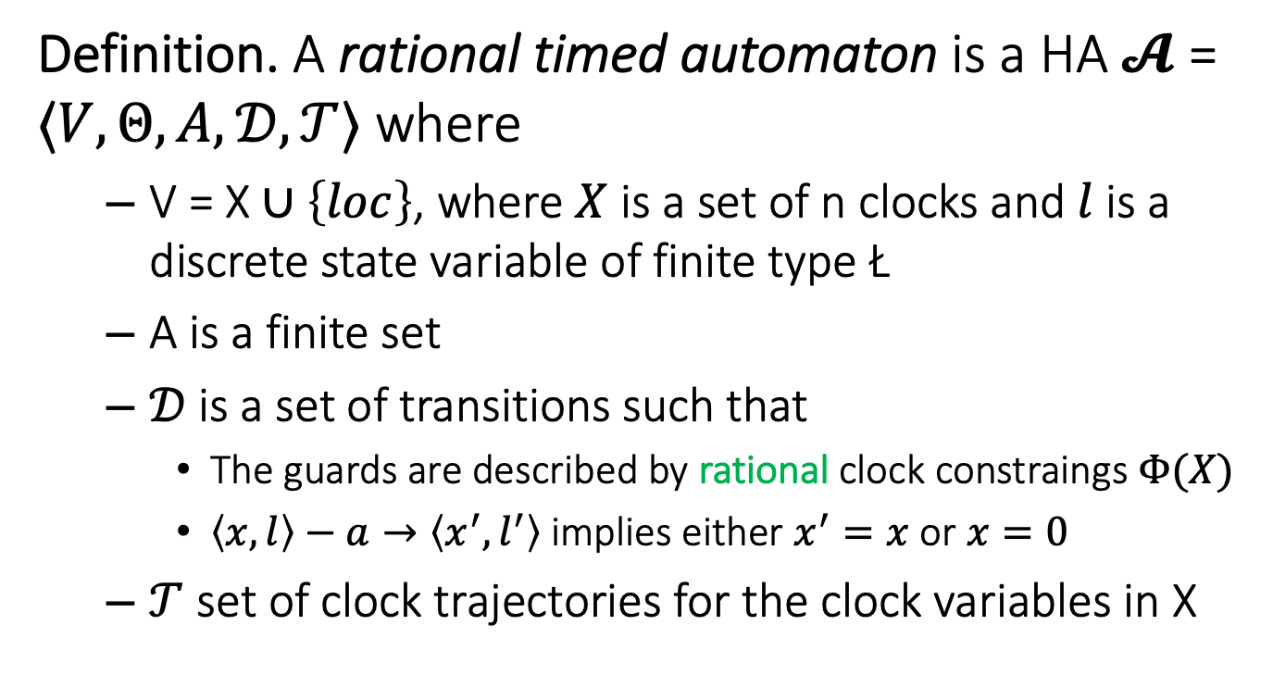
Step 1. Rational Timed Automata
Definition. A rational timed automaton is a HA $𝓐$ = $〈V, Θ, A, 𝒟, 𝒯〉$ where
V = X $∪\left\{loc\right\}$, where $X$ is a set of n clocks and $l$ is a discrete state variable of finite type Ł
A is a finite set
$𝒟$is a set of transitions such that
The guards are described by rational clock constraings $Φ(X)$
$〈x,l〉−a→〈x^{′},l^{′}〉$ implies either $x^{′}=x$ or $x=0$
$𝒯$ set of clock trajectories for the clock variables in X

Slide 27
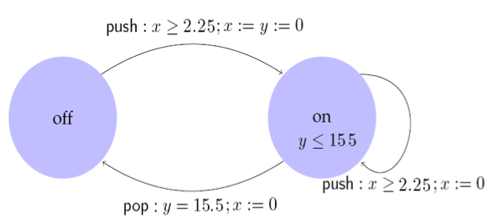
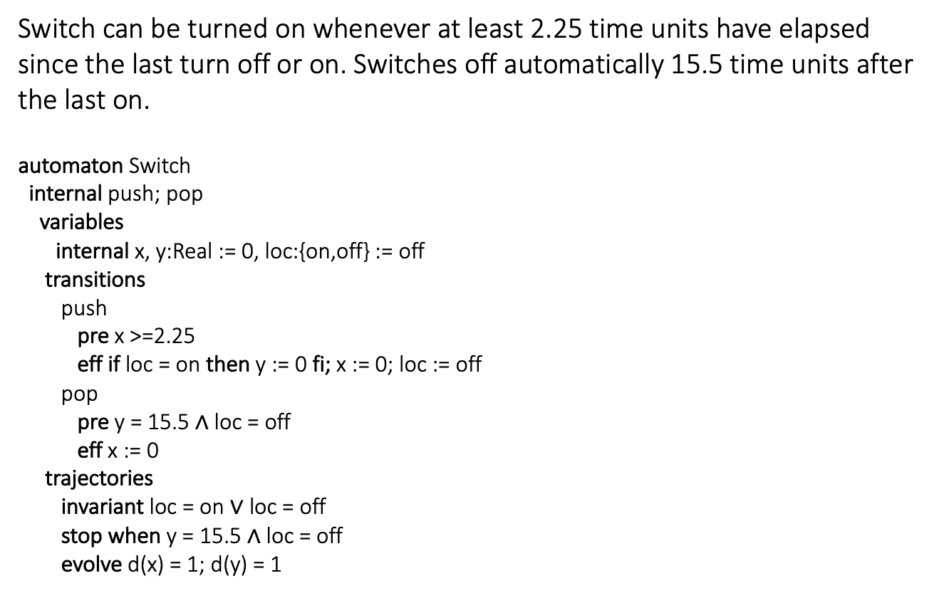
Example: Rational Light switch
Switch can be turned on whenever at least 2.25 time units have elapsed since the last turn off or on. Switches off automatically 15.5 time units after the last on.
automaton Switch
internal push; pop
variables
internal x, y:Real := 0, loc:{on,off} := off
transitions
push
pre x >=2.25
eff if loc = on then y := 0 fi; x := 0; loc := off
pop
pre y = 15.5 $∧$ loc = off
eff x := 0
trajectories
invariant loc = on $∨$ loc = off
stop when y = 15.5 $∧$ loc = off
evolve d(x) = 1; d(y) = 1

Slide 28
Control State (Location) Reachability Problem
Given an RTA, check if a particular mode is reachable from the initial states
Is problem decidable?
Yes
Key idea:
Construct a ITA that has exactly same mode reachability behavior as the given RTA (timing behavior may be different)
Check mode reachability for ITA

Slide 29

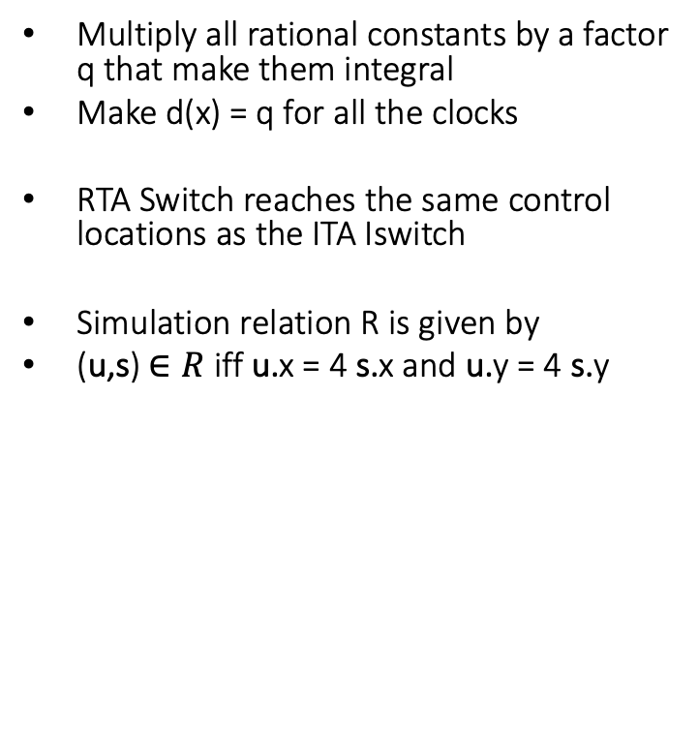
Construction of ITA from RTA
Multiply all rational constants by a factor q that make them integral
Make d(x) = q for all the clocks
RTA Switch reaches the same control locations as the ITA Iswitch
Simulation relation R is given by
(u,s) $∈R$iff u.x = 4 s.x and u.y = 4 s.y
automaton ISwitch
internal push; pop
variables
internal x, y:Real := 0, loc:{on,off} := off
transitions
push
pre x >= 9
eff if loc = on then y := 0 fi; x := 0; loc := off
pop
pre y = 62 $∧$ loc = off
eff x := 0
trajectories
invariant loc = on $∨$ loc = off
stop when y = 62 $∧$ loc = off
evolve d(x) = 4; d(y) = 4

Slide 30
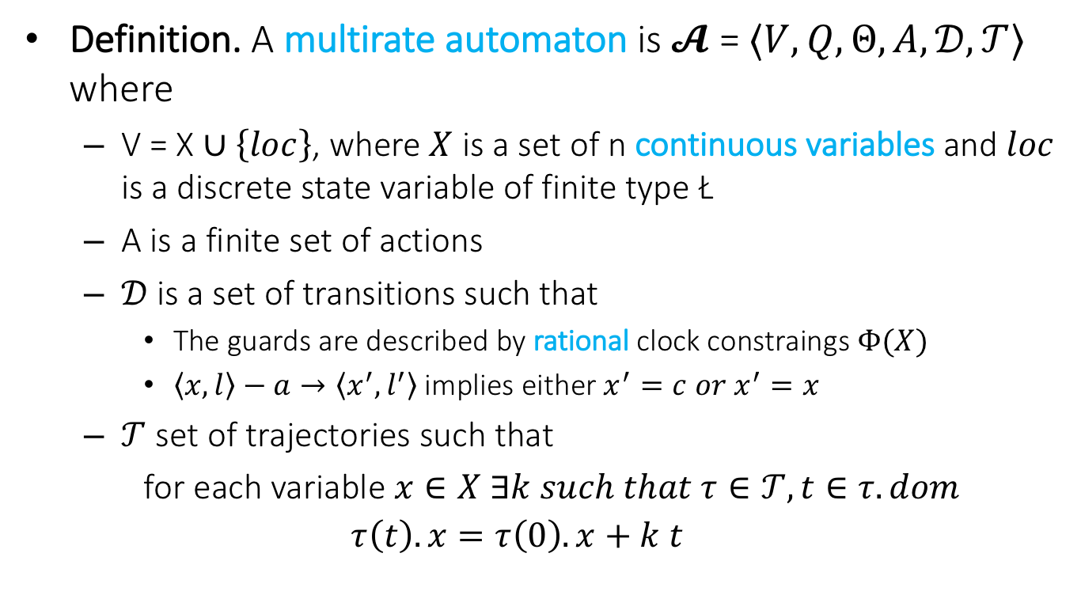
Step 2. Multi-Rate Automaton
Definition. A multirate automaton is $𝓐$ = $〈V, Q, Θ, A, 𝒟, 𝒯〉$ where
V = X $∪\left\{loc\right\}$, where $X$ is a set of n continuous variables and $loc$ is a discrete state variable of finite type Ł
A is a finite set of actions
$𝒟$is a set of transitions such that
The guards are described by rational clock constraings $Φ(X)$
$〈x,l〉−a→〈x^{′},l^{′}〉$ implies either $x^{′}=c{ or x}^{′}=x$
$𝒯$ set of trajectories such that
for each variable $x∈X ∃k such that τ∈𝒯, t∈τ.dom$
$$τ\left(t\right).x=τ\left(0\right).x+k t$$

Slide 31
Control State (Location) Reachability Problem
Given an MRA, check if a particular location is reachable from the initial states
Is problem is decidable? Yes
Key idea:
Construct a RTA that is bisimilar to the given MRA

Slide 32
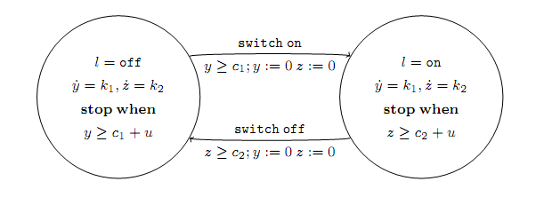
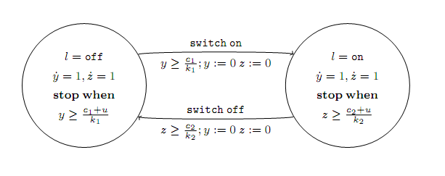
Example: Multi-rate to rational TA

Slide 33
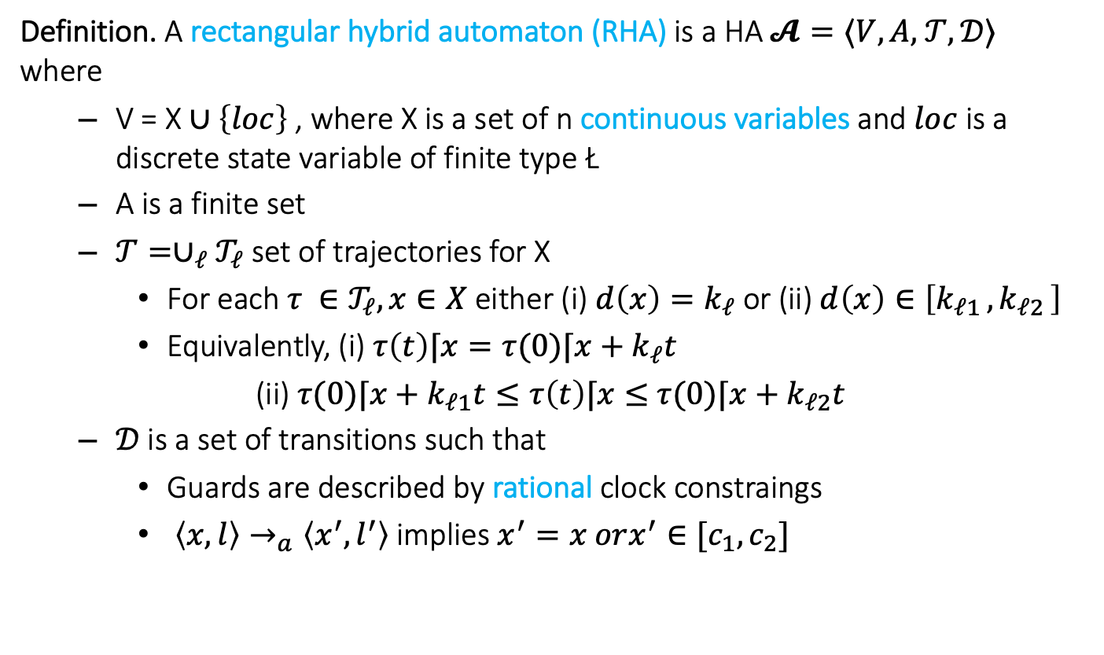
Step 3. Rectangular HA
Definition. A rectangular hybrid automaton (RHA) is a HA $𝓐=⟨V,A,$ $𝒯,𝒟⟩$ where
V = X $∪\left\{loc\right\}$ , where X is a set of n continuous variables and $loc$ is a discrete state variable of finite type Ł
A is a finite set
$𝒯={∪_{ℓ}𝒯}_{ℓ}$ set of trajectories for X
For each $τ ∈𝒯_{ℓ}, x∈X$ either (i) $d\left(x\right)=k_{ℓ}$ or (ii) $d\left(x\right)∈\left[k_{ℓ1 },k_{ℓ2 }\right]$
Equivalently, (i) $τ\left(t\right)⌈x=τ(0)⌈x+k_{ℓ}t$
(ii) $τ(0)⌈x+k_{ℓ1}t≤τ\left(t\right)⌈x≤$ $τ(0)⌈x+k_{ℓ2}t$
$𝒟$is a set of transitions such that
Guards are described by rational clock constraings
$〈x,l〉→_{a}〈x^{′},l^{′}〉$ implies $x^{′}=x orx^{′}∈[c_{1},c_{2}]$

Slide 34
CSR Decidable for RHA?
Given an RHA, check if a particular location is reachable from the initial states?
Is this problem decidable? No
[Henz95] Thomas Henzinger, Peter Kopke, Anuj Puri, and Pravin Varaiya. What's Decidable About Hybrid Automata?. Journal of Computer and System Sciences, pages 373–382. ACM Press, 1995.
CSR for RHA reduction to Halting problem for 2 counter machines
Halting problem for 2CM known to be undecidable
Reduction in next lecture

Slide 35
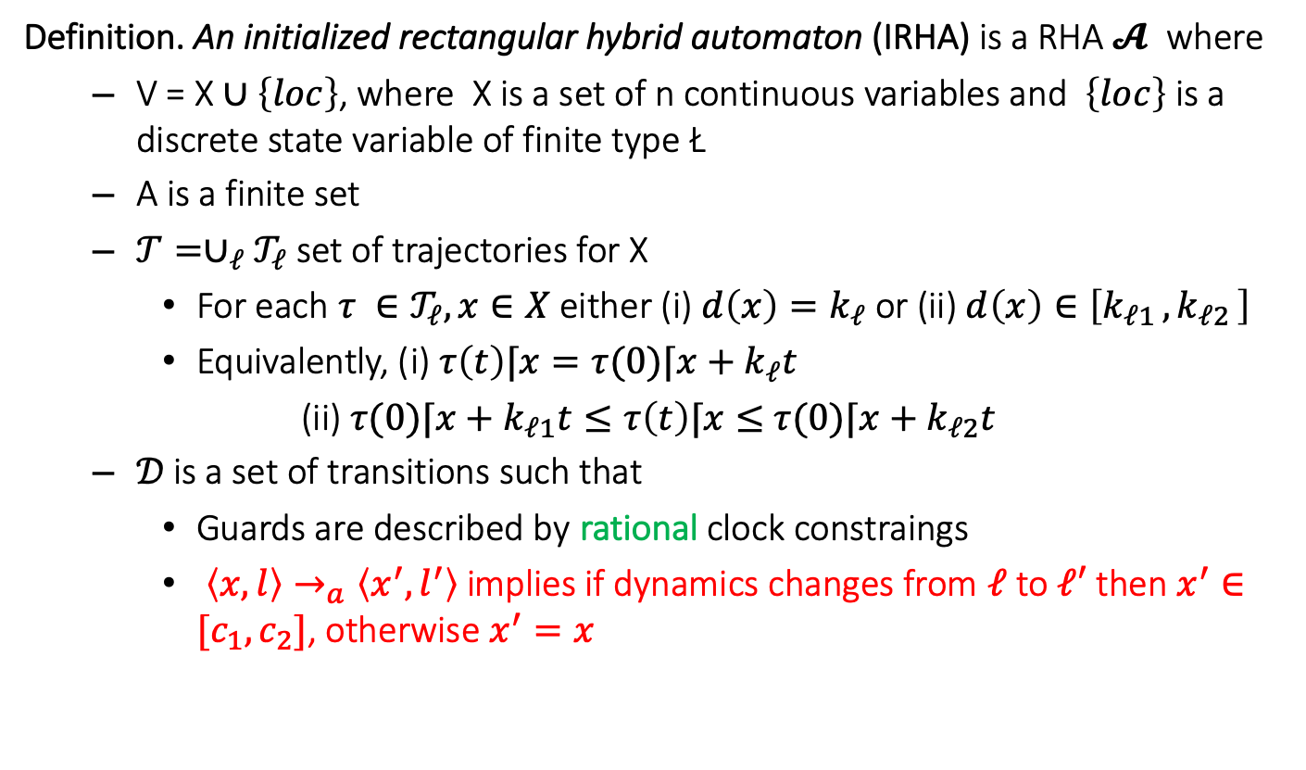
Step 4. Initialized Rectangular HA
Definition. An initialized rectangular hybrid automaton (IRHA) is a RHA $𝓐$ where
V = X $∪\left\{loc\right\}$, where X is a set of n continuous variables and $\left\{loc\right\}$ is a discrete state variable of finite type Ł
A is a finite set
$𝒯={∪_{ℓ}𝒯}_{ℓ}$ set of trajectories for X
For each $τ ∈𝒯_{ℓ}, x∈X$ either (i) $d\left(x\right)=k_{ℓ}$ or (ii) $d\left(x\right)∈\left[k_{ℓ1 },k_{ℓ2 }\right]$
Equivalently, (i) $τ\left(t\right)⌈x=τ(0)⌈x+k_{ℓ}t$
(ii) $τ(0)⌈x+k_{ℓ1}t≤τ\left(t\right)⌈x≤$ $τ(0)⌈x+k_{ℓ2}t$
$𝒟$is a set of transitions such that
Guards are described by rational clock constraings
$〈x,l〉→_{a}〈x^{′},l^{′}〉$ implies if dynamics changes from $ℓ$ to $ℓ′$ then $x^{′}∈[c_{1},c_{2}]$, otherwise $x^{′}=x$

Slide 36
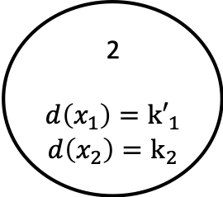

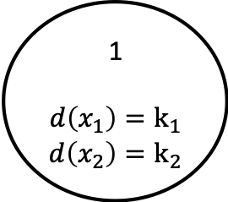
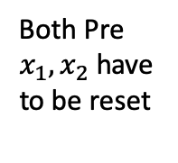
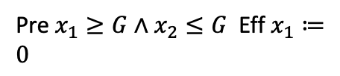
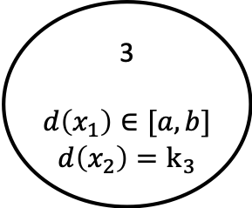
Example: Rectangular Initialized HA
Pre $x_{1}≥G∧x_{2}≤G$ Eff $x_{1}≔0$
1
$$d\left(x_{1}\right)=k_{1}$$
$$d\left(x_{2}\right)=k_{2}$$
2
$$d\left(x_{1}\right)={k′}_{1}$$
$$d\left(x_{2}\right)=k_{2}$$
Both Pre $x_{1}, x_{2}$ have to be reset
3
$$d\left(x_{1}\right)∈[a,b]$$
$$d\left(x_{2}\right)=k_{3}$$
Eff $x_{1}, x_{2}∈[c,d]$

Slide 37
CSR Decidable for IRHA?
Given an IRHA, check if a particular location is reachable from the initial states
Is this problem decidable? Yes
Key idea:
Construct a 2n-dimensional initialized multi-rate automaton that is bisimilar to the given IRHA
Construct a ITA that is bisimilar to the Singular TA

Slide 38
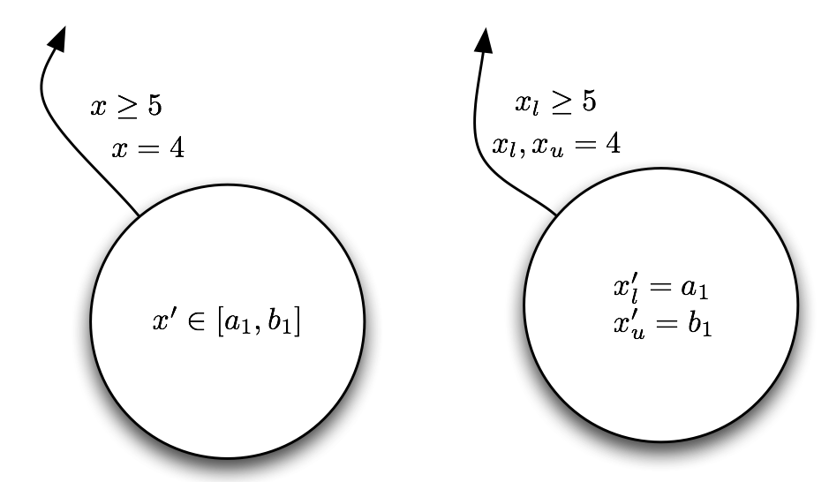
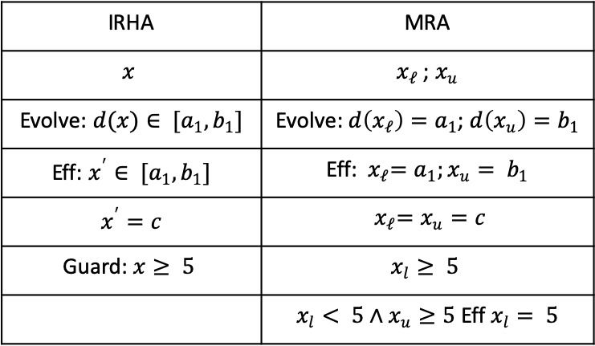
From IRHA to Singular HA conversion
For every variable create two variables---tracking the upper and lower bounds
IRHA | MRA
$$x$$ | $x_{ℓ}$ ; $x_{u}$
Evolve: $d(x)∈ [a_{1},b_{1}]$ | Evolve: $d\left(x_{ℓ}\right)=a_{1}$; $d\left(x_{u}\right)=b_{1}$
Eff: $x^{′}∈ [a_{1},b_{1}]$ | Eff:${ x}_{ℓ}=a_{1};x_{u}= b_{1}$
$x^{′}=c$ | $${ x}_{ℓ}=x_{u}=c$$
Guard: $x≥ 5$ | $$x_{l}≥ 5$$
 | $x_{l}< 5∧x_{u}≥5$ Eff $x_{l}= 5$

Slide 39
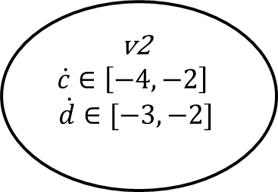
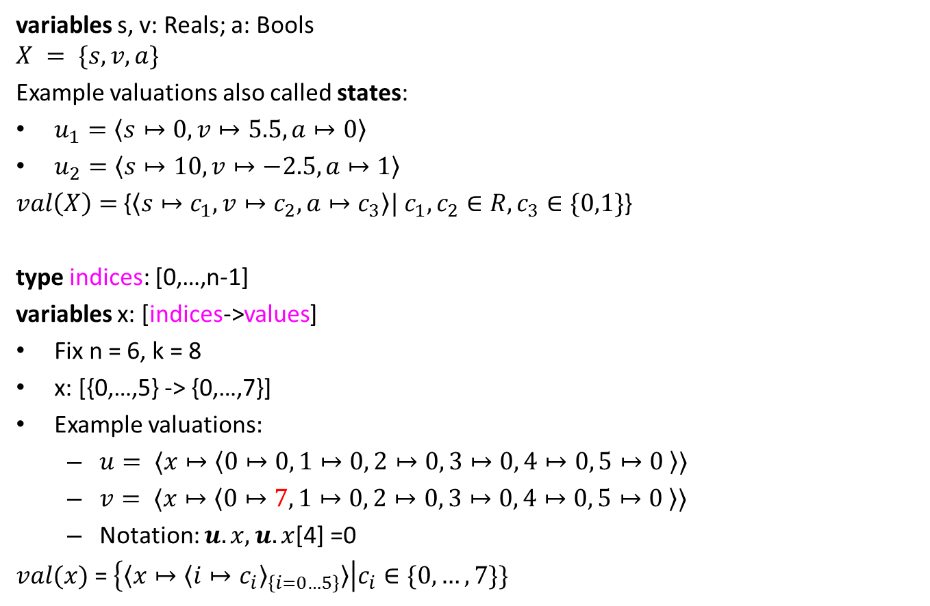
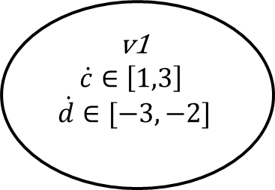
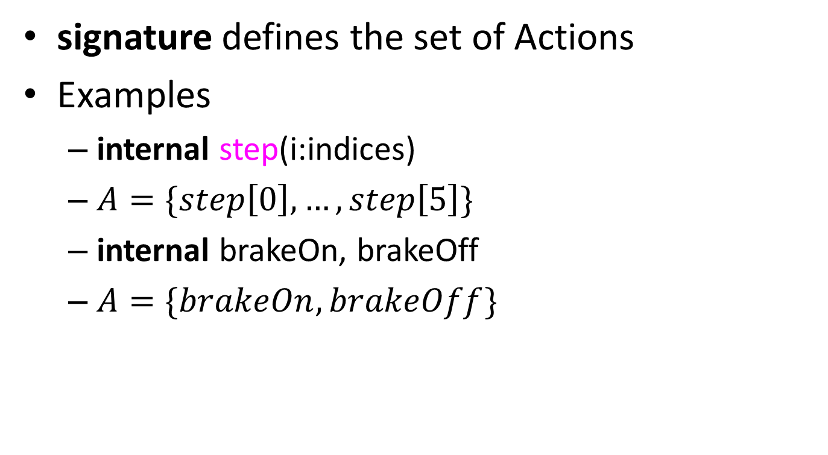
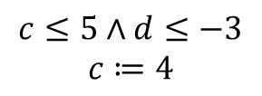



Example IRHA
$$c≔0;d≔1$$
v1
$$\dot{c}∈\left[1,3\right]$$
$$\dot{d}∈[−3,−2]$$
$c≥0∧d≤$2
$$d≔1$$
v4
$$\dot{c}∈\left[1,3\right]$$
$$\dot{d}∈[1,2]$$
$$c≤5∧d≤−3$$
$$c≔4$$
$c≥−3∧d≤−$2
$$c∈[−1,−2]$$
v2
$$\dot{c}∈\left[−4,−2\right]$$
$$\dot{d}∈[−3,−2]$$
$$d≤−5$$
$$d≔−4$$
v3
$$\dot{c}∈\left[−4,−2\right]$$
$$\dot{d}∈[1,2]$$

Slide 40





Initialized Singular HA
$$c_{l},c_{u}≔0;d_{l}, d_{u}≔1$$
v1
$$\dot{c_{l}}=1$$
$$\dot{c_{u}}=3$$
$$\dot{d_{l}}=−3$$
$$\dot{d_{u}}=−2$$
v4
$\dot{\begin{aligned}\dot{c_{l}}=1 \\ \dot{c_{u}}=3 \\ \begin{aligned} \dot{d_{l}}=1 \\ \dot{d_{u}}=2 \end{aligned}\end{aligned}}$
v2
$$\dot{\begin{aligned}\dot{c_{l}}=−4 \\ \dot{c_{u}}=−2 \\ \begin{aligned} \dot{d_{l}}=−3 \\ \dot{d_{u}}=−2 \end{aligned}\end{aligned}}$$
v3
$$\dot{\begin{aligned}\dot{c_{l}}=−4 \\ \dot{c_{u}}=−2 \\ \begin{aligned} \dot{d_{l}}=1 \\ \dot{d_{u}}=2 \end{aligned}\end{aligned}}$$

Slide 41






Transitions
v1
$$\dot{c_{l}}=1$$
$$\dot{c_{u}}=3$$
$$\dot{d_{l}}=−3$$
$$\dot{d_{u}}=−2$$
5
$$c_{u}$$
$$c_{l}$$
$$c_{l}≤5$$
$$c_{l}, c_{u}≔4$$
$d_{u}≤−3$ no reset
$d_{u}>−3∧d_{l}≤−3 d_{u}≔$-3
$${d_{u}}_{ }$$
-3
$$d_{l}$$

Slide 42





Initialized Singular HA
$$c_{l},c_{u}≔0;d_{l}, d_{u}≔1$$
v1
$$\dot{c_{l}}=1$$
$$\dot{c_{u}}=3$$
$$\dot{d_{l}}=−3$$
$$\dot{d_{u}}=−2$$
$c_{l}≥0∧d_{l}≤$2
$$d_{l}, d_{u}≔1$$
v4
$\dot{\begin{aligned}\dot{c_{l}}=1 \\ \dot{c_{u}}=3 \\ \begin{aligned} \dot{d_{l}}=1 \\ \dot{d_{u}}=2 \end{aligned}\end{aligned}}$
$c_{l}<0∧c_{u}≥0∧d_{l}≤$2
$$c_{l}≔0d_{l}, d_{u}≔1$$
$$c_{l}≤5∧d_{u}≤−3$$
$$c_{l}, c_{u}≔4$$
$$c_{l}≤5∧d_{l}≤−3∧d_{u}>−3$$
$$c_{l}, c_{u}≔4 d_{u}≔−3$$
$c_{u}≥−3∧d_{u}≤−$2
$$c_{l}≔−2c_{u}≔−1$$
$c_{u}≥−3∧d_{l}≤−2 ∧d_{u}>−2$
$$c_{l}≔−2c_{u}≔−1 d_{u}−2$$
v2
$$\dot{\begin{aligned}\dot{c_{l}}=−4 \\ \dot{c_{u}}=−2 \\ \begin{aligned} \dot{d_{l}}=−3 \\ \dot{d_{u}}=−2 \end{aligned}\end{aligned}}$$
$$d_{l}≤−5$$
$$d_{l}d_{u}≔−4$$
v3
$$\dot{\begin{aligned}\dot{c_{l}}=−4 \\ \dot{c_{u}}=−2 \\ \begin{aligned} \dot{d_{l}}=1 \\ \dot{d_{u}}=2 \end{aligned}\end{aligned}}$$

Slide 43
Can this be further generalized ?
For initialized Rectangular HA, control state reachability is decidable
Can we drop the initialization restriction?
No, problem becomes undecidable (next time)
Can we drop the rectangular restriction?
No, problem becomes undecidable

Slide 44


Verification in tools

Slide 45

Data structures make reachability go around
Hyperrectangles
$\left[\left[g_{1};g_{2}\right]\right]=\left\{x∈R^{n} \right|{ \left|\left|x−g_{1}\right|\right|}_{ _{∞}}≤{\left|\left|g_{2}−g_{1}\right|\right|}_{ _{∞}}\}=Π_{i}[g_{1i},g_{2i}]$
Polyhedra
Zonotopes [Girard 2005]
Ellipsoids [Kurzhanskiy 2001]
Support functions [Guernic et al. 2009]
Generalized star set [Duggirala and Viswanathan 2018]

Slide 46
Data structures: rectangles and ellipsoids

Slide 47
Zonotopes and polytopes

Slide 48
Summary
ITA: Restricted class of hybrid automata
Clocks, integer constraints
No clock comparison, linear
Control state reachability with Alur-Dill’s algorithm (region automaton construction)
Rational coefficients; multirate Automata
Initialized Rectangular Hybrid Automata
HyTech, PHAVer use polyhedral reachability computations
Notes:
fix-point implementation in tools
We can remove the init. set. Hytech will accept the automaton, but there is no guarantee on termination

