Slide 1
Reachability analysis: Undecidability of Rectangular Hybrid Automata
Sayan Mitra
Verifying cyberphysical systems
mitras@illinois.edu

Slide 2
Is this problem decidable? No
[Henz95] Thomas Henzinger, Peter Kopke, Anuj Puri, and Pravin Varaiya. What's Decidable About Hybrid Automata?. Journal of Computer and System Sciences, pages 373–382. ACM Press, 1995.
We will see that the CSR problem for rectangular hybrid automata (RHA) is undecidable
This implies that automatic verification of invariants and safety properties is also impossible for this class of models
The result was shown by Henzinger et al. [1995] through a reduction from the Halting problem of two counter machines

Slide 3
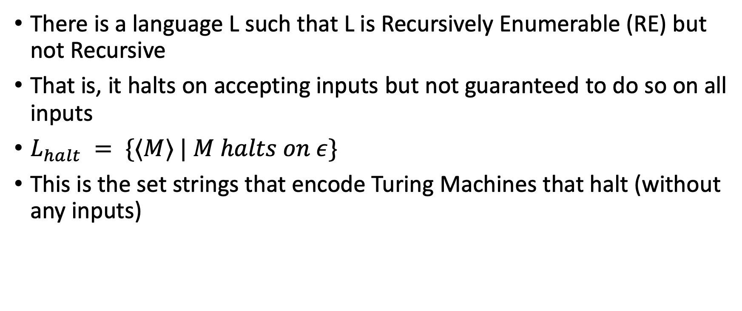
Recall from review of computability theory
There is a language L such that L is Recursively Enumerable (RE) but not Recursive
That is, it halts on accepting inputs but not guaranteed to do so on all inputs
$L_{halt} = \{⟨M⟩ | M halts on ε\}$
This is the set strings that encode Turing Machines that halt (without any inputs)

Slide 4
Reduction from Halting Problem for 2CM
2 CM Halting problem decider
2CM Halting problem: p
Translator f(p)
CSR for RHA: f(p)
CSR algorithm for Rectangular HA
Yes
No
Suppose CSR for RHA is decidable
If we can construct a reduction from 2CM Halting Problem to CSR for RHA then 2CM Halting problem is also decidable

Slide 5
General reductions: Using known hard problem B to show hardness of A
Decision procedure for B
Instance of B (known to be hard)
Translator f: B → A
instance of A
Problem A
Yes
No
Given B is known to be hard
Suppose (for the sake of contradiction) A is solvable
If we can construct a reduction f: B→A (from B to A) then B becomes easy, which is a contradiction

Slide 6
Counter Machines
An n-counter machine is an elementary computer with n-unbounded counters and a finite program written in a minimalistic assembly language.
More precisely: A 2-counter machine (2CM) is a discrete transition system with the following components:
Two nonnegative integer counters C and D. Both are initialized to $0$.
A finite program with one of these instructions at each location (or line):
INCC, INCD: increments counter C (or D)
DECC, DECD: decrements counter C (or D), provided it is not 0,
JNZC, JNZD [label]: moves the program control to line label provided that counter C (or D) is not zero.

Slide 7
Example 2CM for multiplication
A 2-counter machine for multiplying 2x3 is shown below.
INCC;
INCC; % C = 2
INCD; % LOOP
INCD;
INCD;
DECC;
JNZC 3; % Jump to LOOP
% HALT
Exercise: Show that any k-counter machine can be simulated by a 2CM.

Slide 8
Halting problem for 2CM
A configuration of a 2CM is a triple (pc, C, D)
pc is the program counter that stores the next line to be executed
C, D are values of the counter
A sequence of configurations (pc0, D0, C0), (pc1, D1, C1), … is an execution if the ith configuration goes to the (i+1)st configuration in the sequence executing the instruction in line pci
Given a 2CM M a special halting location (pc_halt), the Halting problem requires us to decide whether all executions of M reach the halting location
Theorem [Minsky 67]. The Halting problem for 2CMs is undecidable.

Slide 9
Reduction from 2CM to CSR-RHS
We have to construct a function (reduction) that maps instances of 2CM-Halt to instances of CSR-RHA

Slide 10
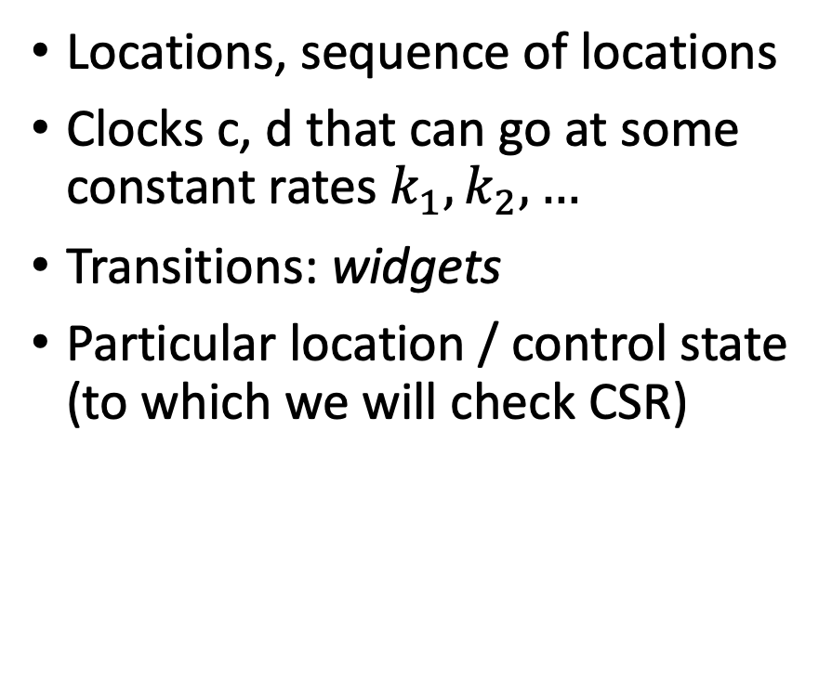
Reduction from 2CM to CSR-RHS
Program counter pc
Counters C, D
Instructions (program)
Halting location
Locations, sequence of locations
Clocks c, d that can go at some constant rates $k_{1},k_{2},…$
Transitions: widgets
Particular location / control state (to which we will check CSR)

Slide 11
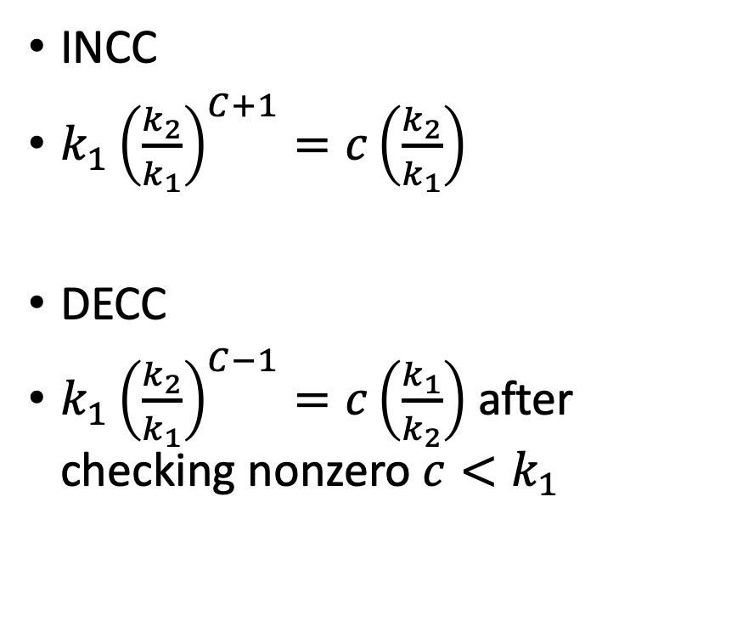

Idea of reduction (an RHA compiler)
Two clocks
$c =k_{1}{\left(\frac{k_{2}}{k_{1}}\right)}^{C}$
d$=k_{1}{\left(\frac{k_{2}}{k_{1}}\right)}^{D}$
INCC
$k_{1}{\left(\frac{k_{2}}{k_{1}}\right)}^{C+1}=c\left(\frac{k_{2}}{k_{1}}\right)$
DECC
$k_{1}{\left(\frac{k_{2}}{k_{1}}\right)}^{C−1}=c\left(\frac{k_{1}}{k_{2}}\right)$ after checking nonzero $c<k_{1}$

Slide 12
A widget that preserves the value of clock c

Slide 13
A widget for checking JNZC (c < k_1)

Slide 14
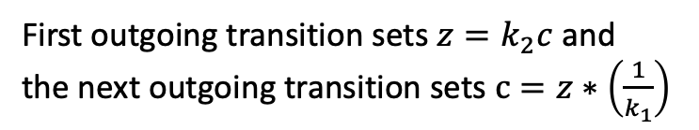
A widget implementing INCC
First outgoing transition sets $z=k_{2}c$ and
the next outgoing transition sets $c=z∗\left(\frac{1}{k_{1}}\right)$

Slide 15
Putting it all together
2 CM Halting problem decider
2CM:
INCC
INCC
DECC
JNC 1
DECC
HALT
Translator f(p)
CSR-RHA
CSR algorithm for Rectangular HA
Yes
No
Suppose CSR for RHA is decidable
If we can construct a reduction from 2CM Halting Problem to CSR for RHA then 2CM Halting problem is also decidable
Theorem: CSR for RHA is undecidable

