Slide 1
Modeling Computation
Sayan Mitra
Verifying cyberphysical systems
mitras@illinois.edu

Slide 2
Automata or discrete transition systems
The “state” of a system captures all the information needed to predict the system’s future behavior
Behavior of a system is a sequence of states
Our ultimate goal: write programs that prove properties about all behaviors of a system
“Transitions” capture how the state can change

Slide 3
All models are wrong, some are useful
The complete state of a computing system has a lot of information
values of program variables, network messages, position of the program counter, bits in the CPU registers, etc.
thus, modeling requires judgment about what is important and what is not
Mathematical formalism used is called automaton a.k.a. discrete transition system

Slide 4
Example: Dijkstra’s mutual exclusion algorithm
Informal Description A token-based mutual exclusion algorithm on a ring network
Collection of processes that send and receive bits over a ring network so that only one of them has a “token” to access a critical resource (e.g., a shared calendar)
Discrete model
Each process has variables that take only discrete values
Time elapses in discrete steps
﻿Self-stabilizing Systems in Spite of Distributed Control, CACM, 1974.

Slide 5
Token-based mutual exclusion in unidirectional ring
Legal configuration
Illegal
N processes with ids 0, 1, …, N-1
Unidirectional means: each i>0 process P_{i} reads the state of only the predecessor P_{i-1;} P₀ reads only P_{N-1}
Legal configuration = exactly one “token” in the ring
Single token circulates in the ring
Even if multiple tokens arise because of faults, if the algorithm continues to work correctly, then eventually there is a single token; this is the self stabilizing property

Slide 6
Dijkstra’s Algorithm [‘74]
N processes: 0, 1, …, N-1
state of each process j is a single integer variable x[j] ∈ {0, 1, 2, K-1}, where K > N
P₀ if x[0] = x[N-1] then x[0] := x[0] + 1 mod K
P_{j} j > 0 if x[j] ≠ x[j -1] then x[j] := x[j-1]
(p_{i} has TOKEN if and only if the blue conditional is true)

Slide 7
Sample executions: from a legal state (single token)
…
…
…
…

Slide 8
Execution from an illegal state
Legal in single “step”
Legal in two steps

Slide 9
A language for specifying automata
automaton DijkstraTR(N:Nat, K:Nat), where K > N
type ID: enumeration [0,...,N-1]
type Val: enumeration [0,...,K]
actions
update(i:ID)
variables
x:[ID -> K]
transitions
update(i:ID) where i = 0
pre i = 0 /\ x[i] = x[(i-1)]
eff x[i] := (x[i] + 1) % K
update(i:ID)$ where
pre i >0 /\ x[i] ~= x[i-1]
eff x[i] := x[i-1]

Slide 10
A language for specifying automata
automaton DijkstraTR(N:Nat, K:Nat), where K > N
type ID: enumeration [0,...,N-1]
type Val: enumeration [0,...,K]
actions
update(i:ID)
variables
x:[ID -> K]
transitions
update(i:ID) where i = 0
pre i = 0 /\ x[i] = x[(i-1)]
eff x[i] := (x[i] + 1) % K
update(i:ID)$ where
pre i >0 /\ x[i] ~= x[i-1]
eff x[i] := x[i-1]
Name of automaton and formal parameters
symbols -> maps, /\ and, \/ or, ~= not equal, % mod

Slide 11
A language for specifying automata
automaton DijkstraTR(N:Nat, K:Nat), where K > N
type ID: enumeration [0,...,N-1]
type Val: enumeration [0,...,K]
actions
update(i:ID)
variables
x:[ID -> Val]
transitions
update(i:ID) where i = 0
pre i = 0 /\ x[i] = x[(i-1)]
eff x[i] := (x[i] + 1) % K
update(i:ID)$ where
pre i >0 /\ x[i] ~= x[i-1]
eff x[i] := x[i-1]
user defined type declarations
symbols -> maps, /\ and, \/ or, ~= not equal, % mod

Slide 12
A language for specifying automata
automaton DijkstraTR(N:Nat, K:Nat), where K > N
type ID: enumeration [0,...,N-1]
type Val: enumeration [0,...,K]
actions
update(i:ID)
variables
x:[ID -> Val]
transitions
update(i:ID) where i = 0
pre i = 0 /\ x[i] = x[(i-1)]
eff x[i] := (x[i] + 1) % K
update(i:ID)$ where
pre i >0 /\ x[i] ~= x[i-1]
eff x[i] := x[i-1]
declaration of “actions” or transition labels; actions can have parameter; this declares the actions update(0), update(1), …, update(N-1)
symbols -> maps, /\ and, \/ or, ~= not equal, % mod

Slide 13
A language for specifying automata
automaton DijkstraTR(N:Nat, K:Nat), where K > N
type ID: enumeration [0,...,N-1]
type Val: enumeration [0,...,K]
actions
update(i:ID)
variables
x:[ID -> Val]
transitions
update(i:ID) where i = 0
pre i = 0 /\ x[i] = x[(i-1)]
eff x[i] := (x[i] + 1) % K
update(i:ID)$ where
pre i >0 /\ x[i] ~= x[i-1]
eff x[i] := x[i-1]
declaration of state variables or variables; this declares an array x[0], x[1], …, x[N-1] of Val’s
symbols -> maps, /\ and, \/ or, ~= not equal, % mod

Slide 14
A language for specifying automata
automaton DijkstraTR(N:Nat, K:Nat), where K > N
type ID: enumeration [0,...,N-1]
type Val: enumeration [0,...,K]
actions
update(i:ID)
variables
x:[ID -> Val]
transitions
update(i:ID) where i = 0
pre i = 0 /\ x[i] = x[(i-1)]
eff x[i] := (x[i] + 1) % K
update(i:ID)$ where
pre i >0 /\ x[i] ~= x[i-1]
eff x[i] := x[i-1]
declaration of transitions: for each action this defines when the action can occur (pre) and how the state is updated when the action does occur (eff)
symbols -> maps, /\ and, \/ or, ~= not equal, % mod

Slide 15
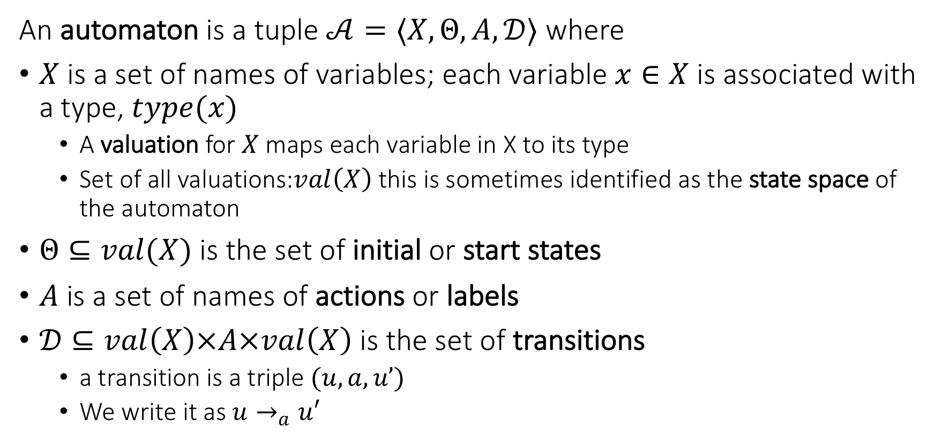
The language defines an automaton
An automaton is a tuple $𝒜=〈X,Θ, A, 𝒟〉$ where
$X$ is a set of names of variables; each variable $x∈X$is associated with a type, $type(x)$
A valuation for $X$ maps each variable in X to its type
Set of all valuations:$val\left(X\right)$ this is sometimes identified as the state space of the automaton
$Θ⊆val(X)$ is the set of initial or start states
$A$ is a set of names of actions or labels
$𝒟⊆val\left(X\right)×A×val\left(X\right)$ is the set of transitions
a transition is a triple $(u,a,u’)$
We write it as $u→_{a}u′$

Slide 16
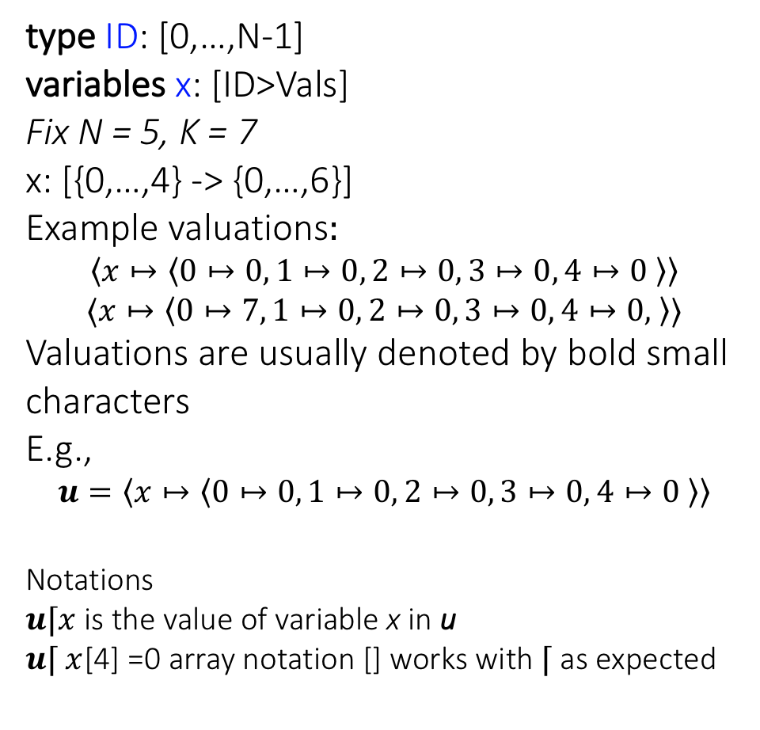
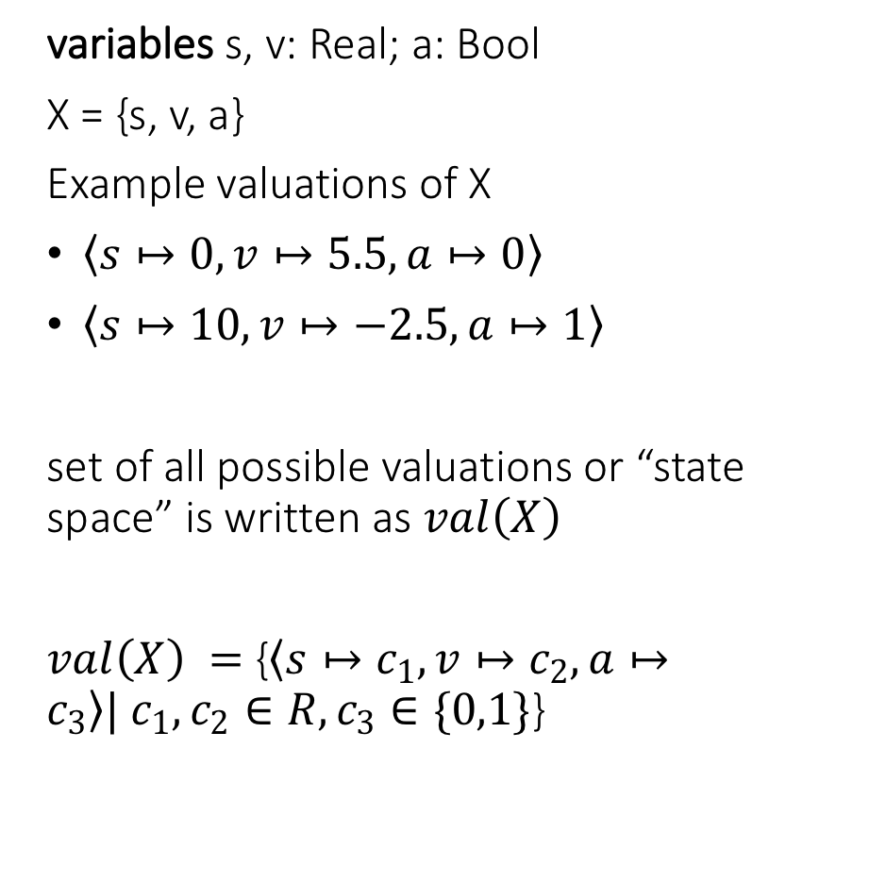
Well formed specifications in IOA Language define automata variables and valuations
type ID: [0,…,N-1]
variables x: [ID>Vals]
Fix N = 5, K = 7
x: [{0,…,4} -> {0,…,6}]
Example valuations$:$
$$〈x↦〈0↦0, 1↦0, 2↦0, 3↦0, 4↦0 〉〉$$
$$〈x↦〈0↦7, 1↦0, 2↦0, 3↦0, 4↦0, 〉〉$$
Valuations are usually denoted by bold small characters
E.g.,
$$u=〈x↦〈0↦0, 1↦0, 2↦0, 3↦0, 4↦0 〉〉$$
Notations
$u⌈x$ is the value of variable x in u
$u⌈ x$[4] =0 array notation [] works with $⌈$ as expected
variables s, v: Real; a: Bool
X = {s, v, a}
Example valuations of X
$〈s↦0, v↦5.5, a↦0〉$
$〈s↦10, v↦−2.5, a↦1〉$
set of all possible valuations or “state space” is written as $val\left(X\right)$
$val\left(X\right) =${$〈s↦c_{1}, v↦c_{2}, a↦c_{3}〉| c_{1},c_{2}∈R, c_{3}∈\{0,1\}$}

Slide 17
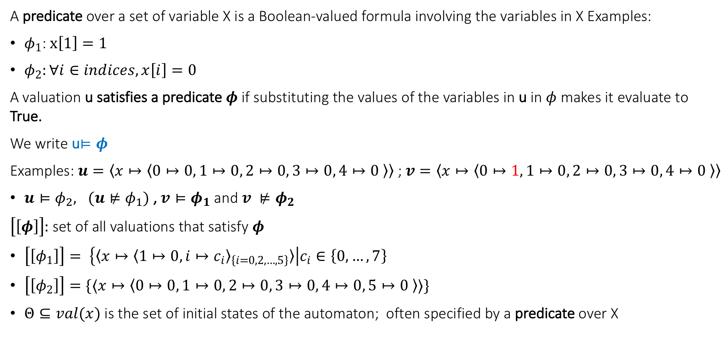
States and predicates
A predicate over a set of variable X is a Boolean-valued formula involving the variables in X Examples:
$φ_{1}$: $x\left[1\right]=1$
$φ_{2}:∀i∈indices, x\left[i\right]=0$
A valuation u satisfies a predicate $φ$ if substituting the values of the variables in u in $φ$ makes it evaluate to True.
We write u$⊨φ$
Examples: $u=〈x↦〈0↦0, 1↦0, 2↦0, 3↦0, 4↦0 〉〉$ ; $v=〈x↦〈0↦1, 1↦0, 2↦0, 3↦0, 4↦0 〉〉$
$u⊨φ_{2}, (u⊭φ_{1})$, $v⊨φ_{1}$ and $v ⊭φ_{2}$
$\left[\left[φ\right]\right]:$ set of all valuations that satisfy $φ$
$\left[\left[φ_{1}\right]\right]= \left\{〈x↦{〈1↦0, i↦c_{i}〉}_{\left\{i=0,2,…,5\right\}}〉\right|c_{i}∈\left\{0,…,7\right\}$
$\left[\left[φ_{2}\right]\right]=\{〈x↦〈0↦0, 1↦0, 2↦0, 3↦0, 4↦0, 5↦0 〉〉\}$
$Θ⊆val(x)$ is the set of initial states of the automaton; often specified by a predicate over X

Slide 18
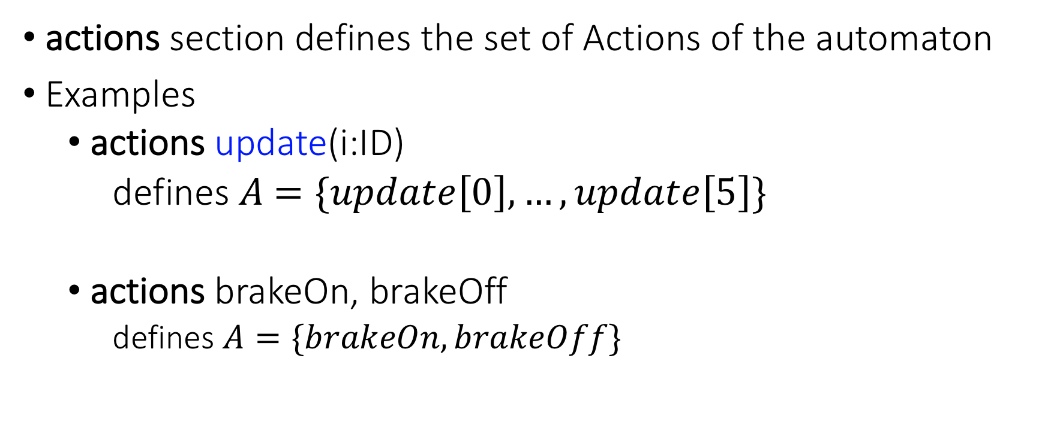
Actions
actions section defines the set of Actions of the automaton
Examples
actions update(i:ID)
defines $A$ $=\{update\left[0\right],…,update\left[5\right]\}$
actions brakeOn, brakeOff
defines $A=\{brakeOn,brakeOff\}$

Slide 19

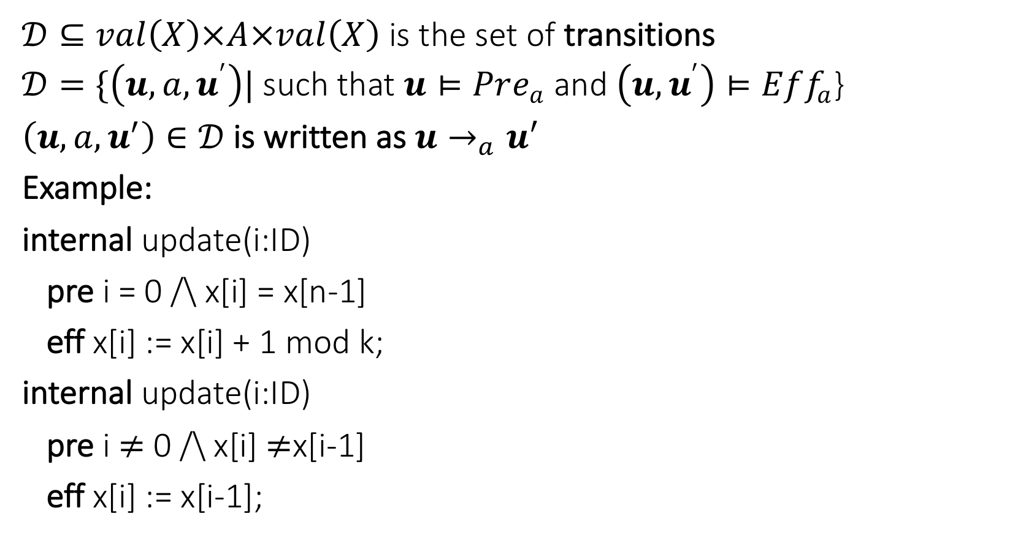
Transitions defined by preconditions and effects
$𝒟⊆val\left(X\right)×A×val\left(X\right)$ is the set of transitions
$𝒟=\{\left(u,a,u^{′}\right)|$such that $u⊨Pre_{a}$ and $\left(u,u^{′}\right)⊨Eff_{a}$}
$\left(u,a,u^{′}\right)∈𝒟$is written as $u→_{a}u′$
Example:
internal update(i:ID)
pre i = 0 /\ x[i] = x[n-1]
eff x[i] := x[i] + 1 mod k;
internal update(i:ID)
pre i $≠$ 0 /\ x[i] $≠$x[i-1]
eff x[i] := x[i-1];
$\left(u,update\left(i\right),u^{′}\right)∈𝒟$ iff
(a) $(i=0∧u⌈ x\left[0\right]=u⌈x\left[5\right]$
$∧u^{′}⌈x\left[0\right]=u ⌈x[0]+1 mod K$) $∨$
(b) ($i≠0∧u ⌈x\left[i\right]≠u ⌈x\left[i−1\right]$
$∧u^{′} ⌈x\left[i\right]=u⌈x[i−1]$)

Slide 20
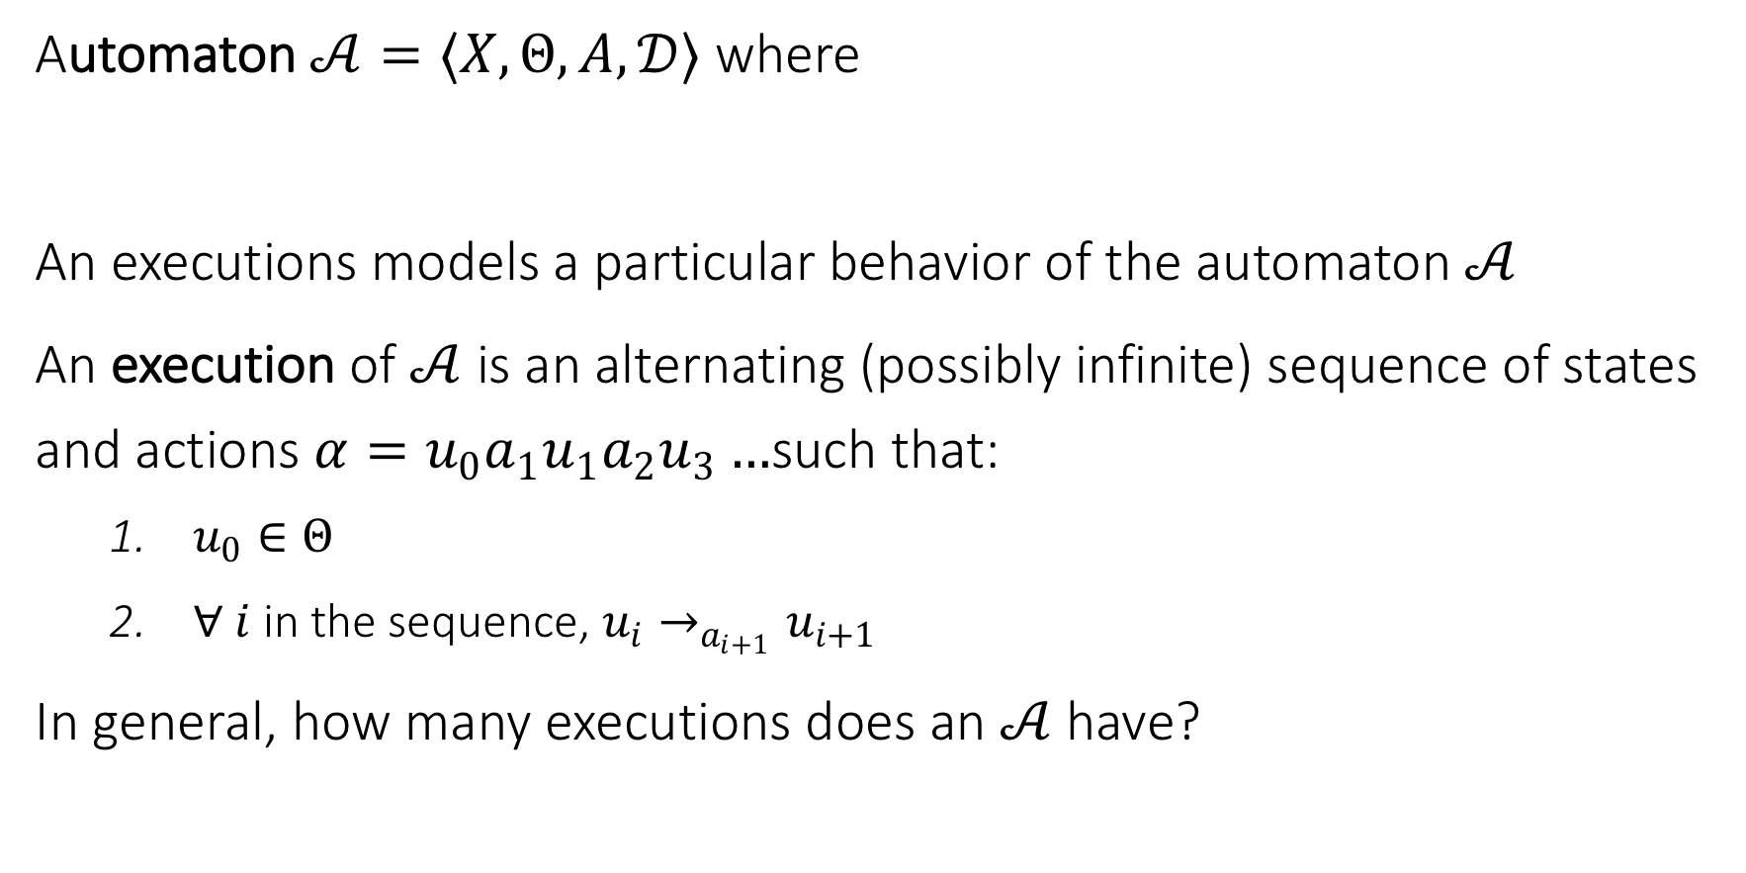
Executions, Reachability, and Invariants
Automaton $𝒜=〈X,Θ, A, 𝒟〉$ where
An executions models a particular behavior of the automaton $𝒜$
An execution of $𝒜$ is an alternating (possibly infinite) sequence of states and actions $α=u_{0}a_{1}u_{1}a_{2}u_{3}…$such that:
$u_{0}∈Θ$
$∀ i$in the sequence, $u_{i}→_{a_{i+1}}u_{i+1}$
In general, how many executions does an $𝒜$have?

Slide 21
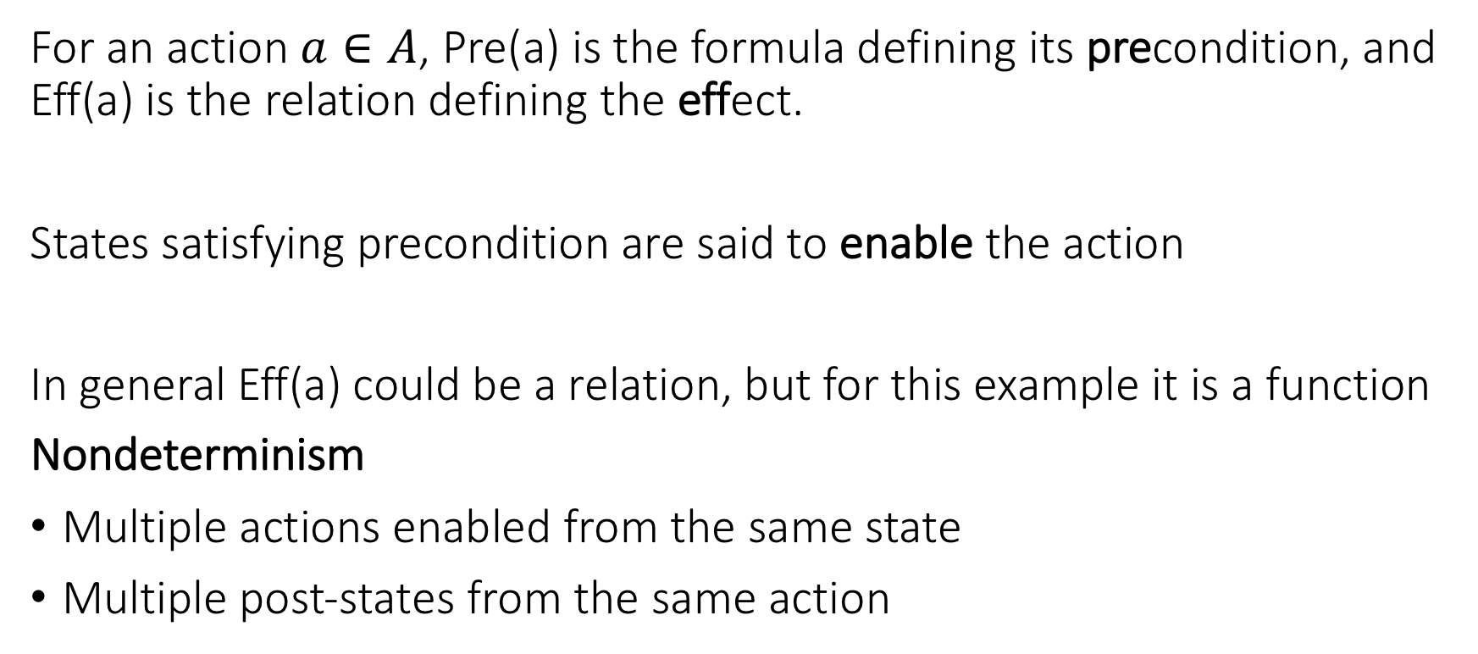
Nondeterminism
For an action $a∈A$, Pre(a) is the formula defining its precondition, and Eff(a) is the relation defining the effect.
States satisfying precondition are said to enable the action
In general Eff(a) could be a relation, but for this example it is a function
Nondeterminism
Multiple actions enabled from the same state
Multiple post-states from the same action

Slide 22
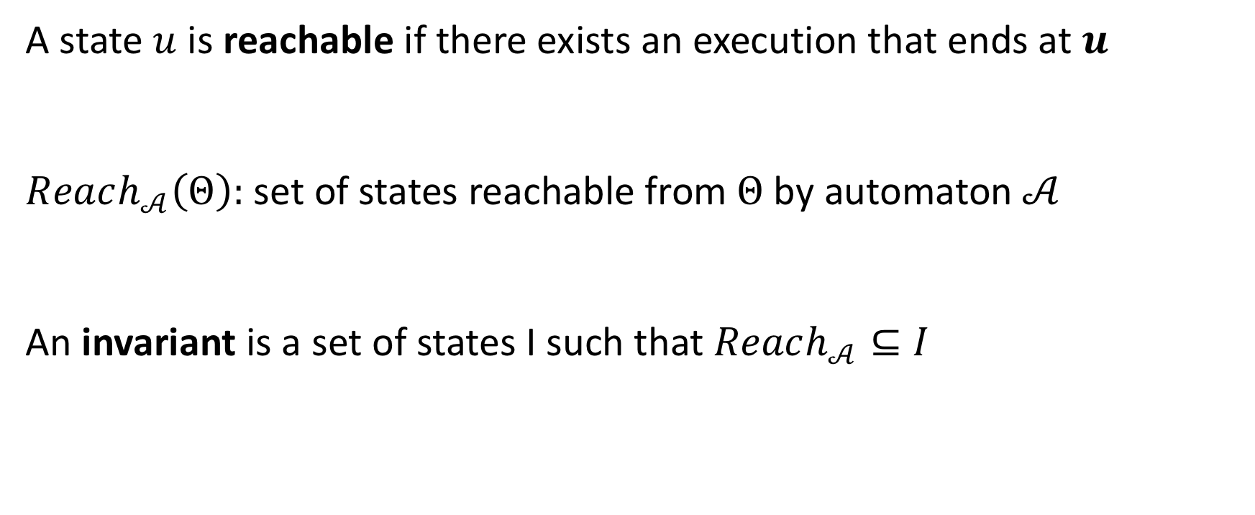
Reachable states and invariants
A state $u$ is reachable if there exists an execution that ends at $u$
$Reach_{𝒜}\left(Θ\right):$ set of states reachable from $Θ$ by automaton $𝒜$
An invariant is a set of states I such that $Reach_{𝒜}⊆I$

Slide 23




Candidate invariants for token Ring
val(X): All states = $I_{3}$
$I_{1}$: “Exactly one process has the token”.
$I_{≥1}$: “At least one process has a token”.
$I_{3}$: “All processes have values at most K-1”.
$$I_{1}$$
$$u_{0}$$

Slide 24
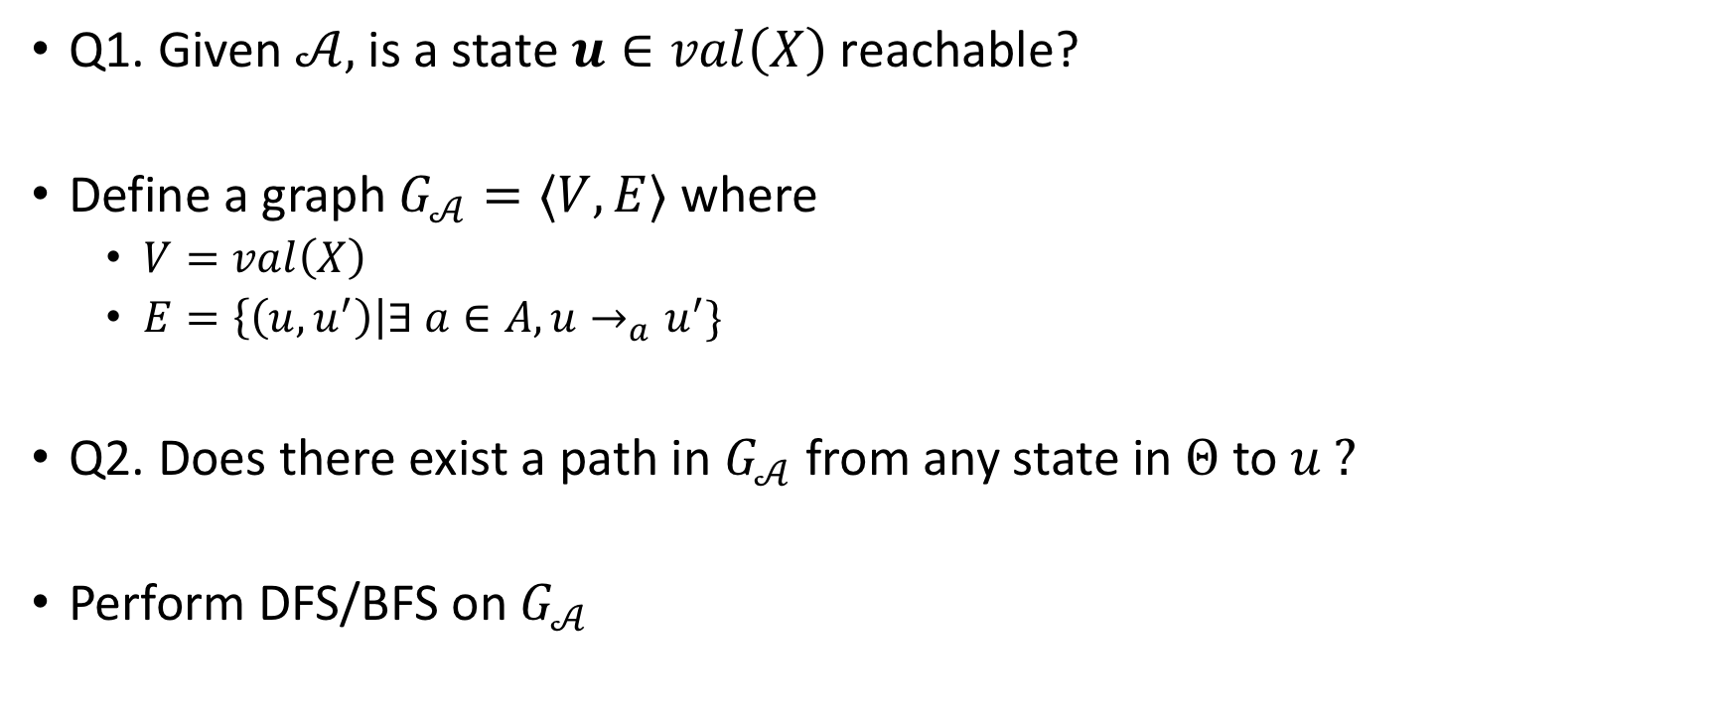
Reachability as graph search
Q1. Given $𝒜,$is a state $u∈val\left(X\right)$ reachable?
Define a graph $G_{𝒜}=〈V,E〉$ where
$V=val\left(X\right)$
$E=\left\{\left(u,u^{′}\right)\right|∃ a∈A, u→_{a}u^{′}\}$
Q2. Does there exist a path in $G_{𝒜}$ from any state in $Θ$ to $u ?$
Perform DFS/BFS on $G_{𝒜}$

Slide 25
Reach as fixpoint of Post?

Slide 26
Importance of Invariants

Slide 27

Reading Assignments
Modeling computation: Chapter 2 of CPSBook
Specification language: Appendix C of CPSBook
Next: Overview of complexity classes for understanding hardness of different verification problems
Reading assignment: Appendix B of CPSBook
Turing Machines
Decidability
Complexity classes P, NP, PSPACE, NL
Reductions
Reference: Any standard textbook on theory of computation, e.g., Introduction to Theory of Computation by Michael Sipser

