Slide 1
CTL Model Checking
Sayan Mitra
Verifying cyberphysical systems
mitras@illinois.edu

Slide 2


This lecture: Requirements
System. A program/system for lane keeping control for vehicles
counterexample. A particular environment situation (lane geometry, sensor failure, computer configuration) that makes the vehicle go outside lanes
Model/assumptions: automaton, ODEs, hybrid automata
System Model/Code & Property
Algorithm
or Method
Bug trace
Requirement. The vehicle does not go outside the lane boundaries
Perception
Controller program
$$u$$
$$\dot{x}=f\left(x, u\right)$$
Proof Certificate
A mathematical proof that establishes that for all allowed inputs and environments the vehicle stays with the lane
Environment
/ Track
$$x$$
Verification tool
When can we build such a tool? How expensive is it? How well is it going to work? Under what assumptions?

Slide 3
Requirements and safety in the real world
Requirements analysis: Set of tasks that ultimately lead to the determination and documentation of the design requirements that the product must meet:
E.g. “0 to 60 mph in 4 seconds on flat road”,
“Petrol car can emit no more than 60mg/km” EURO 6.
Safety standards: Provide guidelines and processes for developing safety-critical systems.
E.g. DO-178C standard is enforced by the FAA for certifying aviation software
ISO2626 is used for functional safety of cars
Standards for Advanced Autonomous and AI-enabled systems are being developed

Slide 4
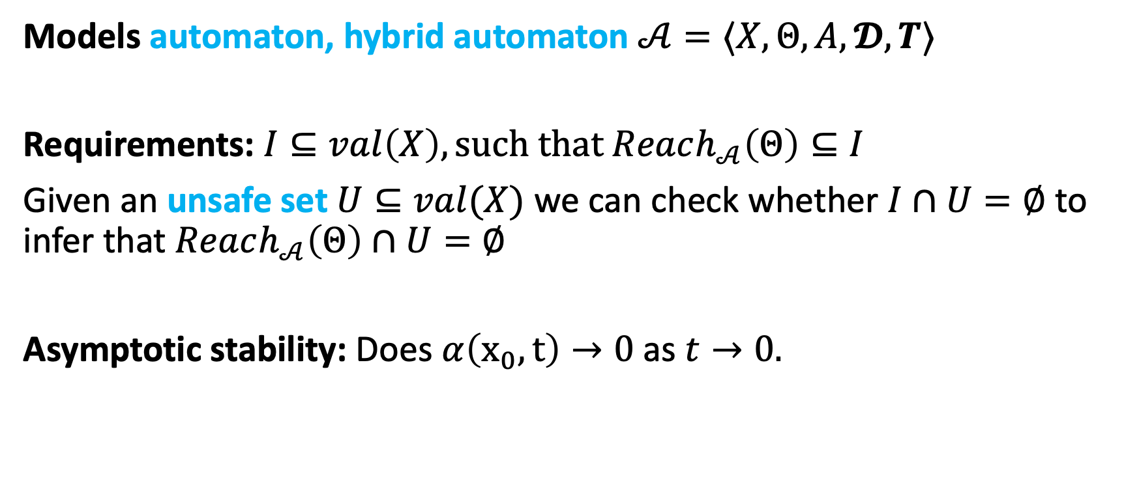
Requirements thus far: Invariants and stability
Models automaton, hybrid automaton $𝒜=〈X,Θ, A, 𝓓,T〉$
Requirements: $I⊆val\left(X\right), such that Reach_{𝒜}\left(Θ\right)⊆I$
Given an unsafe set $U⊆val(X)$ we can check whether $I∩U=∅$ to infer that $Reach_{𝒜}\left(Θ\right)∩U=∅$
Asymptotic stability: Does $α\left(x_{0},t\right)→0$as $t→0.$

Slide 5
What about more general types of requirements, e.g.,
“Eventually the light turns red and prior to that the orange light blinks”
“After failures, eventually there is just one token in the system”
How to express and verify such properties?

Slide 6
Outline
Temporal logics
Computational Tree Logic (CTL)
CTL model checking for automata
Setup
CTL syntax and semantics
Model checking algorithms
Example
References: Model Checking, Second Edition, by Edmund M. Clarke, Jr., Orna Grumberg, Daniel Kroening, Doron Peled and Helmut Veith
Principles of Model Checking, by Christel Baier and Joost-Pieter Katoen

Slide 7
Introduction to temporal logics
Temporal logics: Formal language for representing, and reasoning about, propositions qualified in terms of a sequence
Amir Pnueli received the ACM Turing Award (1996) for seminal work introducing temporal logic into computer science and for outstanding contributions to program verification.
Large follow-up literature, e.g., different temporal logics MTL, MITL, PCTL, ACTL, STL, applications in synthesis and monitoring
Notes:
Bachelor's degree in mathematics from the Technion in Haifa, and Ph.D. in applied mathematics from the Weizmann Institute of Science. His thesis was on the topic of "Calculation of Tides in the Ocean".

Slide 8
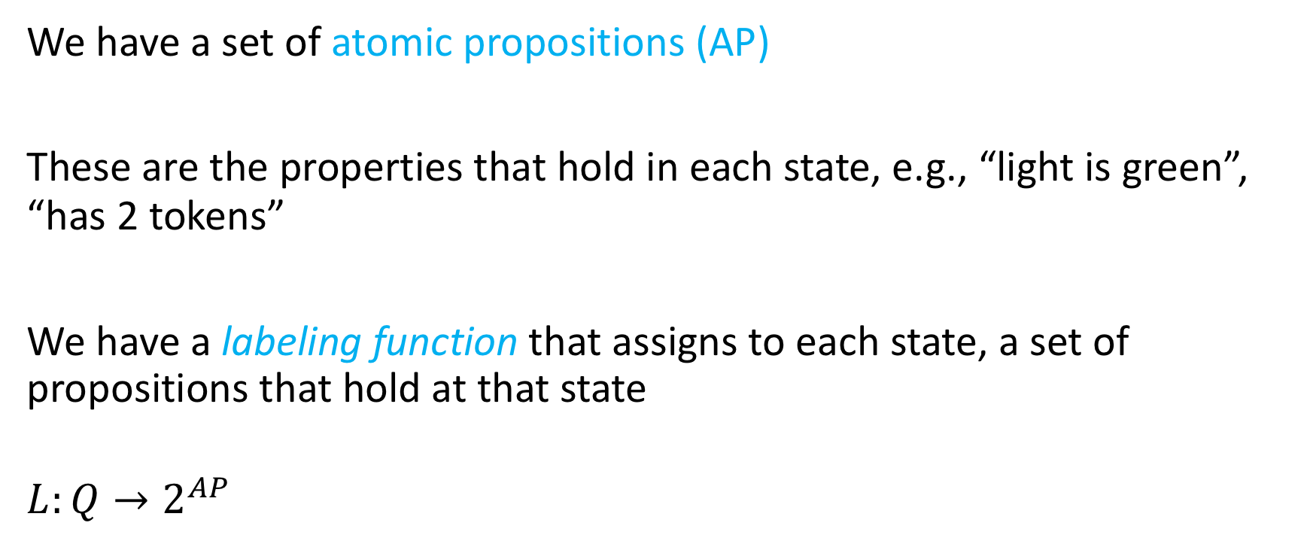
Setup: States are labeled
We have a set of atomic propositions (AP)
These are the properties that hold in each state, e.g., “light is green”, “has 2 tokens”
We have a labeling function that assigns to each state, a set of propositions that hold at that state
$$L:Q→2^{AP}$$

Slide 9

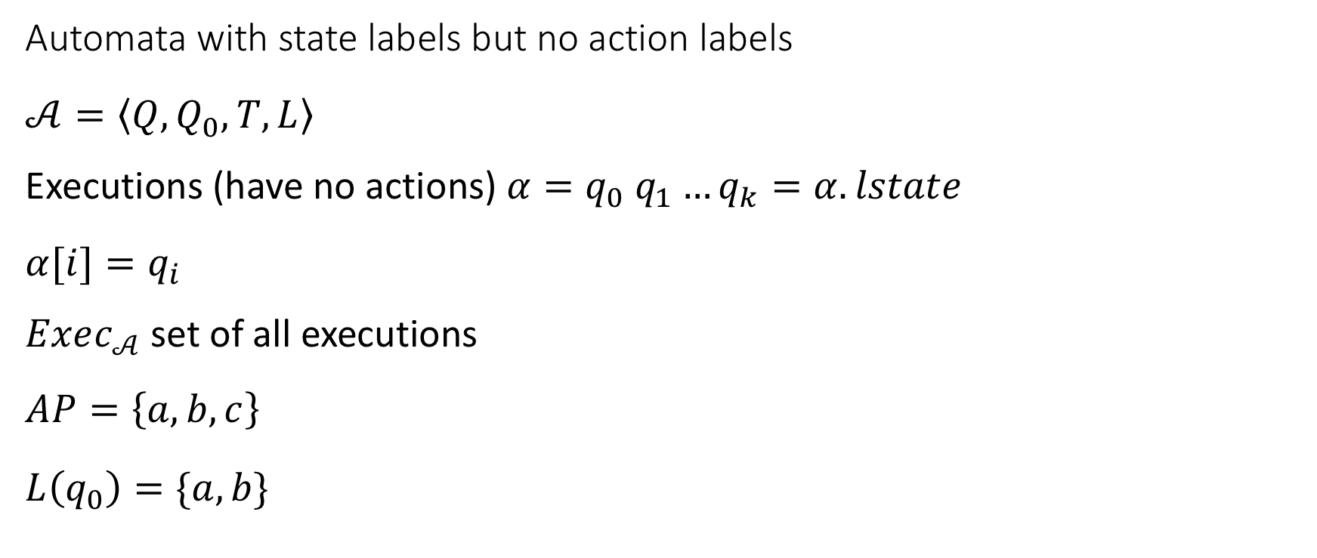


Notations
Automata with state labels but no action labels
$$𝒜=\left\langle Q,Q_{0},T,L\right\rangle$$
Executions (have no actions) $α=q_{0} q_{1}…q_{k}=α.lstate$
$$α[i]=q_{i}$$
$Exec_{𝒜}$ set of all executions
$$AP=\left\{a,b,c\right\}$$
$$L\left(q_{0}\right)=\{a,b\}$$
$$q_{0}$$
$$\{a,b\}$$
$$q_{1}$$
$$\{b,c\}$$
$$q_{2}$$
$$\{c\}$$

Slide 10
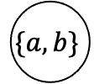

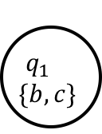


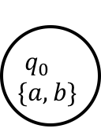
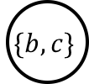
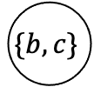


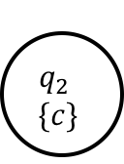


Computational tree logic (CTL)
$$q_{0}$$
$$\{a,b\}$$
Unfolding the automaton
We get a tree
A CTL formula allows us to specify subsets of paths in this tree
$$q_{1}$$
$$\{b,c\}$$
$$q_{2}$$
$$\{c\}$$
$$\{a,b\}$$
$$\{b,c\}$$
$$\{c\}$$
$$\{a,b\}$$
$$\{c\}$$
$$\{c\}$$
$$\{b,c\}$$
$$\{c\}$$
$$\{c\}$$
$$\{c\}$$

Slide 11
CTL quantifiers
Path quantifiers
E: Exists some path
A: All paths
Temporal operators
X: Next state
U: Until
F: Eventually
G: Globally (Always)

Slide 12
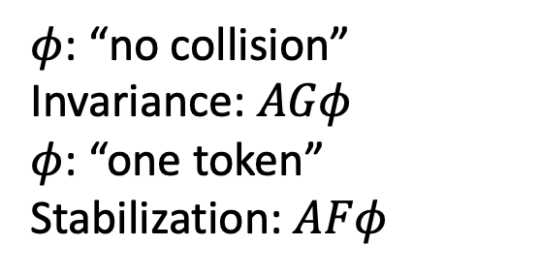
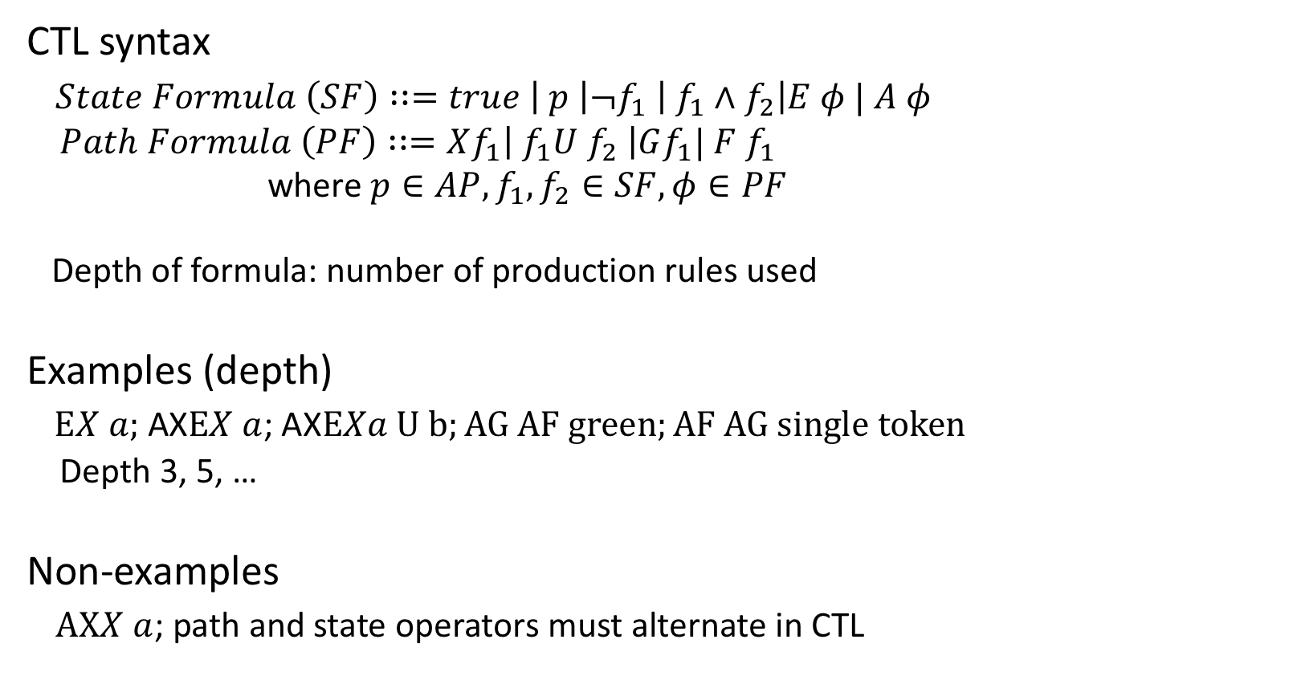
CTL syntax
CTL syntax
$State Formula \left(SF\right)∷=true \left| p \right|¬f_{1} \left| f_{1}∧f_{2}\right|E φ | A φ$
$Path Formula \left(PF\right)∷=Xf_{1}\left| f_{1}U f_{2} \right|Gf_{1}| F f_{1}$
where $p∈AP, f_{1},f_{2}∈SF, φ∈PF$
Depth of formula: number of production rules used
Examples (depth)
$EX a;$ AX$EX a$; AX$EXa U b;AG AF green;AF AG single token$
Depth 3, 5, …
Non-examples
$AXX a$; path and state operators must alternate in CTL
$φ$: “no collision”
Invariance: $AGφ$
$φ$: “one token”
Stabilization: $AFφ$

Slide 13
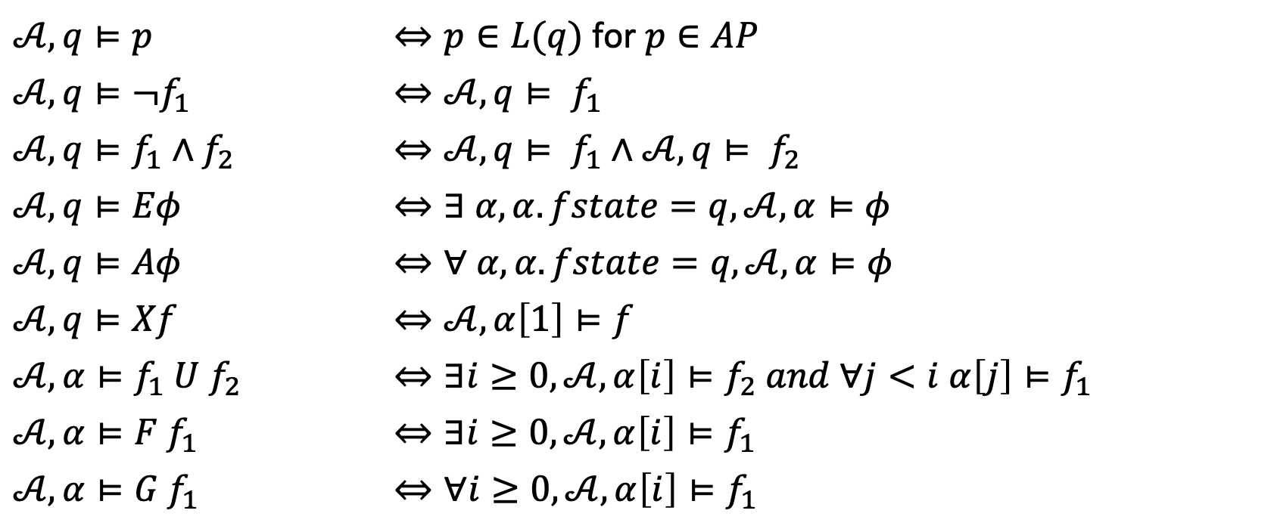

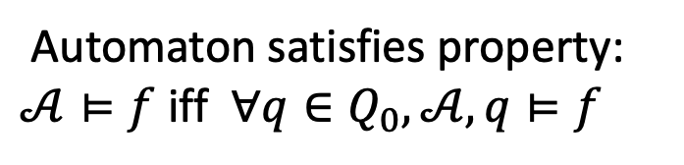
CTL semantics
Automaton $𝒜=〈Q,Q_{0}, T,L〉, q∈Q$ and a CTL formula $φ, q⊨φ$ denotes that $q$ satisfies $φ;$ $α⊨φ$ denotes that path (execution) $α$ satisfies $φ; ⊨$ is defined inductively as:
$𝒜,q⊨p$ | $⇔p∈L(q)$ for $p∈AP$
$𝒜,q⊨¬f_{1}$ | $$⇔𝒜,q⊨ f_{1}$$
$𝒜,q⊨f_{1}∧f_{2}$ | $$⇔𝒜,q⊨ f_{1}∧𝒜,q⊨ f_{2}$$
$$𝒜,q⊨Eφ$$ | $$⇔∃ α, α.fstate=q, 𝒜,α⊨φ$$
$$𝒜,q⊨Aφ$$ | $$⇔∀ α, α.fstate=q, 𝒜,α⊨φ$$
$$𝒜,q⊨Xf$$ | $$⇔𝒜,α\left[1\right]⊨f$$
$$𝒜,α⊨f_{1} U f_{2}$$ | $⇔∃i≥0, 𝒜,α\left[i\right]⊨f_{2} and ∀j<i α\left[j\right]⊨f_{1}$
$$𝒜,α⊨F f_{1}$$ | $$⇔∃i≥0, 𝒜,α\left[i\right]⊨f_{1}$$
$$𝒜,α⊨G f_{1}$$ | $$⇔∀i≥0, 𝒜,α\left[i\right]⊨f_{1}$$
Automaton satisfies property: $𝒜⊨f$ iff $∀q∈Q_{0},𝒜, q⊨f$

Slide 14
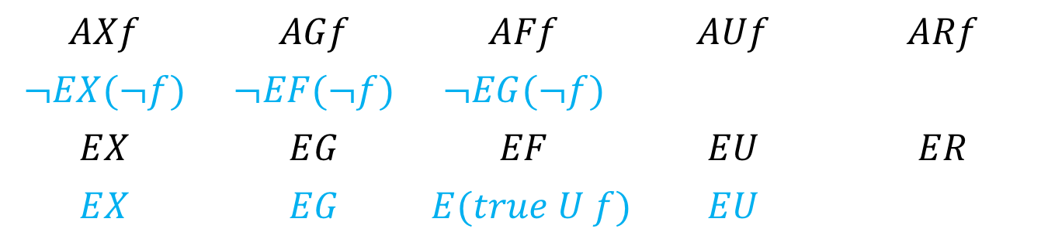
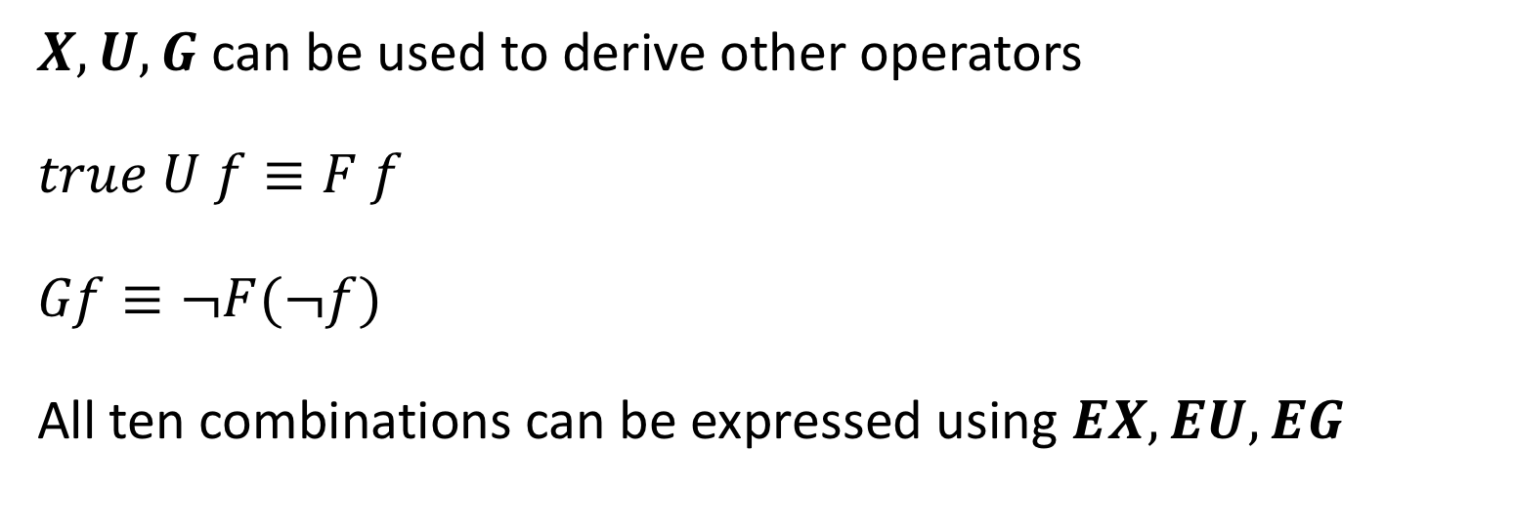
Universal CTL operators
$X,U, G$ can be used to derive other operators
$$true U f≡F f$$
$$Gf≡¬F(¬f)$$
All ten combinations can be expressed using $EX, EU, EG$
$$AXf$$ | $$AGf$$ | $$AFf$$ | $$AUf$$ | $$ARf$$
$$¬EX(¬f)$$ | $$¬EF(¬f)$$ | $$¬EG(¬f)$$
$$EX$$ | $$EG$$ | $$EF$$ | $$EU$$ | $$ER$$
$$EX$$ | $$EG$$ | $$E(true U f)$$ | $$EU$$

Slide 15








Visualizing semantics
$$q$$
$$q$$
$$q⊨EF red$$
$$q⊨EG red$$
$$q$$
$$q$$
$$q⊨AF red$$
$$q⊨AG red$$

Slide 16
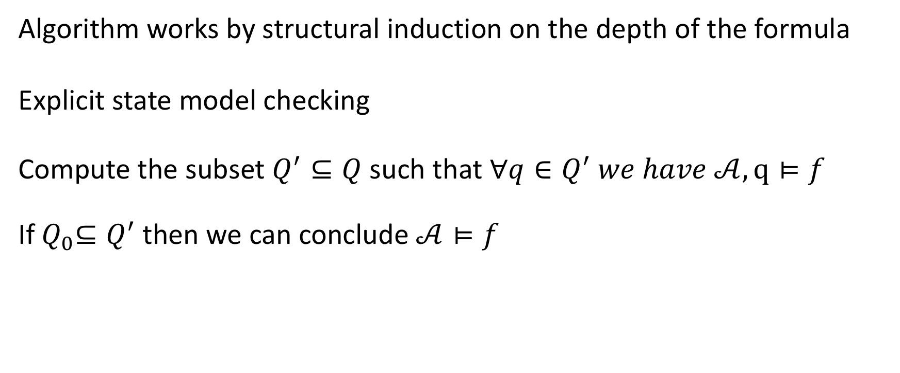

Algorithm for deciding $𝒜⊨f$
Algorithm works by structural induction on the depth of the formula
Explicit state model checking
Compute the subset $Q^{′}⊆Q$ such that $∀q∈Q^{′} we have 𝒜,q⊨f$
If${ Q}_{0}⊆Q^{′}$then we can conclude $𝒜⊨f$

Slide 17
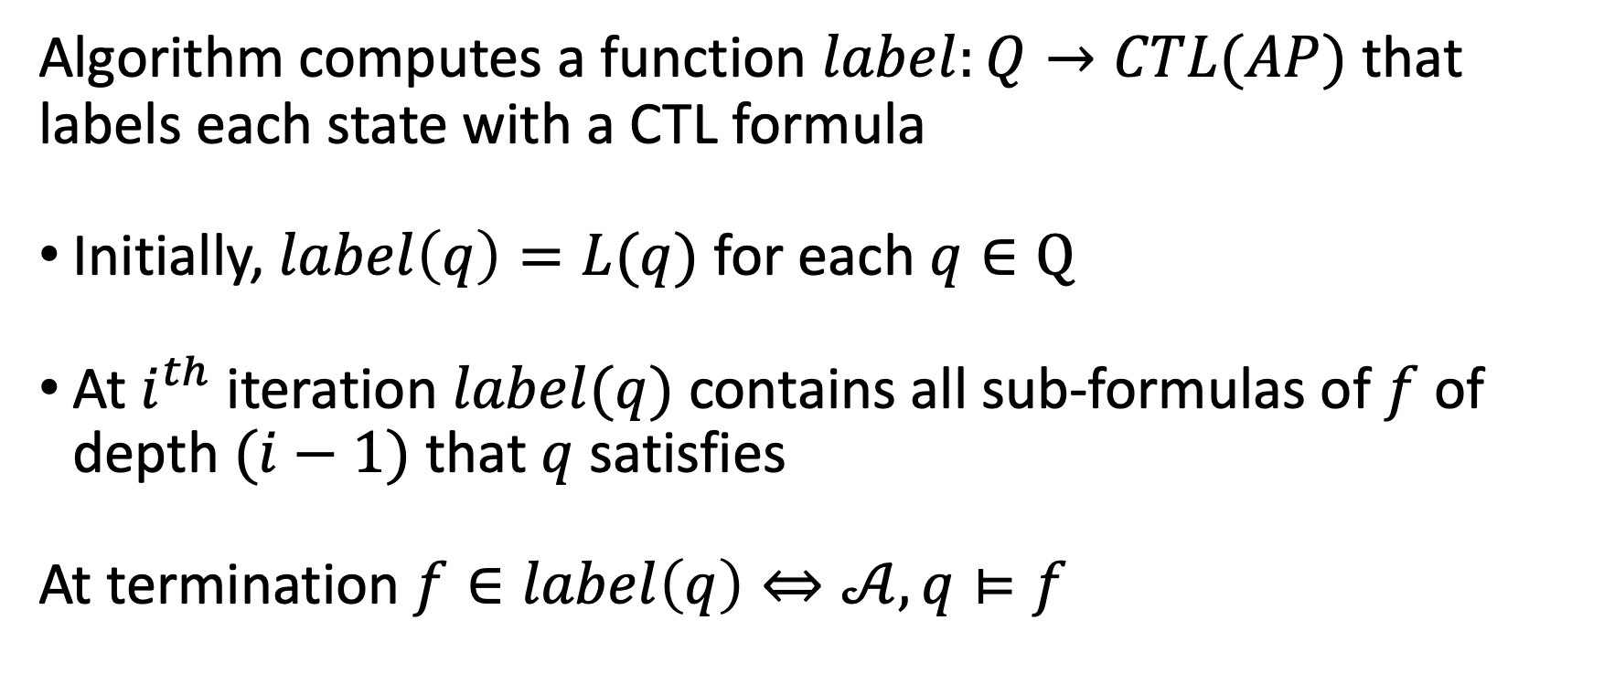
Induction on depth of formula
Algorithm computes a function $label:Q→CTL(AP)$ that labels each state with a CTL formula
Initially, $label\left(q\right)=L(q)$ for each $q∈Q$
At $i^{th}$ iteration $label(q)$ contains all sub-formulas of $f$ of depth $(i−1)$ that $q$ satisfies
At termination $f∈label\left(q\right)⇔𝒜,q⊨f$

Slide 18
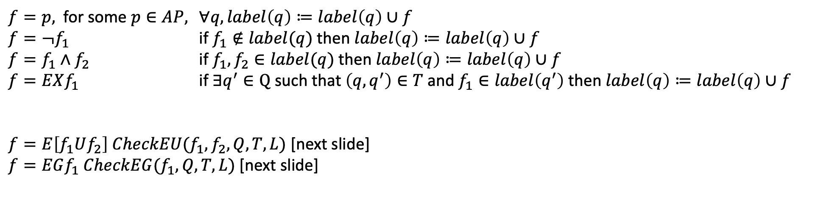

Structural induction on formula
Six cases to consider based on structure of $f$
$f=p,$ for some $p∈AP,$ $∀q, label\left(q\right)≔label\left(q\right)∪f$
$f=¬f_{1}$ if $f_{1}∉label(q)$ then $label\left(q\right)≔label\left(q\right)∪f$
$f=f_{1}∧f_{2}$ if $f_{1}, f_{2}∈label(q)$ then $label\left(q\right)≔label\left(q\right)∪f$
$f=EXf_{1}$ if$∃q^{′}∈Q$ such that $\left(q,q^{′}\right)∈T$ and $f_{1}∈label\left(q^{′}\right)$ then $label\left(q\right)≔label\left(q\right)∪f$
$f=E\left[f_{1}Uf_{2}\right] CheckEU(f_{1},f_{2},Q,T,L)$ [next slide]
$f=EGf_{1} CheckEG(f_{1}, Q,T,L)$ [next slide]

Slide 19
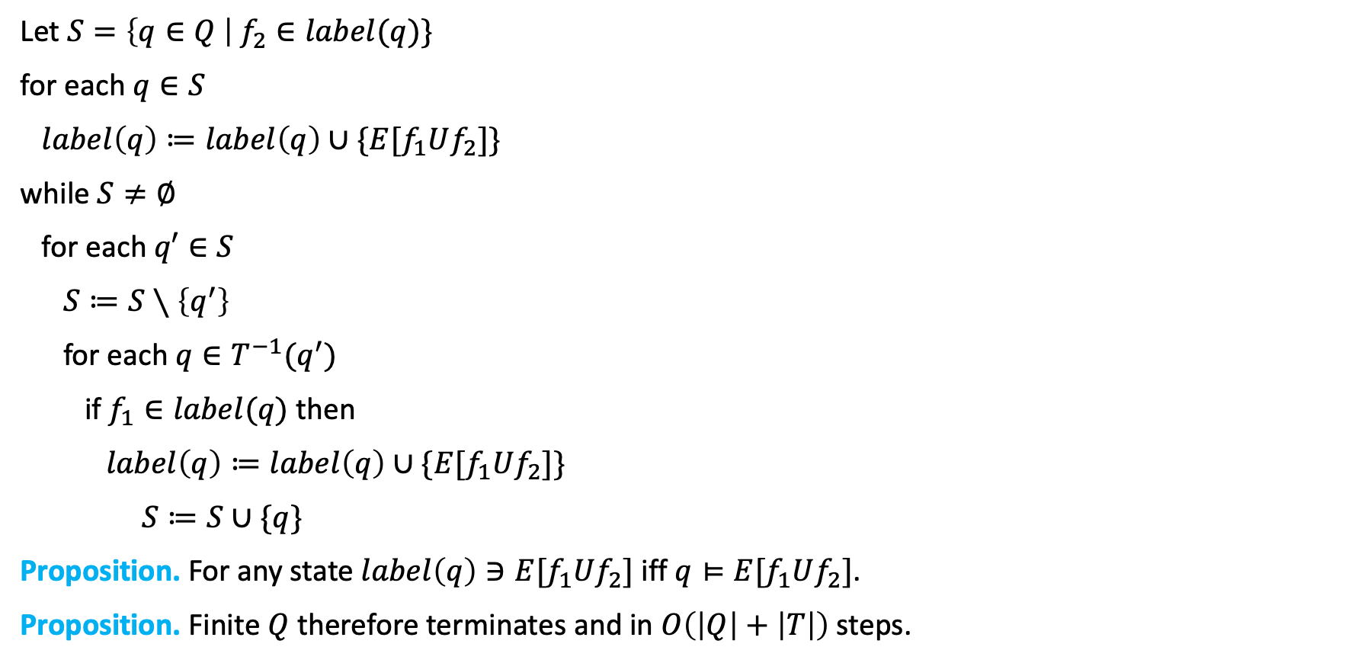
$CheckEU(f_{1},f_{2},Q,T,L)$
Let $S=\left\{q∈Q \right| f_{2}∈label(q)\}$
for each $q∈S$
$label\left(q\right)≔label\left(q\right)∪\{E[f_{1}Uf_{2}]\}$
while $S≠∅$
for each $q′∈S$
$S≔S∖\left\{q^{′}\right\}$
for each $q∈T^{−1}(q^{′})$
if $f_{1}∈label(q)$ then
$label\left(q\right)≔label\left(q\right)∪\{E[f_{1}Uf_{2}]\}$
$S≔S∪\{q\}$
Proposition. For any state $label\left(q\right)∋E[f_{1}Uf_{2}]$ iff $q⊨E[f_{1}Uf_{2}]$.
Proposition. Finite $Q$ therefore terminates and in $O\left(\left|Q\right|+\left|T\right|\right)$ steps.

Slide 20
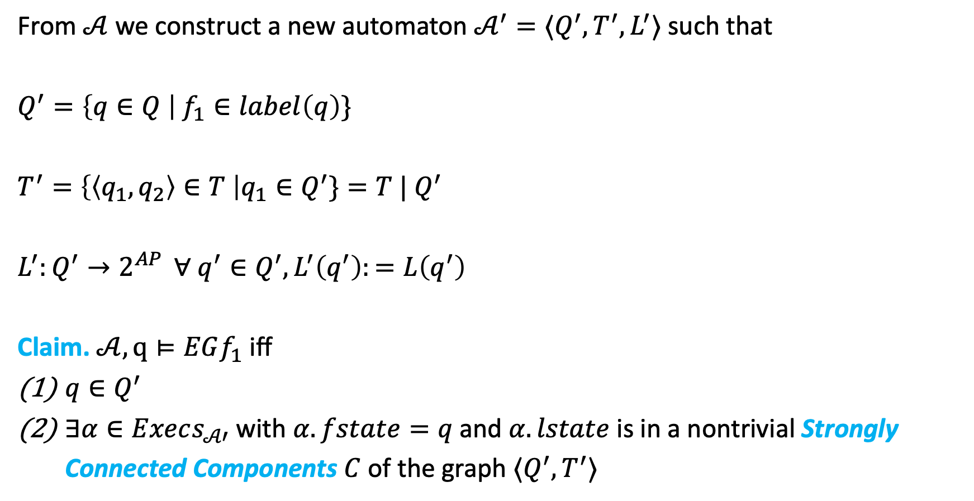
$CheckEG(f_{1}, Q,T,L)$
From $𝒜$ we construct a new automaton $𝒜^{′}=⟨Q^{′},T^{′},L^{′}⟩$ such that
$$Q^{′}=\left\{q∈Q \right| f_{1}∈label\left(q\right)\}$$
$$T^{′}=\left\{\left\langle q_{1},q_{2}\right\rangle ∈T \right|q_{1}∈Q^{′}\}=T | Q^{′}$$
$L^{′}:Q^{′}→2^{AP }$ $∀ q^{′}∈Q^{′}, L^{′}\left(q^{′}\right):=L\left(q^{′}\right)$
Claim. $𝒜,q⊨EGf_{1}$ iff
$q∈Q^{′}$
$∃α∈Execs_{𝒜′}$ with $α.fstate=q$and $α.lstate$ is in a nontrivial Strongly Connected Components $C$ of the graph $⟨Q^{′},T^{′}⟩$

Slide 21
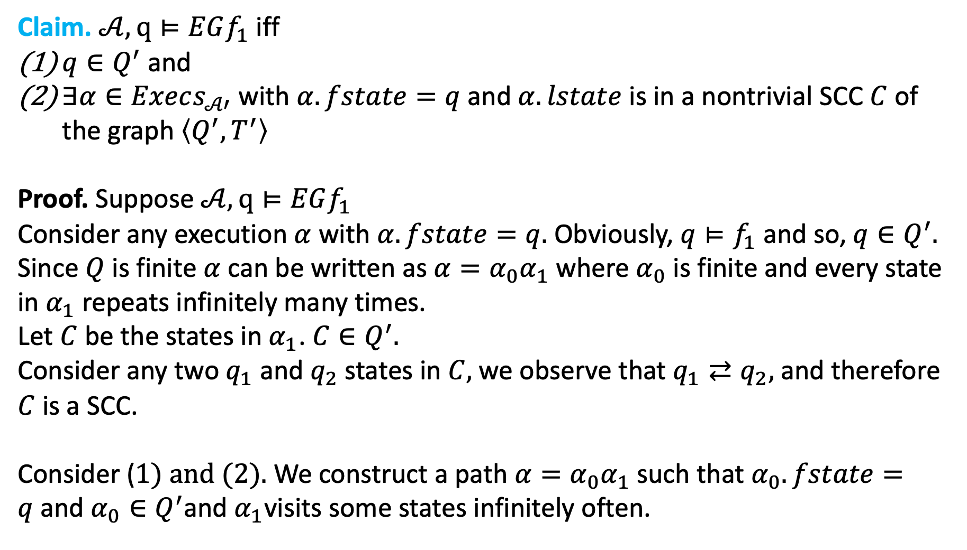
Claim. $𝒜,q⊨EGf_{1}$ iff
$q∈Q^{′}$ and
$∃α∈Execs_{𝒜′}$ with $α.fstate=q$and $α.lstate$ is in a nontrivial SCC $C$ of the graph $\left\langle Q^{′},T^{′}\right\rangle$
Proof. Suppose $𝒜,q⊨EGf_{1}$
Consider any execution $α$ with $α.fstate=q.$ Obviously, $q⊨f_{1}$ and so, $q∈Q^{′}.$
Since $Q$ is finite $α$ can be written as $α=α_{0}α_{1}$ where $α_{0}$ is finite and every state in $α_{1}$ repeats infinitely many times.
Let $C$ be the states in $α_{1}$. $C∈Q^{′}.$
Consider any two $q_{1}$ and $q_{2}$ states in $C,$we observe that $q_{1}⇄q_{2},$and therefore $C$is a SCC.
Consider ($1) and (2).$ We construct a path $α=α_{0}α_{1}$ such that $α_{0}.fstate=q$and $α_{0}∈Q^{′}$and $α_{1}$visits some states infinitely often.

Slide 22
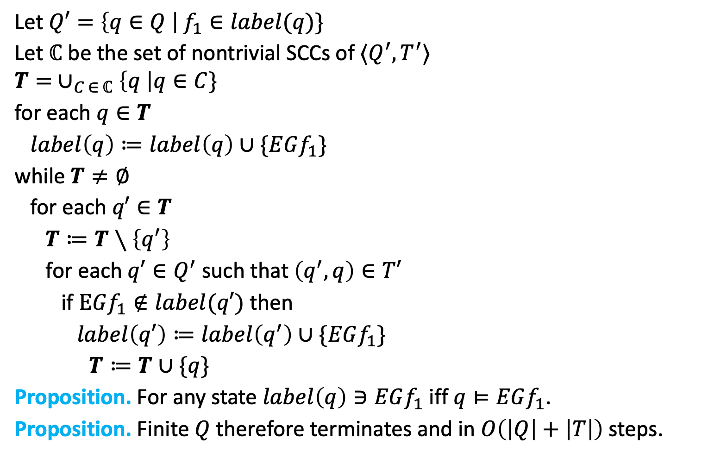
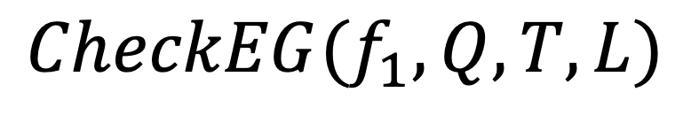
$CheckEG(f_{1}, Q,T,L)$
Let $Q′=\left\{q∈Q \right| f_{1}∈label(q)\}$
Let $ℂ$ be the set of nontrivial SCCs of $⟨Q^{′},T^{′}⟩$
$$T= ∪_{C ∈ ℂ}\left\{q \right|q∈C\}$$
for each $q∈T$
$label\left(q\right)≔label\left(q\right)∪\{EGf_{1}\}$
while $T≠∅$
for each $q′∈T$
$T≔T∖\left\{q^{′}\right\}$
for each $q′∈Q^{′}$ such that $\left(q^{′},q\right)∈T′$
if $EGf_{1}∉label(q′)$ then
$label\left(q′\right)≔label\left(q^{′}\right)∪\{EGf_{1}\}$
$T≔T∪\{q\}$
Proposition. For any state $label\left(q\right)∋EGf_{1}$ iff $q⊨EGf_{1}$.
Proposition. Finite $Q$ therefore terminates and in $O\left(\left|Q\right|+\left|T\right|\right)$ steps.

Slide 23
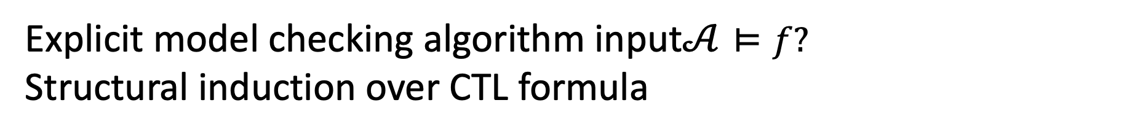
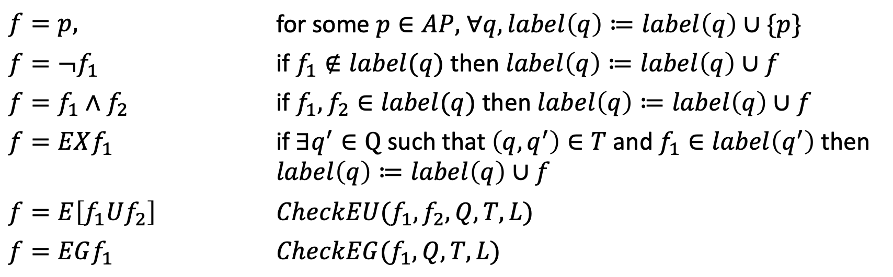
Putting it all together
Explicit model checking algorithm input$𝒜⊨f?$
Structural induction over CTL formula
$f=p,$ | for some $p∈AP,$ $∀q, label\left(q\right)≔label\left(q\right)∪\{p\}$
$$f=¬f_{1}$$ | if $f_{1}∉label(q)$ then $label\left(q\right)≔label\left(q\right)∪f$
$$f=f_{1}∧f_{2}$$ | if $f_{1}, f_{2}∈label(q)$ then $label\left(q\right)≔label\left(q\right)∪f$
$$f=EXf_{1}$$ | if$∃q^{′}∈Q$ such that $\left(q,q^{′}\right)∈T$ and $f_{1}∈label\left(q^{′}\right)$ then $label\left(q\right)≔label\left(q\right)∪f$
$$f=E\left[f_{1}Uf_{2}\right]$$ | $$CheckEU(f_{1},f_{2},Q,T,L)$$
$$f=EGf_{1}$$ | $$CheckEG(f_{1}, Q,T,L)$$
Proposition. Overall complexity of CTL model checkign $O(\left|f\right|\left(\left|Q\right|+\left|T\right|\right))$ steps.

Slide 24
1
!Start
!Close
!Heat
!Error
Start oven
Open door
Open door
Close door
2
Start
!Close
!Heat
Error
3
! Start
Close
!Heat
!Error
4
!Start
Close
Heat
!Error
Close door
Open door
Start oven
Start cooking
Reset
5
Start
Close
!Heat
Error
6
Start
Close
!Heat
!Error
7
Start
Close
Heat
!Error
Warmup

Slide 25
AG (Start -> AF Heat)
1
!Start
!Close
!Heat
!Error
Start oven
Open door
Open door
Close door
2
Start
!Close
!Heat
Error
3
! Start
Close
!Heat
!Error
4
!Start
Close
Heat
!Error
Close door
Open door
Start oven
Start cooking
Reset
5
Start
Close
!Heat
Error
6
Start
Close
!Heat
!Error
7
Start
Close
Heat
!Error
Warmup

Slide 26



! EF (Start $∧$EG ! Heat)
1
!Start
!Close
!Heat
!Error
! [True EU (Start $∧$EG ! Heat)]
Start oven
Open door
Open door
Close door
2
Start
!Close
!Heat
Error
3
! Start
Close
!Heat
!Error
4
!Start
Close
Heat
!Error
Close door
Open door
Start oven
Start cooking
Reset
5
Start
Close
!Heat
Error
6
Start
Close
!Heat
!Error
7
Start
Close
Heat
!Error
Warmup

Slide 27

! EF (Start $∧$EG ! Heat)
1
!Start
!Close
!Heat
!Error
! [True EU (Start $∧$EG ! Heat)]
Start oven
Open door
Open door
Close door
2
Start
!Close
!Heat
Error
3
! Start
Close
!Heat
!Error
4
!Start
Close
Heat
!Error
Close door
Open door
Start oven
Start cooking
Reset
5
Start
Close
!Heat
Error
6
Start
Close
!Heat
!Error
7
Start
Close
Heat
!Error
Warmup

Slide 28

! EF (Start $∧$ EG ! Heat)
Nontrivial SCC of ! Heat
Start, ! Heat
EG ! Heat
1
!Start
!Close
!Heat
!Error
Start oven
Open door
Open door
Close door
2
Start
!Close
!Heat
Error
3
! Start
Close
!Heat
!Error
4
!Start
Close
Heat
!Error
Close door
Open door
Start oven
Start cooking
Reset
5
Start
Close
!Heat
Error
6
Start
Close
!Heat
!Error
7
Start
Close
Heat
!Error
Warmup

Slide 29

! EF (Start $∧$ EG ! Heat)
EG ! Heat
Set of states that can reach n
nontrivial SCC of ! Heat
Start, ! Heat
EG ! Heat
1
!Start
!Close
!Heat
!Error
Start $∧$ EG ! Heat
Start oven
Open door
Open door
Close door
EG ! Heat
2
Start
!Close
!Heat
Error
EG ! Heat
3
! Start
Close
!Heat
!Error
4
!Start
Close
Heat
!Error
Close door
Open door
Start oven
Start cooking
Reset
5
Start
Close
!Heat
Error
6
Start
Close
!Heat
!Error
7
Start
Close
Heat
!Error
Warmup
EG ! Heat

Slide 30


! EF (Start $∧$ EG ! Heat)
EG ! Heat
Start, ! Heat
EG ! Heat
1
!Start
!Close
!Heat
!Error
Start $∧$ EG ! Heat
Start oven
Open door
Start $∧$ EG ! Heat
Open door
Close door
EG ! Heat
2
Start
!Close
!Heat
Error
EG ! Heat
3
! Start
Close
!Heat
!Error
4
!Start
Close
Heat
!Error
Close door
Open door
Start oven
Start cooking
Reset
5
Start
Close
!Heat
Error
6
Start
Close
!Heat
!Error
7
Start
Close
Heat
!Error
Warmup
EG ! Heat
Start $∧$ EG ! Heat

Slide 31


! EF (Start $∧$ EG ! Heat)
EG ! Heat
Start, ! Heat
EG ! Heat
1
!Start
!Close
!Heat
!Error
Start $∧$ EG ! Heat
EF (Start $∧$ EG ! Heat)
Open door
Start oven
Start $∧$ EG ! Heat
Open door
Close door
EG ! Heat
2
Start
!Close
!Heat
Error
EG ! Heat
3
! Start
Close
!Heat
!Error
4
!Start
Close
Heat
!Error
Close door
Open door
Start oven
Start cooking
Reset
5
Start
Close
!Heat
Error
6
Start
Close
!Heat
!Error
7
Start
Close
Heat
!Error
Warmup
EG ! Heat
Start $∧$ EG ! Heat

Slide 32
! EF (Start $∧$ EG ! Heat)
EG ! Heat
Start, ! Heat
EG ! Heat
1
!Start
!Close
!Heat
!Error
Start $∧$ EG ! Heat
EF (Start $∧$ EG ! Heat)
Open door
Start oven
Start $∧$ EG ! Heat
Open door
Close door
EG ! Heat
2
Start
!Close
!Heat
Error
EG ! Heat
3
! Start
Close
!Heat
!Error
4
!Start
Close
Heat
!Error
Close door
Open door
Start oven
Start cooking
Reset
5
Start
Close
!Heat
Error
6
Start
Close
!Heat
!Error
7
Start
Close
Heat
!Error
Warmup
EG ! Heat
Start $∧$ EG ! Heat

Slide 33








! EF (Start $∧$ EG ! Heat)
EG ! Heat
EF (Start $∧$ EG ! Heat)
Set of states that can reach
Start $∧$ EG ! Heat
Start, ! Heat
EG ! Heat
1
!Start
!Close
!Heat
!Error
Start $∧$ EG ! Heat
EF (Start $∧$ EG ! Heat)
Open door
Start oven
EF (Start $∧$ EG ! Heat)
Open door
Close door
Start $∧$ EG ! Heat
EG ! Heat
EF (Start $∧$ EG ! Heat)
2
Start
!Close
!Heat
Error
EF (Start $∧$ EG ! Heat)
3
! Start
Close
!Heat
!Error
4
!Start
Close
Heat
!Error
EG ! Heat
Close door
Open door
Start oven
Start cooking
Reset
5
Start
Close
!Heat
Error
6
Start
Close
!Heat
!Error
7
Start
Close
Heat
!Error
Warmup
EG ! Heat
Start $∧$ EG ! Heat
EF (Start $∧$ EG ! Heat)
EF (Start $∧$ EG ! Heat)
EF (Start $∧$ EG ! Heat)

Slide 34

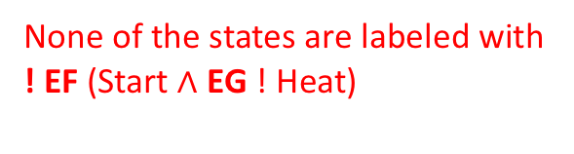
! EF (Start $∧$ EG ! Heat)
EG ! Heat
EF (Start $∧$ EG ! Heat)
None of the states are labeled with
! EF (Start $∧$ EG ! Heat)
Start, ! Heat
EG ! Heat
1
!Start
!Close
!Heat
!Error
Start $∧$ EG ! Heat
EF (Start $∧$ EG ! Heat)
Open door
Start oven
EF (Start $∧$ EG ! Heat)
Open door
Close door
Start $∧$ EG ! Heat
EG ! Heat
EF (Start $∧$ EG ! Heat)
2
Start
!Close
!Heat
Error
EF (Start $∧$ EG ! Heat)
3
! Start
Close
!Heat
!Error
4
!Start
Close
Heat
!Error
EG ! Heat
Close door
Open door
Start oven
Start cooking
Reset
5
Start
Close
!Heat
Error
6
Start
Close
!Heat
!Error
7
Start
Close
Heat
!Error
Warmup
EG ! Heat
Start $∧$ EG ! Heat
EF (Start $∧$ EG ! Heat)
EF (Start $∧$ EG ! Heat)
EF (Start $∧$ EG ! Heat)

