Slide 1

Exploring and Predicting Violent Crime in Chicago
By: Vivian and Cherry
Notes:
Hello everyone. Today we will be presenting our data-driven analysis on exploring and predicting violent crime in Chicago. First off we will be discussing the motivations behind this project. After that, our exploratory data analysis, regression, and clustering results will be explained.

Slide 2
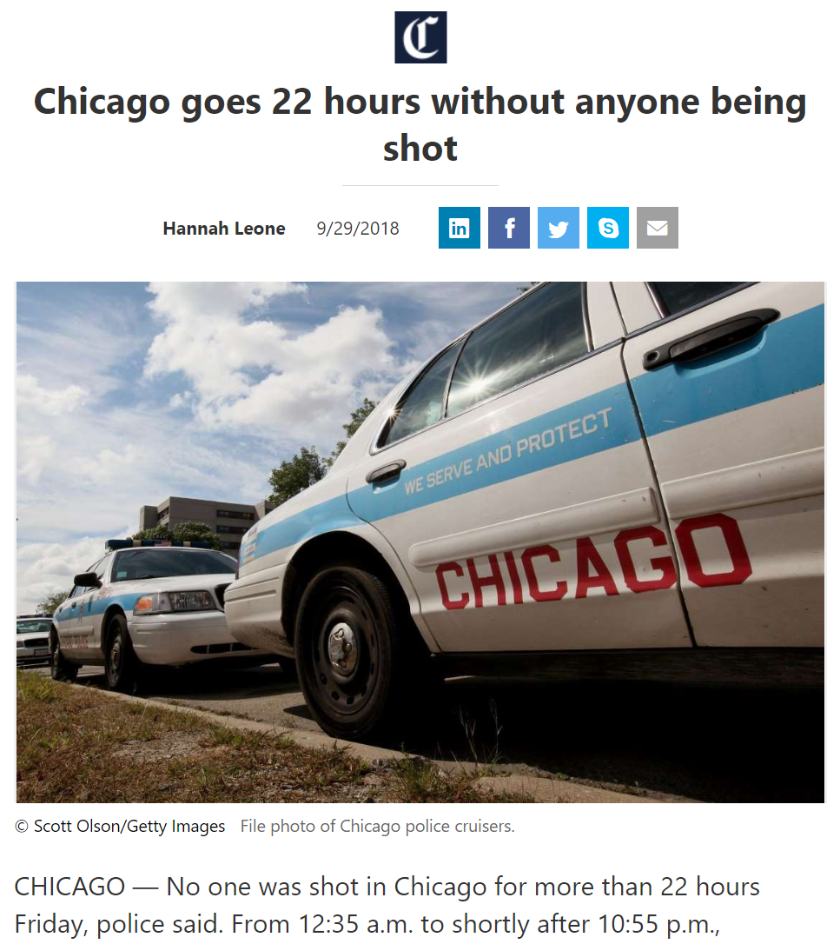

Background
Notes:
Crime in Chicago has been recorded since the last century by the city, and throughout this period, statistics show that the city has had a consistently higher rate of violent crimes compared to the U.S. average. As a result, the city has been under intense scrutiny for its high violent crime rates. In 2016, almost half of the increase in crime in America was solely due to violence in Chicago. It’s also sad to see news that such as “Chicago goes 22 hours without anyone being shot” as actual news. Such high rates of violent crime naturally lead to a need for better police resource allocation to areas in the city where violent crimes are most likely to occur. This is where we believe data science help.

Slide 3




Hypothesis
The rate of violent crime of a community area in Chicago is correlated with the community area’s demographics, education, parks, and health.
Notes:
We hypothesize that there may be multiple city-related predictors such as demographic, educational, health, and urban planning data that may be correlated with the rate of violent crime in Chicago.

Slide 4
Community Areas
TODO: show R map of the community areas
Notes:
Each of these predictors will be grouped by ‘community area’. Chicago has 77 official community areas, and these areas have been historically used in sociological research of Chicago, and is thus deemed an appropriate geographic unit of choice for this project.
These include: *go to the next slide*

Slide 5
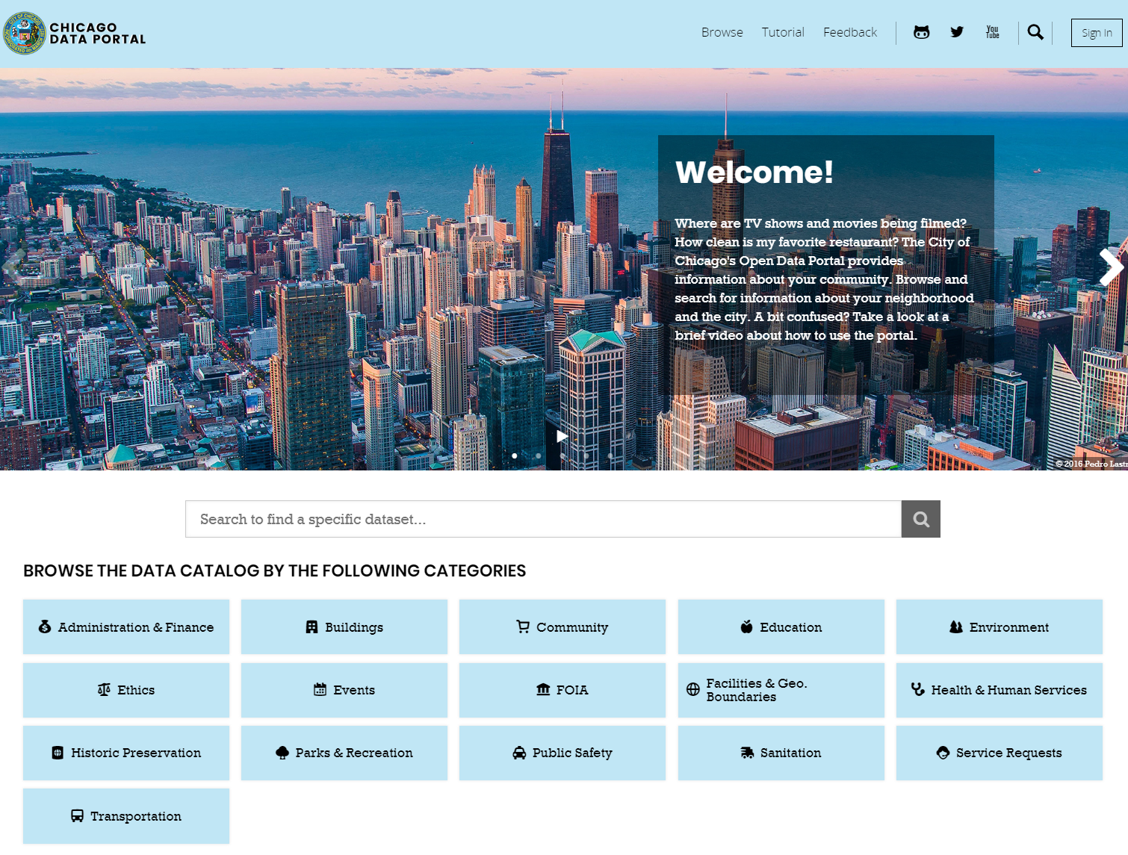
Data

Slide 6
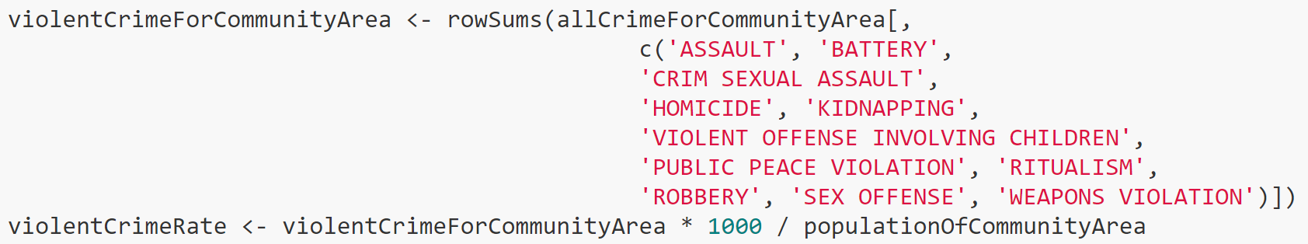
Class Variable
Notes:
The class variable is the rate of violent crime in an area. In order to scale the results so that communities with higher populations are not overrepresented, the class variable is calculated as the percent of violent crime per 1000 people in the specified community area.
Note that the multiplier of 1000 is not important in prediction, as all of the constants of a regression model will simply be scaled up. It is also not important in clustering or association rule mining, as the former normalizes all of its explanatory variables, and the latter bins them. This multiplier is simply included as it is a standard way to assess rate by population in social sciences

Slide 7
Predictors
Average Quality of Schools
Average SSL Rating
Total Park Area
Number of Hospitals
Teenage Pregnancy Birth Rate
Infant Mortality Rate
Percent Children in Poverty
Proportion of each Race
Notes:
Average quality of schools in a community area (based on the Chicago Public School Board’s official “School Quality Rating” measurements for each school in the city)
Average SSL rating of “strategic subjects” in a community area (‘strategic subject rating’ being defined by the CPD as how likely target people on ‘their list’ will be involved in a shooting in the near future)
Normalized total park area,
health statistics such as number of hospitals,
teenage pregnancy rate,
Infant mortality rate,
and demographics of the neighborhood that the crime took place in such as poverty rate,
And the proportion of each race for each community area

Slide 8
Sample Rows of Class Variable
Community | Community Area Number | Violent Crime Rate
ROGERS PARK | 1 | 612.3729
WEST RIDGE | 2 | 318.6595
UPTOWN | 3 | 512.4375
LINCOLN SQUARE | 4 | 297.2172
NORTH CENTER | 5 | 239.0875

Slide 9
Sample Rows of Predictors
School Rating | SSL Rating | Park Area | Number of Hospitals | Teen Mom Rate | Infant Death Rate | Hispanic | Black | Asian | White | Other | Poverty Rate
3.571429 | 277.6664 | 287364.9 | 0 | 51.61818 | 0.24 | 0.24 | 0.45 | 0.05 | 0.03 | 0.319509 | 0.24
3.5 | 286.1914 | 725446.2 | 0 | 31.52727 | 0.2 | 0.13 | 0.41 | 0.21 | 0.04 | 0.372624 | 0.2
3.428571 | 266.0711 | 1437616 | 4 | 51.02727 | 0.16 | 0.19 | 0.51 | 0.11 | 0.03 | 0.278424 | 0.16
4.2 | 281.7773 | 419080.8 | 3 | 37.98182 | 0.18 | 0.06 | 0.62 | 0.1 | 0.04 | 0.168878 | 0.18
3.428571 | 282.6642 | 161026.1 | 0 | 37.07273 | 0.11 | 0.09 | 0.73 | 0.04 | 0.03 | 0.058669 | 0.11

Slide 10
Results

Slide 11
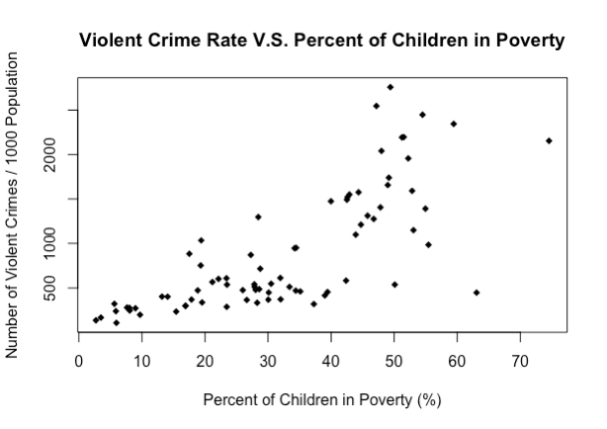
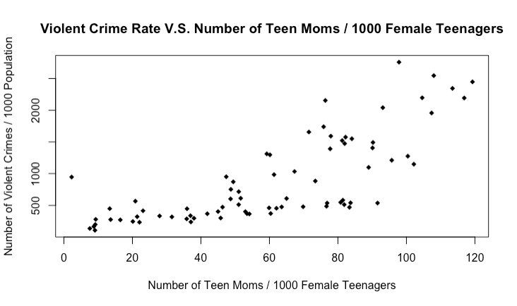
Exploratory Data Analysis

Slide 12
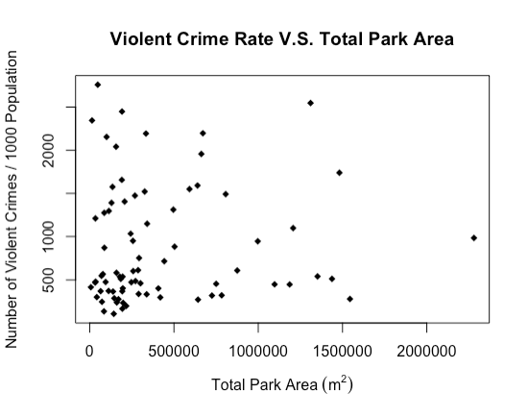
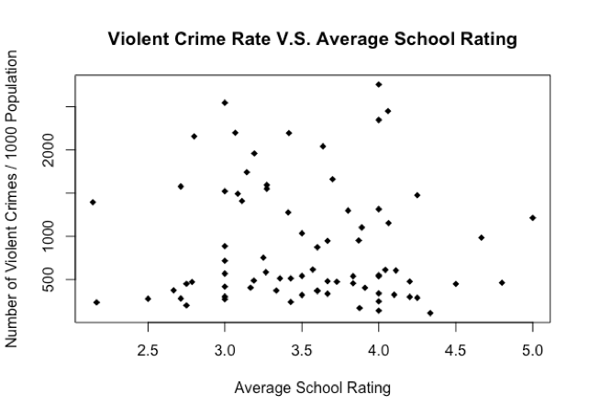
Exploratory Data Analysis

Slide 13
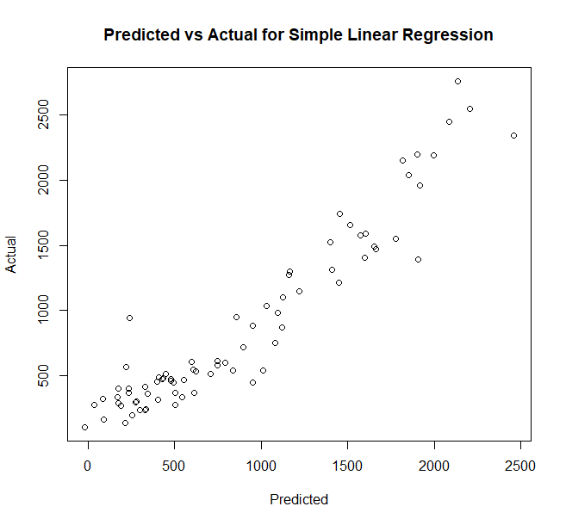
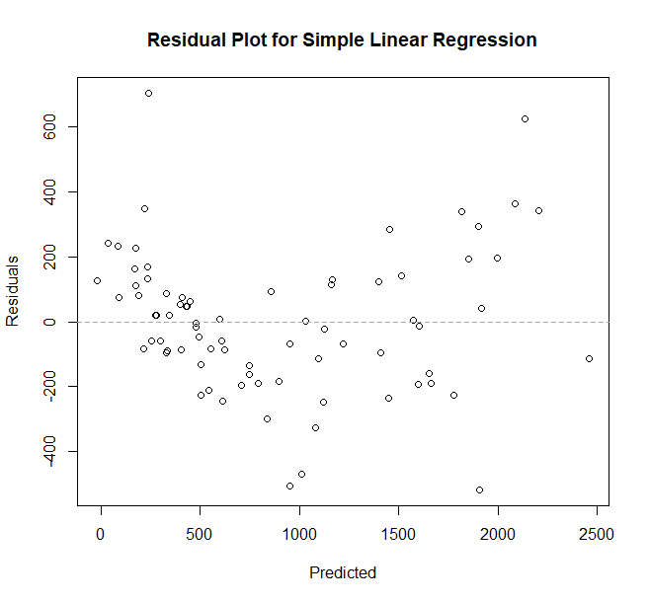
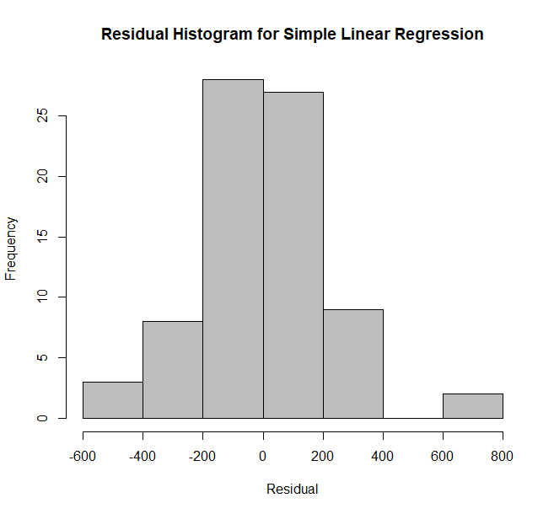
Regression
RMSE | R² | MAE
285.24 | 0.822 | 206.54

Slide 14
Clustering
RMSE | R² | MAE
285.24 | 0.822 | 206.54

Slide 15
Classification

