Slide 1

Exploring and Predicting Violent Crime in Chicago
By: Vivian and Cherry
Notes:
Hello everyone. Today we will be presenting our data-driven analysis on exploring and predicting violent crime in Chicago. First off we will be discussing the motivations behind this project. After that, our exploratory data analysis, regression regression, and clustering results will be explained.

Slide 2
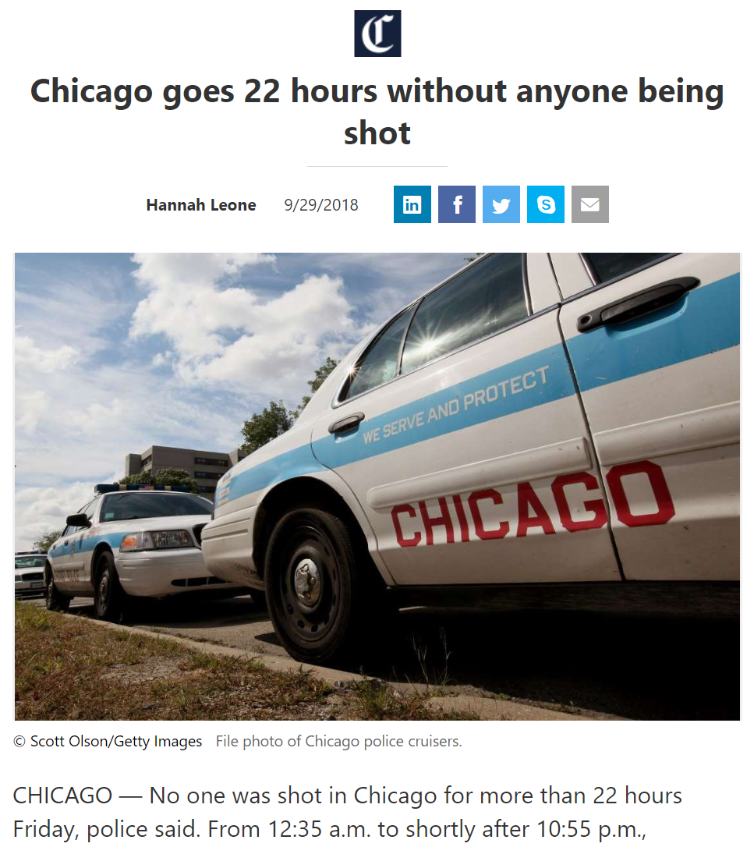
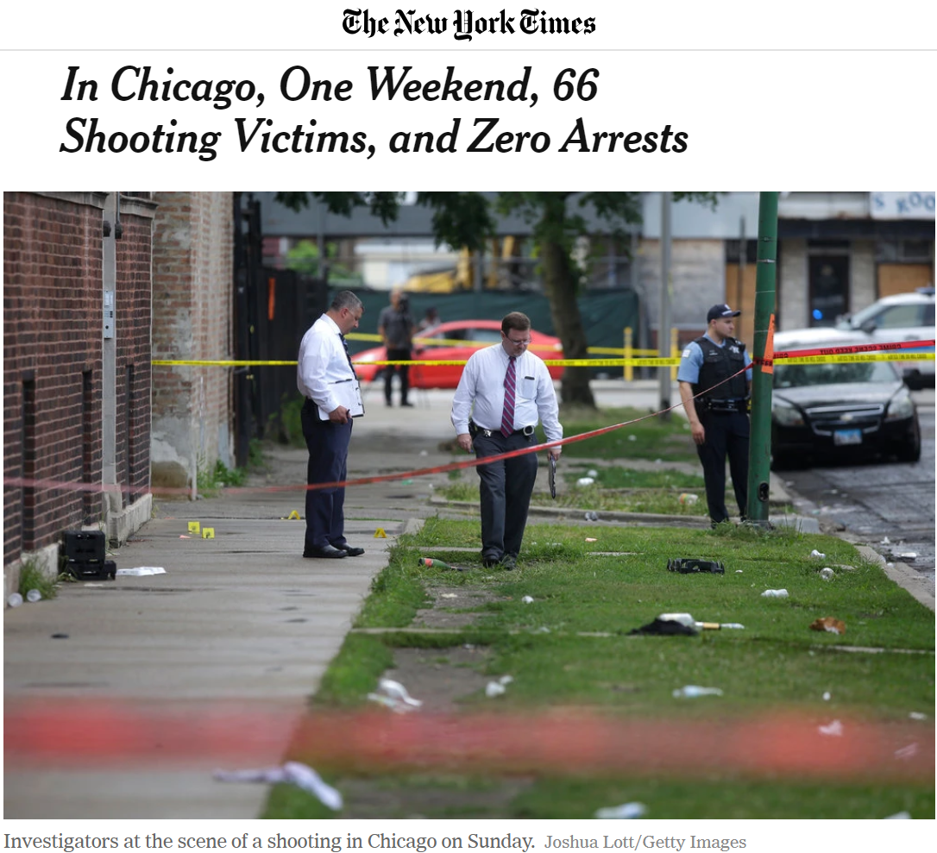
Background
Notes:
Crime in Chicago has been recorded since the last century by the city, and throughout this period, statistics show that the city has had a consistently higher rate of violent crimes compared to the U.S. average. As a result, the city has been under intense scrutiny for its high violent crime rates. In 2016, the murder rate in the U.S. rose about 13%, and almost half of that increase is solely due to violence in Chicago [1]. In fact, in recent years, Chicago had recorded more murders and victims of shooting than both Los Angeles and New York City combined [2]. Such high rates of violent crime naturally lead to a need for better police resource allocation to areas where violent crimes are most likely to occur.

Slide 3




Hypothesis
The rate of violent crime of a community area in Chicago is correlated with the community area’s demographics, education, parks, and health.

Slide 4

Data

Slide 5
Predictors
Average Quality of Schools
Average SSL Rating
Total Park Area
Number of Hospitals
Teenage Pregnancy Birth Rate
Infant Mortality Rate
Percent Children in Poverty
Etc.

Slide 6
Results

Slide 7
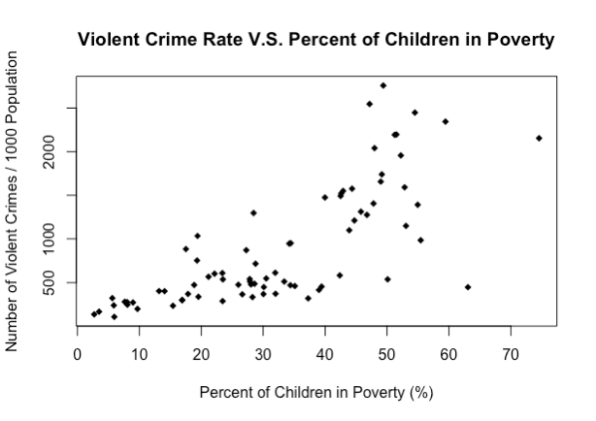
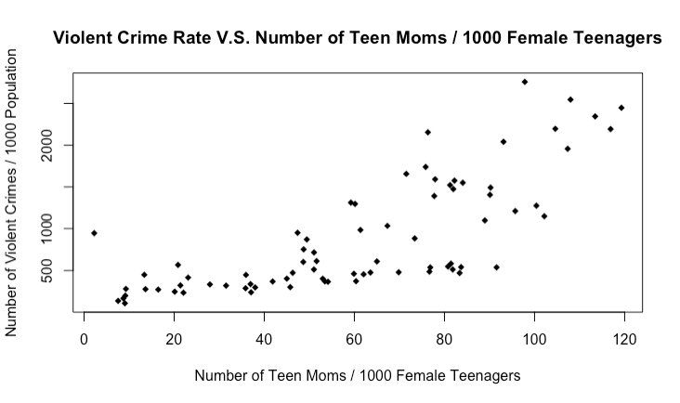
Exploratory Data Analysis

Slide 8
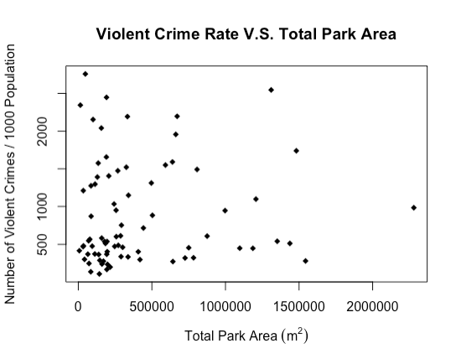
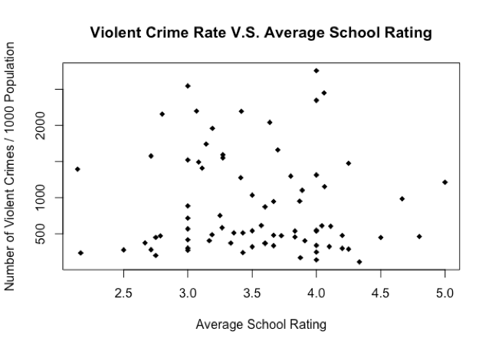
Exploratory Data Analysis

Slide 9
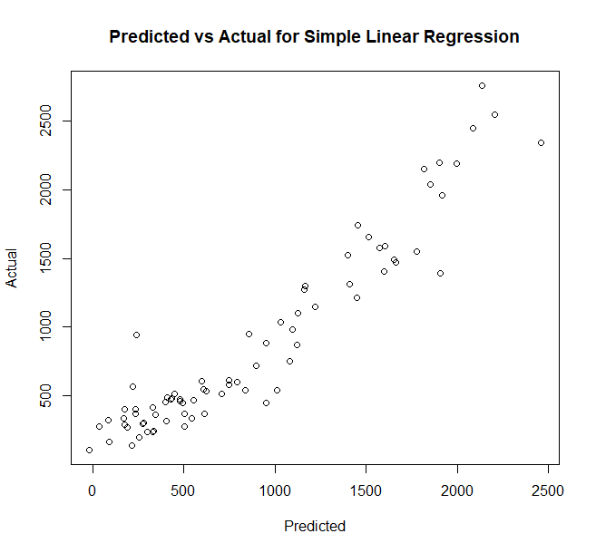
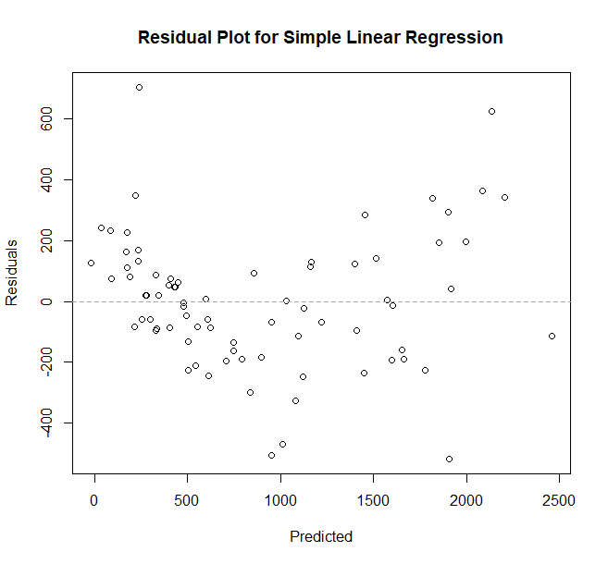
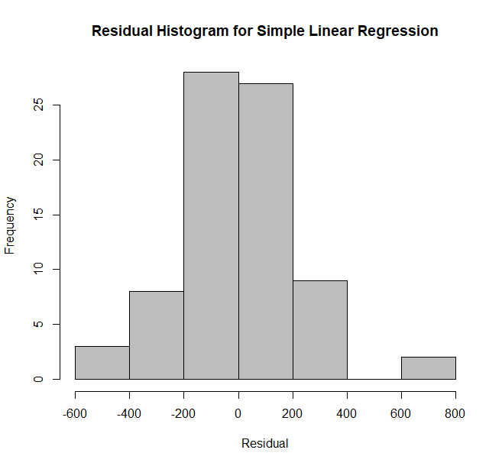
Regression
RMSE | R² | MAE
285.24 | 0.822 | 206.54

Slide 10
Clustering
RMSE | R² | MAE
285.24 | 0.822 | 206.54

Slide 11
Classification

