Slide 1

Exploring and Predicting Violent Crime in Chicago
By: Vivian and Cherry

Slide 2
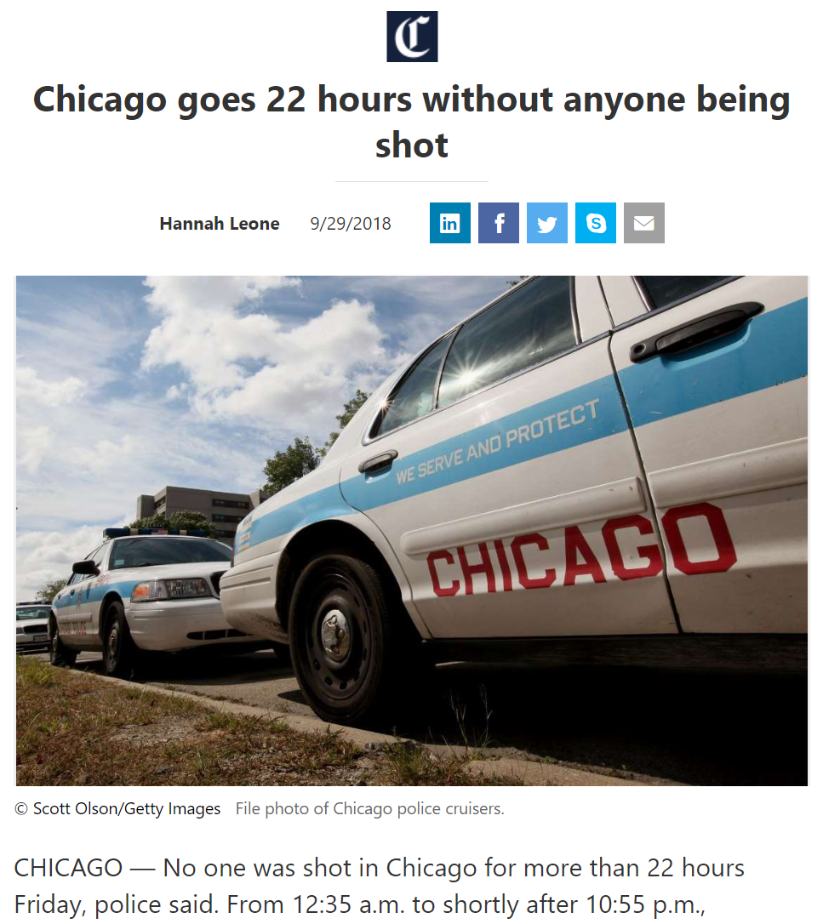
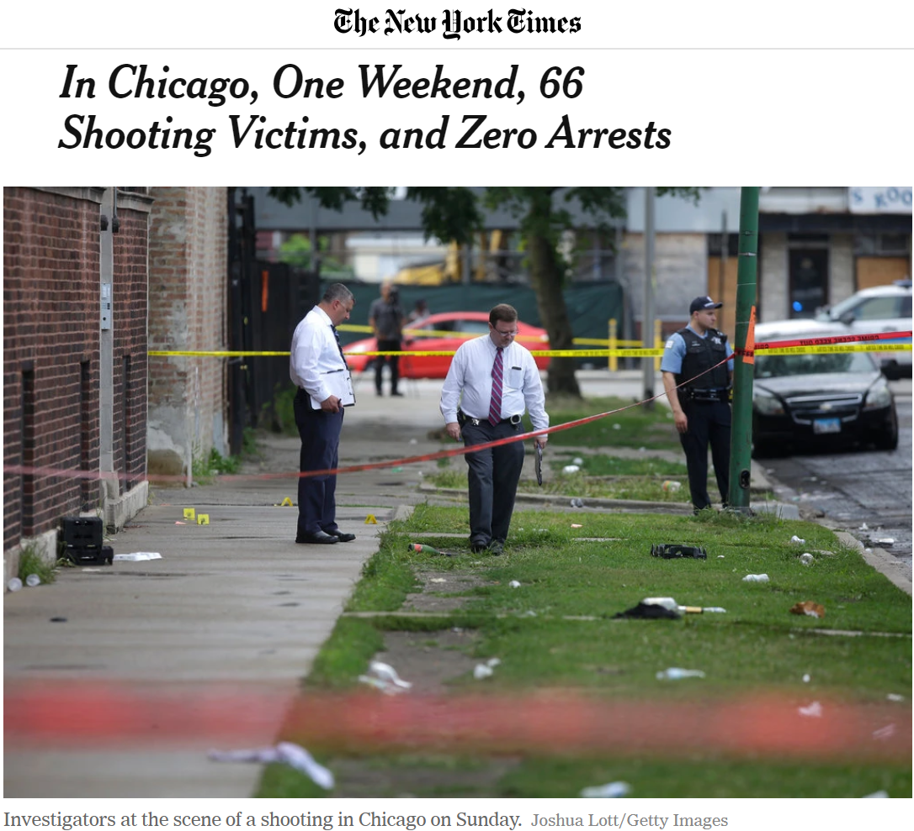
Background

Slide 3




Hypothesis
The rate of violent crime of a community area in Chicago is correlated with the community area’s demographics, education, parks, and health.

Slide 4
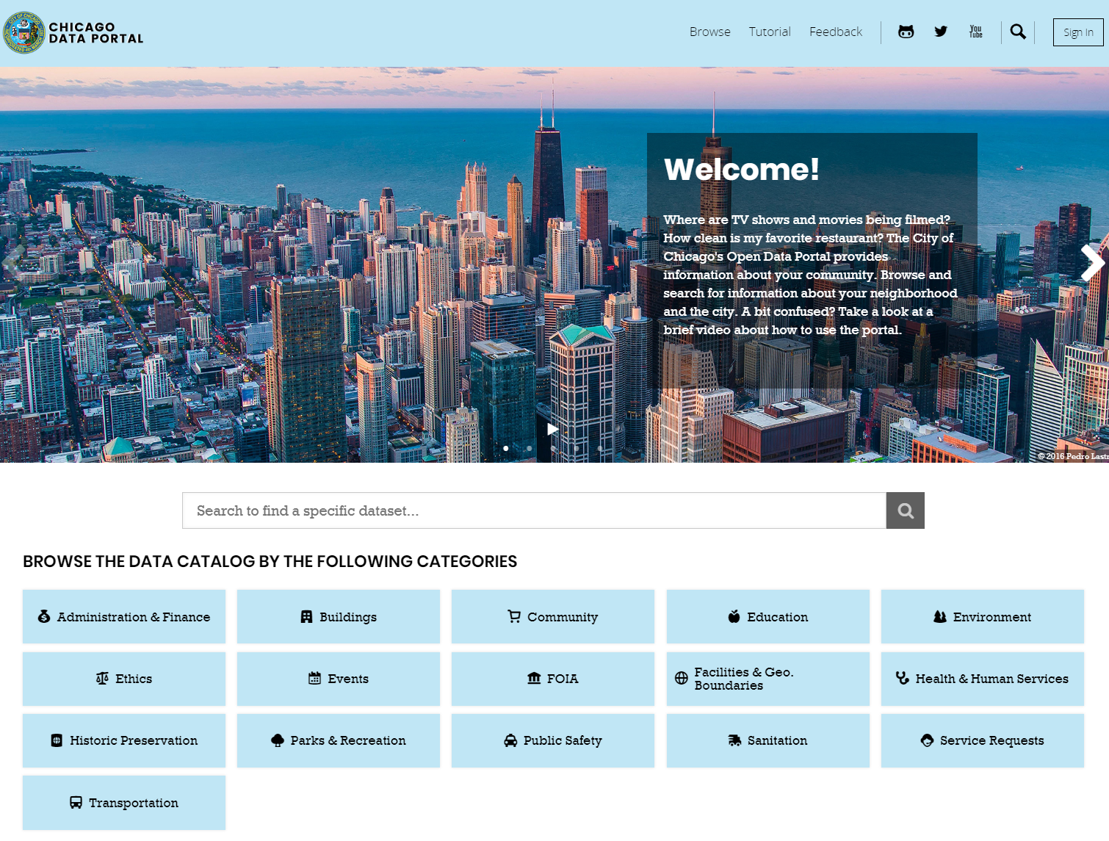
Data

Slide 5
Predictors
Average Quality of Schools
Average SSL Rating
Total Park Area
Number of Hospitals
Teenage Pregnancy Birth Rate
Infant Mortality Rate
Percent Children in Poverty
Etc.

Slide 6
Results

Slide 7
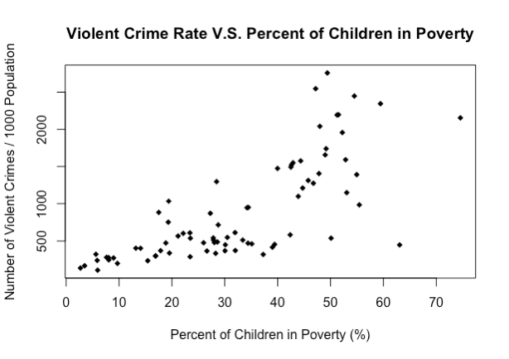
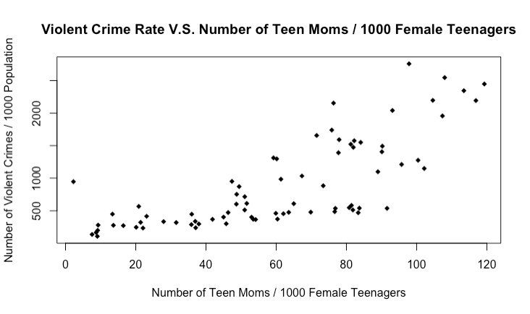
Exploratory Data Analysis

Slide 8
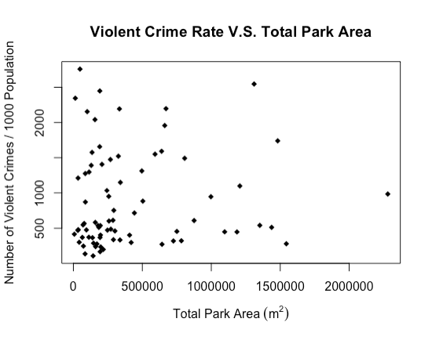
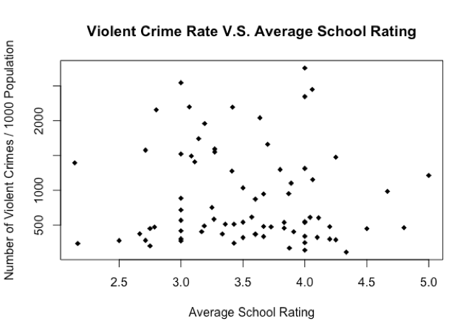
Exploratory Data Analysis

Slide 9
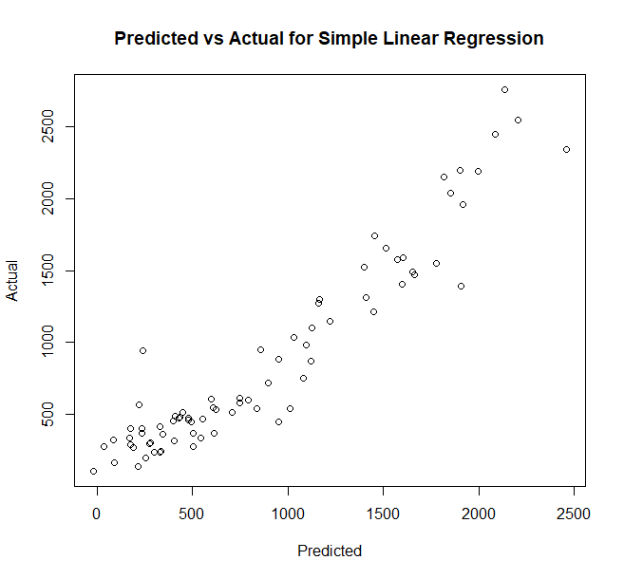
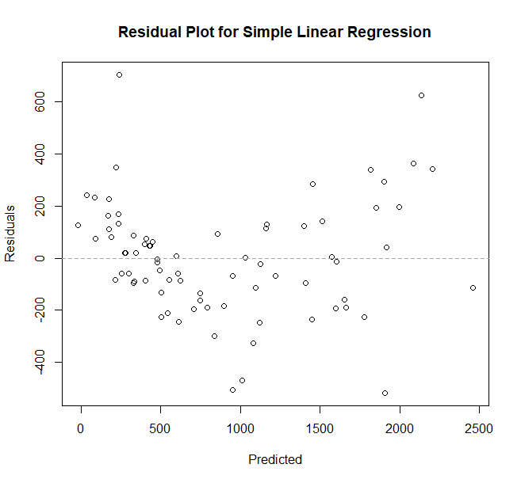
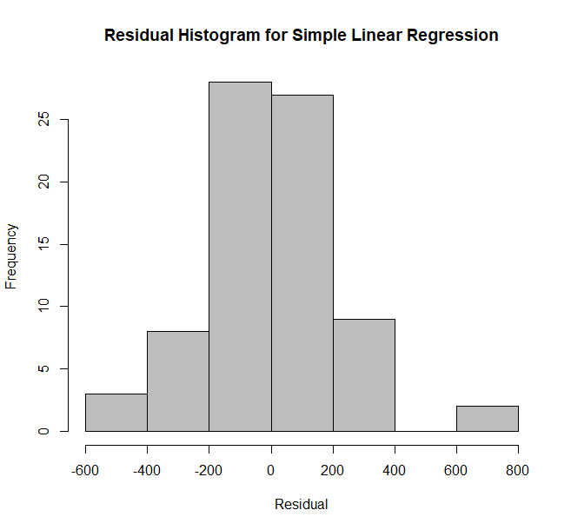
Regression
RMSE | R² | MAE
285.24 | 0.822 | 206.54

Slide 10
Clustering
RMSE | R² | MAE
285.24 | 0.822 | 206.54

