Slide 1
Drowsiness detection using opencv
~ ANISH SHARMA (219310042)
~ AVINASH UPADHYAY (219310238)
~ Divyaditya Singh (219310304)

Slide 2
INTRODUCTION
The aim of the Drowsiness Detection Project is to enhance road safety by employing Python and OpenCV to detect driver drowsiness in real-time. This project addresses the critical issue of driver fatigue, ensuring timely alerts to prevent potential accidents. Its use cases extend to long journeys, night driving, and commercial transportation, significantly reducing the risk of accidents caused by drowsy driving. This project is crucial for promoting vigilant and safe driving habits, contributing to overall road safety.

Slide 3
PROBLEM
The problem addressed by the Drowsiness Detection Project is the potential danger of driver fatigue leading to accidents. As drivers become drowsy, their alertness decreases, risking safety on the road. The project uses OpenCV, a computer vision library in Python, to monitor the driver's eyes and facial features in real-time. By analyzing factors such as blink frequency and eye closure duration, the system can identify signs of drowsiness. When these signs are detected, the project triggers timely alerts, such as sounds or visual warnings, to prompt the driver to stay awake or take a break. This proactive approach helps prevent accidents caused by drowsy driving, contributing to improved road safety.

Slide 4
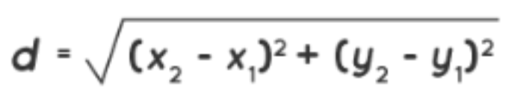
Calculating distance between eyes using Euclidean Distance
1. We Access the camera and mark the landmarks from the (.dat) file to predict the location of the ear and eyes.
2. We then use the Euclidean distance function to calculate the distance between landmarks on the opposite sides of the eyes. This function requires two points in a plane to calculate the distance.
3. We Mark the eye points in a face so that it will be easy for the user to get the detection.
4. Then we calculate the aspect ratio for the left and right eyes and set the criteria for the closing of eyes (drowsiness detection).

Slide 5
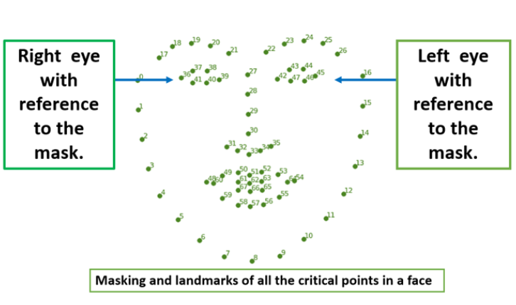
Face landmark mapping points
Here, the image below shows all the masking and landmarks numerically-wise of all the critical points in a normal face with the reference of the right and left eye accordingly.

Slide 6
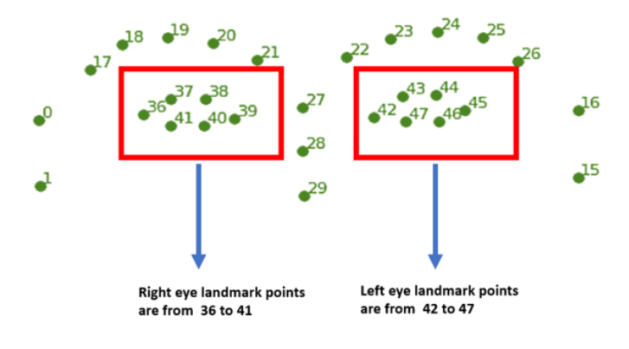

Needed Points in a Face Mask
With reference to the above image, we are focusing on the right and the left eye and getting all the critical points connecting the eye.

Slide 7
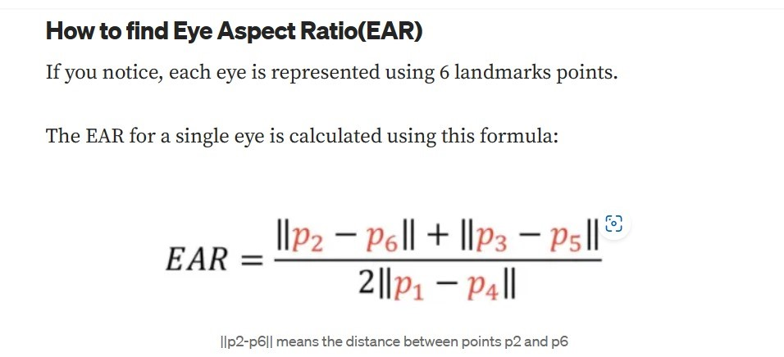
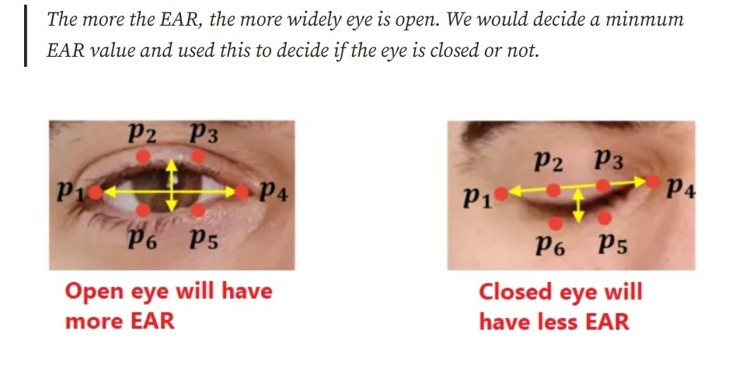
Calculating EAR
Eye aspect ratio (EAR) quantifies the ratio of horizontal to vertical eye dimensions, crucial in fields like driver monitoring, human-computer interaction, and emotion recognition. Calculated from facial landmarks, EAR tracks eye movements for applications such as drowsiness detection in drivers and enhancing interactive technologies through natural eye-based interfaces and emotion recognition systems.

Slide 8
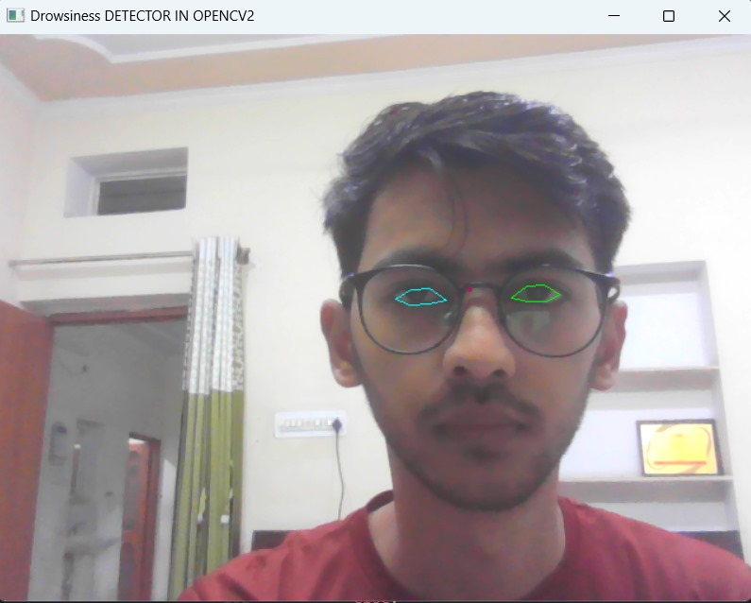
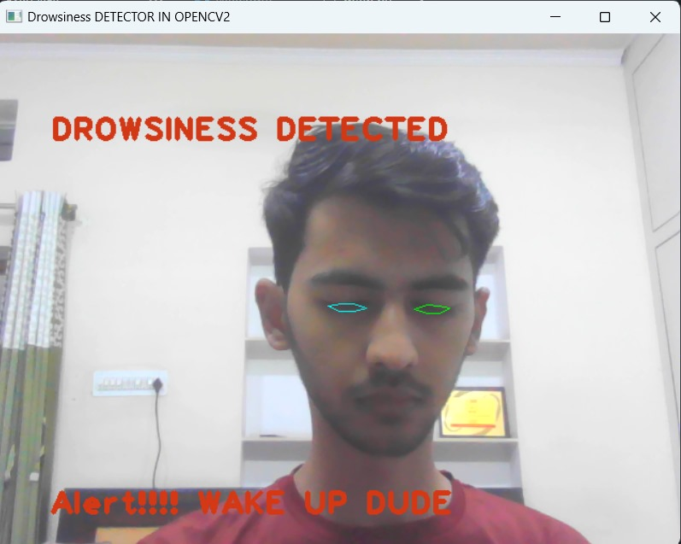
OUTPUT:
AWAKE STATE
DROWSY STATE

Slide 9
FUTURE PROSPECTS
Integration in Vehicles: Drowsiness detection systems may become a standard feature in modern vehicles, integrated with advanced driver-assistance systems (ADAS) to enhance safety.
2. Wearable Technology: Drowsiness detection could extend beyond vehicles to wearable devices, alerting individuals in various settings, such as during work or while operating heavy machinery.
3. IoT Integration: The Internet of Things (IoT) could play a role in creating a network of connected devices that monitor and share drowsiness data, potentially improving overall safety on the roads.
4. Research in Neuroscience: Deeper insights into the neuroscience of fatigue and drowsiness could contribute to the development of more effective detection methods.
5. Commercial and Industrial Applications: Drowsiness detection technology may find applications beyond road safety, including in industries where operator alertness is critical, such as aviation, maritime, and manufacturing.

Slide 10
CONCLUSION
In conclusion, our drowsiness detection project has developed a robust real-time system utilizing facial recognition, eye-tracking, and machine learning. Successful testing across diverse driving conditions highlights its adaptability and precision. This technology's potential extends beyond automotive settings, with applications in wearables and various industries. Insights gained into drowsiness patterns contribute to ongoing improvements. Collaboration between neuroscience, AI, and sensor technology proves crucial. The project underscores the need for industry standards and regulatory consideration. Overall, this advancement signifies a significant stride toward enhancing safety, emphasizing the role of technology in mitigating risks associated with human fatigue across multiple domains.

