Slide 1

Analysing Customer Behaviour
For Retaining Existing Customers

Slide 2

Use Case
Business can identify at-risk customers early and take proactive measures to retain them.
Business prioritize customer retention efforts and invest in strategies such as personalized marketing, loyalty programs etc.

Slide 3
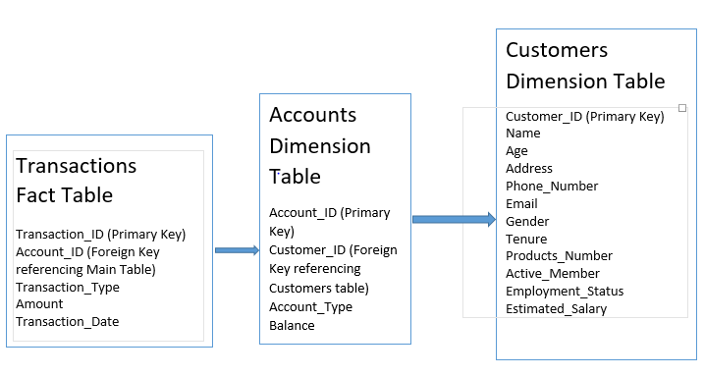
Data Model – Snowflake Schema

Slide 4
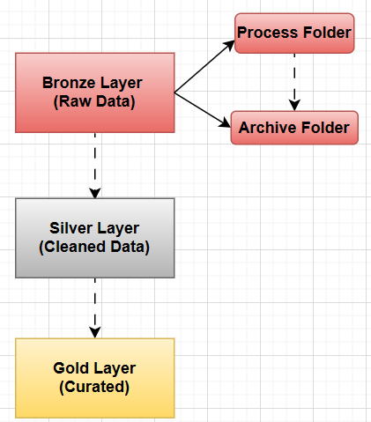

Medallion Architecture

Slide 5
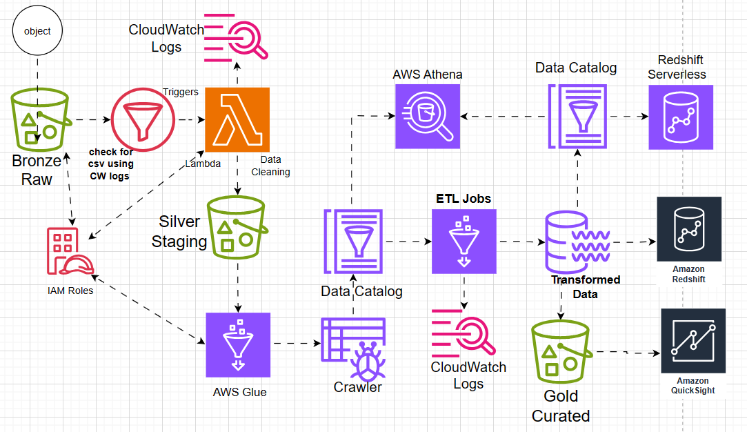
End-to-End Flow of Project - AWS
Batch Processing

Slide 6
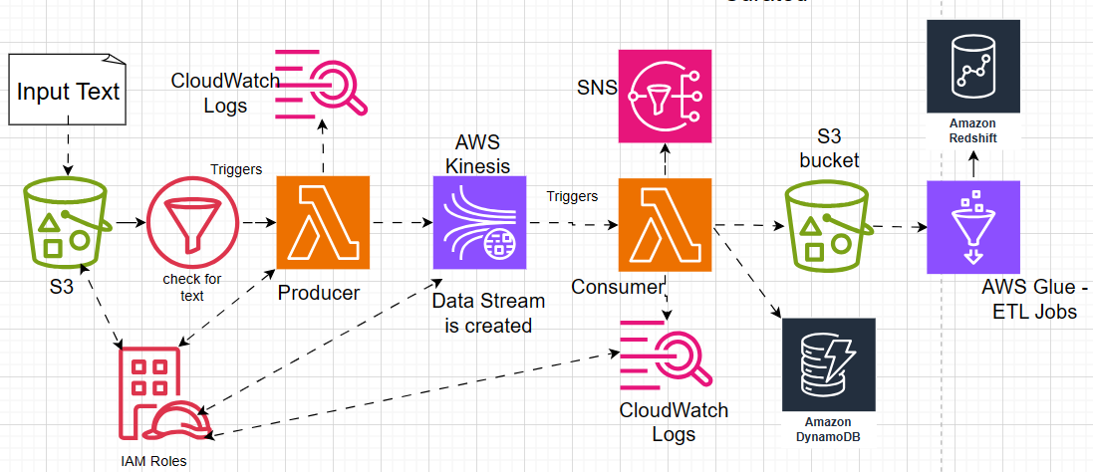
Real Time Data Processing

Slide 7
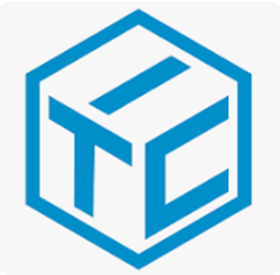
AWS Services Used:
S3 bucket
IAM – Identity & Access Management
Lambda
AWS Glue : Crawler, Data Catalog, ETL Jobs
Cloudwatch
Aws Athena
Kinesis
Redshift
Quick sight

Slide 8
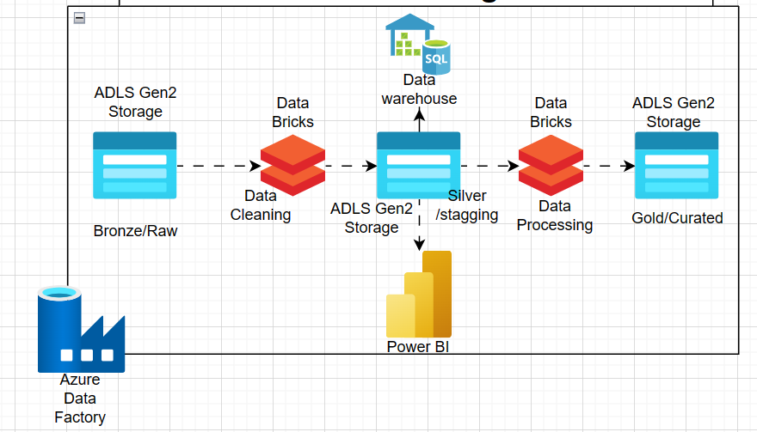

End-to-End Flow of Project - AZURE

Slide 9

Challenges Faced
Implement Real Time Data Processing.
Cloudwatch logs helped in finding out errors while running lambda as well as ETL jobs.
Writing cleaned dataframes back to the silver folder in Azure Data Lake Gen2 from Data bricks has been challenging, with several errors encountered along the way.
Will try to implement Incremental loads – Inserts, Updates and deletes in Batch Processing.
Automating the process leads to greater efficiency, reliability, and agility in handling data and repetitive tasks.
Will try to implement the entire AWS project pipeline using infrastructure as a code (Terraform)
Will try to complete end-to-end project in Azure
9

Slide 10


Slide 11

Thank You…!

Slide 13
Further Enhancements
Will try to implement Incremental loads – Inserts, Updates and deletes in Batch Processing.
Automating the process leads to greater efficiency, reliability, and agility in handling data and repetitive tasks.
Will try to implement the entire pipeline using infrastructure as a code - Terraform

