Slide 1

Bank Customer Churn Prediction
For Retaining Existing Customers

Slide 2

Use Case
Business can identify at-risk customers early and take proactive measures to retain them.
Business prioritize customer retention efforts and invest in strategies such as personalized marketing, loyalty programs etc.

Slide 3
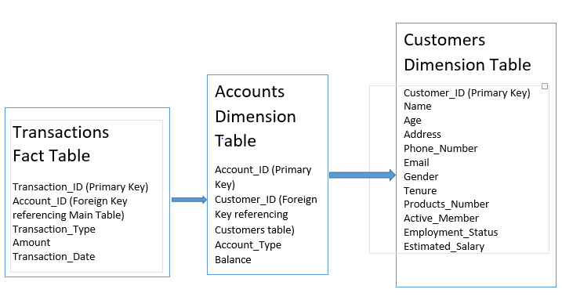
Data Model – Snowflake Schema

Slide 4
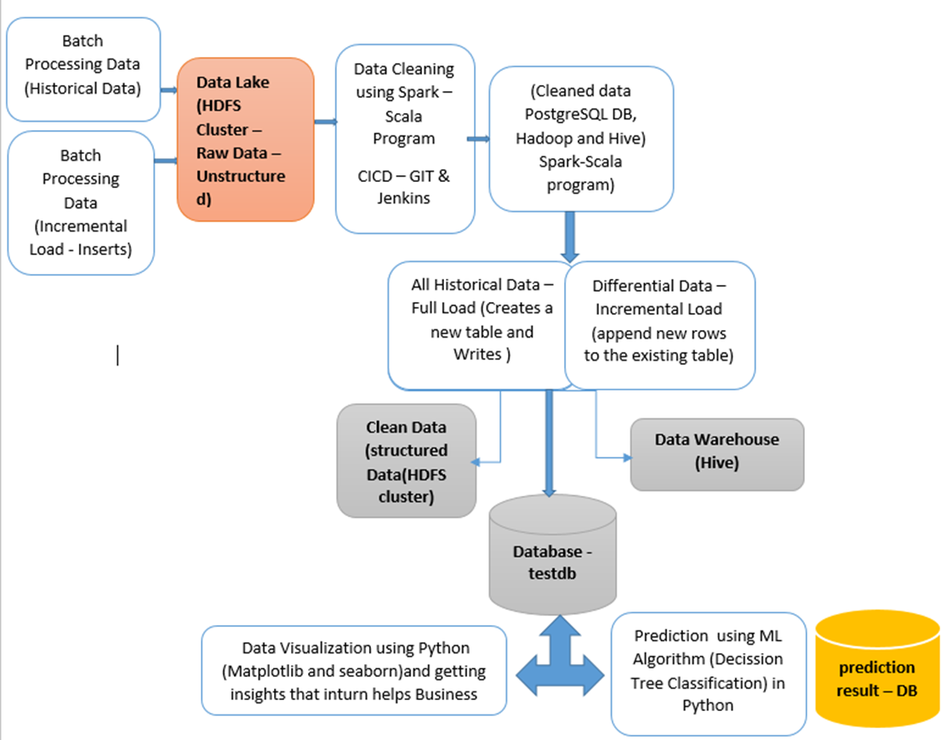
End-to-End Flow of Project
Full Load & Incremental Load - Inserts

Slide 5
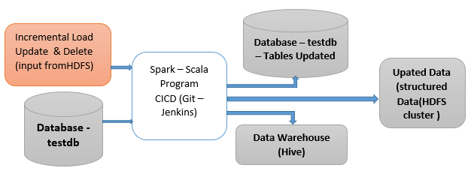
Incremental Load Updates & Deletes

Slide 6
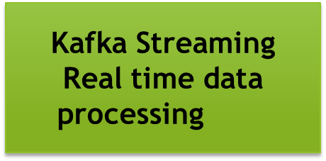
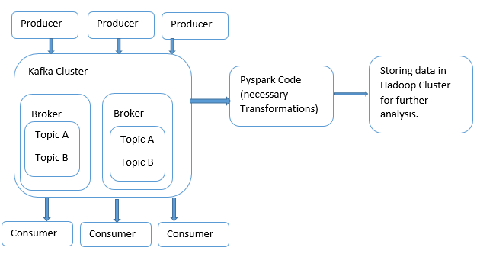


Slide 7
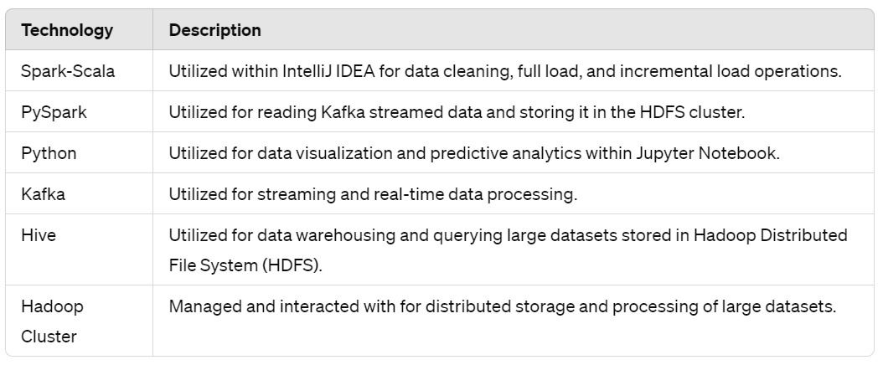
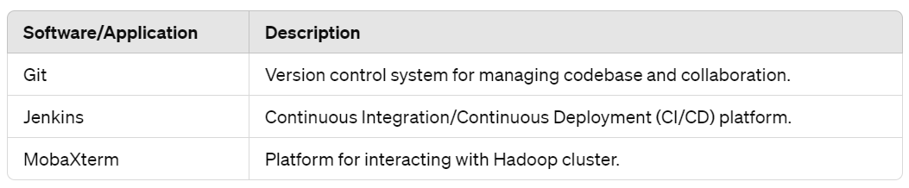

Technologies & Applications
Postgresql Relational Database Management System

Slide 8
Challenges Faced
Connecting PostgreSQL using JDBC driver in the Hadoop cluster.
Incremental Load – Updates and deletes in PostgreSQL DB.
Faced issues executing Mysql-connector python library in PySpark.
Connected Jupyter Notebook to server but unable to write to Hadoop cluster and Hive Table.

Slide 9
Further Enhancements
Curated data can be stored in HBase, as it provides low latency
Delta Lake enables efficient updates and deletes, facilitating incremental updates to data without rewriting the entire dataset. This saves processing time and resources, especially for large datasets.
Using Docker and Kubernetes streamlines deployment, scaling, and management for improved efficiency and resource utilization.

Slide 10


Slide 11

Thank You…!

