Slide 1
Secure AKS
Authorization - AKS
Authentication for AKS Admins
Integrate AAD – Azure Active Directory with AKS
Kubernetes RBAC
Role
Role Binding
Cluster Role
Cluster Role Binding
Integrate AAD with Kubernetes RBAC

Slide 2




Authorization
Control access through AAD and RBAC
Admins
Developers
Bots
(Jenkins)

Slide 3



Authentication for AKS Admins
Browser
Admin
2
3
Azure AKS Cluster
1
kubectl get nodes
Azure Active Directory
5
Azure AD User: PeratonAdmin
4
K8S API Server
Credentials Cached
Azure AD Groups: PeratonAdminGrp

Slide 4
Kubernetes RBAC
Subjects
API Groups
Resources
Verbs
Users or processes that need access to the Kubernetes API
The K8s API objects that we grant access to
List of actions that can be taken on a resource
Core
Pods
Create
Patch
Kind: Group, User
Kind: ServiceAccount
Extensions
Deployments
List
get
Apps
Services
Watch
Replace
Batch
Stateful sets
Delete
Read

Slide 5
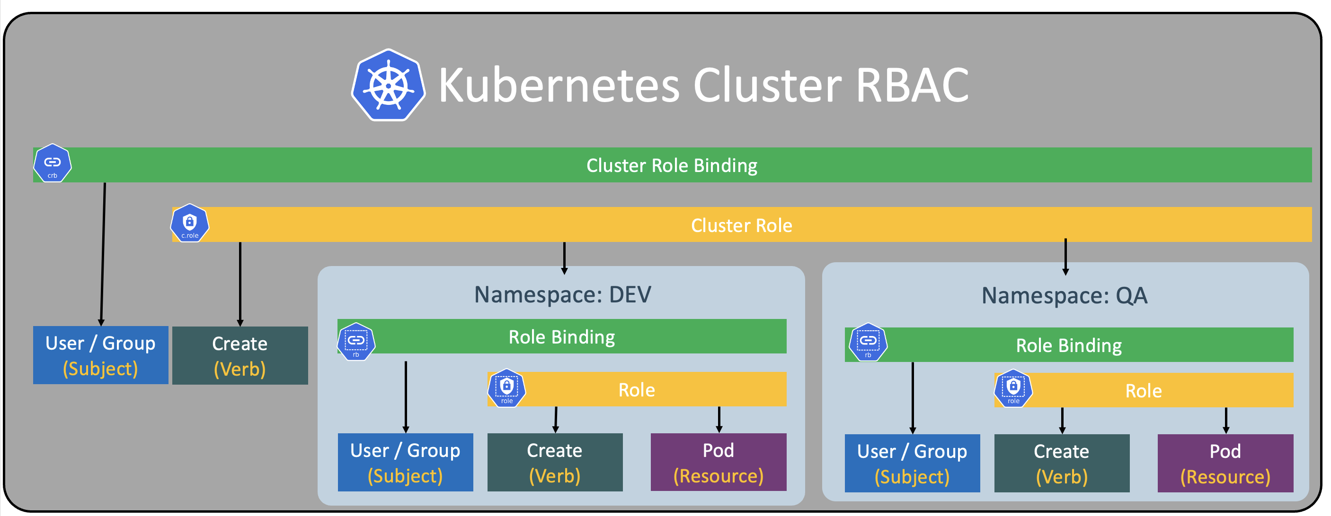
Kubernetes RBAC

Slide 6

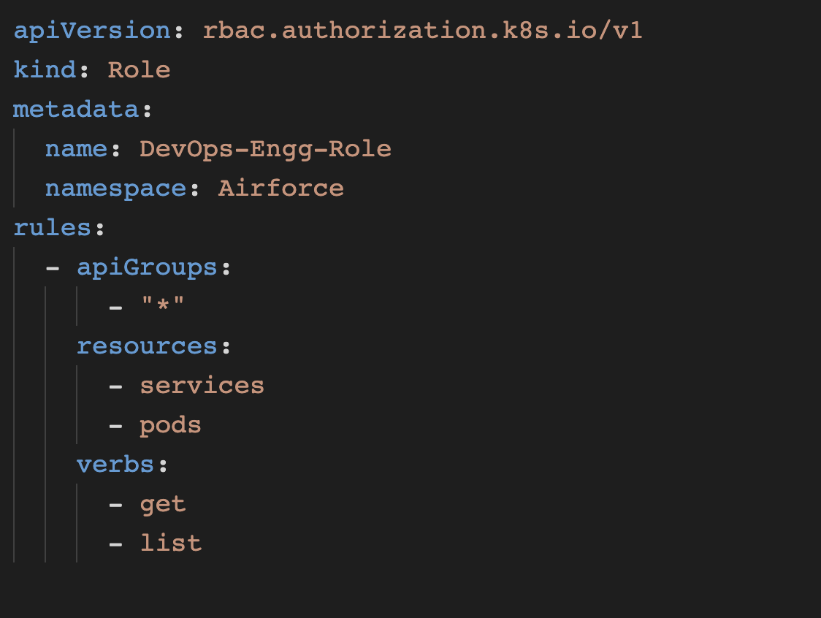
Kubernetes RBAC – Kind: Role
Role Binding

Slide 7

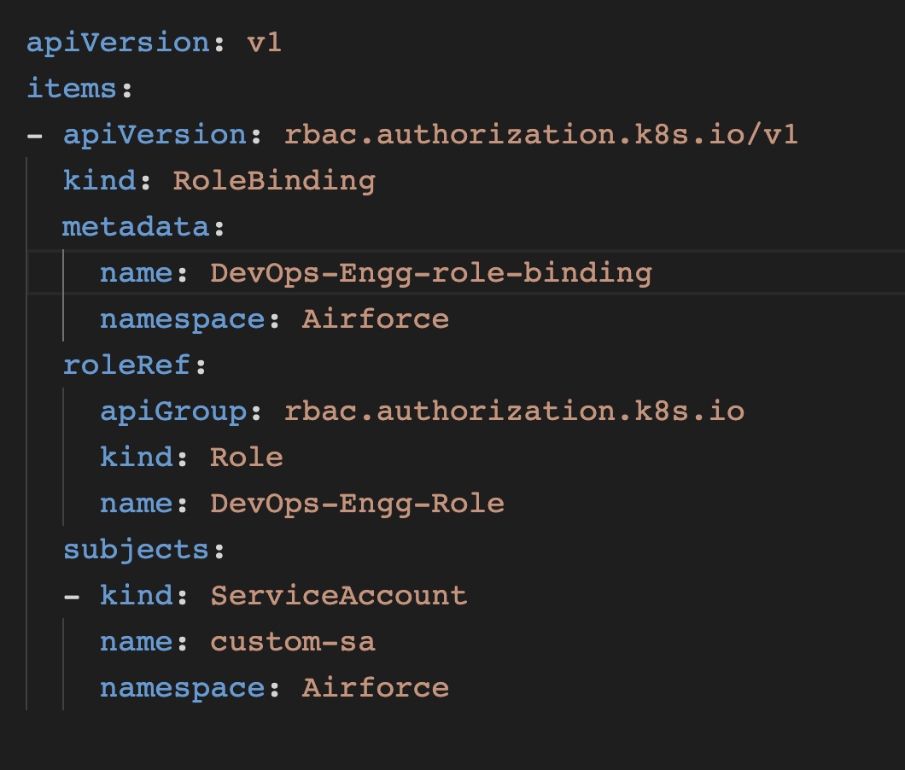
Kubernetes RBAC – Kind: RoleBinding
Role

Slide 8
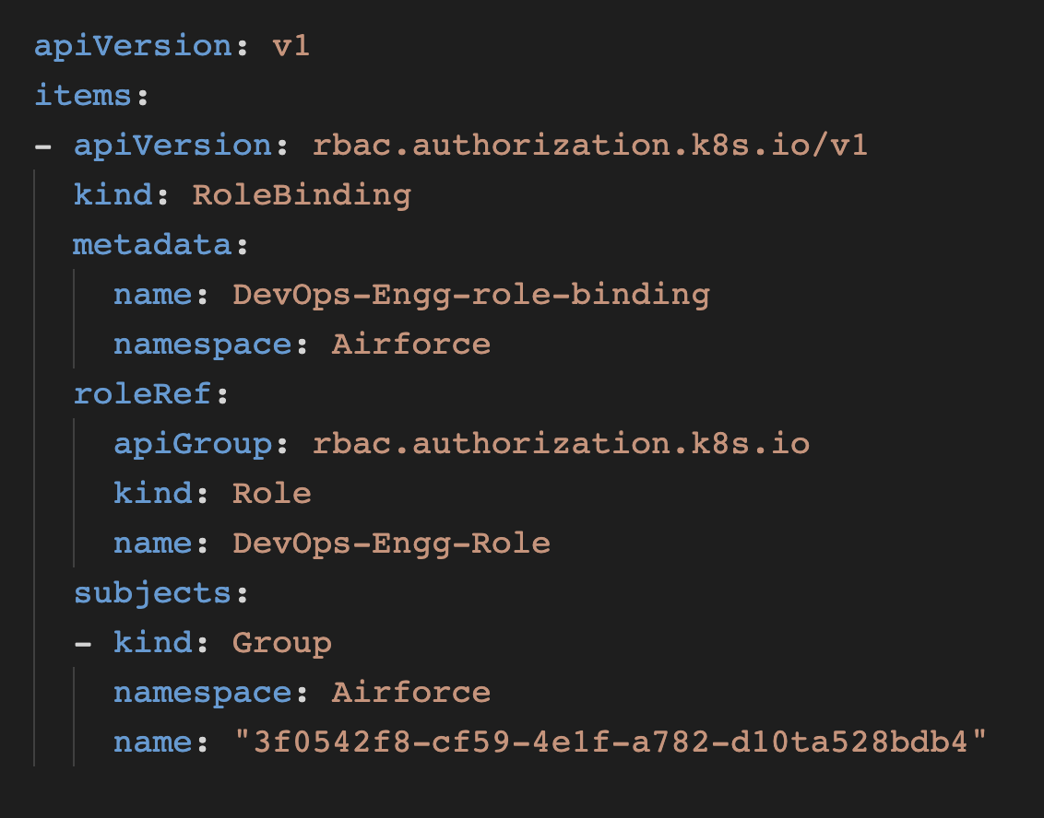
Integrate AAD with Kubernetes RBAC
Azure Active Directory

Slide 9
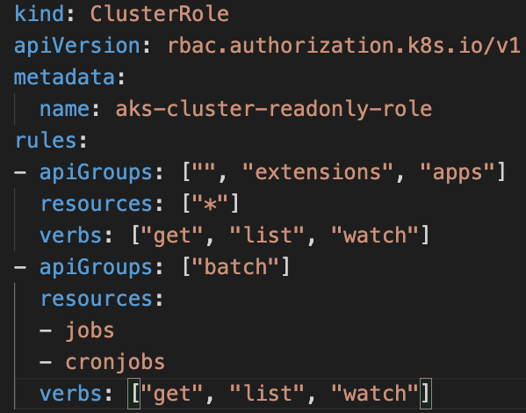

ClusterRole
Read Only access to AKS Cluster

