Slide 1

AdStream Analytics
Ad Tech Revenue Optimization Platform
Documentation and Operational Readiness
Presented by Cherwin N · Department: CSE (AI & ML) · Role: AI Engineer

Slide 2

What Is AdStream Analytics?
An AI-powered advertisement optimization platform that analyzes real-time user behavior signals to recommend the most effective ad placement and format — improving publisher revenue and viewability.
Scroll Depth
Tracks how far users scroll to identify high-attention zones.
Engagement Time
Measures dwell time to gauge content relevance and intent.
Device & Page Type
Adapts recommendations based on device form factor and page context.
AI Explanations
Gemini generates contextual, human-readable rationale for each recommendation.

Slide 3


The Business Problem
Why Revenue Is Falling
Publisher revenue is under pressure from poor ad placement, cookie deprecation, and tightening privacy regulations. The current viewability rate of ~55% falls significantly short of the 70% industry benchmark.
Improve Viewability
Increase RPM
Reduce Latency
Close the gap to the 70% benchmark through smarter placement.
Maximize revenue per mille with format and position optimization.
Deliver recommendations fast enough for real-time bidding flows.

Slide 4

System Architecture & Data Flow
User
Validate
Cache
Optimize
Explain
The pipeline is designed for low-latency, cache-first processing. Redis intercepts repeated requests to avoid redundant computation. Future extensibility includes Kafka for event streaming, ClickHouse for analytics, React for dashboards, and OpenTelemetry + Grafana for observability.

Slide 5






Technologies & Design Decisions
Each technology was selected to support performance, scalability, maintainability, and ease of deployment.
FastAPI
Redis
Async REST API with auto-generated docs and high throughput.
In-memory caching reduces repeated computation and cuts latency.
Docker
Gemini API
Isolates Redis in a portable, reproducible container environment.
Generates contextual, natural-language explanations for each recommendation.
Pydantic
Locust
Enforces strict input validation, preventing malformed requests.
Simulates concurrent user traffic to benchmark API performance.

Slide 6
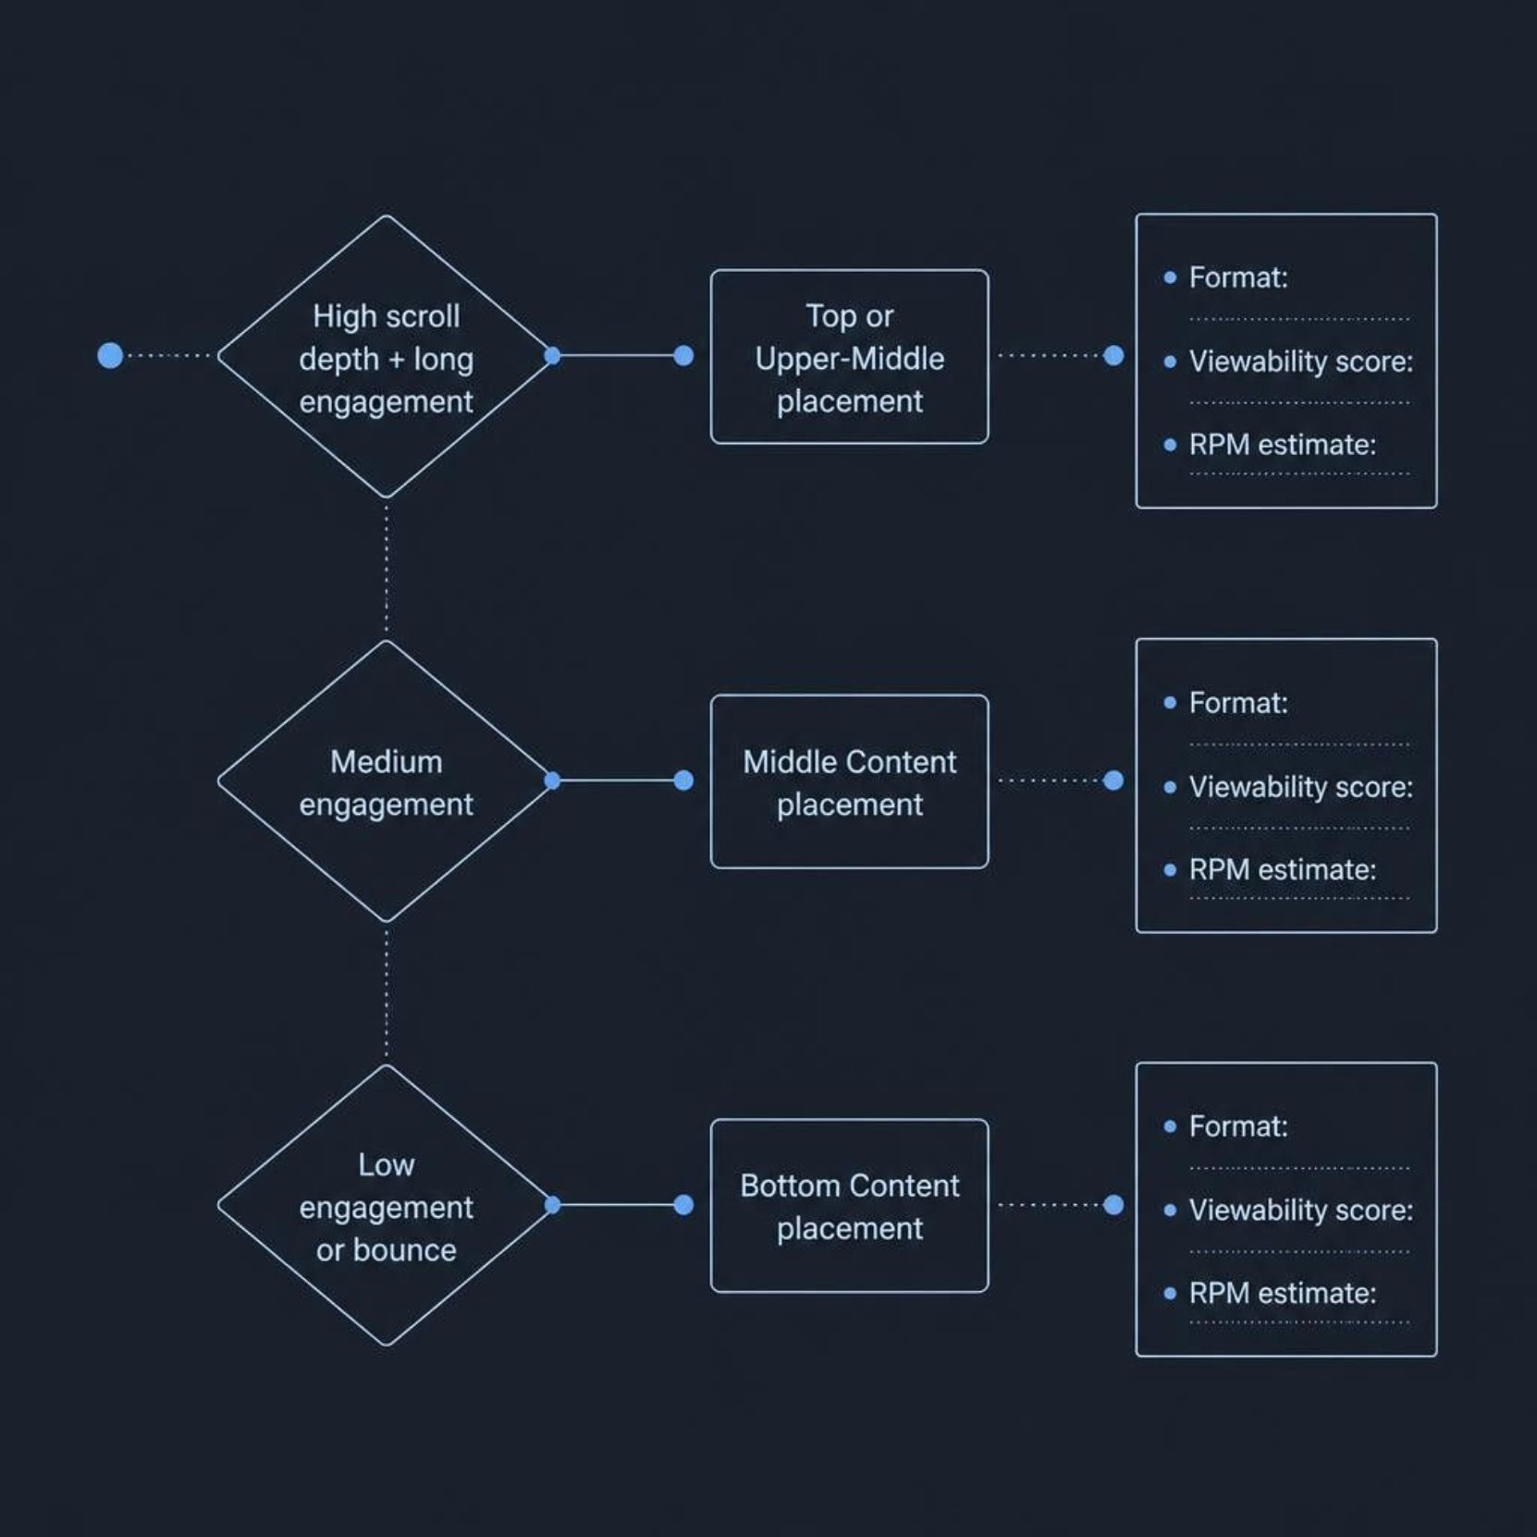
API Endpoints & Optimization Logic
GET /health
Verifies FastAPI availability and Redis connectivity. Used for uptime monitoring and orchestration health checks.
POST /optimize-placement
Accepts scroll depth, time on page, device type, and page type. Returns:
Recommended ad position (top, upper-middle, middle, bottom)
Ad format and predicted viewability score
Estimated RPM and Gemini-generated explanation
LLM usage status flag

Slide 7

Operational Runbook & Maintenance
01
02
03
Start Services
Health Verification
Log Inspection
Launch FastAPI and Redis via Docker. Confirm both are running before accepting traffic.
Call GET /health to confirm API and Redis connectivity.
Review application and Docker logs for validation errors, timeouts, or connection failures.
04
05
Service Recovery
Routine Maintenance
Restart failed services, re-verify health, and document root cause and resolution.
Update dependencies, rotate API keys via environment variables, run scheduled load tests, and back up configurations.
Gemini Fallback: If the Gemini API is unavailable, the system degrades gracefully to rule-based explanations — ensuring zero downtime for recommendations.

Slide 8

Monitoring & Incident Response
Observability Stack
Incident Response Flow
Today, /health and Docker logs provide baseline visibility. The roadmap includes OpenTelemetry for distributed tracing and Grafana for dashboards tracking:
Detect — Health endpoint alerts or log anomalies trigger investigation.
Request count and latency (p50, p99)
Failure rate and error breakdown
CPU and memory utilization
Service availability and cache hit rate
Isolate — Identify the failed component: FastAPI, Redis, or Gemini.
Recover — Restart the service and verify via /health.
Document — Record root cause and resolution for post-mortem review.

Slide 9

Load Testing with Locust
Locust simulates concurrent users hitting GET /health and POST /optimize-placement to measure throughput, latency, and failure rate under load.
Metric
Result
Concurrent Users
[Enter Locust result]
Total Requests
[Enter Locust result]
Requests / Second
[Enter Locust result]
Average Response Time
[Enter result] ms
Maximum Response Time
[Enter result] ms
Failure Percentage
[Enter result] %
Replace placeholder values with actual Locust test results. Include a screenshot of the Locust web UI report alongside this table for visual validation.

Slide 10

Conclusion & Roadmap
AdStream Analytics delivers data-driven ad placement recommendations with a performant, cache-aware backend and AI-generated explanations — directly addressing the viewability and revenue gap.
✅ Delivered
FastAPI REST API, Redis caching, Gemini explanations, Pydantic validation, Docker deployment, and Locust load testing.
🔭 Next: Real-Time Events
Integrate Kafka for streaming user engagement events and ClickHouse for large-scale analytics.
🔭 Next: Publisher Dashboard
Build a React dashboard for publishers to view recommendations, RPM trends, and viewability scores.
🔭 Next: Advanced ML
Replace rule-based logic with trained models for more accurate viewability and revenue predictions.

