Slide 1


Slide 2

AI BOT
IT’S A BOT IN WHICH IT WORKS ON MESSENGERS LIKE FACEBOOK WHATSAPP ETC…
THE MAIN FEATURE OF THIS BOT IS THROUGH VOICE WE CAN CONTROL THE OTHER MESSENGER LIKE KNOWING THE PERSON WHO ARE ONLINE, MESSAGING ANY PERSON WITH VOICE .

Slide 3
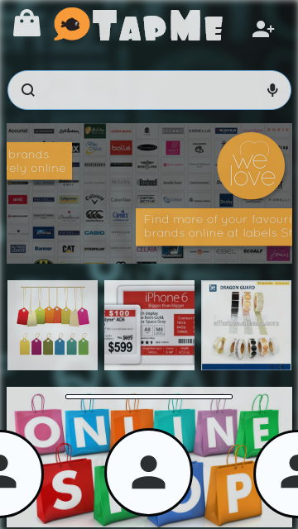
INNOVATIVE WAY OF MARKETING
IT’S A FEATURE BASED ON A SURVEY IN WHICH PRESENT
E-COMMERCE WEBSITES ARE WORKING – “ GIVEING A FEEL OF SHOPPING TOGETHER THROUGH ONLINE.”

Slide 4
INCULCATING OF CLOUD COMPUTING
THE ADVANTAGE OF THIS APP IS WITH THE HELP OF CLOUD COMPUTING THE APP WILL BE INSTALLED IN A SERVER AND WHEN WE CREATE AN ACCOUNT AN INSTANCE OF THE APP WILL BE GENERATED AS A RESULT OF WHICH THE APP WILL BE OF SIZE LESS THAN SOME 20 MB.
EVEN ONE DISADVANTAGE IS THE INTERNET CONNECTION MUST BE GOOD.

Slide 5
LOCATING NEAREST FRIENDS
IT IS A FEATURE IN WHICH THE APP GONA GIVE YOU A NOTIFICATION ONCE A FRIEND OF YOURS IS NEAR BY YOU, PROVIDED YOU HAVE GIVEN THE PERMISSION.
ONCE THE PERSON IS NEAR BY THE LOCATION , BUTTON WILL INDICATE BY CHANGING COLOR.
EVEN YOU CAN INVITE YOUR FRIEND WITH THE LOCATION ATTACHED.

Slide 6
Partial grouping of members
IT IS A FEATURE IN WHICH PARTIALLY A GROUP WILL BE FORMED AND THE MEMBERS ARE BASED ON THE USER REQUIREMENT.
THE USER ONLY HAVE TO DECIDE THE TIME PERIOD FOR THE VALIDITY OF THE GROUP AND ONCE THE VALIDITY IS OVER THE MESSAGES WILL BE DELETED AUTOMATICALLY.

Slide 7
MUTUAL INTERCHANGE OF CALLS
IT’S A FEATURE IN WHICH YOU CAN TALK WITH A GROUP OF PERSON IN BOTH AUDIO CALL AND VIDEO CALL COMBINED TOGETHER.
IT EVEN INCLUDES MUTUAL CHANGE OF AUDIO TO VIDEO CALL SIMULTANIOUSLY

Slide 8

Thank you

