Slide 1

Name: Cheryl Achieng ,Regno: C027-01-2630/2021
Mobile Banking: Revolutionizing Business and Information Technology

Slide 2
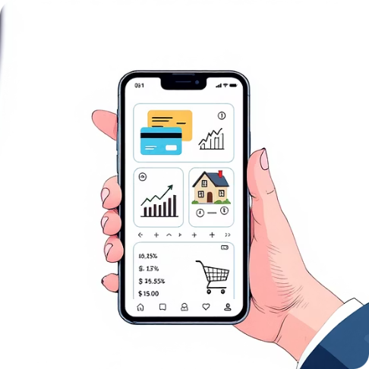
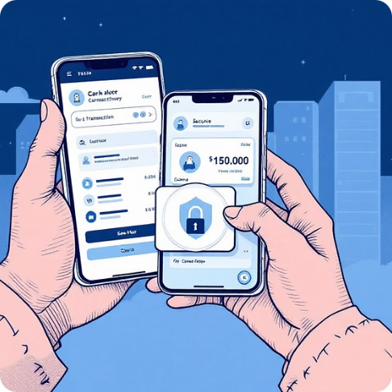
The Dawn of a New Banking Era: Mobile Innovation
Accessibility Redefined
Services at Your Fingertips
Mobile banking and banking applications stand as pivotal innovations within the realms of Business and Information Technology. This groundbreaking development empowers customers to seamlessly access a comprehensive suite of banking services directly from their mobile phones and internet-enabled devices.
Gone are the days of mandatory physical visits to banking halls. Mobile banking applications facilitate a wide array of functionalities, including instant fund transfers, convenient bill payments, real-time balance inquiries, streamlined loan applications, and efficient online customer support.

Slide 3
Driving Efficiency and Inclusion: The Core Benefits
Improved Operational Efficiency
Reduced Costs for Banks
Enhanced Financial Inclusion
Increased Customer Convenience
The shift to digital platforms translates directly into reduced operational costs for banks. Lower overheads associated with physical infrastructure and human resources allow banks to reallocate capital towards innovation and improved customer offerings.
For financial institutions, mobile banking has significantly enhanced operational efficiency. Automating routine transactions reduces the need for extensive branch networks and manual processing, leading to substantial cost savings and optimized resource allocation.
Perhaps one of the most profound impacts is the enhancement of financial inclusion. Mobile banking extends banking services to previously underserved populations, particularly in rural areas, bringing more people into the formal financial system.
Customers benefit immensely from unparalleled convenience. The ability to manage finances anytime, anywhere, fosters greater financial autonomy and satisfaction, aligning with the demands of a fast-paced, digital lifestyle.

Slide 4
Transformative Impact in Developing Countries
In developing countries, the impact of mobile banking has been nothing short of revolutionary. A prime example is Kenya, where mobile banking has fundamentally reshaped the financial sector.
Accessibility for All: Mobile banking has made financial services accessible to both urban and rural populations, bridging geographical divides and socioeconomic barriers that once excluded millions from traditional banking.
Economic Empowerment: This increased accessibility has fostered greater economic empowerment, enabling small business owners, farmers, and individuals to manage money more effectively, save, and access credit.
Innovation Hubs: The success of mobile banking in these regions has also positioned them as innovation hubs for financial technology, inspiring similar advancements across the globe.

Slide 5


Navigating the Future of Mobile Banking
Components
Challenges
Evolution
Benefits
Future
This presentation will delve deeper into the multifaceted landscape of mobile banking, offering a comprehensive discussion on its evolution from nascent technology to a global phenomenon. We will explore its core components, analyze the myriad benefits it offers to both consumers and institutions, and critically examine the challenges that still need to be addressed. Finally, we will cast an eye towards the future, contemplating the next wave of innovations and prospects for mobile banking in the dynamic business environment.

