Slide 1

Name :Cheryl Achieng RegNo:C027-01-2630/2021
The Rhythm of a Continent: African Music's Enduring Impact
African music is more than just sound; it's the heartbeat of culture, deeply interwoven with leadership, social cohesion, and societal transformation. Join us on a journey to explore its profound influence.

Slide 2
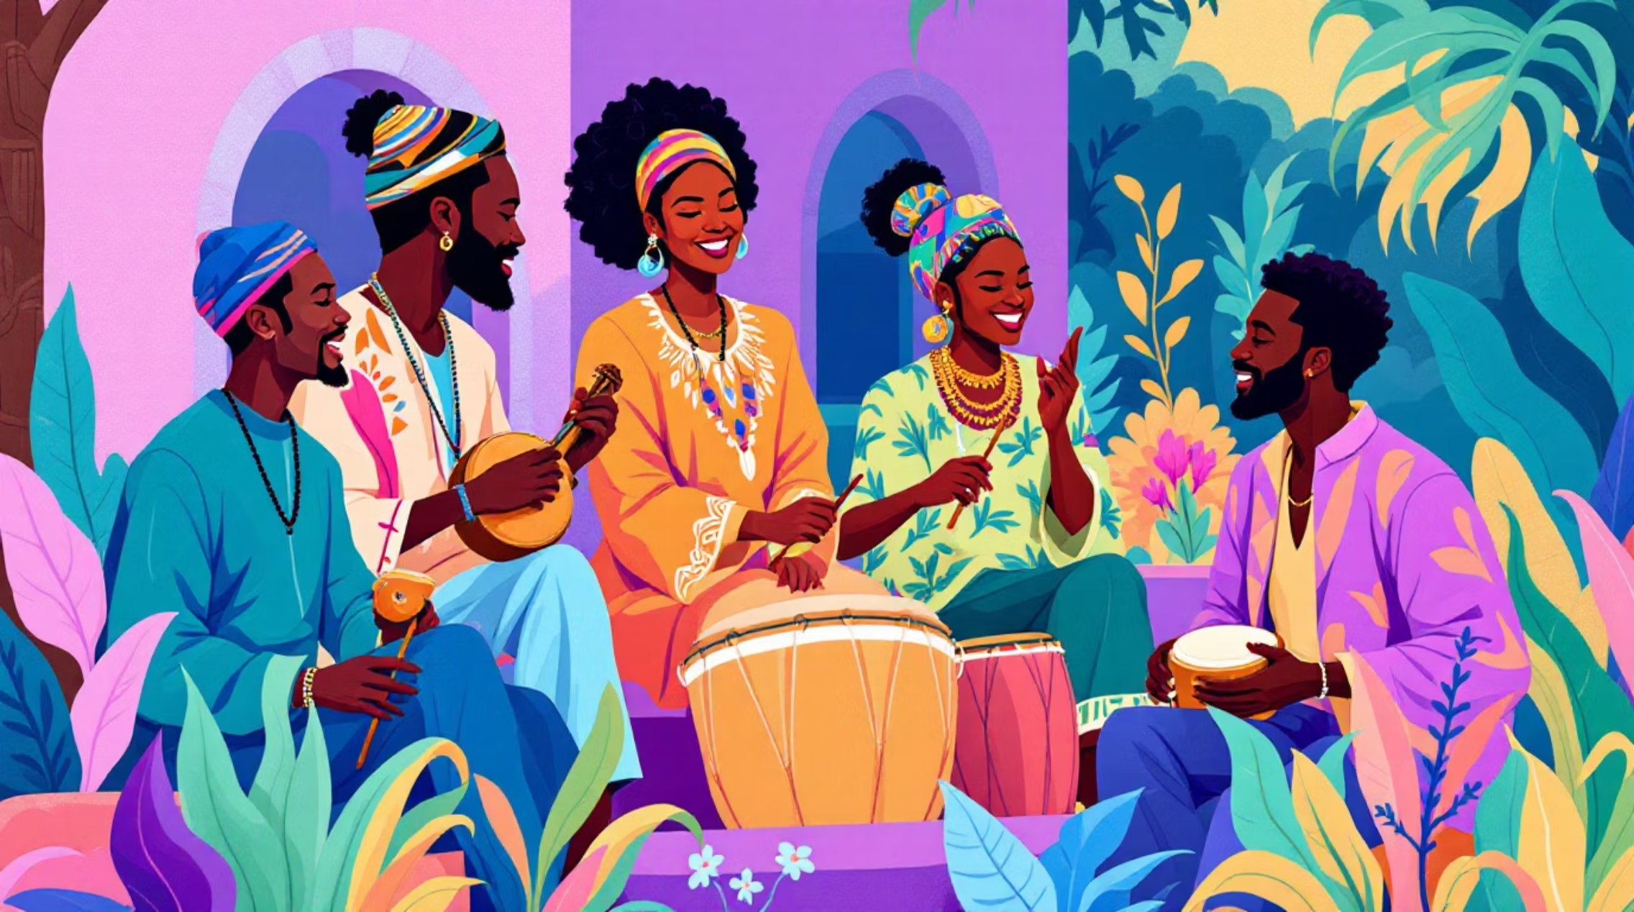
THE VOICE OF A CONTINENT
FOUNDATION
Music: The Unifying Force in African Societies
Traditionally, African music transcends mere entertainment, serving as a powerful medium for communication, historical preservation, and even governance. Through its diverse forms—from rhythmic drumming to melodic praise songs and captivating storytelling—music has always played a central role in reinforcing leadership, fostering unity, and strengthening the collective identity of communities.
Praise Songs
Storytelling
Communal Rhythms
Celebrating leaders and achievements.
Preserving history and wisdom.
Uniting hearts and minds.

Slide 3


EVOLUTION & EMPOWERMENT
TRANSFORMATION
Challenging Norms: Music and Gender Awareness
While traditional music often mirrored existing gender roles—with certain instruments or performance styles reserved for men—contemporary African music is actively challenging these stereotypes. Today, female musicians are increasingly using their platforms to advocate for women’s rights, equality, and social justice, spearheading a movement towards greater gender awareness and inclusion.
Advocacy Through Art
Breaking Barriers
Promoting Equality
Female artists amplify voices for change.
Challenging traditional gender-specific roles.
Music as a catalyst for social justice.

Slide 4
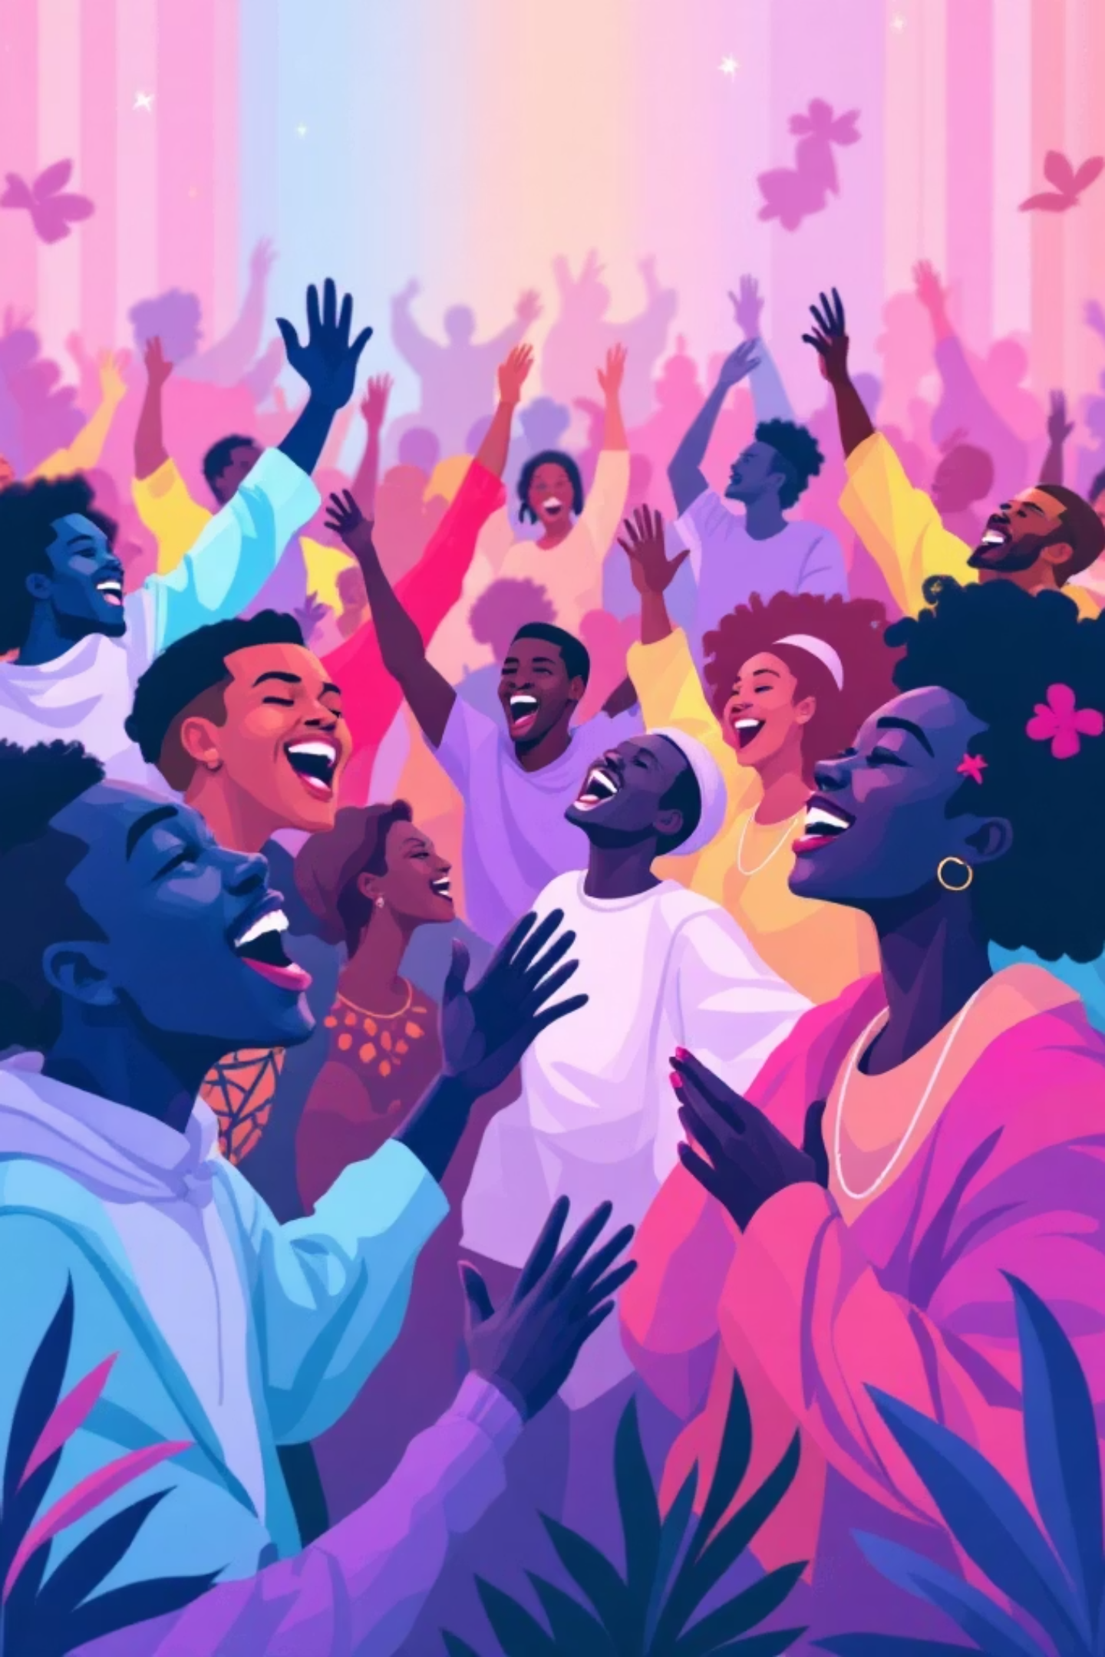
Preserving Heritage, Embracing Progress
African music stands as a cultural cornerstone, strengthening leadership and fostering social cohesion. Yet, its evolution also promotes crucial gender awareness. It's a testament to the power of art to both honor positive traditions and champion inclusive, equitable participation for all.
Let's continue to celebrate this vibrant heritage while embracing its role in forging a more just and harmonious future.

