Slide 1
Boston 311 Service Request Performance Analysis (2015–2019)
ALY6015 – Intermediate Analytics
Instructor: Prof. Roy Wada
Group Members: Krithika Krishna Murthy, Cheryl Mushangwe, Vanessa Mutimaamba, Wenjun Chen

Slide 2




Project Overview
Introduction
Boston 311 is a centralized system for non-emergency service requests submitted by residents. Analyzing this data provides insight into municipal service efficiency, response speed, and equity across neighborhoods.
Goal: Evaluate trends and determinants of service request closure performance between 2015 and 2019.
Submit Request
System Intake
Department Action
Resolve Case
This streamlined process connects residents directly to city services for efficient problem resolution.

Slide 3



Key Questions
Research Questions
Trends Over Time
Channel Impact
Predictive Factors
How did service request volume, closure time, and timely closure change from 2015–2019?
Is submission channel associated with timely closure?
Which request characteristics predict longer or shorter closure times?

Slide 4
Data Source
Dataset Description
Key Variables
Boston 311 Service Requests (2015–2019)
~1.2 million service requests
Source: Boston Open Data Portal
Open & closure dates
Department and subject
Neighborhood
Submission channel

Slide 5
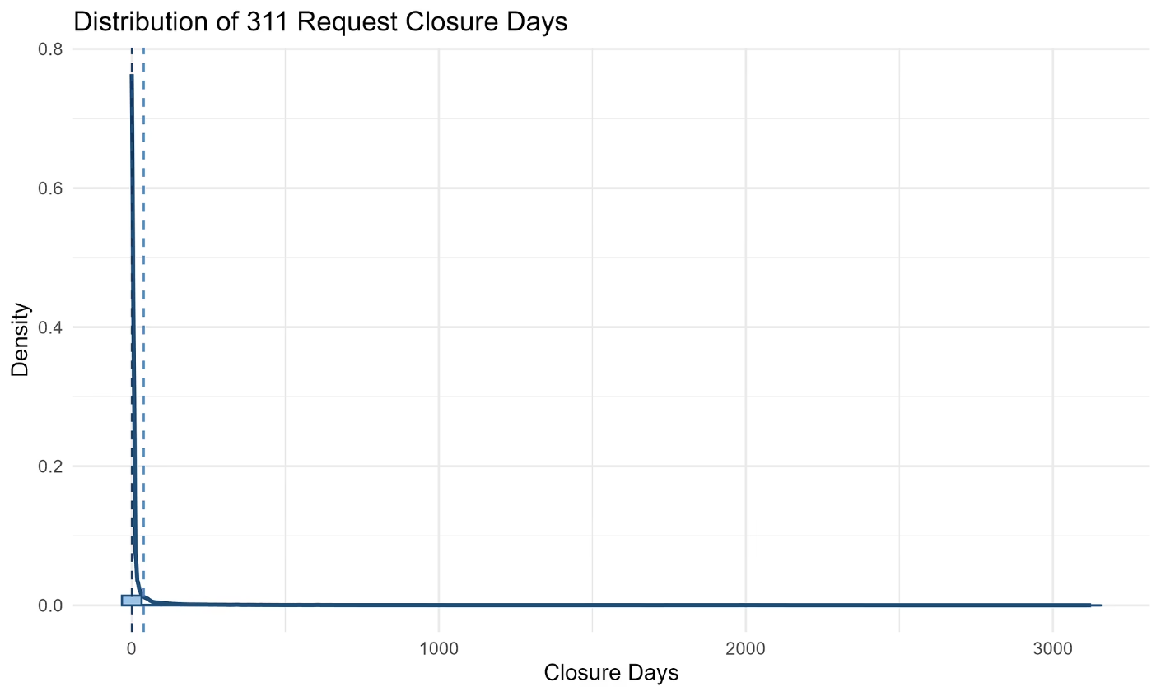
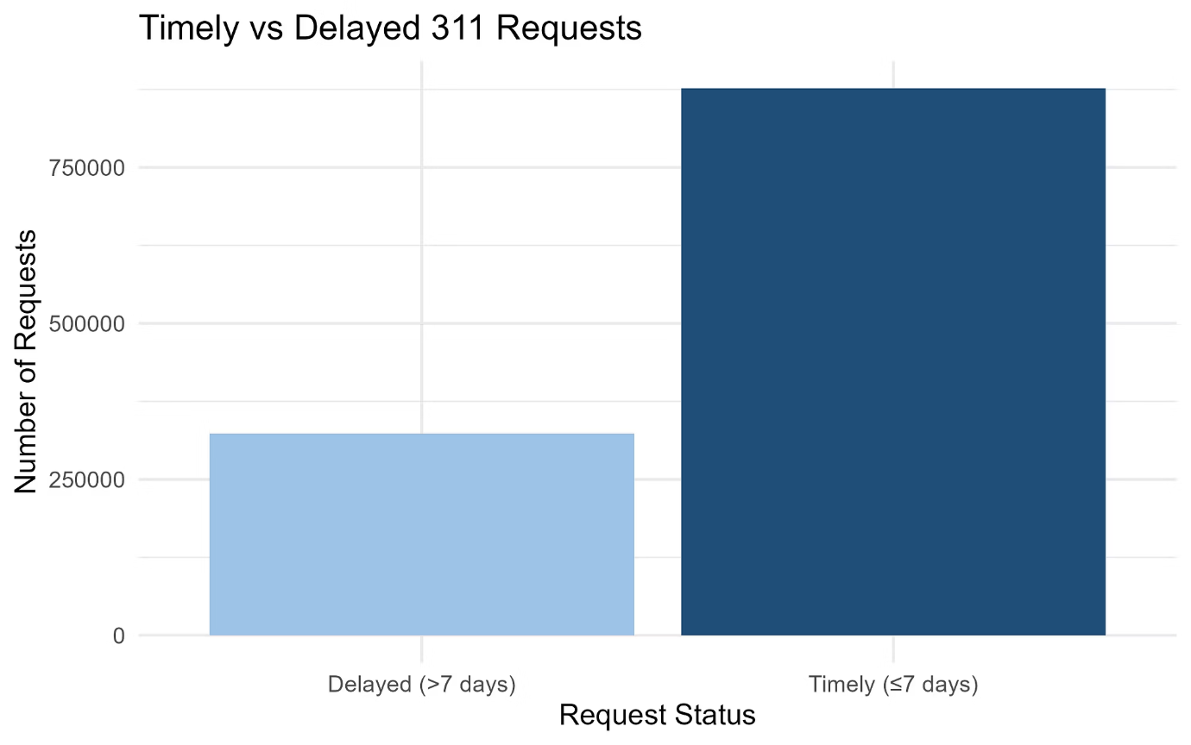
Key Outcomes
Outcome Variables
Closure Days
Timely Closure
Days between request opening and closure
Binary indicator (closed within 7 days)
Data Characteristics
Highly right-skewed distribution
Small number of extreme delays

Slide 6
Analytical Approach
Methods Overview
Analytical Approach
Why These Methods
Descriptive statistics
Chi-square test
Logistic regression
LASSO regression
Suitable for large administrative data
Handle skewed and binary outcomes
Identify key predictors

Slide 7

Descriptive Statistics
Summary Statistics (2015–2019)
1.2M
38.79
0.77
71.86%
Total Requests
Mean Closure Days
Median Closure Days
Timely Closure Rate
Interpretation: Large gap between mean and median indicates extreme delays in a small subset of cases

Slide 8
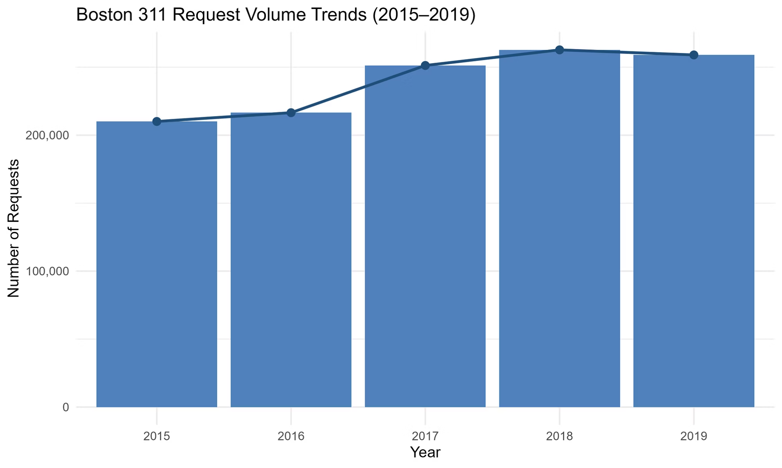
Request Volume Trends
Requests Over Time
Key Findings
Volume increased from 2015–2018
Slight decline in 2019
Interpretation: Growing demand places pressure on service delivery

Slide 9
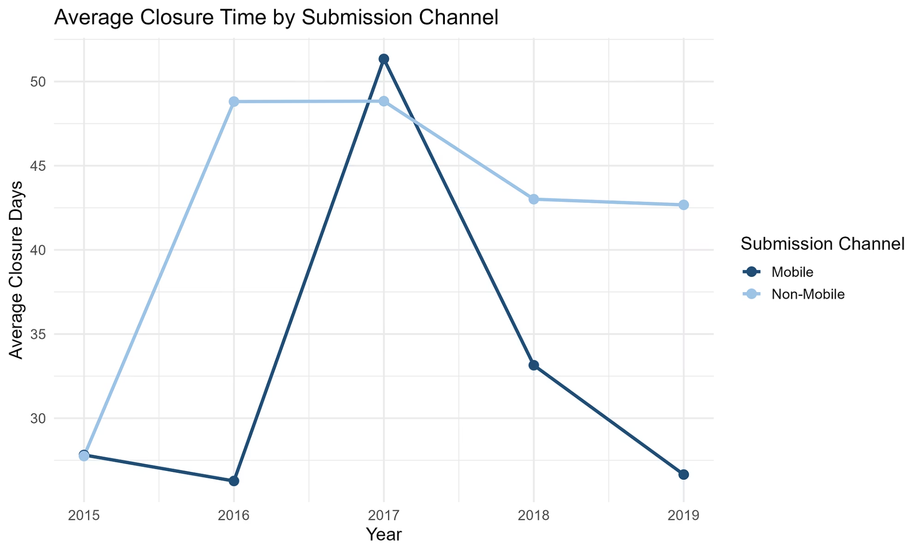
Closure Time Trends
Average Closure Days by Year
Analysis
Increased sharply, peaking in 2017
Improved after 2017 but remained above 2015 levels
Interpretation: The spike in 2017 represents a critical period where service delivery faced significant challenges before recovery efforts took effect.

Slide 10
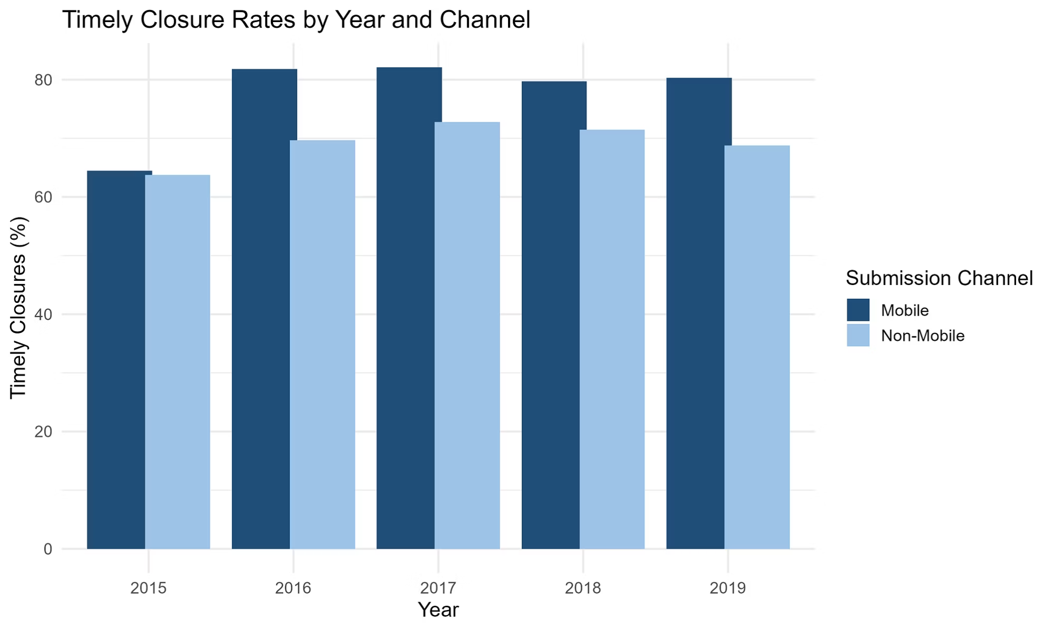
Timely Closure Rates
Percent Closed Within 7 Days
Key Insights
Increased significantly after 2015
Stabilized above 70% after 2017
Interpretation: Efficiency improved despite higher demand

Slide 11
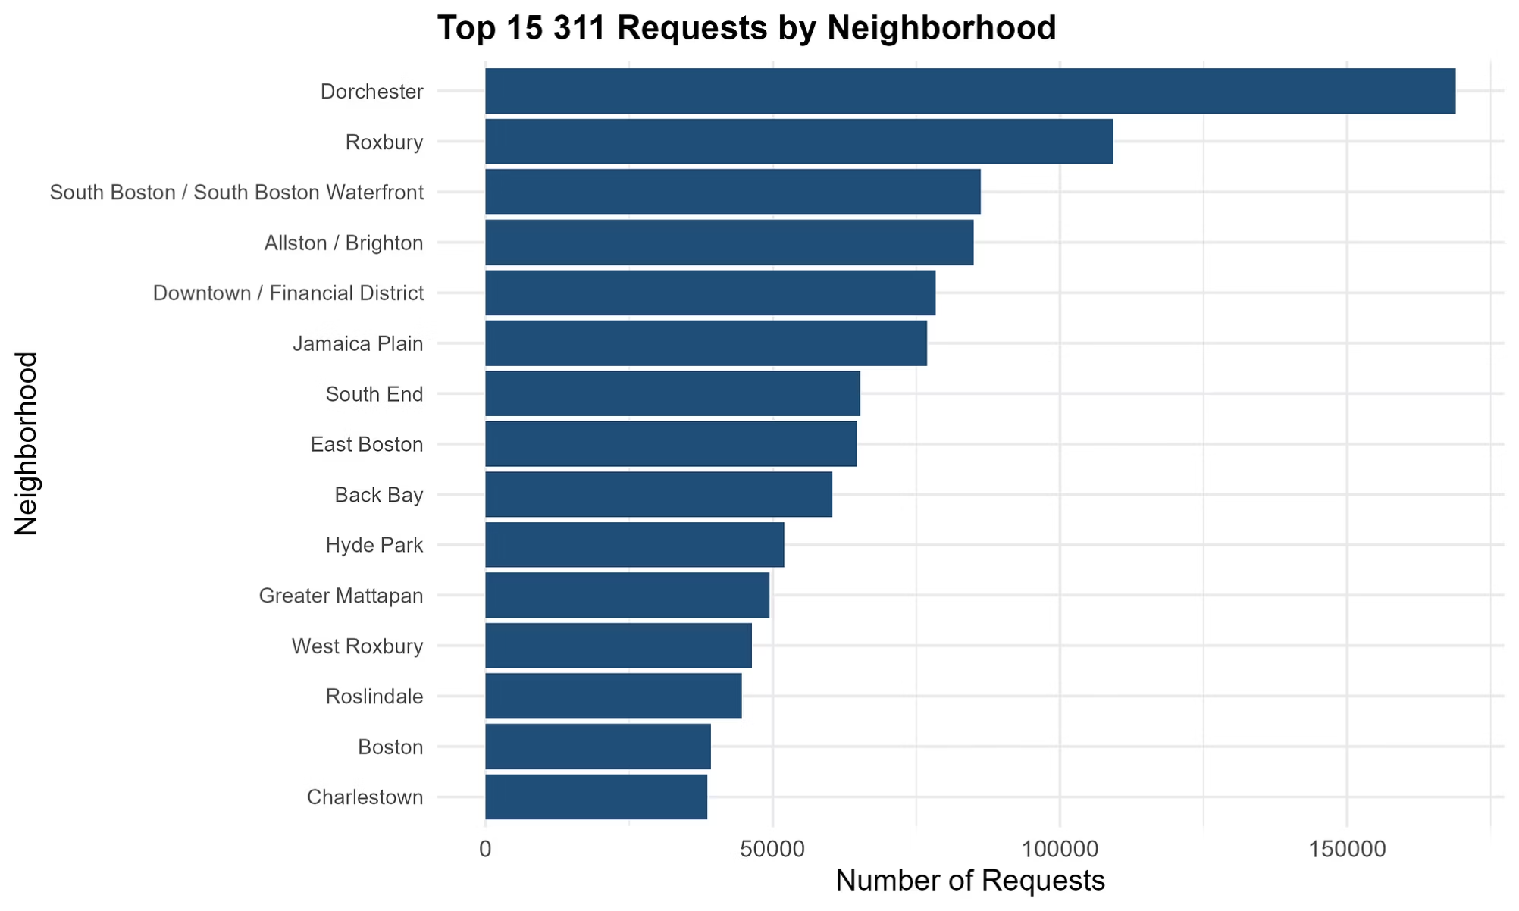
Neighborhood Analysis
Request Volume by Neighborhood
Findings
Highest volume: Dorchester, Roxbury
Reflects population density and area size
The distribution of service requests across neighborhoods provides insight into where municipal resources are most needed.

Slide 12
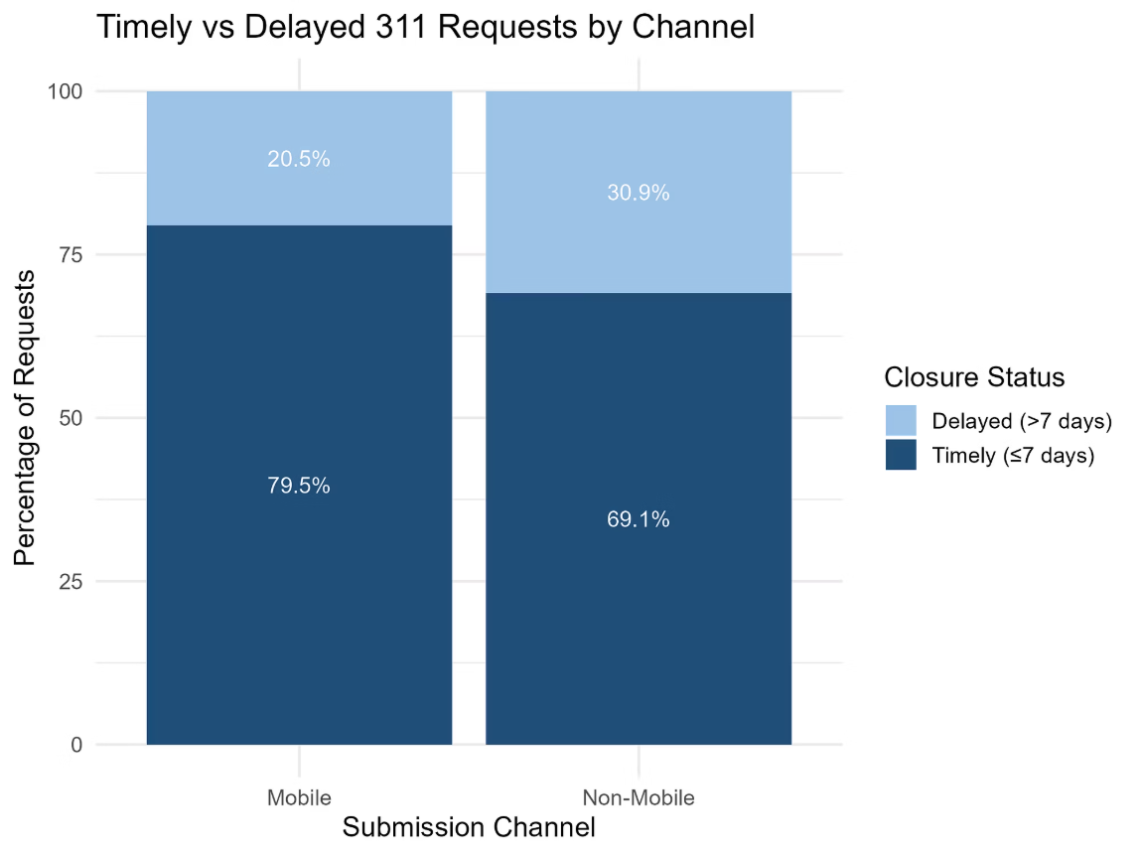
Statistical Test
Chi-Square Test: Channel vs Timely Closure
Mobile
94169
364682
458851
79.5
20.5
Non-Mobile
228980
511826
740806
69.1
30.9
Chi-Square: 15531.83 | df: 1 | p-value: 0
Test Results
Tests association between submission channel and timely closure
Results indicate a statistically significant relationship
Interpretation: Submission channel influences closure performance

Slide 13
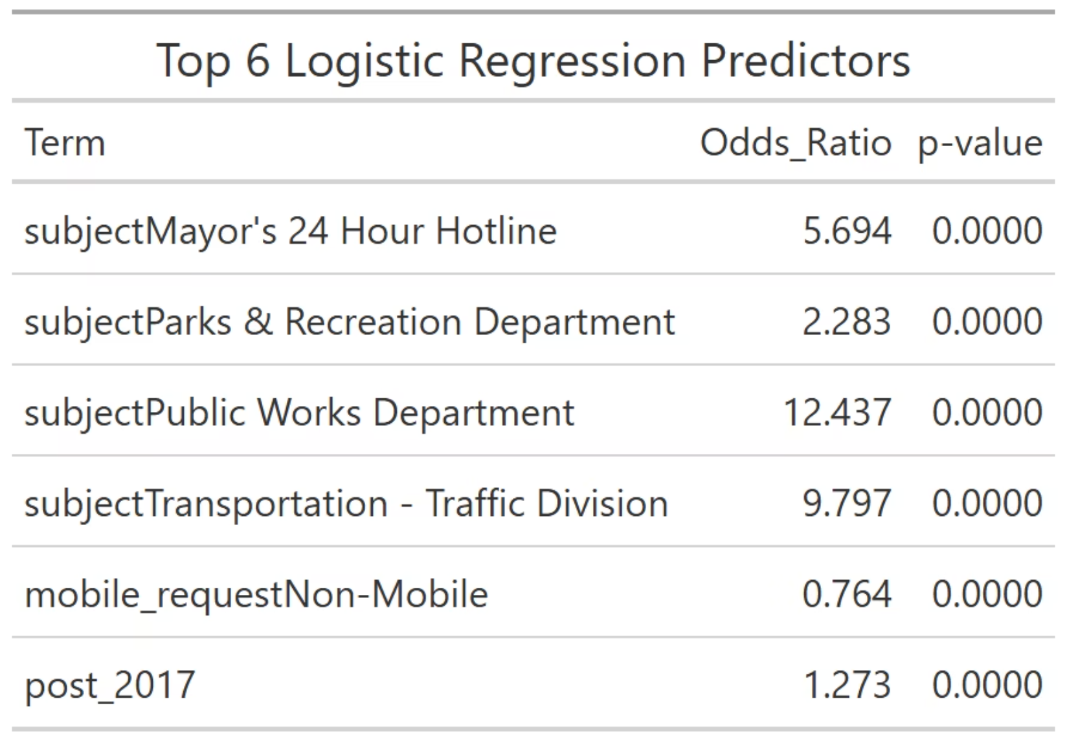
Logistic Regression
Predictors of Timely Closure
Temporal Effects
Channel Impact
Later years → higher odds of timely closure
Submission channel significantly associated
Contextual Variation
Effects vary by subject and neighborhood
Interpretation: Operational improvements over time increased efficiency

Slide 14
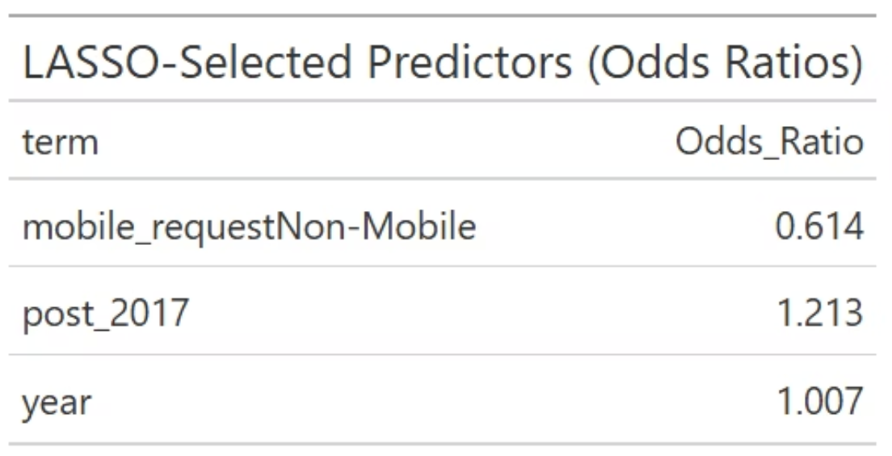
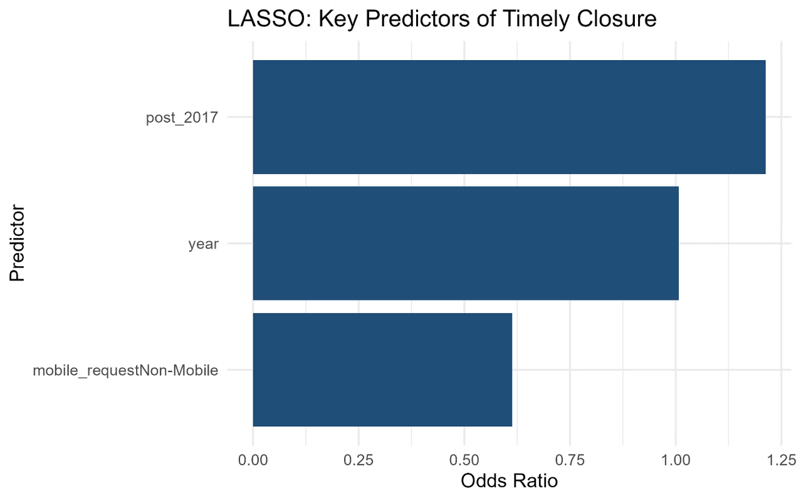
LASSO Regression
Predicting Closure Days
Key Drivers
Identifies strongest drivers of long delays
Service Complexity
Model Efficiency
Infrastructure and regulatory services linked to longer closures
Many predictors shrunk to zero
Interpretation: Delays driven by service complexity, not overall inefficiency

Slide 15




Key Findings
Performance Recovery
Channel Advantage
Demand increased, but performance recovered post-2017
Mobile submissions support faster resolution
Outlier Impact
Geographic Variation
Extreme delays inflate average closure time
Performance varies across neighborhoods and services

Slide 16
Final Answer
Answer to Research Question
Boston's 311 system improved timely closure rates after 2017 despite rising demand. Service delays are primarily driven by the complexity of certain request types and departments rather than system-wide inefficiency.

Slide 17
Actionable Insights
Recommendations
1
2
Focus Improvement Efforts
Streamline Workflows
Focus improvement efforts on high-delay service categories
Streamline workflows for complex departments
3
4
Leverage Technology
Target Neighborhoods
Leverage digital and mobile reporting tools
Target neighborhoods with persistent delays

Slide 18
Conclusion
01
02
03
Collect & Analyze
Generate Insights
Act & Implement
Aggregate 311 requests and metrics
Identify patterns and priority areas
Deploy improvements and monitor results
This data-driven approach transforms raw service request information into actionable strategies for municipal improvement.
311 data provides valuable operational insight
Extreme delays deserve focused attention
Data-driven decisions can improve equity and efficiency

Slide 19
References
Boston Open Data Portal. (2015-2019). Boston 311 Service Requests. Retrieved from Boston Open Data Portal.

Slide 20
Any questions?

