Slide 1
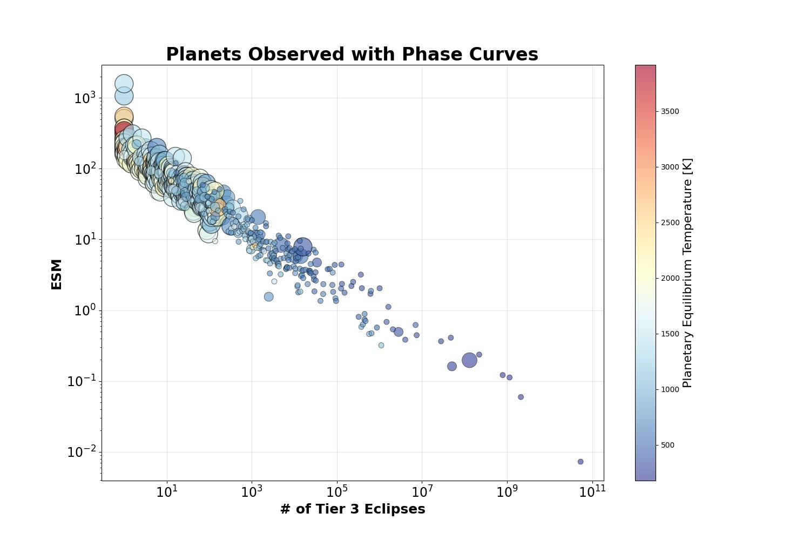

Ariel Emission Metric $≈$ ESM

Slide 2
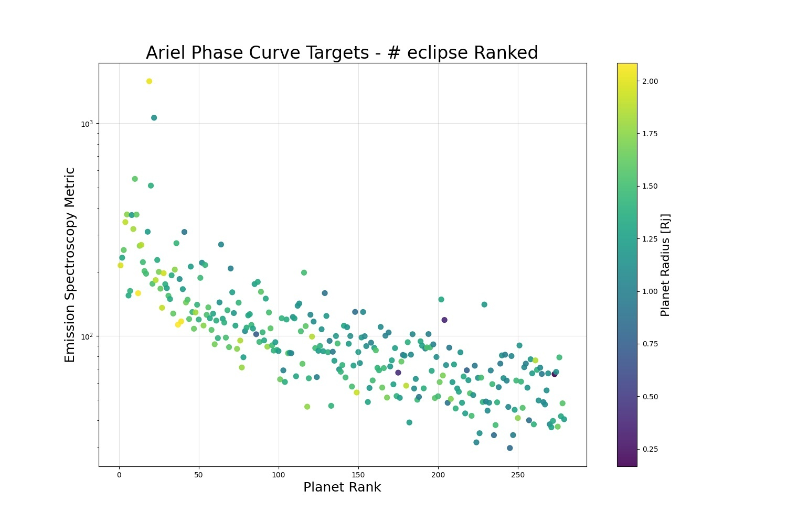
Top 100 Ariel Emission Targets have ESM > 100

Slide 3
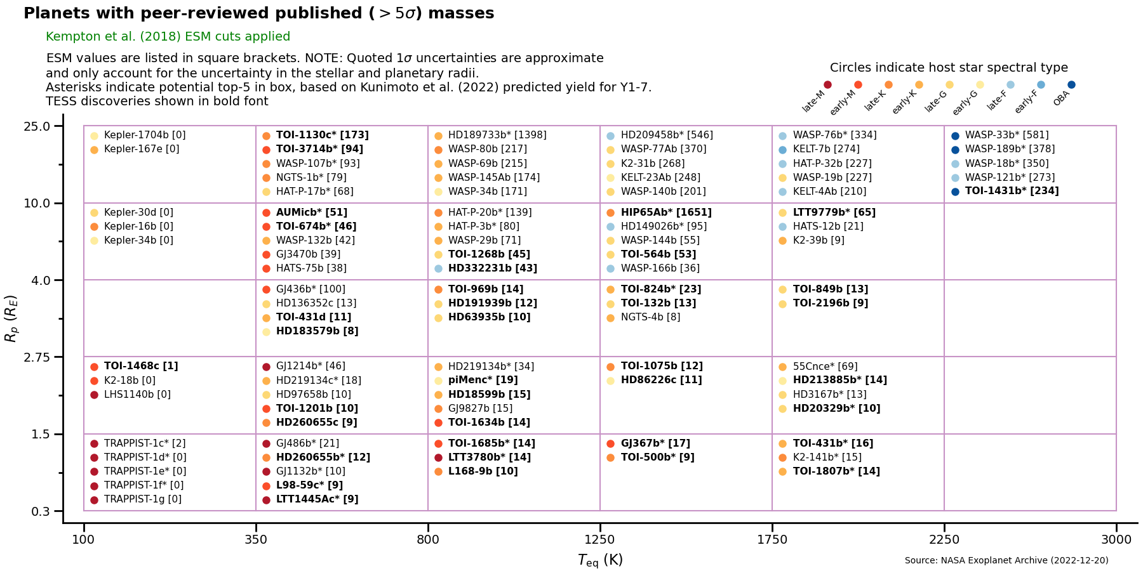
Putting ESM=100 in context

Slide 4
Ariel obtains full-orbit phase curves of top 100 emission targets

Slide 5
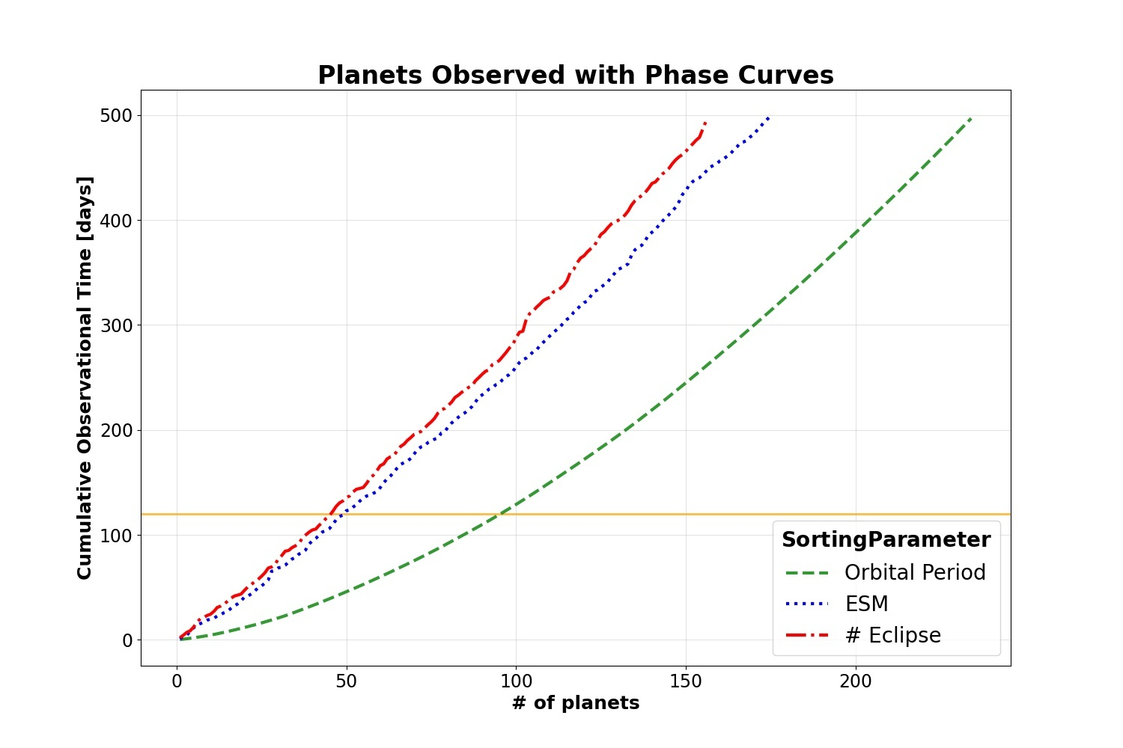

Phase Curves of Top 100 Ariel Targets $≈$ 300 days

Slide 6
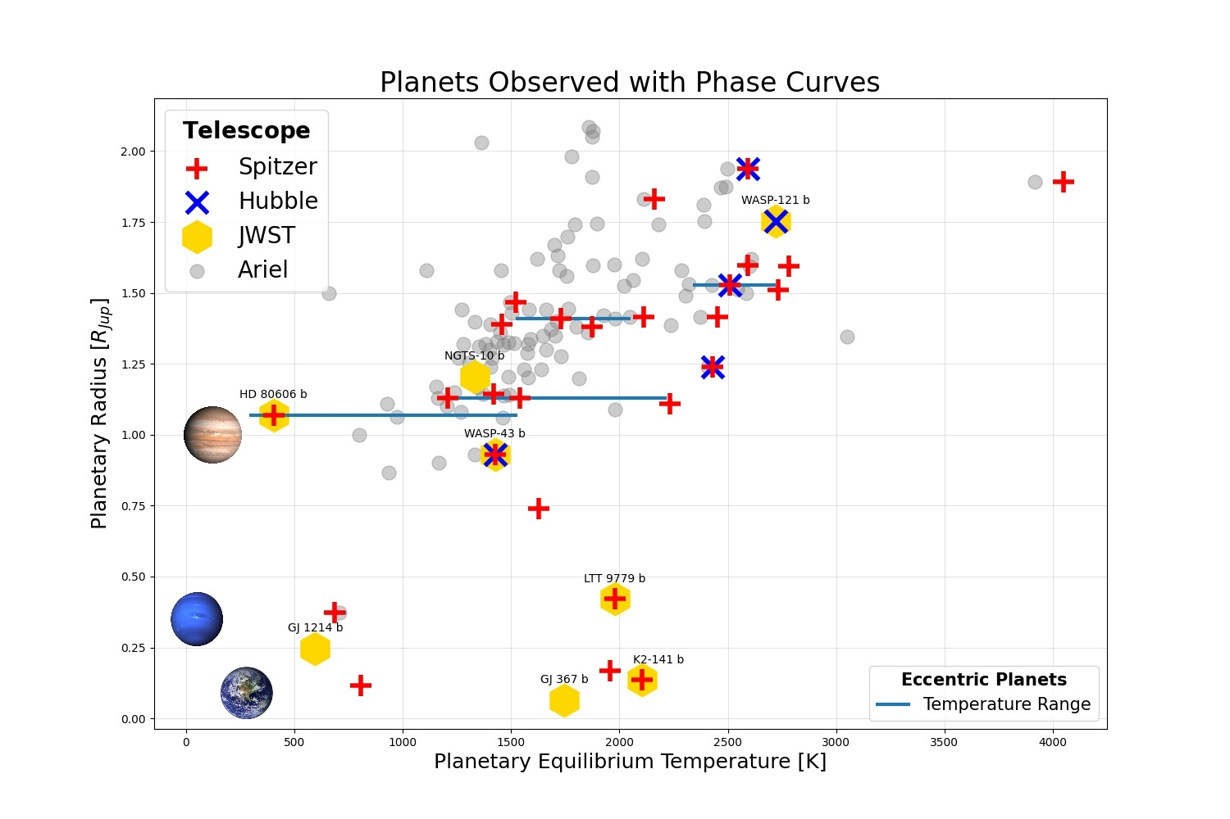
100 Ariel Full-Orbit Phase Curves

Slide 7
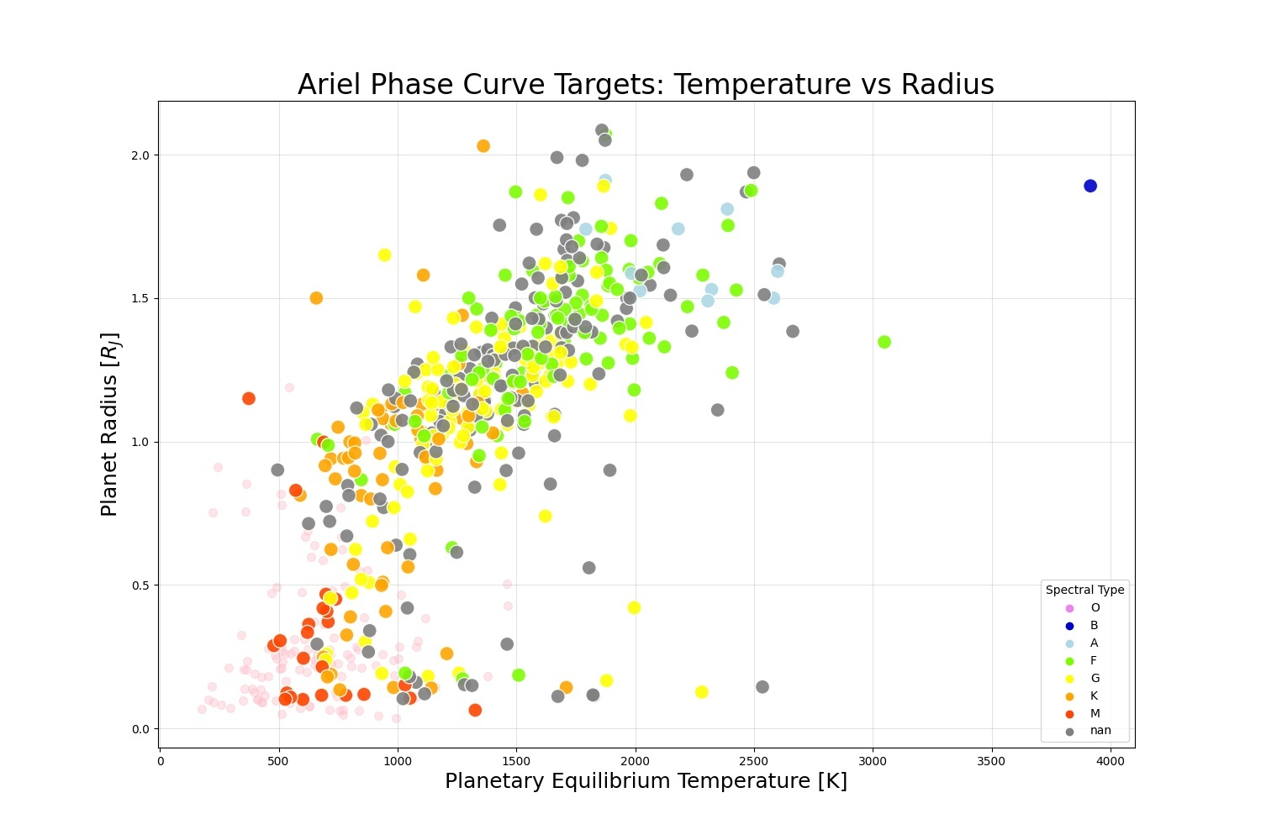
Mostly around F and G stars

Slide 8
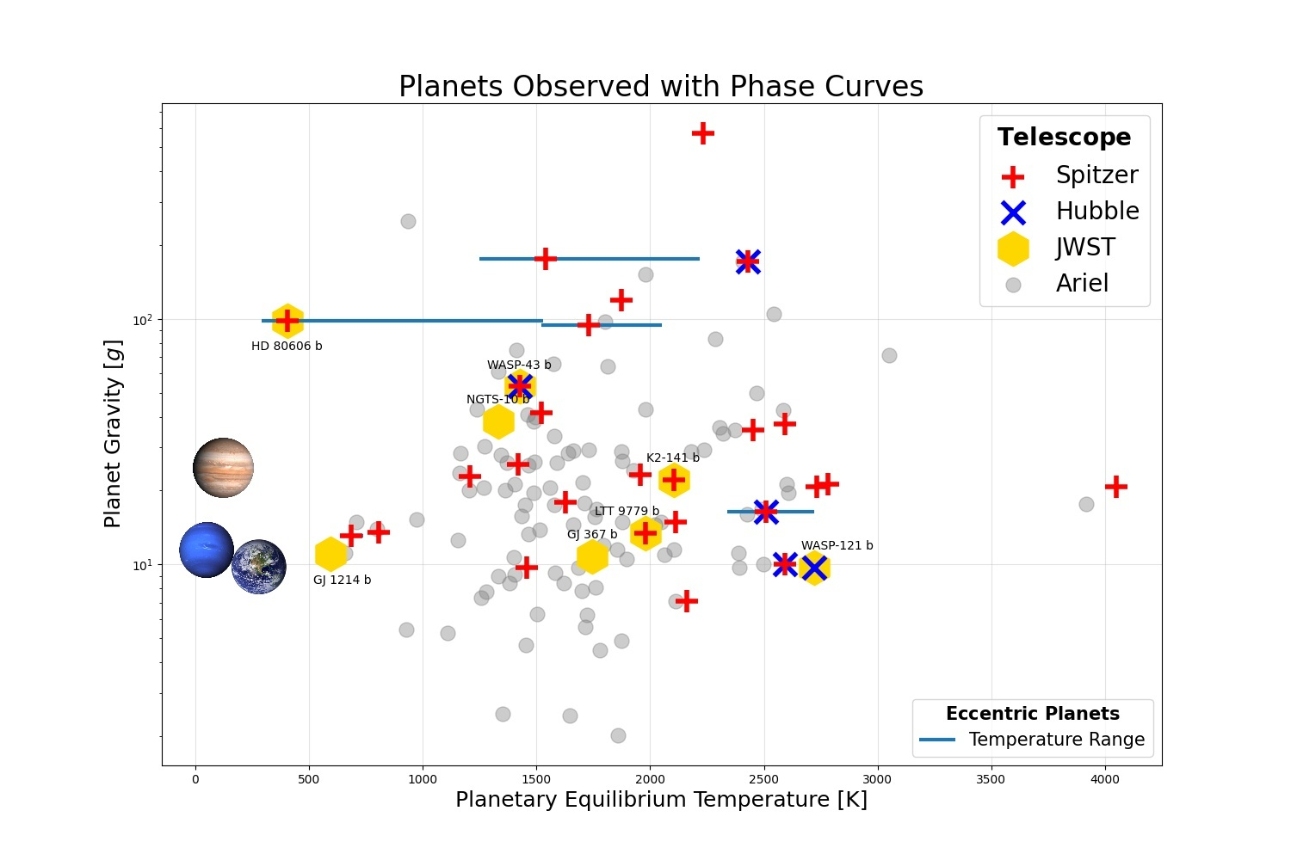
Better spread in gravity

Slide 9
Ariel obtains full-orbit phase curves of emission targets with P<48 hrs, partial phase curves otherwise

Slide 10
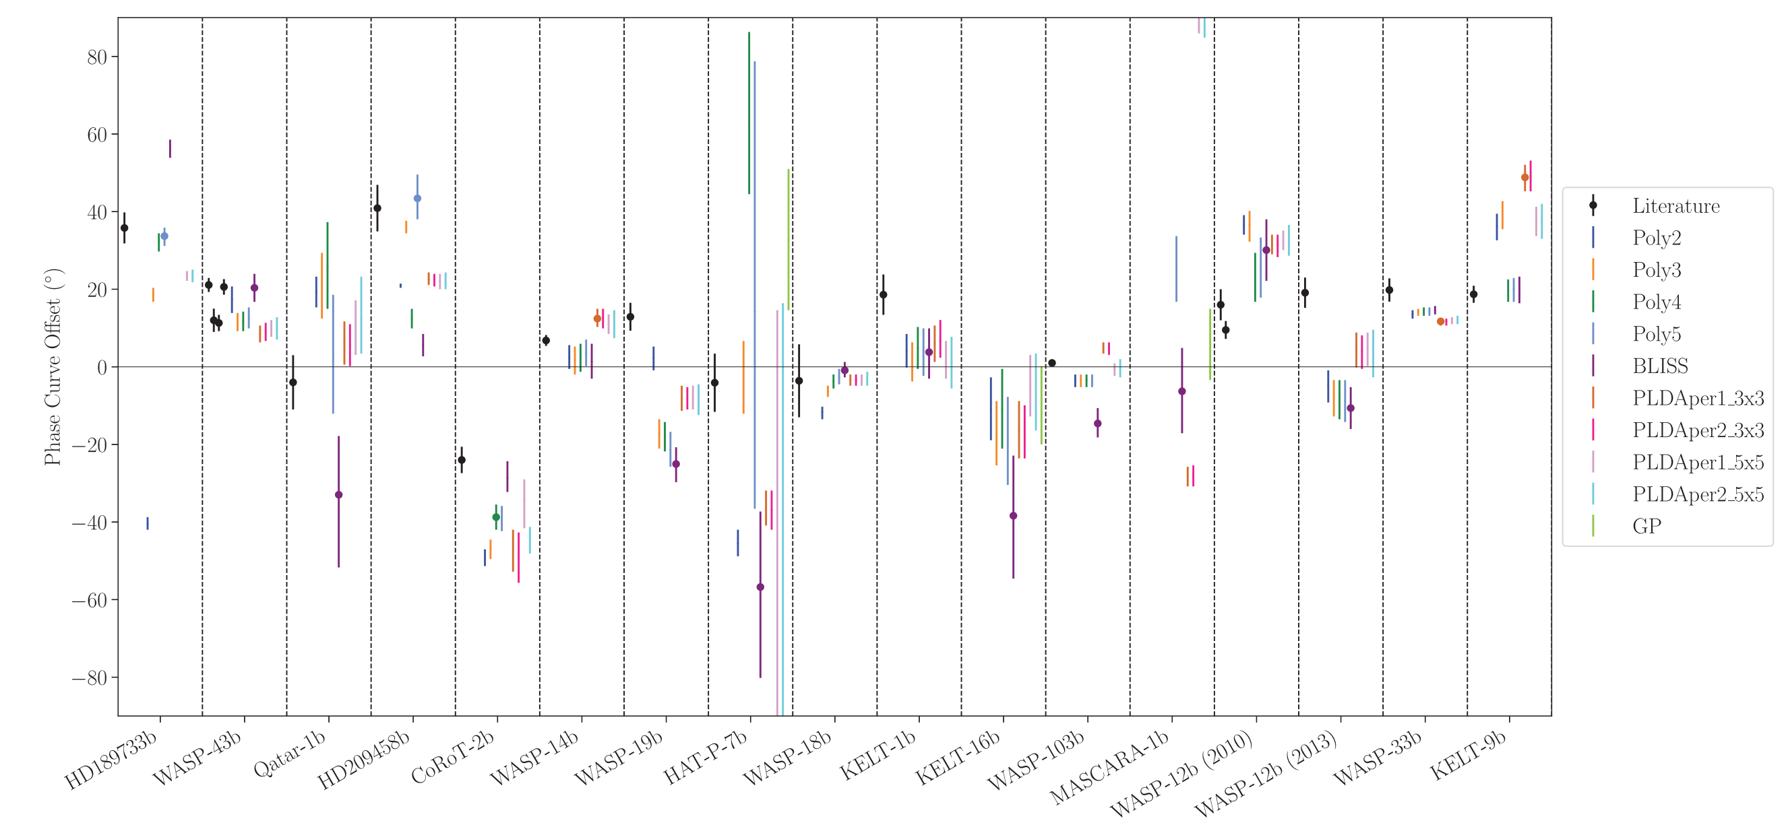
Measure Phase Offsets with Quarter Orbit Phase Curves
Observing 45º either side of eclipse
= Observing ¼ of orbit

