Slide 1
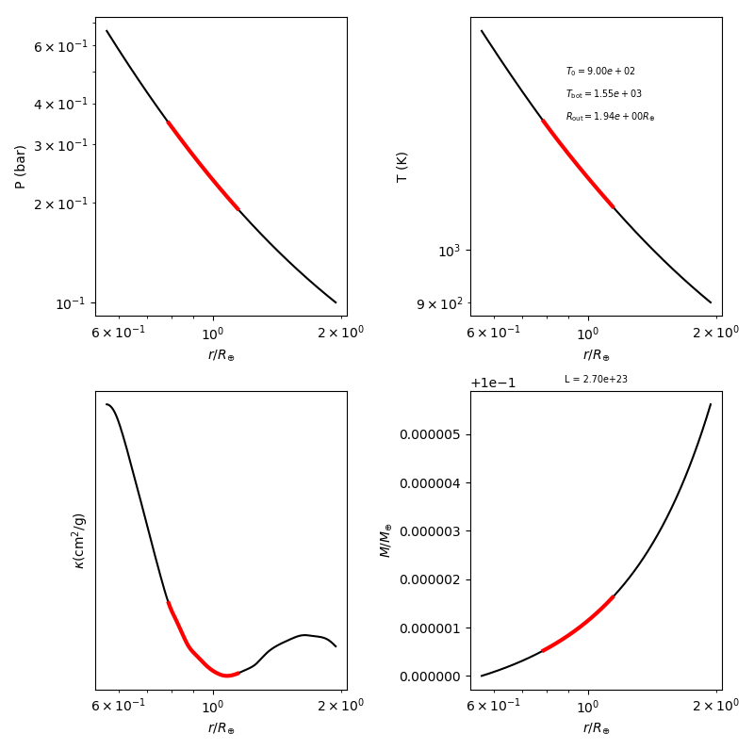
1st converged solution
Semi-major axis (a) = 0.12
L = 2.7e+23
Etas = 5.614e-5
T_max = 1550K

Slide 2
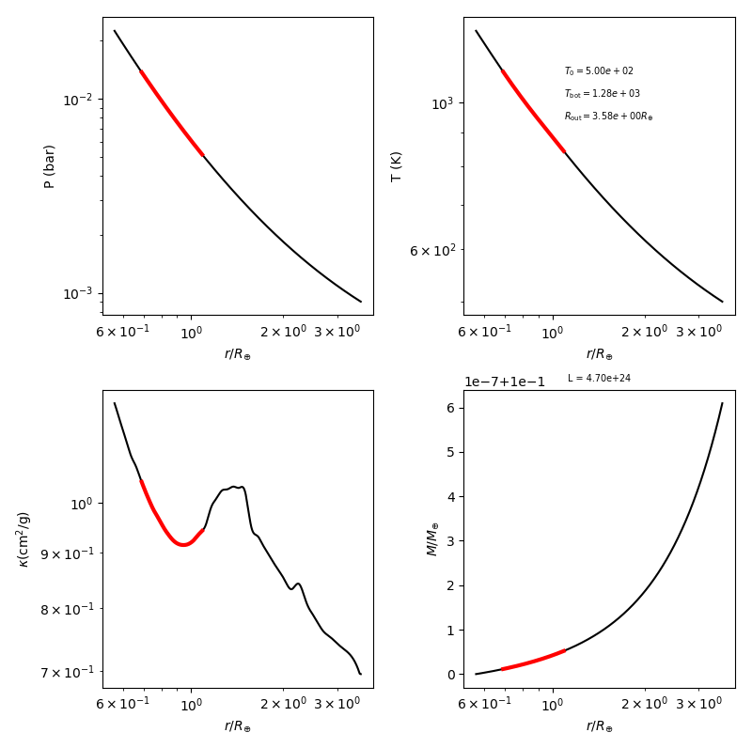
2nd Converged Solution
Semi-major axis (a) = 0.5
L = 4.7e24
Etas = 6.094e-6
T_max = 1280K (< 1500K)

Slide 3
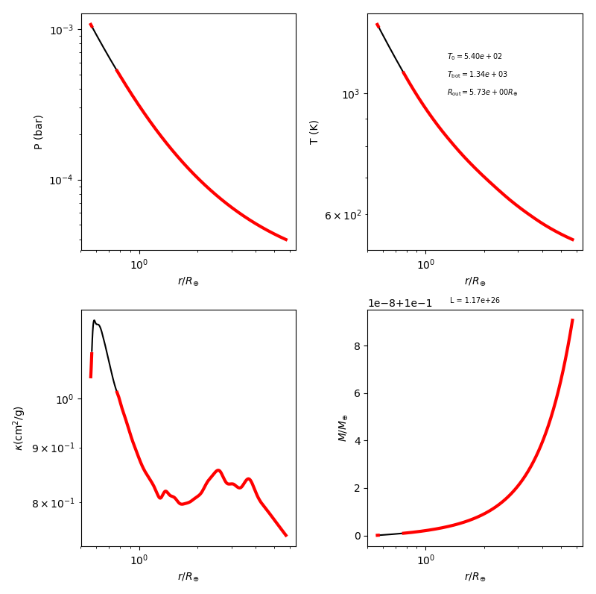
3rd Converged Solution
Semi-major axis (a) = 1.5
Tfrac = 1.8
T_max ~ 1340K
*** reaching a rad-conv-rad boundary condition
I.C.:
sys.argv = ['xxx', 'CL_mod', 'solar', 1, 1.8 , 0.10, 'ideal', 1.5, 1, 1, 1, 3.9, 'ferg', 'H+He', 'const', 0.00]
etas, Ls = [9.07*10**(-7), 1.17*10**(26)]

Slide 4
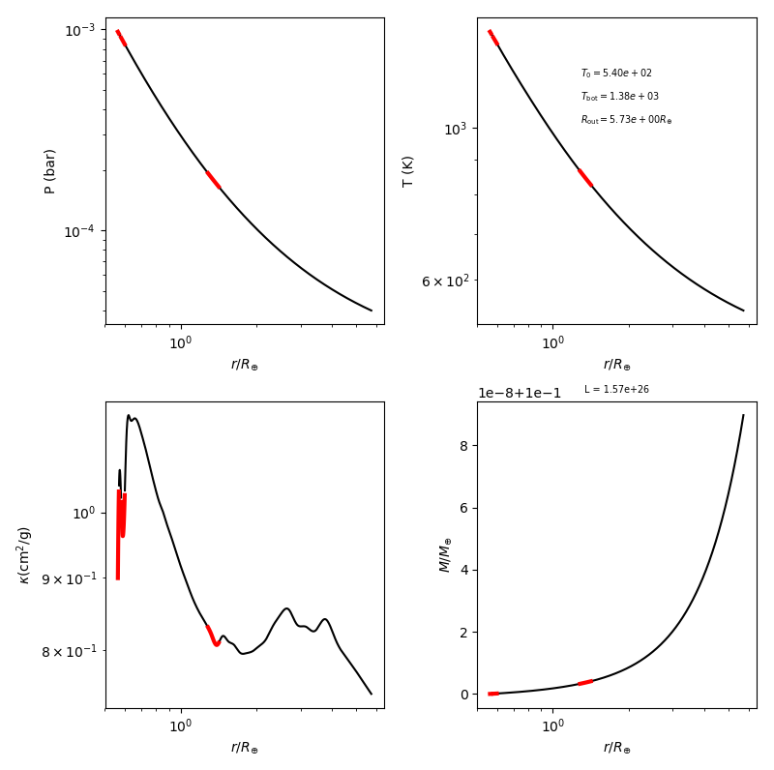
4th Converged Solution
Semi-major axis (a) = 1.5
Tfrac = 1.8
T_max ~ 1380K
I.C.:
sys.argv = ['xxx', 'CL_mod', 'solar', 1, 1.8 , 0.10, 'ideal', 1.5, 1, 1, 1, 3.9, 'ferg', 'H+He', 'const', 0.00]
etas, Ls = [8.97047*10**(-7), 1.57*10**(26)]

Slide 5
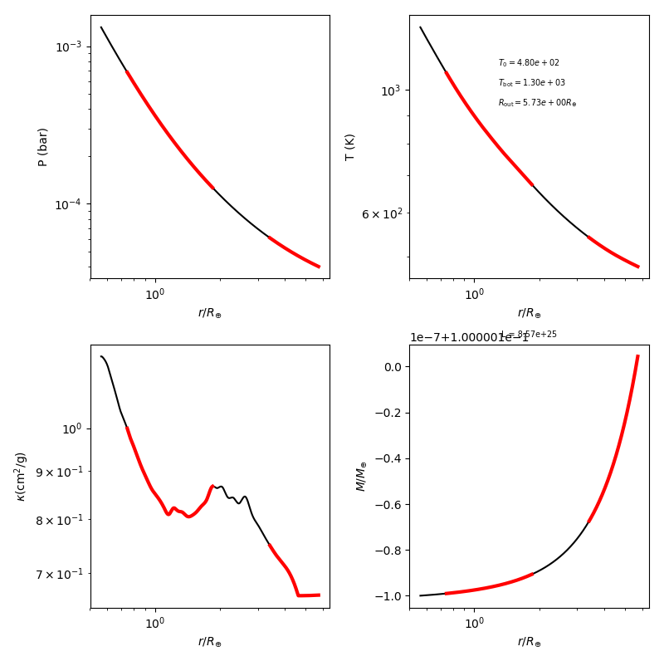
5th Converged Solution
Semi-major axis (a) = 1.5
Tfrac = 1.6
T_max ~ 1300K
I.C.:
sys.argv = ['xxx', 'CL_mod', 'solar', 1, 1.6 , 0.10, 'ideal', 1.5, 1, 1, 1, 3.9, 'ferg', 'H+He', 'const', 0.00]
etas, Ls = [1.0445*10**(-6), 8.57*10**(25)]

