Slide 1
Asynchronous Programming in ECMAScript 2015

Slide 2

In the beginning…

Slide 3
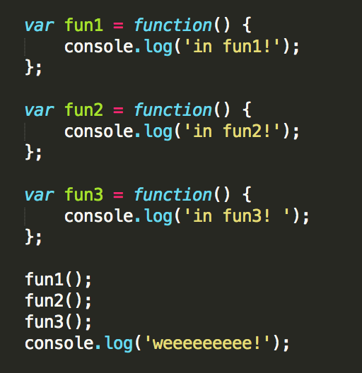
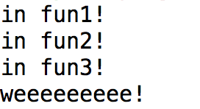
Synchronous Coding
When we first start programming, we learn how to code synchronously.
Every statement runs to completion, followed by the next statement in the control flow, until the application completes.

Slide 4
Problems with Sync Code
What is the major downside of coding this way?
SLOW! If a portion of our code takes a long time to execute, the user is left waiting for it to finish for any other actions to occur.
Doesn’t allow us to create applications that the user can easily interact with.
Asynchronous Programming to the rescue!
Tasks are NOT necessarily run in their control flow order.
It is not known at runtime when certain portions of code will run.

Slide 5
Benefits of Async Code
Allows applications to be executed in a way that makes the most of the system's processing power.
Allows for event handling - the application can wait and respond to user events, such as clicking a button.
Application can run several actions at once (or seemingly at once), allowing for a richer experience even if some actions are slow.
Enables servers to handle more requests, and therefore more customers, without being blocked by slow I/O calls, for instance requests to a database.

Slide 6
How to run multiple actions at once?
Multithreading - Executing some work for a period of time, then switching to another task for some time, etc… An illusion of code running in parallel.
Multiprocessing - Executing different tasks on different processors, literally running code in parallel.

Slide 7
What does Javascript do?
Javascript allows for asynchronous programming in a single thread, using callbacks.
Code that is meant to be run asynchronously is wrapped in a function.
This function will take any arguments necessary to perform it’s task, but will also have arguments defining one or more callback functions.
When the asynchronous function is called, we pass these callback functions as arguments, and the code in these functions will be executed when the main operations of the asynchronous function have completed.

Slide 8
What does Javascript do?
Under the hood, threads ARE used, but we don’t have to worry about this.
Once an asynchronous function is called, execution continues with the next statement in the control flow.

