Slide 1
Asynchronous Programming in ECMAScript 2015

Slide 2

In the beginning…

Slide 3
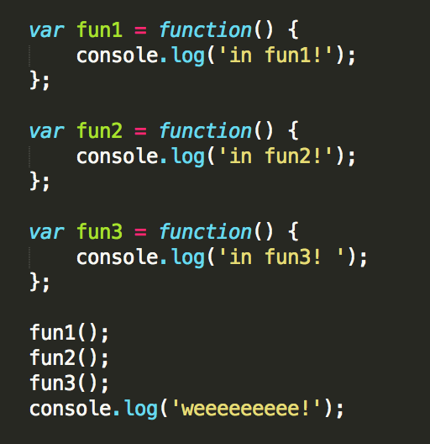
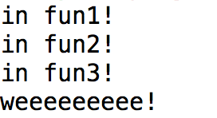
Synchronous Coding
When we first start programming, we learn how to code synchronously.
Every statement runs to completion, followed by the next statement in the control flow, until the application completes.

Slide 4
Problems with Sync Code
What is the major downside of coding this way?
SLOW! If a portion of our code takes a long time to execute, the user is left waiting for it to finish for any other actions to occur. Operations like this are said to “block” the application.
Doesn’t allow us to create applications that the user can easily interact with.
Asynchronous Programming to the rescue!
Tasks are NOT necessarily run in their control flow order.
It is not known at runtime when certain portions of code will run.
We want something that is “non-blocking” – that will not cause the user to sit waiting.

Slide 5
Benefits of Async Code
Allows applications to be executed in a way that makes the most of the system's processing power.
Allows for event handling - the application can wait and respond to user events, such as clicking a button.
Application can run several actions at once (or seemingly at once), allowing for a richer experience even if some actions are slow.
Enables servers to handle more requests, and therefore more customers, without being blocked by slow I/O calls, for instance requests to a database.

Slide 6
How to run multiple actions at once?
Multithreading - Executing some work for a period of time, then switching to another task for some time, etc… An illusion of code running in parallel.
Multiprocessing - Executing different tasks on different processors, literally running code in parallel.

Slide 7
What does Javascript do?
Javascript allows for asynchronous programming in a single thread, using callbacks.
Code that is meant to be run asynchronously is wrapped in a function.
This function will take any arguments necessary to perform it’s task, but will also have arguments defining one or more callback functions.
When the asynchronous function is called, we pass these callback functions as arguments, and the code in these functions will be executed when the main operations of the asynchronous function have completed.

Slide 8
What does Javascript do?
Once an asynchronous function is called, execution continues with the next statement in the control flow.
Code that is dependent on the asynchronous action should be placed in the callback.
Code that is not dependent on the asynchronous action can be placed after the asynchronous call.
We can now be assured that code will be executed at the proper time, without the rest of our application being slowed down.
Under the hood, threads ARE used, but we don’t have to worry about this.

Slide 9
Event Loop & Callback Queue
This is implemented using an event loop and a callback queue.
Both the browser and Node.js have an event loop.
Normally when function calls are made, they are added to the call stack. When a function returns, it is popped off the stack.
With calls that involve asynchronous operations, the call is added to the stack.
The asynchronous operation is then handed over to some other process.
That function is then popped off the stack, as if it completed.
The application can continue to run with the next statement (it is not blocked by the asynchronous operation).
When the earlier action that was running in another process completes, a message is added to the queue along with the callback.

Slide 10
Event Loop & Callback Queue
The next time the call stack is empty, the event loop comes along.
The event loop reads a message from the callback queue.
The corresponding callback is added to the call stack and processed as if it had been called normally.
The event loop continually processes such messages until the callback queue is empty.
This way, work done via other processes is neatly tucked away, and the developer can interface with only the main thread.
Using a single thread this way makes coding easier - the developer doesn’t have to worry about sharing data between threads or how the different threads are accessing the system’s resources. The resulting code is also generally easier to read.

Slide 11
Call Stack & Callback Queue
Stack
fun1();
setTimeout(fun2, 2000);
fun3();
setTimeout(fun4, 1000);
console.log('weeeeeeeee!');
Queue

Slide 12
Event Loop
Stack
fun1();
setTimeout(fun2, 2000);
fun3();
setTimeout(fun4, 1000);
console.log('weeeeeeeee!');
Queue
fun4
fun4
fun2
fun2
Event Loop

Slide 13
Promises - Introduction
But coding is always evolving. While using callbacks for async operations solves some problems, this coding style does still have it’s own downsides:
While easier to read than code with multiple threads, it is still not as easy to read and understand as synchronous code.
We cannot always pass separate callbacks for success and failure - instead, we have to check for errors in one callback.
We cannot simply return to a specific point of execution from a callback - if there is code that must execute after the asynchronous call, it must be wrapped in the callback, which can get large and unwieldy. This makes callback code seem more like “side-effects” of the application, rather than main functionality.
Multiple nested callbacks can result in the “pyramid of doom.”

Slide 14
Promises - Introduction
Promises, which are new in ES6 Javascript 2015 ECMAScript 2015, are created to help solve these problems.
What are promises?
A cleaner way of writing the same single-threaded asynchronous code we have been discussing. There’s no new “magic” on how Javascript asynchronous code works. It’s more like syntactic sugar. But it’s really good syntactic sugar, more like syntactic HFCS.
Promises allow us to treat the result of asynchronous code as a first-class citizen, similar to how Javascript allows us to pass functions around as arguments. We can now code in a way that is closer to how we would if we had the result synchronously - we can treat the promise itself as the result, even if the result is not complete yet.
Promises follow a standard, allowing us to be assured of what the callbacks are, and that only one will be called.

Slide 15
Promises – Handling
Let’s start with how to handle a function that returns a Promise.
Where before we would pass the callback(s) as an argument to a function call, we now pass that code to handlers that are already attached to the promise - using the then function.
If the asynchronous operation causes an error? The then handler covers this as well - the callback function to handle failures is passed to then as the second argument.
For convenience, Promises also have a catch handler. This is simply a shorthand for then(null, function()..).

Slide 16
Promises – Handling
Some notes about handling promises:
When a call is made to the asynchronous function, that operation will be performed whether the then/catch handlers are used or not.
Only one of the handlers will be called (success or failure).
At any given time, a promise is in one of three states:
Pending - the asynchronous code has not completed yet.
Fulfilled - the asynchronous code has completed successfully.
Rejected - the asynchronous code has failed.
Once the promise is fulfilled or rejected and the correct handler has been called, the promise is considered complete - the handlers will not be called again.
However, handlers can be added to the promise after it has been fulfilled or rejected, and the proper handler will still execute.

Slide 17
Promises - Chaining
A great feature of promises is that it allows us to break up and order asynchronous code that depends on earlier asynchronous code.
From a then or catch handler, we can execute other asynchronous operations. The results of this code can then be handled in a subsequent then or catch handler.
This is possible because the handlers themselves return a promise. When you see a return statement in a handler, what is actually returned is a Promise that resolves to that return value.

Slide 18
Promises - Chaining
Some important notes about chaining:
It’s good practice to end with a catch handler, as errors will flow down the chain like in a try/catch block. If we don’t, any uncaught errors are simply lost.
The result of a catch that doesn’t throw another error is a resolved promise.
Using then and catch is NOT the same as using then with two callbacks - instead, catch is a handler for the next iteration of the chain. The upside of this is that errors from the previous then will be caught. (If we were instead to pass two callbacks to then, any new errors that come back from the first callback are not handled in the second callback.)

Slide 19
Promises - Retrospective
Let’s take a step back - did this resolve the 4 issues above with callbacks?
Easier to read. ☑
Can pass separate callbacks for success and failure. ☑
Return to a specific point of execution from a callback. ☒
We can never truly make this happen, but now we can better organize our callback code, and use return and throw statements to indicate a logical flow.
Avoid “pyramid of doom” from nested callbacks. ☑

Slide 20
Promises – Define Your Own
Occasionally you are going to want to define your own promises, so that client code can handle your asynchronous function.

