Slide 1
“ASA TA KAON?” A FOOD ESTABLISHMENT LOCATOR MOBILE APPLICATION
By:
Alda Zoe Kenji P. Barral Marnel M. Rosal
Stephanie B. Pasignasigna Franchesca Dominic E. Valdez

Slide 2


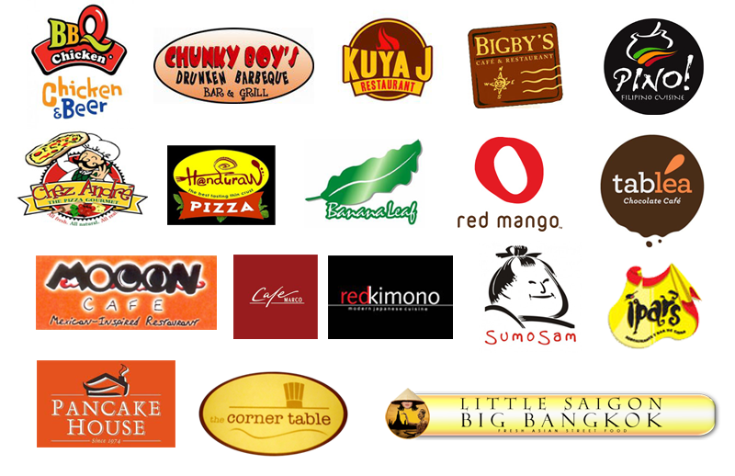
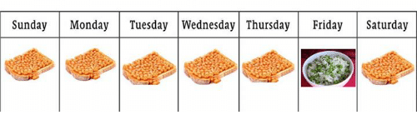
Rationale of the Study
ASA TA KAON?

Slide 3
Designing a Food Establishment Locator Mobile Application
Identified the possible food establishments within the user’s location and the credentials of the establishment.
Tested and evaluated the system.
Designed a mobile application that displayed food establishments.
Deployed the system locally.
Statement of the Problem

Slide 4
Significance of the Study
Owners of Food Establishments
Customers
Future researchers
Students of University of San Carlos – Talamban
ASA
TA KAON?

Slide 5
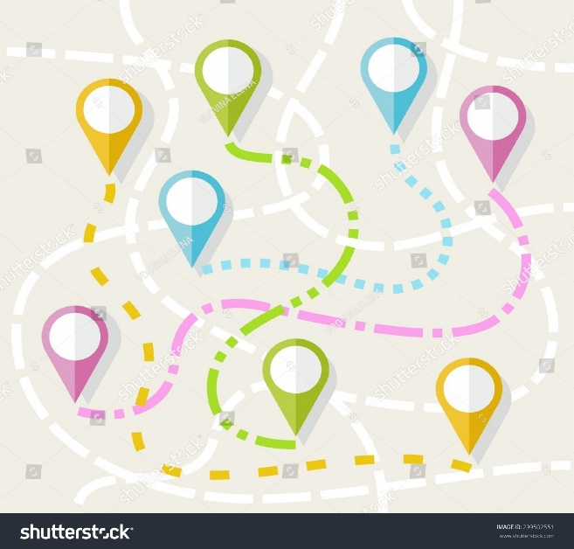
Scope and Limitations
ASA TA KAON?
Delivery
Ordering
Description and Menu
Type of Food Served
Limited Area
Price Range
Reviews and Ratings

Slide 6
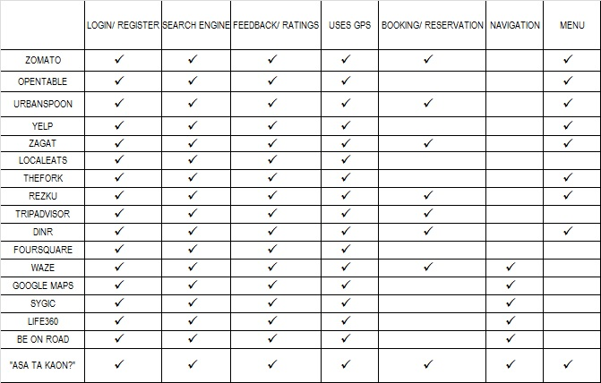
Summary of Related Systems

Slide 7




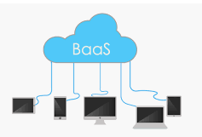


Summary of Technical Background
USER
SYSTEM

Slide 8
Design and Methodology

Slide 9
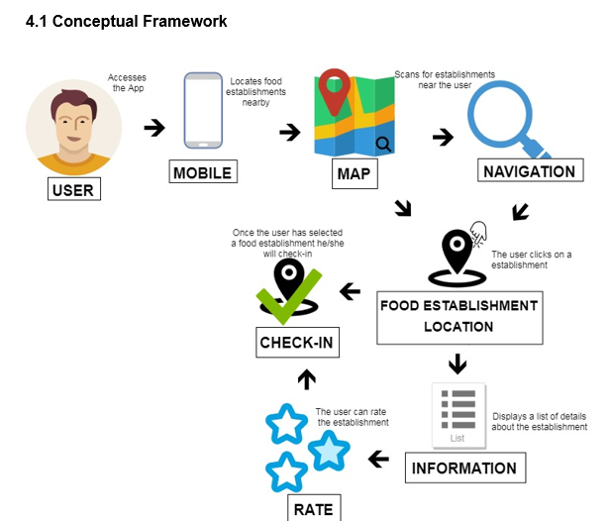
Conceptual Framework

Slide 10
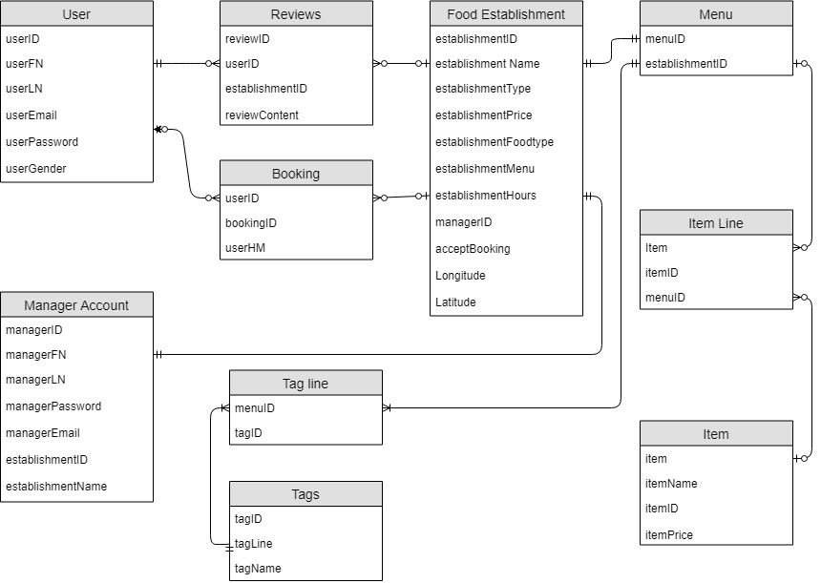
Entity Relationship Diagram

Slide 11
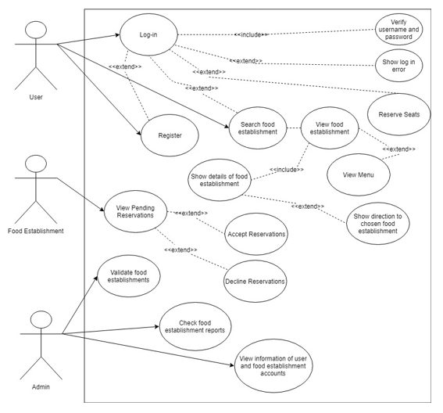
Use Case Diagram

Slide 12

Development Model

Slide 13
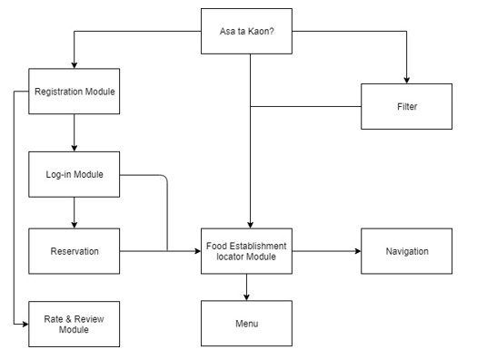
Development Approach

Slide 14
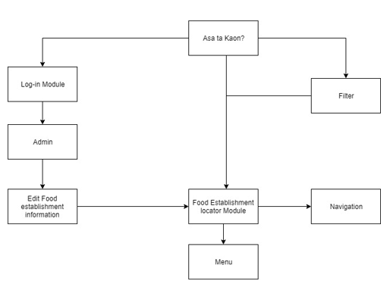

Slide 15





Software Development Tools

Slide 16
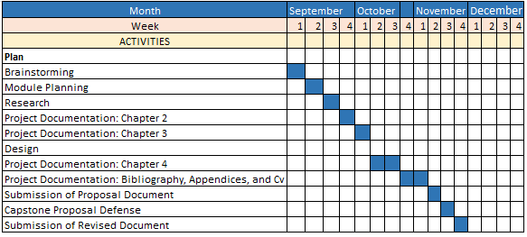
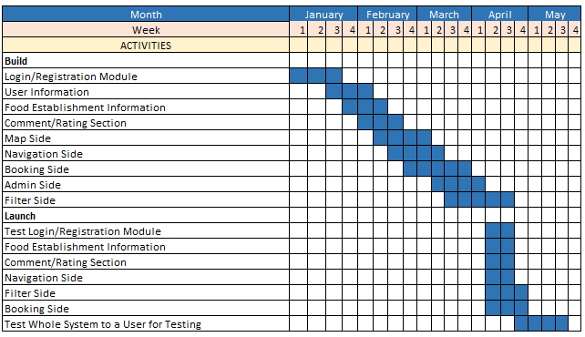
1ST Semester 2018-2019
2nd Semester 2018-2019

Slide 17
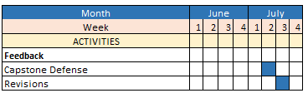
Summer 2019

Slide 18
Results and Analysis

Slide 19
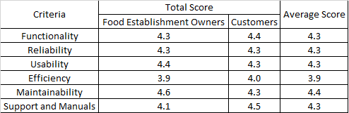
UAT Results

