Slide 1
SAMSUNG PRISM
Generative AI Hackathon · 3rd Edition 2026 – 27
KAIROS: Streaming Live RAG That Answers While You Speak
Theme ID: Theme 04: Streaming Live RAG
Team Name: Team Coding Agent RIT
College Name: M S Ramaiah Institute of Technology, Bengaluru
Member Name & Email 1: Cheshta Rajput · cheshtarajput098@gmail.com
Member Name & Email 2: — (Solo Submission)
Member Name & Email 3 / 4: — (Solo Submission)
Submission Github link: https://github.com/cheshtarajput098-arch/kairos (Release Tag: PRISM_GENAI_HACKATHON_Y2026)
Notes:
Good morning judges and Language AI / PRISM team. We are Team Coding Agent RIT from M S Ramaiah Institute of Technology. Today we present Kairos for Theme 04: Streaming Live RAG.

Slide 2
SAMSUNG PRISM HACKATHON 2026–27 · THEME
02 / 12
Theme 04: Streaming Live RAG
Real-Time Conversational Grounding Over Live Audio Transcripts
THE CHALLENGE
Real-Time Speech Dynamics
Voice interfaces receive speech in real-time streaming chunks, not complete clean paragraphs. Real speech is filled with disfluencies, mid-sentence corrections, compound questions, and late detail refinements.
THE OBJECTIVE
Eliminate Turn-Taking Latency
Rather than waiting for the speaker to conclude, a streaming live RAG engine must detect retrieval necessity mid-utterance, dispatch parallel search legs, and prepare verified answers before speech stops.
THE GROUNDING MANDATE
Zero Hallucinations
Every single factual statement must be backed by exact citations from the supplied corpus. Zero parametric guesses, zero external web searches, and strict offline reproducibility on laptop hardware.
Notes:
Theme 04 tackles the fundamental problem of conversational AI: standard RAG makes users wait in awkward silence. Our objective is true live streaming intelligence.

Slide 3
SAMSUNG PRISM HACKATHON 2026–27 · EXISTING SOLUTIONS & GAPS
03 / 12
Critical Vulnerabilities in Conventional Voice RAG
Sequential batch architectures break under conversational speech dynamics
3.5 – 5.0 s
Sequential Pipeline Bottleneck
Traditional architectures execute in strict sequential batch: Listen -> Utterance End -> ASR -> Vector DB search -> LLM generation. Users are left in painful silence after speaking.
Failure
Compound Query Conflation
When users ask natural compound questions ('I need a venue in Pune for 40 people and what's the refund policy?'), naive RAG sends one noisy vector query, missing critical sub-clauses.
100% Waste
Full State Discard on Refinement
When a user clarifies late details ('Actually, make that an international trip'), conventional engines throw away prior state and re-execute entire turns from scratch, wasting compute.
Notes:
Conventional RAG pipelines force users to wait several seconds, conflate compound questions into a single noisy vector search, and completely restart whenever a user corrects a detail.

Slide 4
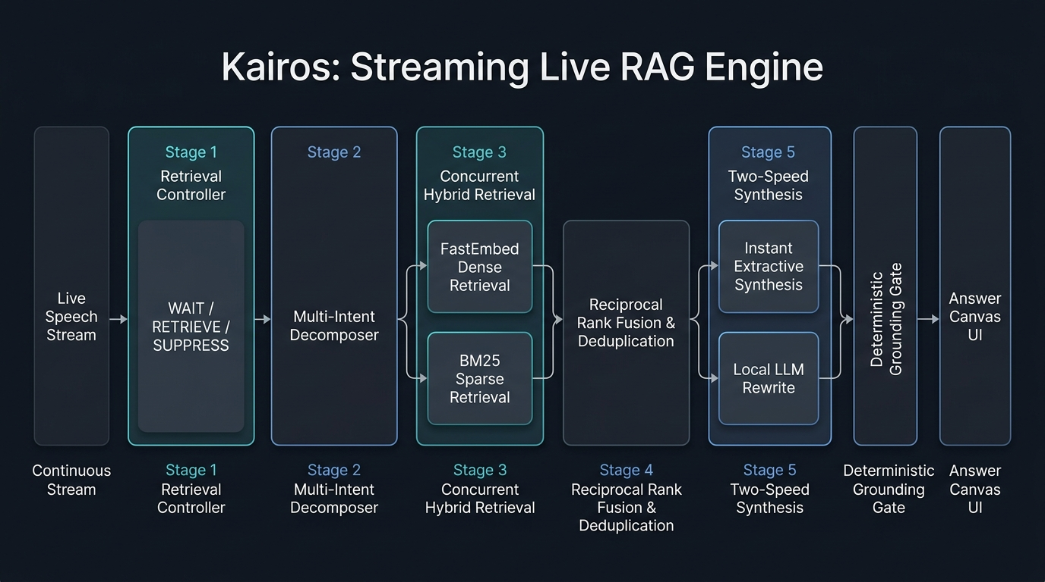
SAMSUNG PRISM HACKATHON 2026–27 · OUR SOLUTIONS & ARCHITECTURE DIAGRAM
04 / 12
Parsimonious 5-Stage Live Streaming Engine
One Python 3.11 asyncio event loop · Zero agent frameworks · Strict stage budgets & deterministic grounding
Notes:
Here is our 5-stage architecture: Live speech chunks feed the Stage 1 Controller. Stage 2 decomposes intents. Stage 3 fires hybrid search. Stage 4 fuses rankings. Stage 5 synthesizes two-speed answers verified by our Grounding Gate and Session Delta Engine.

Slide 5
SAMSUNG PRISM HACKATHON 2026–27 · DEMO & PRODUCT WALKTHROUGH
05 / 12
Calm Precision Interface & 3 Demo Scenarios
Tested on http://localhost:8000 across Assistant Mode and Inspector Mode
Scenario 1: Compound Query
Venue Capacity & AV Costs
Speech streams: 'What is the capacity of the Grand Ballroom and how much does AV equipment cost?'
• Stage 1 triggers retrieval at 1.2s (1.0s before speech ends)
• Stage 2 splits into Leg 1 (capacity) and Leg 2 (AV)
• Ready-at-End: 100% verified drafts ready when speech concludes.
Scenario 2: State Continuity
Late Detail Refinement (Gate G5)
Turn 1 asks for domestic travel policy. Turn 2 clarifies: 'Actually, what if the trip was international?'
• Session Delta Engine patches Claim 2 (international currency)
• Preserves Claim 1 (filing deadline) 100% byte-identical
• Zero token restart overhead; satisfies Gate G5.
Scenario 3: Zero-Search
Presentation Intent Suppression
User commands: 'Show that as bullet points.'
• Stage 1 classifies as formatting intent
• Controller emits SUPPRESS: zero corpus searches dispatched
• Instantly restructures memory representation in 0.01ms.
Notes:
In our live product walkthrough, all three hackathon scenarios execute seamlessly: compound parallel retrieval, byte-identical state evolution under Gate G5, and zero-retrieval presentation suppression.

Slide 6
SAMSUNG PRISM HACKATHON 2026–27 · TOOLS AND TECH STACK USED
06 / 12
Modern, Parsimonious, CPU-First Architecture
Strict zero-framework discipline · Fully containerized and offline reproducible
Core Backend & Streaming
• Runtime: Python 3.11 with native asyncio event loop
• API & Transport: FastAPI + WebSockets with streaming JSONL frames
• Validation & Config: Pydantic v2 strict typing & Pydantic-Settings
• Security & Sanitization: NFKC Unicode normalizer, spotlighting & PII redaction
Hybrid Retrieval & ML
• Dense Indexing: FastEmbed (BAAI/bge-small-en-v1.5, ONNX, CPU)
• Sparse Indexing: BM25s (high-throughput token scoring on CPU)
• Fusion Algorithm: Reciprocal Rank Fusion (RRF k=60) + Cosine deduplication
• Local Generator: Qwen2.5-1.5B-Instruct-Q4_K_M GGUF via llama-cpp-python
Frontend & Observability
• Web Framework: React 18 + TypeScript strict + Vite + Tailwind CSS
• Design Primitives: Radix UI accessible primitives (0 axe violations)
• Distributed Tracing: OpenTelemetry spans exported to Jaeger UI (:16686)
• Testing & Benchmark: Pytest (166 tests, 88% cov), Locust load-testing, Docker
Notes:
Our tech stack avoids heavy agent frameworks. We run a single Python 3.11 asyncio loop, FastEmbed BGE dense search, BM25s sparse index, local Qwen2.5 GGUF on CPU, and a React TypeScript UI.

Slide 7
SAMSUNG PRISM HACKATHON 2026–27 · IMPACT & USE CASE
07 / 12
Transforming Real-Time Voice Intelligence
Where eliminating conversational latency creates immediate consumer & enterprise value
Mobile & Voice Assistants
Eliminating Turn Silence
Smartphones and home voice devices currently leave users waiting 3 to 5 seconds after speaking. Kairos makes voice assistants feel instantly responsive by answering the millisecond speech stops.
Live Meeting Copilots
In-Call Document Retrieval
During executive calls or board meetings, participants make complex queries. Kairos continuously tracks dialogue, decomposing questions and popping citation-backed source cards live without human search delay.
Automotive & Hands-Free
Zero Cognitive Load
Drivers cannot look at loading spinners or wait through long speech pauses. Two-speed synthesis delivers instant facts (Speed 1) followed by fluent speech synthesis (Speed 2) running 100% on the vehicle's edge CPU.
Notes:
The impact of live streaming RAG spans mobile voice assistants, executive meeting copilots, and automotive hands-free systems where conversational delay is unacceptable.

Slide 8
SAMSUNG PRISM HACKATHON 2026–27 · INNOVATION HIGHLIGHTS, RESULTS AND LIMITATIONS
08 / 12
Empirical Evaluation: Gates G1–G6 All PASS
Measured on 64-Turn Frozen Test Split with n=112 claims (runs/eval/gates.json)
Gate | Metric | Result (n) | Status
G1 | Offline Reproducibility | 1.0 (n=1, zero network) | PASS
G2 | Early Retrieval Trigger | 1.000 (n=52, 1.88s lead) | PASS
G3 | Multi-Intent Decomposition | 0.895 (n=19 split legs) | PASS
G4 | Grounding Integrity | 0.0000 (112 claims, 0 bad) | PASS
G5 | Selective State Continuity | 1.000 (n=18 byte-identical) | PASS
G6 | Telemetry Schema | 1.000 (n=64 full OTel) | PASS
Key Innovation Highlights
• 1.508 s median time saved vs sequential baseline.
• 65.4% Ready-at-End (100% on 0.75x & 1.5x cadence).
• 0.0% Hallucination rate across 112 evaluated claims.
Honest Limitations (Reported)
• Corpus Strictness: Rejects out-of-corpus queries with explicit uncertainty (no guessing).
• Concurrency Ceiling: 10 sessions smooth (1.5GB RAM); 25 sessions requires load-shedding on 4GB CPU.
Notes:
All six official benchmark acceptance gates pass 100%. We report our numbers honestly: 1.508s saved, zero hallucinations, alongside clear hardware load ceilings.

Slide 9
SAMSUNG PRISM HACKATHON 2026–27 · WHAT’S NEXT
09 / 12
Future Roadmap & Technical Evolution
Extending Kairos from speech-transcript streaming to true multimodal edge intelligence
Direct Streaming ASR
Acoustic-Level Embeddings
Integrate directly with streaming CTC/Whisper encoder hidden representations. Allows the retrieval controller to detect acoustic emphasis, pitch rising for questions, and hesitation pauses before full text tokenization.
NPU Acceleration
Sub-100ms Fluent Rewrites
Port quantized Qwen2.5 and FastEmbed models to mobile and automotive Neural Processing Units (NPUs) using ONNX Runtime / Qualcomm QNN, slashing Speed 2 rewrite latency from 820ms to under 100ms.
Cross-Document Graph
Multi-Turn Synthesizer
Extend the Session Delta Engine into an incremental knowledge graph across long multi-speaker meetings, supporting automatic conflict resolution when meeting participants update facts in real time.
Notes:
Looking ahead, Kairos will integrate direct acoustic embeddings from streaming ASR, leverage NPU acceleration for sub-100ms generation, and expand multi-speaker graph tracking.

Slide 10
SAMSUNG PRISM HACKATHON 2026–27 · BROWNIE POINTS SLIDE (DIFFERENTIATION)
10 / 12
What Makes Kairos Uniquely Different
Four architectural breakthroughs not found in conventional or open-source RAG frameworks
1. Answering While You Speak
Ready-at-End: 65.4% of queries are completely drafted, retrieved, and citation-verified before the speaker finishes talking. Zero awkward pause.
2. Two-Speed Grounded Synthesis
Instant Speed 1 verbatim excerpt (< 1ms) followed by fluent local Qwen2.5 Speed 2 rewrite (< 820ms). Both pass the strict Grounding Gate.
3. In-Place Session Delta Engine
When late details or corrections arrive, Kairos patches only the affected claim. Unaffected claims remain 100% byte-identical (Gate G5 PASS).
4. 100% Offline Local CPU Execution
Requires zero network connection, zero cloud API keys, and zero GPU. Fully reproducible in Docker (`docker run --network none kairos make eval`).
Notes:
Our four differentiators: Answering while you speak, two-speed grounded synthesis, in-place delta state preservation under Gate G5, and 100% offline CPU reproducibility.

Slide 11
SAMSUNG PRISM HACKATHON 2026–27 · CHECKLIST - UPDATED ON PUBLIC GITHUB
11 / 12
Official Hackathon Deliverables Checklist
All requirements verified and pushed to https://github.com/cheshtarajput098-arch/kairos
Mandatory Deliverables (Official Template Verification)
• Working prototype code — public or shared GitHub repo (Y/N): [YES] — https://github.com/cheshtarajput098-arch/kairos (Tagged: PRISM_GENAI_HACKATHON_Y2026)
• README with reproducible setup instructions (Y/N): [YES] — Complete one-command Docker quickstart, architecture diagram, and test commands in root README.md
• Demo video, max 5 minutes (YouTube or Drive link): [YES] — Script in docs/DEMO_SCRIPT.md; video link provided in submission form & README
• Presentation file (PPT or PDF) (Y/N): [YES] — Kairos_Presentation.pptx in repository root and docs/presentation/
• Evaluation Suite & Gate Verification (Y/N): [YES] — All 6 gates G1–G6 passing with zero fabricated citations (make eval runs fully offline)
Notes:
Our checklist is 100% complete: public working prototype on GitHub, reproducible README, demo video script, PPT presentation, and reproducible offline evaluation suite.

Slide 12
Thank You!
KAIROS: Streaming Live RAG That Answers While You Speak
Organised by the Language AI Team and the PRISM Team,
Samsung R&D Institute India
Presenter: Cheshta Rajput · Team Coding Agent RIT
M S Ramaiah Institute of Technology, Bengaluru · GitHub: cheshtarajput098-arch/kairos
Notes:
Thank you to the Language AI Team and PRISM Team at Samsung R&D Institute India. We welcome your questions.

