Slide 1
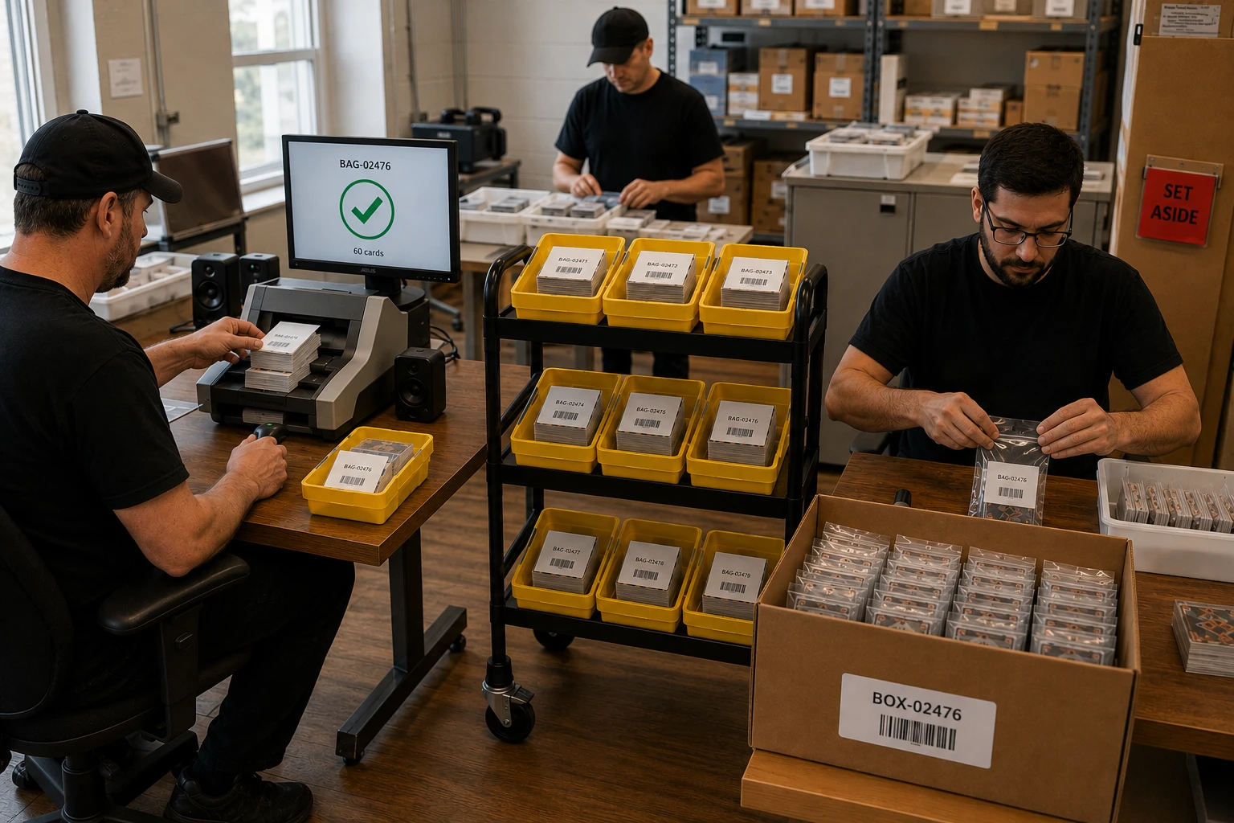
MAX COLLECTION
How the
Card Line Works
From a box of loose cards to a barcoded bag
in a barcoded box — and every step is a scan.
PREP
SCAN
BAG
BOX
MAX COLLECTION · VSS TECHNOLOGY

Slide 2
Three rules run the floor
1
2
3
Everything is a scan
Sounds are load-bearing
Flags never stop the line
No keyboards, no typing, no logins at the line. Tickets, bags, boxes, the SET-ASIDE card — every action is a barcode read, and every read is recorded with who and when.
A good tone and a problem tone, distinct and unmissable. Every session starts with a sound check — a dead speaker is found before the first bin, not after.
When validation finds a problem it flags silently. The scanner keeps scanning; the flag is caught physically at bagging, and an admin resolves it in Diagnose.
MAX COLLECTION · VSS TECHNOLOGY

Slide 3
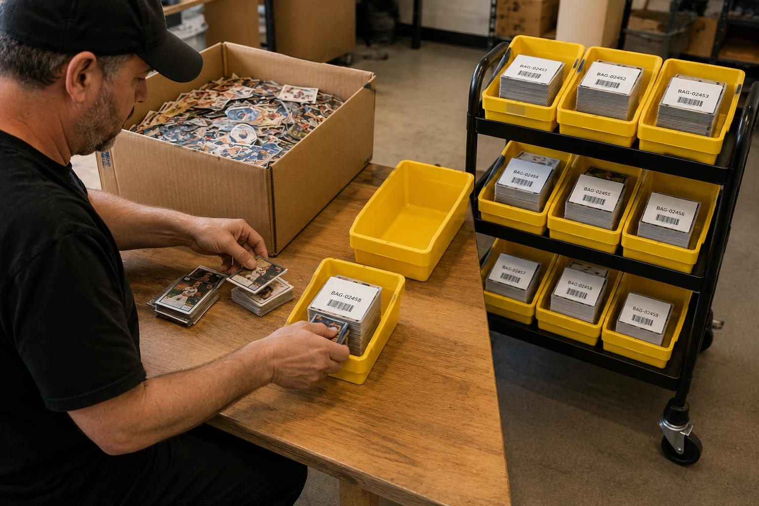
STEP 1 · PREP
Loose cards become bins
50–70 raw cards go into each yellow bin — straight from the inbound box, no sorting needed
One bag sticker per bin — unpeeled, on a stiff ticket card, laid on top of the stack
No computer at this station — hands, cards, bins, and a cart — nothing else
Finished bins stack on the rolling cart — the cart is the queue that feeds the scan desk
The ticket on top is the whole trick: it will slice the scanner's stream into batches with zero screen time.
MAX COLLECTION · VSS TECHNOLOGY

Slide 4
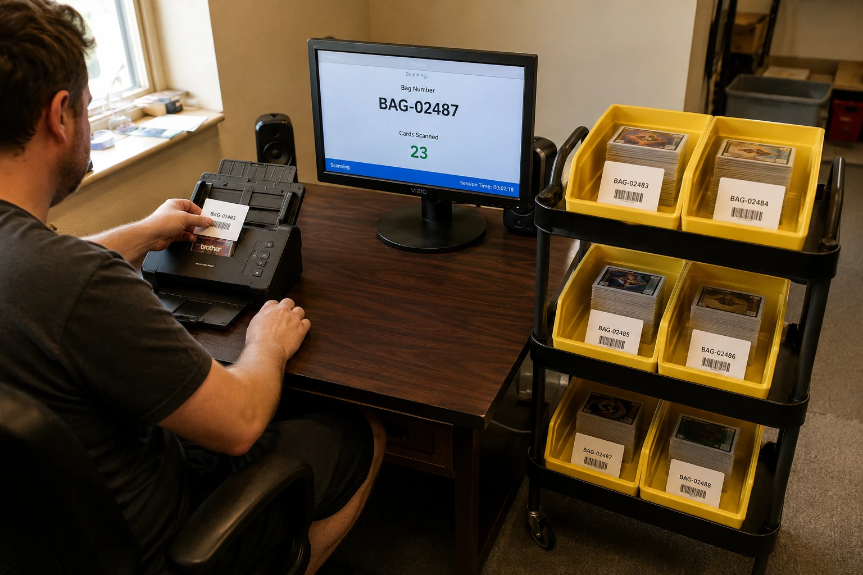
STEP 2 · SCAN
The ticket feeds first
The ticket goes through the scanner before the cards — the system reads its bag number and opens the batch — pre-bound to that bag
Cards follow, front and back — one image per side, landing on the server as they scan
The monitor shows status only — bag number, cards counted, session time — no keyboard, no verdicts, no decisions
Validation runs about one second after the batch closes — bag registered? every card has two sides? — mechanical checks, no AI
Problems flag silently — the operator never knows, the line never stops
MAX COLLECTION · VSS TECHNOLOGY

Slide 5
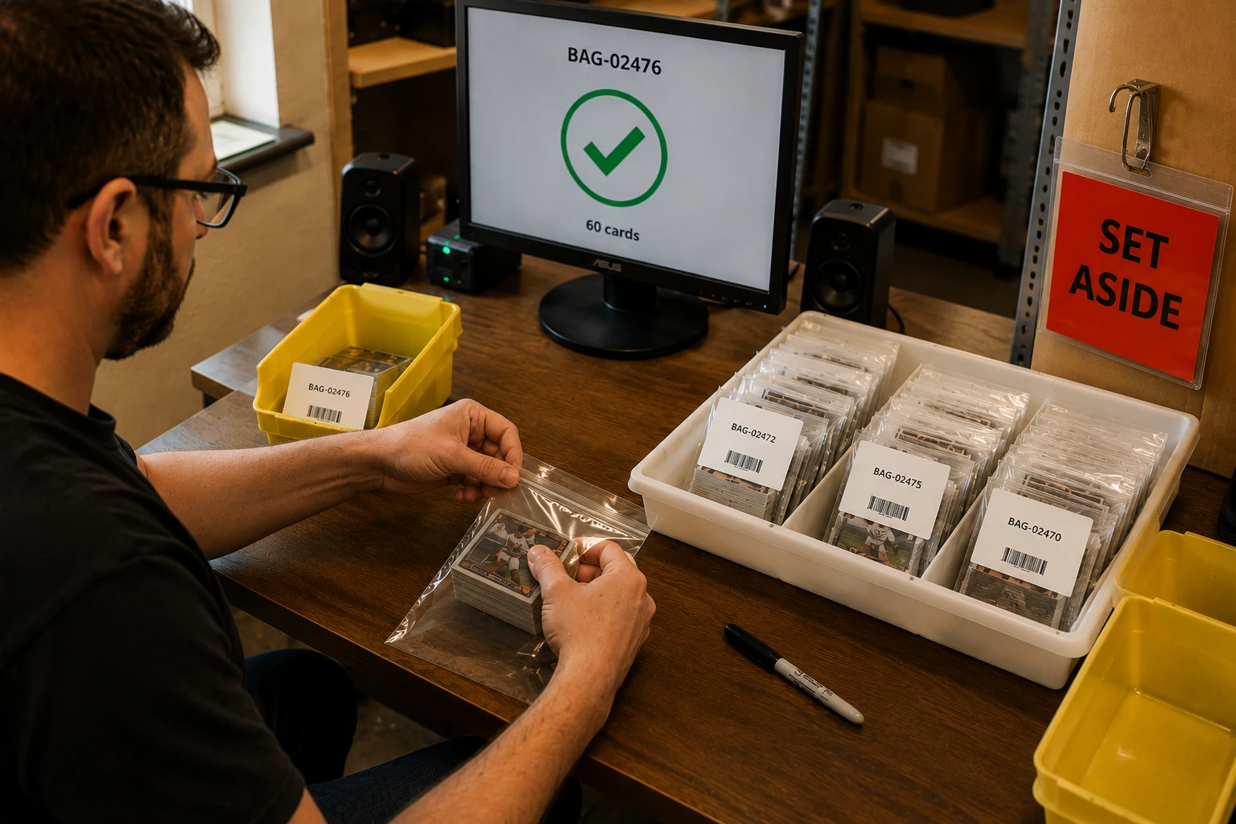
STEP 3 · BAG
Scan in, scan out —
enforced
Scan the bin's ticket first — the verdict appears before a single card moves
GOOD — peel the sticker onto the bag, fill, seal — then scan the bag again to close it out. Both scans are timed
FLAGGED — problem tone. The line locks until the red SET-ASIDE card is scanned — the bin physically leaves the flow
Three flagged bags in a row — triple alarm tone and the admin is alerted on the KPI dashboard
Bagging is where silent flags get caught — the bagger is the net.
MAX COLLECTION · VSS TECHNOLOGY

Slide 6
STEP 4 · BOX
Sealed bags become
findable forever
Every sealed bag scans into a box — the box wears a jumbo barcode label, readable from feet away
A flagged bag is refused at the box — the backstop intercept, in case one slips past bagging
The chain never breaks — card → bag → box → divider → shelf: any card can be walked to its physical spot
Originals auto-archive to Dropbox — renamed to their bag number, the moment the bag is bound
The AI works in the background — reading and cataloging every card — it never blocks the floor
MAX COLLECTION · VSS TECHNOLOGY

Slide 7
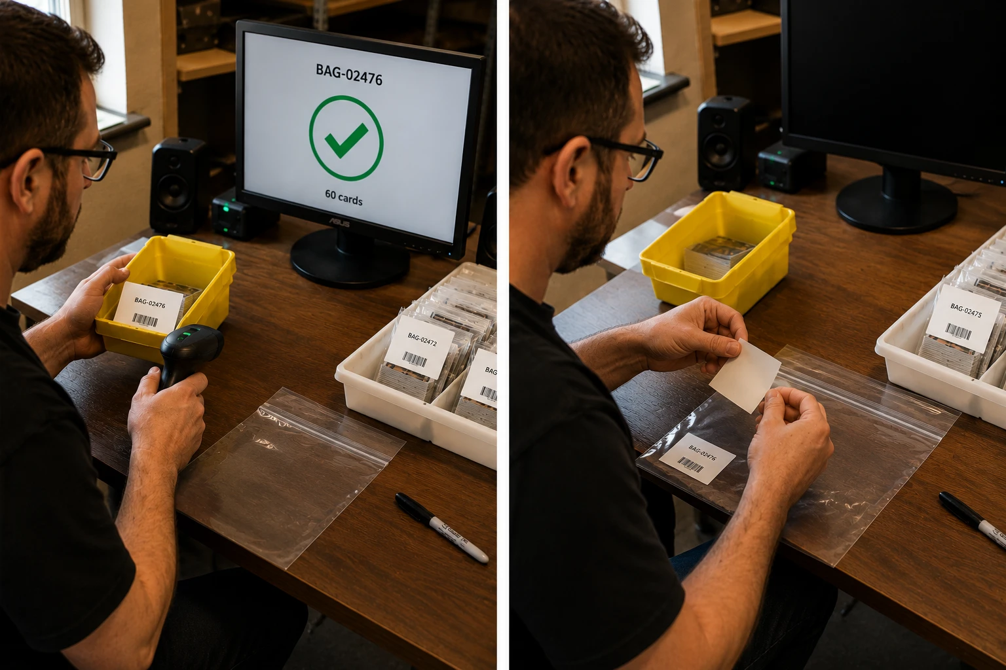
Every card can answer:
“Where are you?”
CARD → BAG → BOX → DIVIDER → SHELF
Every scan is recorded — who, what, when. Every sticker is accounted for. Every flag ends in a resolution. And every image lives in three places before anyone relaxes.
maxcollection.vsstechnology.com
MAX COLLECTION · VSS TECHNOLOGY

