Slide 1
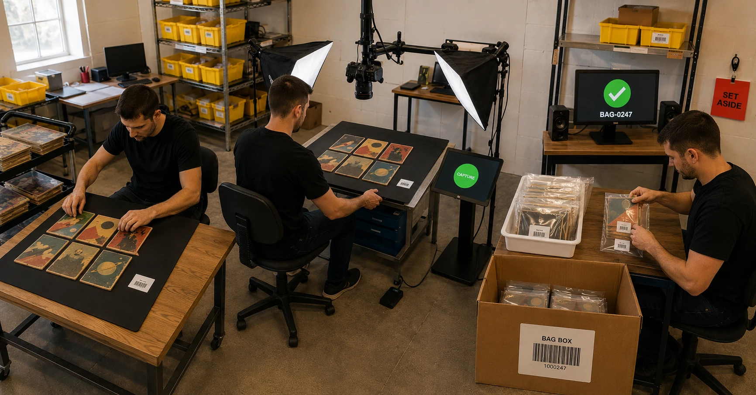
MAX COLLECTION
How the
Comic Line Works
Six comics, one photograph —
and the picture itself is the paperwork.
LAY
SHOOT
BAG
BOX
MAX COLLECTION · VSS TECHNOLOGY

Slide 2
Three rules run the comic line
1
2
3
Front cover only
The photo is the paperwork
Six at a time
Comic backs are usually advertisements. The front cover carries everything — title, issue number, publisher, cover date — so every comic is one photograph, never two.
Every frame contains the six comics AND the bag ticket. The photograph documents itself: the system reads the ticket in the image and binds the batch to its bag with zero screen time.
Lay six bare comics on the panel, step on the pedal, swap the panel. The camera never moves, the hands never leave the table, and the pace is seconds per comic.
MAX COLLECTION · VSS TECHNOLOGY

Slide 3
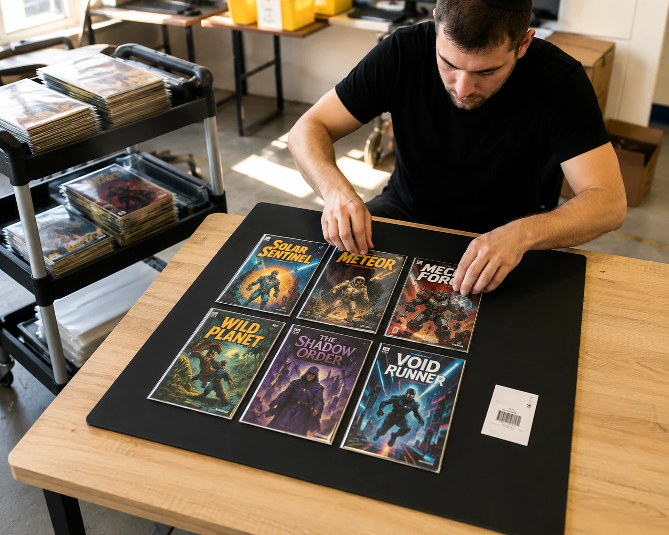
STEP 1 · LAY
Six comics on a panel
Raw books only — never bagged, never boarded, never graded — those have their own path
Two rows of three, face up — on the matte black panel; a little crooked is fine, the software straightens
The bag ticket goes on the panel too — inside the frame, so the photo carries its own bag number
Carts stage the next stacks — lay, shoot, swap — the panel is the unit of work
MAX COLLECTION · VSS TECHNOLOGY

Slide 4
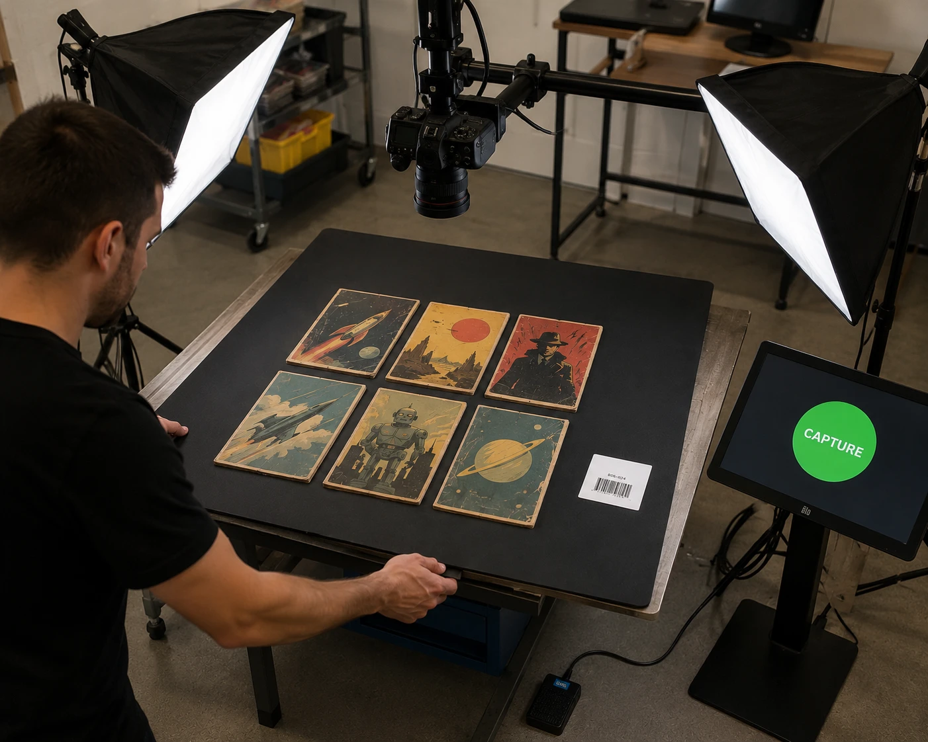
STEP 2 · SHOOT
One pedal, zero wear
The camera never moves — fixed overhead on a boom, framed once on the panel, tethered to the controller PC
Electronic shutter — no moving parts — a hundred thousand frames costs the camera nothing
Soft light from both sides at 45° — glossy covers, zero glare — the AI reads what it can see
The foot pedal is the shutter — hands stay on the comics; the kiosk shows one giant button as backup and the running count
Six comics per press. A 100,000-comic library is about 17,000 pedal steps.
MAX COLLECTION · VSS TECHNOLOGY

Slide 5
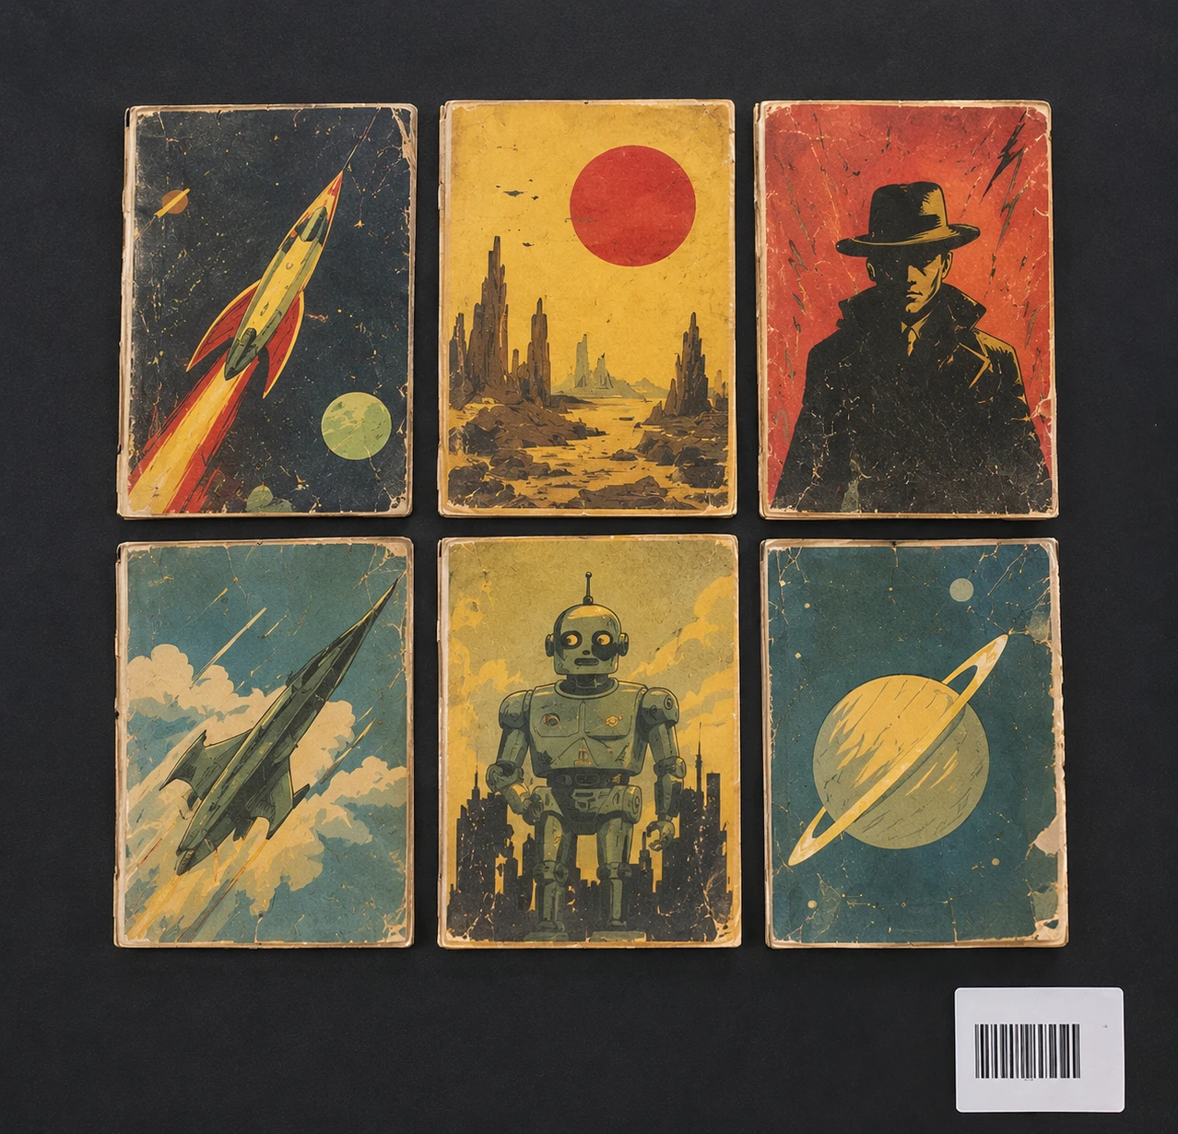
WHAT THE CAMERA SEES
One frame,
six comics,
and the ticket.
The software splits the frame into six comics and reads the bag barcode right out of the image — the batch binds itself. Then the AI reads each cover: title, issue, publisher, year. The age — Golden, Silver, Bronze, Copper, Modern — derives from the year on its own.
MAX COLLECTION · VSS TECHNOLOGY

Slide 6
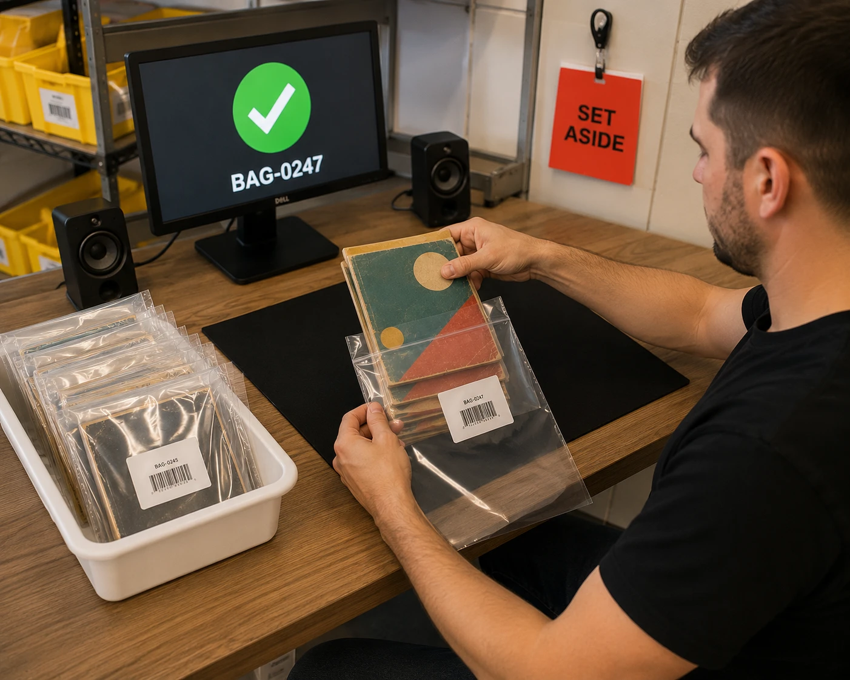
STEP 3 · BAG
Same bags, same rules
Comics bag exactly like cards — scan the ticket → verdict before anything moves
GOOD — peel the sticker onto the bag, comics in, seal — scan the bag again to close it out
FLAGGED — problem tone, line locks, red SET-ASIDE card scan — then the next batch
One bagging discipline for the whole floor — cards and comics share the station, the sounds, and the timings
MAX COLLECTION · VSS TECHNOLOGY

Slide 7
STEP 4 · BOX
Into the same chain
Sealed bags scan into barcoded boxes — comic → bag → box → divider → shelf, the identical chain cards use
Originals auto-archive to Dropbox — renamed to their bag number the moment the bag is bound
Browsing is Publisher → Age — pick Marvel, pick Silver Age, see the books — with Format and Genre filters on top
The AI catalogs in the background — and your corrections always outrank it
MAX COLLECTION · VSS TECHNOLOGY

Slide 8
Every comic can answer:
“Where are you?”
COMIC → BAG → BOX → DIVIDER → SHELF
One photograph digitizes six comics and files its own paperwork. Every scan recorded, every sticker accounted for, every book findable — same floor, same rules, same chain as the cards.
maxcollection.vsstechnology.com
MAX COLLECTION · VSS TECHNOLOGY

