Slide 1

Downloading & Uploading Files
By Sanjay and Arvind Seshan

Slide 2
Uploading and Downloading Files
Downloading – adding a file to the brick from your computer
Example: Our PIX3L PLOTT3R project requires that an image file be downloaded in addition to the EV3 code.
Uploading – adding a file from the brick to your computer
Example: You want to see the what was recorded in a text file

Slide 3
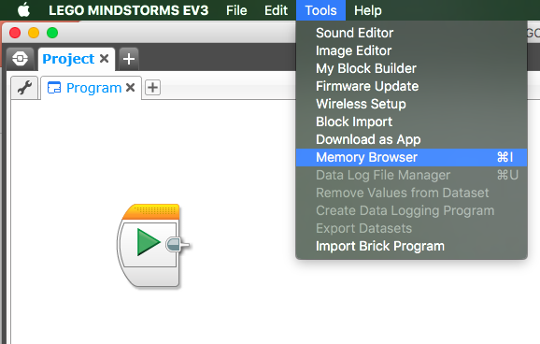
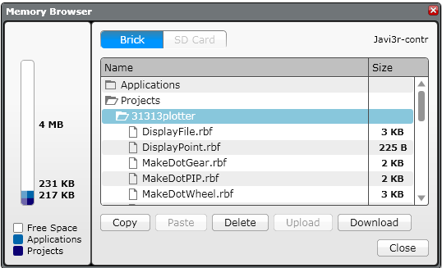
Download a File
Select Tools → Memory Browser
Select the Folder for the project you want the file added to and select Download

Slide 4
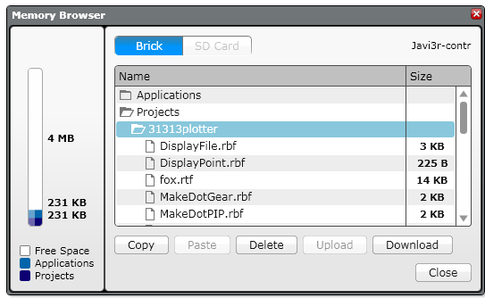

Download a File Continued
Pick the file from your computer that you want to add to the brick. In this example, the file fox.rtf is being selected.
You can now see that fox.rtf is on the brick

Slide 5
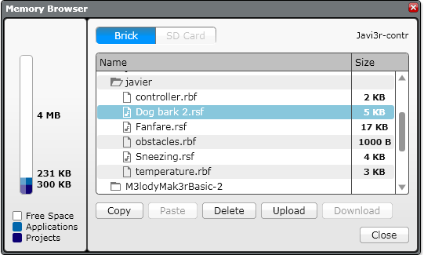
Upload a File
Select Tools → Memory Browser
Select the item inside the folder that you want to upload to your computer

Slide 6
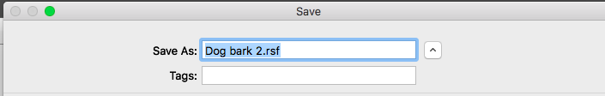
Upload a File Continued
Save the file to your computer

Slide 7
Credits
This tutorial was created by Sanjay Seshan and Arvind Seshan
More lessons at www.ev3lessons.com
This work is licensed under a Creative Commons Attribution-NonCommercial-ShareAlike 4.0 International License.

