Slide 1

Data Logging (Part 1)
By Sanjay and Arvind Seshan

Slide 2
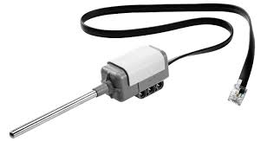
Lesson Objectives
Learn what data logging is
Learn the different ways of doing data logging on the EV3
Learn how to use the Live Data Logging, Remote Data Logging and Brick Data Logging feature using a temperature sensor
Prerequisites: Must own an NXT Temperature Sensor, Must have the Edu version of the EV3 Software and Edu version of brick firmware.

Slide 3
What is Data Logging?
The EV3 software provides a simple way to continuously record sensor readings to a file and to plot the values later. This is called Data Logging.
Why use Data Logging:
Great for science experiments. In Part 1, we will show how you can record values like temperature for a science project.
Great for understanding robot programming blocks. In Part 2, we will show how to use data logging to measure the difference between turns.
Great for understanding sensor behavior. In Part 3, we will show how to use data logging to understand the details of sensors such as the gyro sensor.

Slide 4
How do you data log on an EV3?
There are 4 ways to data log using the EV3 MINDSTORMS:
Lesson 1: Temperature Sensor Experiment
Live Data Logging: Real time data collected directly in the EV3 software
Remote Data Logging: Use the the brick to collect data, and transfer the data to the computer for analysis
Brick Data Logging: Run the experiment directly from the brick
Autonomous. Collect data with the Data Logging block. The data is stored on the brick.
Lesson 2: Differences Between Turns

Slide 5
Live Data Logging
Challenge: We will use a Temperature Sensor to log the changing temperature of water.
Design your own experiment. For example, you can try placing the temperature sensor probe at room temperature water, then boiling water and then cold water.

Slide 6

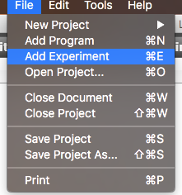

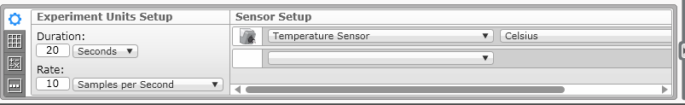
Live Data Logging (Temperature Sensor)
STEP 1:
Start a New Experiment in an existing project
STEP 2:
Turn off Oscilloscope Mode
STEP 3: Pick your duration, sample rate, sensor and units.

Slide 7

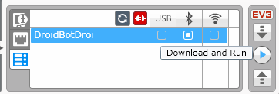
Live Data Logging (Temperature Sensor)
STEP 4:
All sensors connected to the EV3 will be automatically added. If you do not want to collect data with a particular sensor, click the “X” next to it.
STEP 5: Download and Run
STEP 6: Place temperature probe in hot/cold liquid and watch the graph (see next slide)

Slide 8
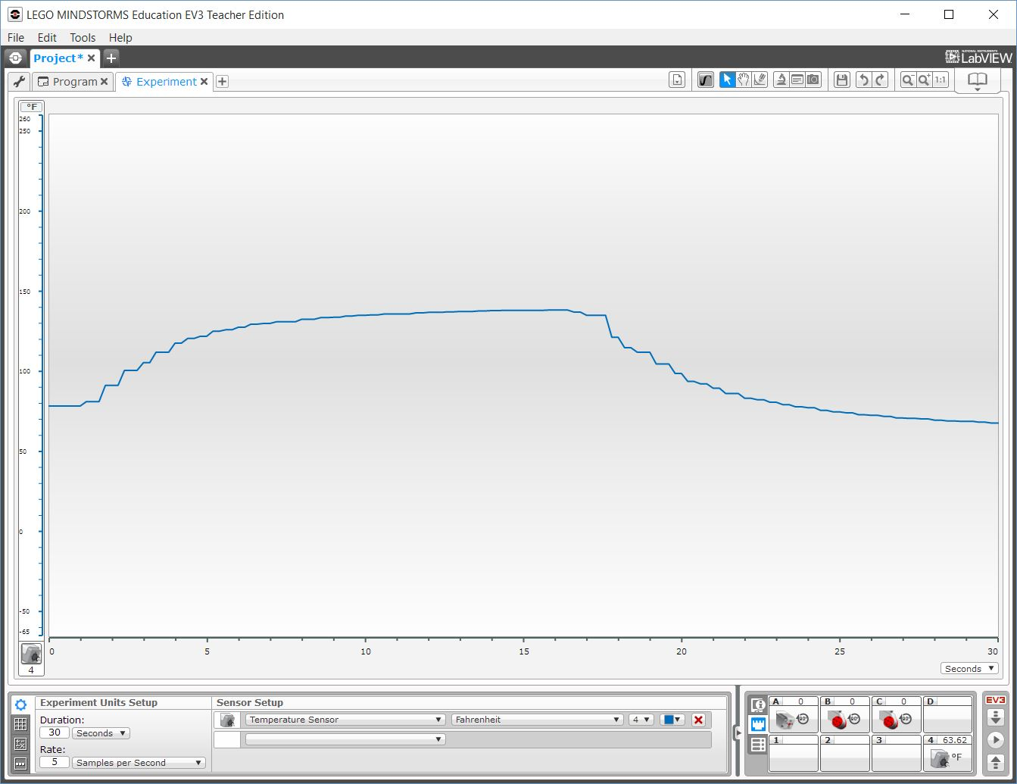
Results/Solution
A similar graph will appear live on your screen.
3. Probe removed and placed in cold water
2. Temperature increases
1. Room temperature probe placed in boiling water

Slide 9
Other Ways to Collect Data
Now that we have tried Live Data Logging, let’s look at two other ways to collect data when the computer isn’t around:
Remote Data Logging: Use the the brick to collect data, and transfer the data to the computer for analysis
Brick Data Logging: Run the experiment directly from the brick

Slide 10
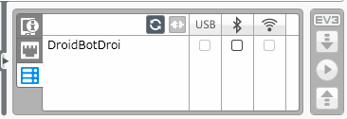
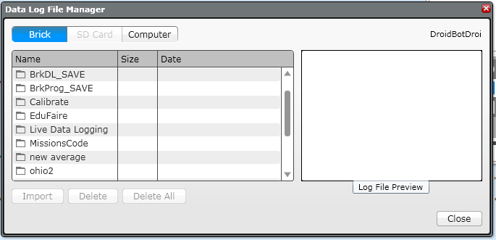
Remote Data Logging Instead
Download Icon
STEP 1-4: Repeat steps 1-4 of the Live Data Logging
STEP 5: Click on the Download icon
STEP 6: Take your robot somewhere else and run the experiment from the screen
These icons appear only when you are in an open EXPERIMENT (not a Project)
Upload Icon
STEP 7: Place temperature probe in hot/cold liquid
STEP 8: Connect your robot and click on the Upload Icon. In the Data Log File Manager, pick the correct file to import.

Slide 11
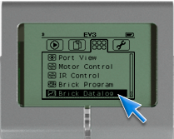
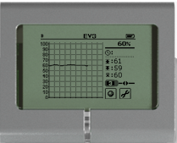
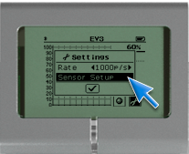
Using Brick Data Logging Instead (Part 1)
STEP 1: Go to third tab on Brick Menu and pick Brick Datalog
STEP 3: Click on icon with numbers to see the data for a different sensor
STEP 2: Click on the wrench to set up sensors
STEP 4: Place temperature sensor probe in hot/cold liquid
Step 5: Click on the sphere icon to start and stop collecting data

Slide 12
Brick Data Logging (Part 2)
STEP 6: Pick name for the file on the brick
STEP 7: Connect your robot and click on the Upload Icon after you are in an Experiment. In the Data Log File Manager, pick the correct file to import.
Upload Icon
These icons appear only when you are in an open EXPERIMENT (not a Project)

Slide 13
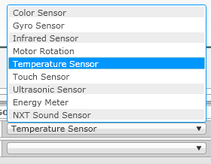
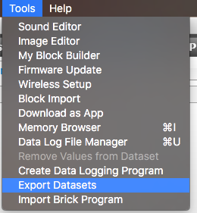
Next Steps
Can you think of other experiments?
Try data logging using other sensors.
Try exporting your data into Excel or another spreadsheet tool.
Learn how to use Autonomous Data Logging in Part 2 of the Data Logging series of lessons.

Slide 14
Credits
This tutorial was written by Sanjay Seshan and Arvind Seshan
More lessons at www.ev3lessons.com
This work is licensed under a Creative Commons Attribution-NonCommercial-ShareAlike 4.0 International License.

