Slide 1

Data Logging (Part 2)
By Sanjay and Arvind Seshan

Slide 2
Lesson Objectives
Learn what data logging is
Learn the different ways of doing data logging on the EV3
Learn how to use the Data Logging Block
Prerequisites: Must own Edu version of EV3 Software

Slide 3
What is Data Logging?
The EV3 software provides a simple way to continuously record sensor readings to a file and to plot the values later. This is called Data Logging.
Why use Data Logging:
Great for science experiments. In Part 1, we will show how you can record values like temperature for a science project.
Great for understanding robot programming blocks. In Part 2, we will show how to use data logging to measure the difference between turns.
Great for understanding sensor behavior. In Part 3, we will show how to use data logging to understand the details of sensors such as the gyro sensor.

Slide 4
How do you Data Log on an EV3?
There are 4 ways to data log using the EV3 MINDSTORMS:
Lesson 1: Temperature Sensor Experiment
Live Data Logging: Real time data collected directly in the EV3 software
Remote Data Logging: Use the the brick to collect data, and transfer the data to the computer for analysis
Brick Data Logging: Run the experiment directly from the brick
Autonomous. Collect data with the Data Logging block. The data is stored on the brick.
Lesson 2: Differences Between Turns

Slide 5
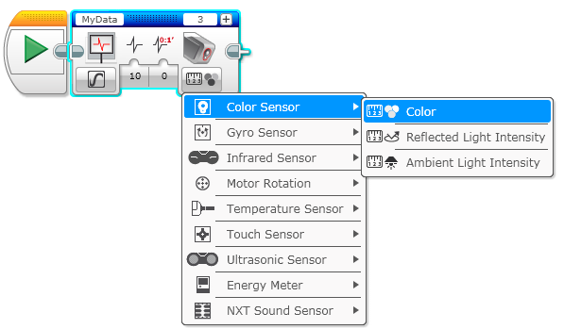
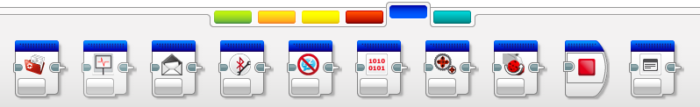
Autonomous Data Logging
File name
Port
Autonomous Data Logging requires the Data Logging Block
Add more sensors
Pick the sensor and what you want to measure
Data Logging block is in the blue tab

Slide 6
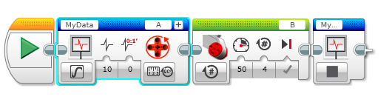
How do you use the Data Logging Block?
To use this block, simply drag a Data Logging Block in front of the code you want to log and turn it “on”. To stop logging, add another Data Logging Block set to “off”.
Pick all the other parameters – the ports, the sensors you want to log, what you want to record (rotations/degrees, etc.)
Download and run program
On
Off

Slide 7
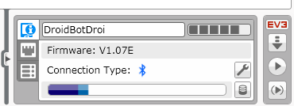
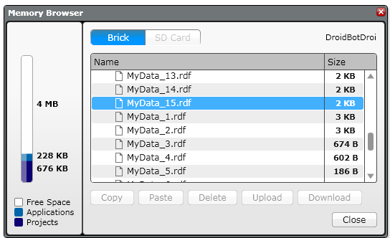
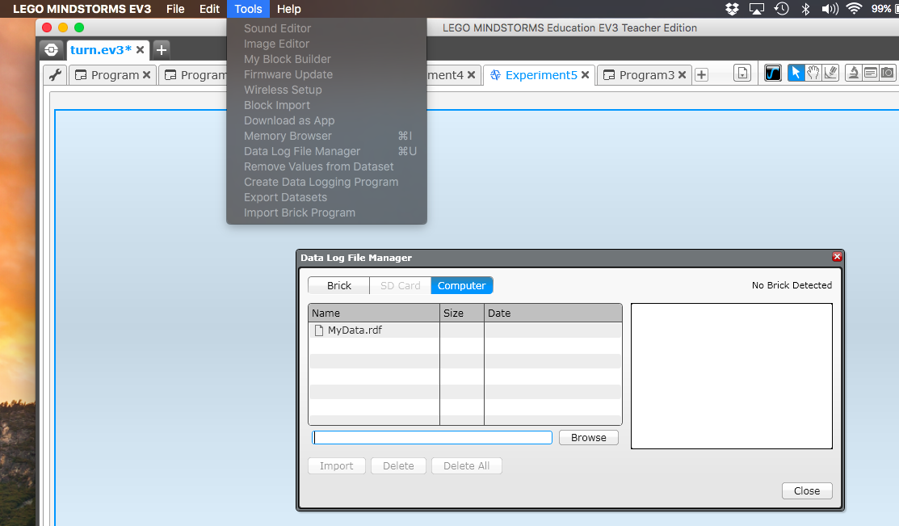
How to View your Data
1
If you want to get the file from your brick to the computer:
Click on the Brick Information Icon
Press the Open Browser Memory Icon.
Find the correct .rdf file.
If you want to view the data file from either the brick or the computer:
Tools → Datalog File Manager → Select BRICK or COMPUTER and pick the correct file
3
2

Slide 8
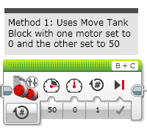
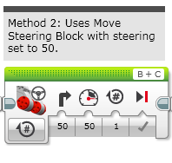
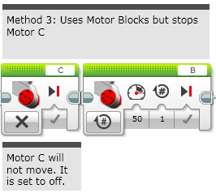
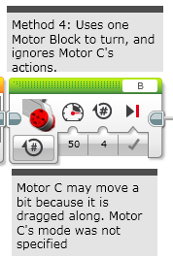
Challenge 1: Comparing Turns
Make four different programs that do a pivot turn and compare the data from the rotation sensor

Slide 9

Steps to Remember
STEP 1: In the Data Logging My Block, select the sensor you are reading, the ports they are in.
STEP 2: Select the duration and rate
STEP 3: Remember to stop data logging at the end of your code
STEP 4: Remember to change the name of the file each time otherwise they will all be called MyData.
STEP 5: Import your data file and compare the graphs. Which type of pivot turn is the most reliable?

Slide 10
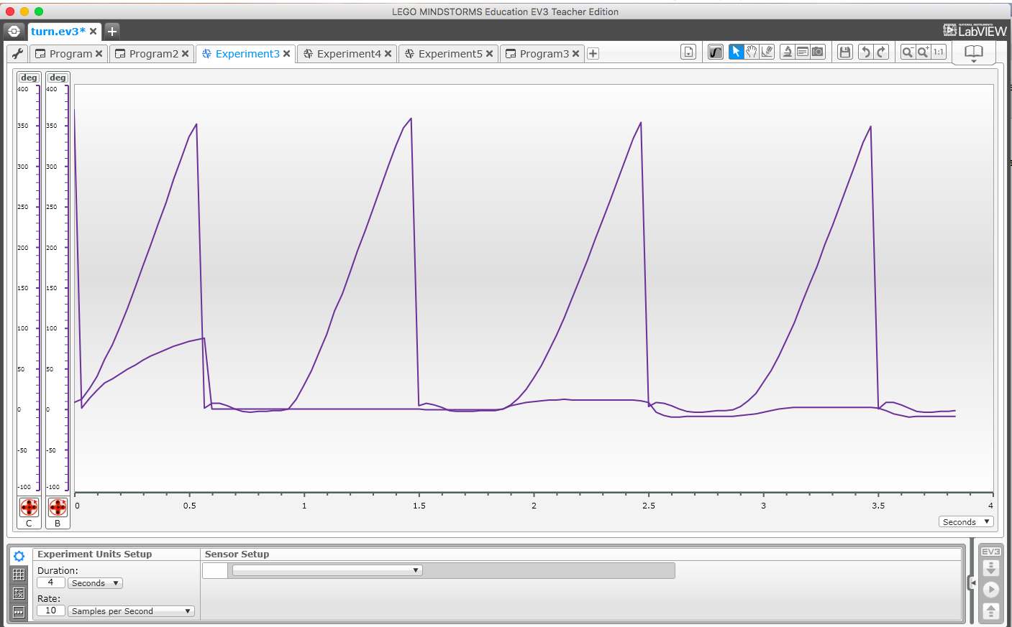
Challenge 1 Solution
Below, we ran all 4 together, but you will find it easier to run each method separately (because you can avoid adding motor resets)
In Method 4, Motor C is dragged along.
Methods 1 and 2 are very similar.
Method 3 appears to be the most reliable. You may not notice much difference in real life, but the data log shows us the true reading.
Motor B line
Method 4
Method 3
Method 1
Method 2
Motor C line

Slide 11
Credits
This tutorial was written by Sanjay Seshan and Arvind Seshan
More lessons at www.ev3lessons.com
This work is licensed under a Creative Commons Attribution-NonCommercial-ShareAlike 4.0 International License.

