Slide 1

Proportional Control with the Sound Sensor
By Sanjay and Arvind Seshan

Slide 2
Lesson Objectives
Learn to use the Sound Sensor with proportional control
Pre-requisites: Proportional Control, Sound Sensor, Data wires, Loops

Slide 3
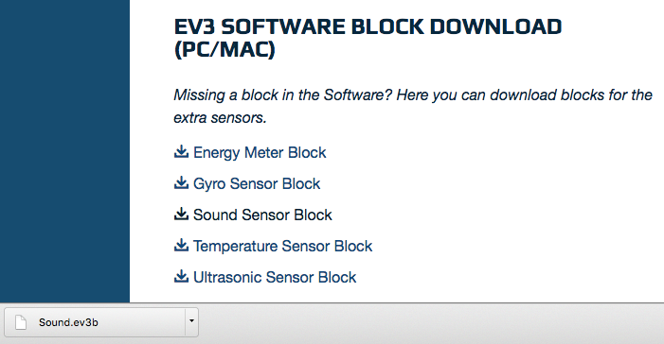
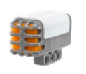

Downloading the Sound Block
The Sound Block is available for download on the LEGO.com site:
http://www.lego.com/en-us/mindstorms/downloads
Download the block using the Importing Additional Blocks Lesson in Beginner

Slide 4
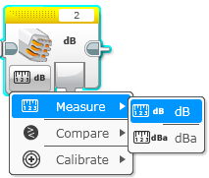
Sound Sensor: Measure Mode
Measure Mode
dB
Sound level, scaled to a percentage
dBa
Sound level, adjusted to approximate human ear sensitivity, and then scaled to a percentage
Source: EV3 Help Menu

Slide 5
Sound Sensor Challenge
In the Sound Sensor lesson in Beginner, the challenge was to write a “Celebration” program where the robot moves faster or slower depending on how loud the sound is
For this challenge, we will improve this code by using proportional control
Hint
The Sound Sensor Block in Measure Mode will be used
You can use dB or dBa for this challenge

Slide 6
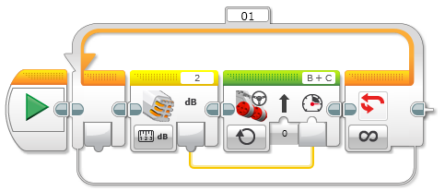
Challenge Solution

Slide 7
Credits
This tutorial was created by Sanjay Seshan and Arvind
More lessons are available at www.ev3lessons.com
This work is licensed under a Creative Commons Attribution-NonCommercial-ShareAlike 4.0 International License.

