Slide 1

Ramping Up Speed
By Sanjay and Arvind Seshan

Slide 2
Lesson Objectives
Learn what ramp up means
Learn how and when to use ramp up
Learn how to use the Timer Block
Prerequisites: Data Wires, My Blocks with Inputs & Outputs

Slide 3
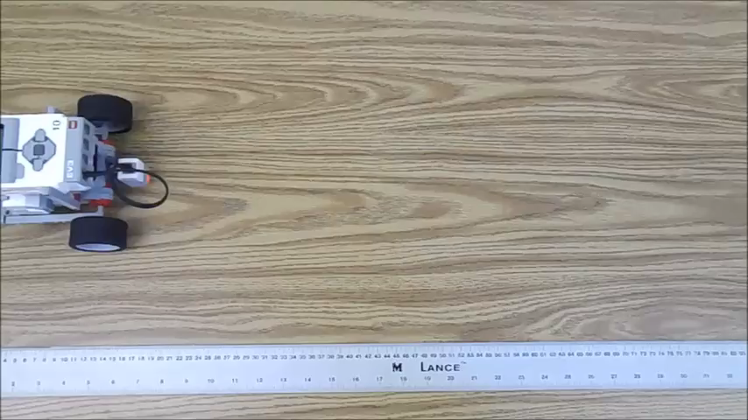
Why Ramp Up
Ramping up speed is very helpful when running fast-paced programs
Usually, if the robot starts up with high speed, then there would be a small jolt in the beginning. The jolt may change the position of the robot.
With the ramp up, it would start up slowly and increase speed over time (see video on the right)

Slide 4
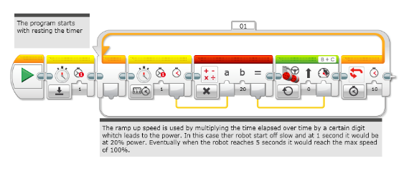
New Tool: Timer Block
The timer block is used to count time
It is found in the Yellow (sensor tab) in the EV3 Software.
Multiple timers are available (up to 8 timers)
You can use the block to reset a specific timer back to 0 seconds
You can use the block to output the time since reset…
If you are an FLL team, you can use timers to track time or for the ramp up code in this lesson
Timer #
Elapsed time for that timer

Slide 5
Ramp Up in 4 Easy Steps
1. Reset timer
2. In a loop, read the number of seconds passed and multiply the power by 20.
3. Still in the loop, take the result of the multiplication and connect it to the move block.
4. Repeat the Loop for 5 seconds

Slide 6
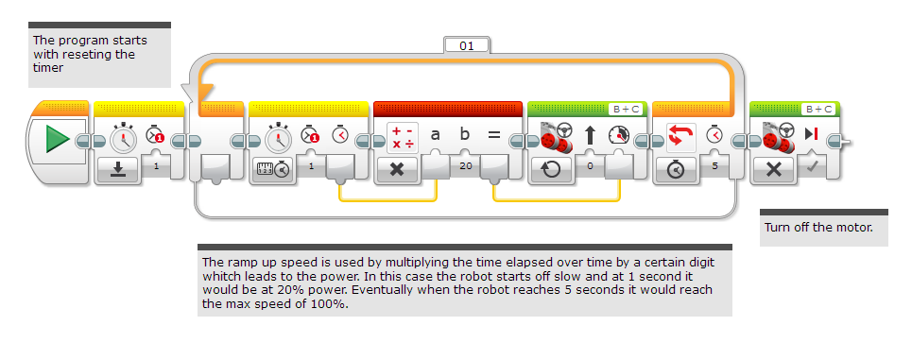
Base Ramp Up
Code by Mesa Robles Robotworks. Modified by Droids Robotics

Slide 7
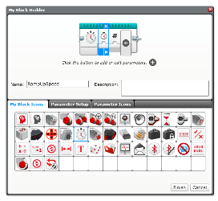
Ramp Up Challenge
Step 1: Can you now make a ramp up program that takes 2 inputs (total duration of ramp up and how much you want the motor to ramp up per second)? Create a My Block.
Step 2: Ramp up your robot, then move until a black line.

Slide 8
Making the My Block
A
Highlight all the blocks (without stop block) then go to My Block Builder
Add 2 inputs: one for how quickly you want to ramp up and one for and seconds
Refer to the My Blocks with Inputs & Outputs lesson if you need help setting up the My Block
B

Slide 9
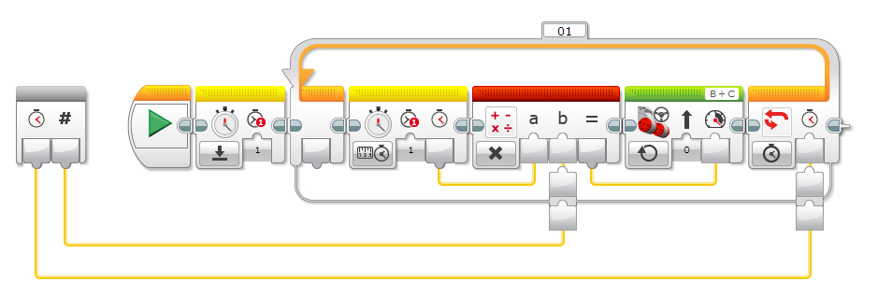
Wire the My Block
how quickly you want to ramp up
Seconds to ramp up
Wire the “How quickly you want to ramp up” input to the Math Block and the Seconds input to the Move Steering block
Code by Mesa Robles Robotworks. Modified by Droids Robotics

Slide 10
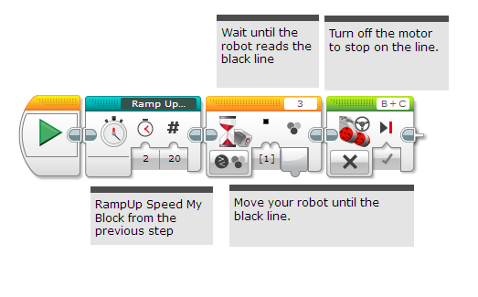
Challenge Solution
Code by Mesa Robles Robotworks. Modified by Droids Robotics

Slide 11
Discussion Guide
What is ramping up? Ans. Ramping up is starting slow and getting gradually faster.
Why should you bother? Ans. Ramping up can reduce sudden jerk in robot movement.

Slide 12
Next Steps
Think about what else you might be able to use a timer block for.

Slide 13
Credits
This code for this tutorial was created by Mesa Robles Robotworks (mesarobotworks@gmail.com)
Sanjay and Arvind Seshan added content to complement the original lesson (team@droidsrobotics.org)
More lessons at www.ev3lessons.com
This work is licensed under a Creative Commons Attribution-NonCommercial-ShareAlike 4.0 International License.

