Slide 1

Random Block
By Sanjay and Arvind Seshan

Slide 2
Lesson Objectives
Understand what the random block does
Fix the random block’s “lack of randomness”
Create a game using the random block
Prerequisites: Math Blocks, Data Wires, Variables, Constants, My Blocks with Inputs and Outputs

Slide 3
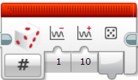
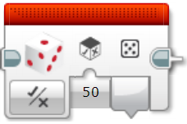
What Does the Random Block Do?
Random Block (Numeric Mode)
Two inputs: The minimum and maximum values for the output
It outputs a number between the range specified
The output is only integers (no decimals/fractions)
Random Block (Logic Mode)
One input: The probability of True being the output
It outputs either True of False

Slide 4
What Can You Use a Random Block For?
As a replacement for dice
Making your robot unpredictable (e.g. random animal movements)
Making a Game

Slide 5
Challenge 1: Is the Random Block Random?
Make a random number generation system to pick a number between 1 and 3
In a loop, record how many times you get each number using three variables
Run your system 1000 times
Display the results to the screen
What do you notice about the number of times you got #1 vs. #2 vs. #3?

Slide 6
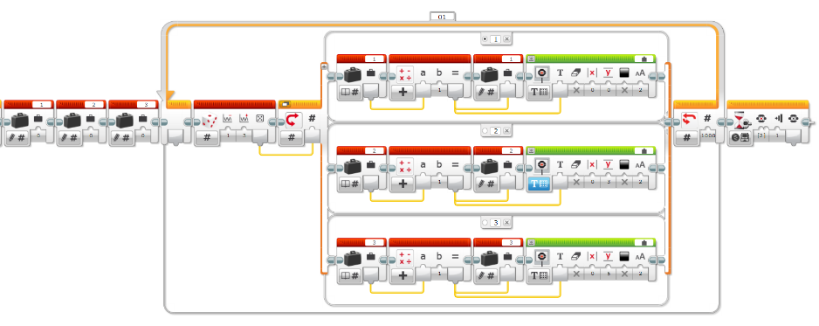
Challenge 1 Solution
Loop 1000 times
Add 1 to the variable decided by the random block and display to the screen
Three variables – one for each number
Get random number
Wait before exiting

Slide 7
Challenge 1 Discussion
You will notice that you got the #1 and #3 about 250 times each. But you got the #2 around 500 times
This is due to a bug in the EV3 that causes the boundary values (1 and 3 in our example) to occur half as often as the middle values (2 in our example). This is true no matter what your range of numbers is.
Can you think of how you might fix this problem to get a better random number?

Slide 8
Challenge 2: Fix the “Lack of Randomness”
Create a new system that is more random in picking a number in Challenge 1 and fixes for the bug in the EV3 code
Record how many times you get each number and compare the results to the previous results

Slide 9
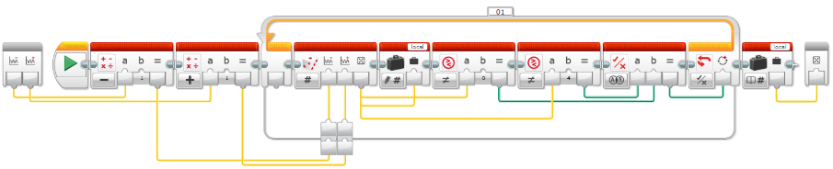
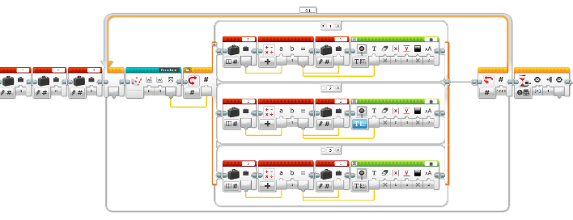
Challenge 2 Solution
In our solution, we subtract one from the lowest range value and add one to the highest range value, and reject those two values (so that we eliminate using the boundary values)
Add and Subtract 1 from the range
Get random value
If random is a boundary value -> repeat
Same code as Challenge 1 except the random block is replaced with our new My Block

Slide 10
Challenge 2 Discussion
#1, #2 and #3 have an equal chance of being picked at random with our fix

Slide 11
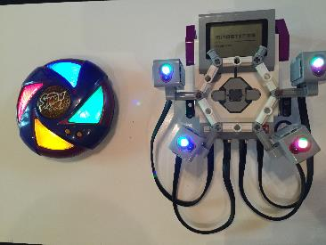
Bonus Challenge: Create a Simon Game
Make a game that is similar to the Simon Game using your EV3
Unfamiliar with the game? See: Wikipedia Simon Game
You can use touch sensors, color sensors, brick buttons (see Simon Game by Damien Kee), or even the Mindsensors PSP-Nx Controller (see the PSP-Nx Controller Lesson in Beyond on EV3Lessons.com)
Our version (see photo on the right) uses four color sensors. The code to play the game can be downloaded on ev3lessons.com

Slide 12
Credits
This tutorial was created by Sanjay Seshan and Arvind Seshan
More lessons at www.ev3lessons.com
This work is licensed under a Creative Commons Attribution-NonCommercial-ShareAlike 4.0 International License.

