Slide 1

Parallel Beam Synchronization
By Sanjay and Arvind Seshan

Slide 2
Lesson Objectives
Understand what the “synch problem” is when you use parallel beams
Learn techniques to to ensure that two beams end before moving to the next block of code (variables, data wires, loops and My Blocks)
Prerequisites: Parallel Beams Lesson, Data Wires, Variables, My Blocks with Inputs and Outputs

Slide 3
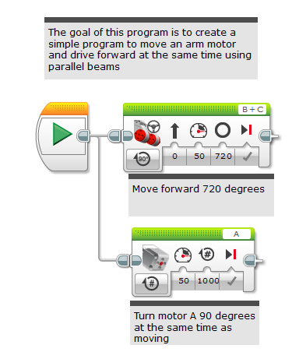
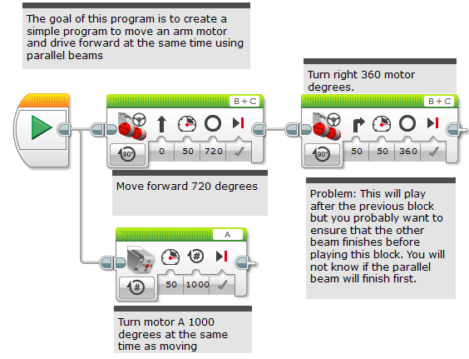
Using Parallel Beams Inside Programs
Parallel beams are great for doing two things at the same time
Often want to do something after you complete the Parallel Beam
Hard to tell which beam will finish first (called the “synch problem”)
Need to synchronize the beams to make sure that blocks execute when you expect them to
In the picture below, will the turn start after motor A is done or before?
Answer: You do not know

Slide 4
Ensure That Both Beams Finished
In this example, we want both the 720 degree move steering (the move) and the motor A move to finish before the 360 degree move steering (the turn)
There are several ways to do this:
Variables (see slide 4)
Wires (see slide 5)
Loops (see slide 6)
My blocks (see slide 7)
This is labeled as “synch problem” in the corresponding EV3 code file

Slide 5
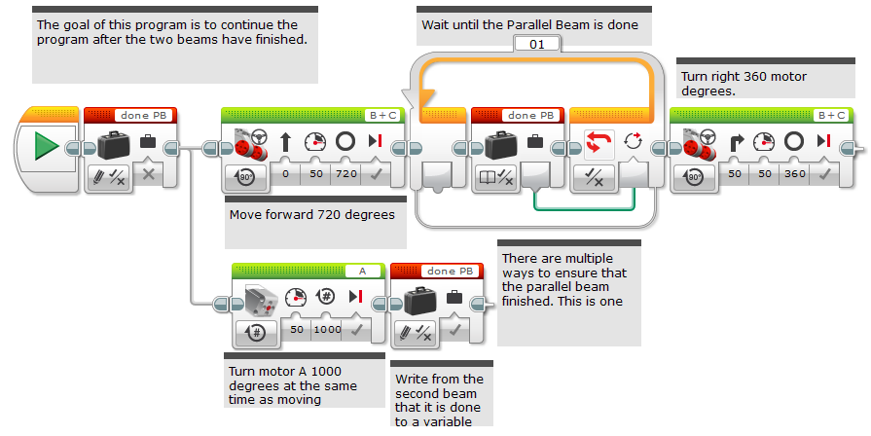
Use Variables To Synchronize
This is labeled as “variables” in the corresponding EV3 code file

Slide 6
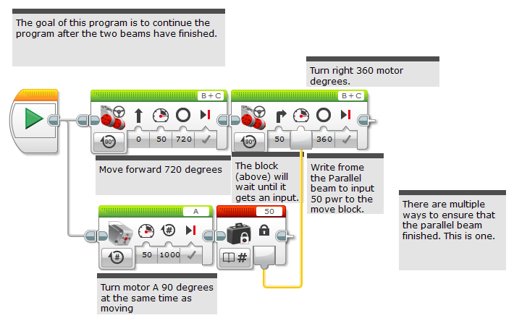
Use Wires to Synchronize
This is labeled as “wires” in the corresponding EV3 code file

Slide 7
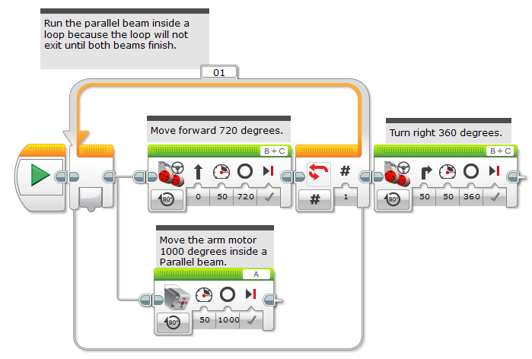
Use Loops to Synchronize
This is labeled as “loops” in the corresponding EV3 code file

Slide 8
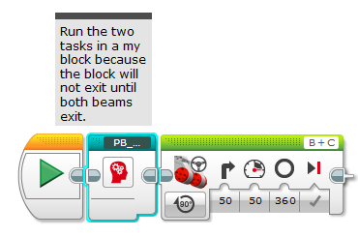
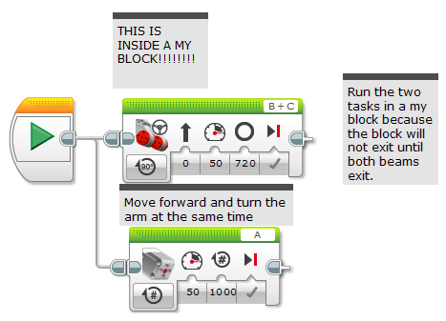
Use My Blocks to Synchronize
This is labeled as “My Blocks” in the corresponding EV3 code file
This is labeled as “Parallel_Beam_My_Blocks” in the corresponding EV3 code file
Inside the My Block

Slide 9
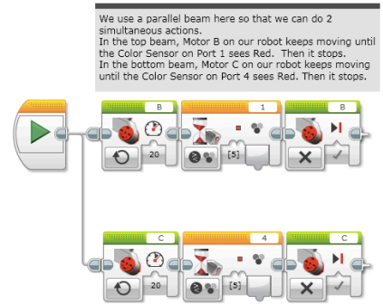
Challenge: Squaring on a Line
Synchronization is critical for aligning on a line using parallel beams
As a challenge, complete the Squaring on Line lesson.
Note: You must ensure that both beams in an align are completed before moving onto the next block
Otherwise, the robot will not be straight on a line
This example is from the Squaring on a Line Lesson

Slide 10
Discussion Guide
What is the “sync problem”? Ans. When you write code with parallel beams, you are not certain when the two beams will complete. You don’t know if one beam might finish before the other.
What are 4 ways to solve this problem? Ans. Use variables, data wires, loops or My Blocks to make sure that the parallel beams compete before moving on to the next block of code.

Slide 11
Credits
This tutorial was created by Sanjay Seshan and Arvind Seshan
More lessons at www.ev3lessons.com
This work is licensed under a Creative Commons Attribution-NonCommercial-ShareAlike 4.0 International License.

