Slide 1

Beginner Programming Lesson
Basic Line Follower (NXT)

Slide 2
LESSON OBJECTIVES
Learn how humans and robots follow lines
Learn how to get a robot to follow a line using the NXT Color Sensor
Learn how to get a robot to follow a line using the NXT Light Sensor
Learn how to follow a line until a sensor is activated
Learn how to follow a line for a particular distance
Learn how to combine sensors, loops and switches

Slide 3

FOLLOW THE MIDDLE?
Humans want to follow the line in the middle.
Let’s have the robot do the same thing using the Color Sensor
What type of questions can we ask using this sensor
Are you on line or not?

Slide 4
If we are on black, keep going straight
If we are on white, turn left to get back to the line
Seems to work fine here…

Slide 5
If we are on black, keep going straight
If we are on white, turn left to get back to the line
OH NO… my robot is running away….
When the robot leaves the left side of the line, the program no longer works!

Slide 6
Line Following: ROBOT STYLE
Why could the Human follow the middle?:
They can see ahead.
They can see the whole line and its surroundings
They see both sides and which side they left
Why can’t the Robot do the same thing?:
Can’t tell right or left side of the line
How do we make sure the robot always veers off on the SAME SIDE of the line?
Instead of the middle, could the robot follow the “edge”?
So now the robot will fall off only the same side.
We will now show you how this works!

Slide 7
ROBOT LINE FOLLOWING Happens on the edges
Left side line following
Right side line following
If on black, turn left.
If on white turn right.
If on black, turn right.
If on white turn left.
The robot has to choose which way to turn when the color sensor sees a different color.
The answer depends on what side of the line you are following!

Slide 8
starting the roboT on the correct side
✗
✔
✔

Slide 9
Instructor Notes WHEN USING AN NXT
We used CyberBot (see EV3Lessons.com Robot Design page)
CyberBot has color sensors behind the wheel
Therefore, students will have to line follow backwards (negative power)
Programming a line follower on an NXT brick with an EV3 requires some adjustments
We found that Move Steering with an angle does not work with the NXT for pivot turns
Therefore, the code uses Large Motor blocks instead for turning

Slide 10
Line Follower challenge 1
Step 1: Write a program that follows the RIGHT edge of a line.
If your sensor sees black, turn right
If your sensor sees white, turn left
Use loops and switches!
You will need to use Large Motor block in “ON” Mode.
You will need to control each motor (B and C) separately.
Step 2: Try it out on different lines.
B
B
C
C

Slide 11
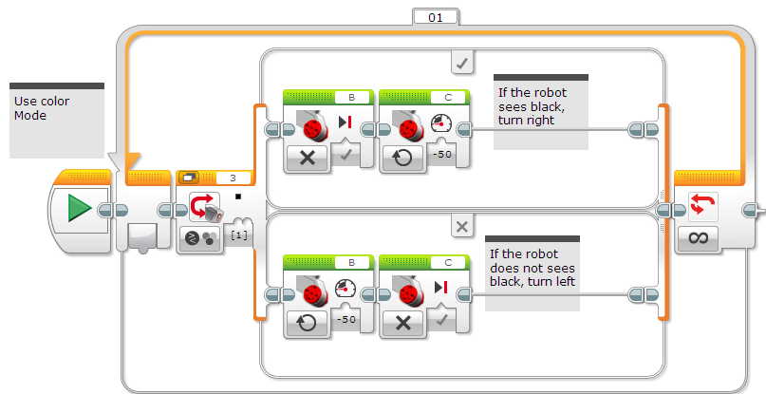
Line Following challenge Solution
Q. Does this program follow the Right or Left side of a line?
A. The robot is following the Right Side of the line.
Notes:
Right side

Slide 12
CHALLENGE 1 SOLUTION
Q. This line follower goes forever. How do we make this stop?
A. Change the end condition on the loop.
Notes:
Right side

Slide 13
Line follower challenge 2
Part 1: Make a line follower that stops when you press the touch sensor
Part 2: Make a line follower that stops after it travels a particular distance

Slide 14
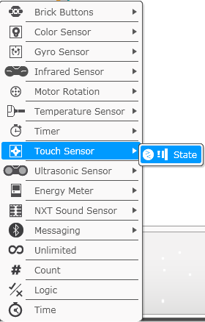
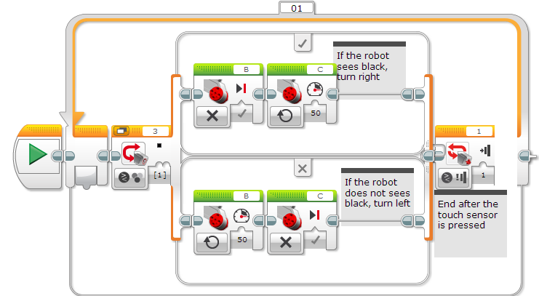
Challenge 2 SOLUTION: Sensor

Slide 15
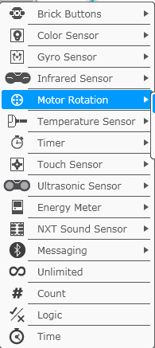
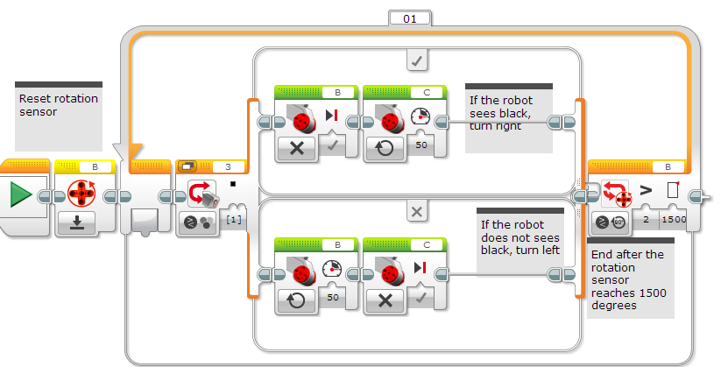

Challenge 2 Solution: Particular distance

Slide 16
Line follower challenge 3
Make a line follower that uses the NXT Light Sensor to follow the line.
Note: You have to use the Sound Block. (Refer to the lesson on using NXT Light sensors on EV3Lessons.com if you need help with this.)

Slide 17
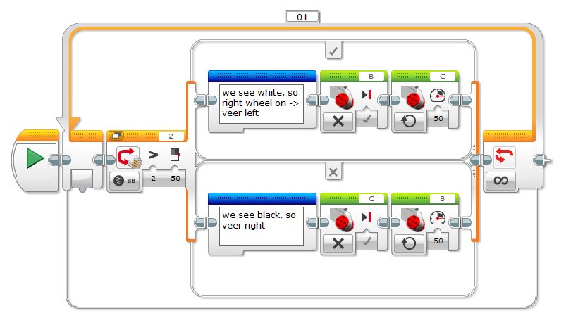
Line follower challenge 3
The program below shows an example of a line-follower that works with a light sensor pretending to be a sound sensor. For much more discussion on line-following, see the light-follower tutorials at EV3lessons.com.
Challenge solution provided by Cathy Sarisky

Slide 18
DISCUSSION GUIDE
Why is it important for the robot to follow the same side of the line?
The robot only knows to check if it is on or off the line.
This is a basic line follower. What are some things that were not good about this line follower? Do you think the line follower can be improved?
It wiggles a lot. Smoother line followers are described in the Advanced lessons
What sensor measures how far you have travelled?
The rotation sensor used in Challenge 2 solution measures how much the wheels have turned
How would you write a line follower that will stop when it sees a line? Or another color?
Change the loop exit condition to use the color sensor.

Slide 19
CREDITS
This tutorial was created by Sanjay Seshan and Arvind Seshan
More lessons are available at www.ev3lessons.com
This work is licensed under a Creative Commons Attribution-NonCommercial-ShareAlike 4.0 International License.

