Slide 1

BEGINNER PROGRAMMING LESSON
Importing Additional LEGO Blocks

Slide 2
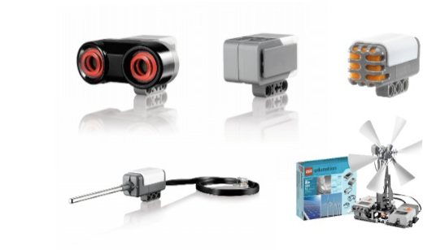
Adding Official LEGO Blocks
If you installed the Home Edition of the EV3 Software, you might want to add the Gyro and Ultrasonic Sensor Blocks later on
If you find that your version of the software does not have the Sound and Temperature Sensors, and Energy Meter Blocks ,you can add them at any time.
These blocks are free to download from LEGO

Slide 3
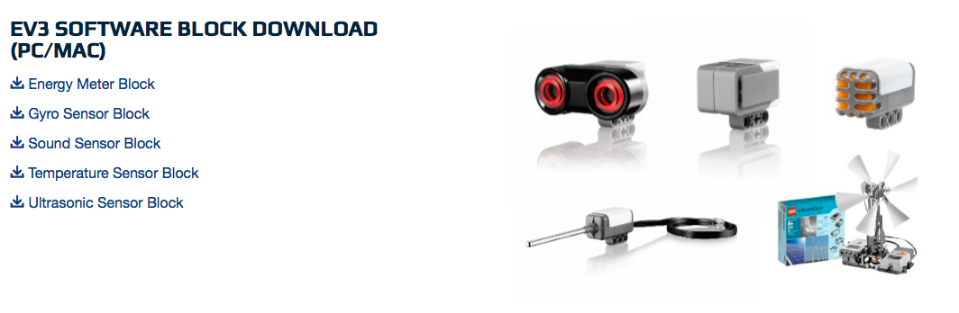
Step 1: Download Block
Download the necessary block online from:
http://www.lego.com/en-us/mindstorms/downloads

Slide 4
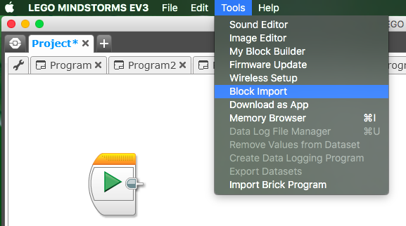
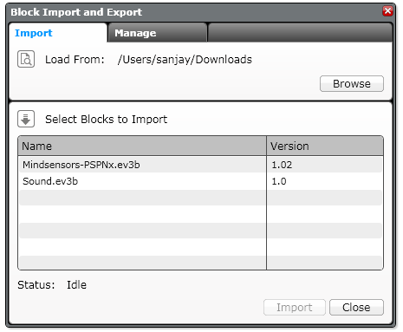
Step 2: Import Block
Open your EV3 software
Go to Tools → Block Import
Browse through your files and find the file you downloaded in Step 1
Select the block and click Import
You will have to restart your software before using the block

Slide 5
CREDITS
Author: Sanjay and Arvind Seshan
More lessons are available at www.ev3lessons.com
This work is licensed under a Creative Commons Attribution-NonCommercial-ShareAlike 4.0 International License.

