Slide 1

BEGINNER PROGRAMMING LESSON
Introduction to the NXT Brick and Software

Slide 2
Lesson Objectives
Learn how the NXT brick operates
Learn about the main components of the EV3 software

Slide 3
The “Brick” Buttons
1 = Left, Right → Navigate menus
2 = Center Button → Select options Run Program Turn robot on
3 = Back → Undo Stop Program Turn robot off
2
1
1
3

Slide 4
The “Brick” Screen
Menus on Screen
My Files Find programs you downloaded
2. Use left/right
buttons to find other menus such as “View”

Slide 5
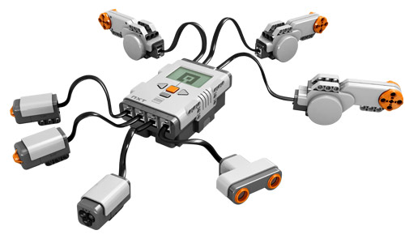
Ports, Sensors, motors
Motors: make your robot move
Ports A, B, C = Motors
Default setup assumes Right Motor is in C, Left Motor is in B
Touch Sensor: Make your robot detect objects
Ultrasonic sensor: Make your robot measure distances
Color sensor: Make your robot detect colors
B
Default setup
Front
Ports 1, 2, 3, 4 = Sensors
C

Slide 6
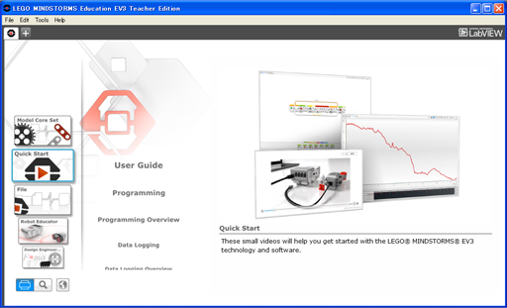
EV3 Software
Open Saved Project
Open New Project

Slide 7

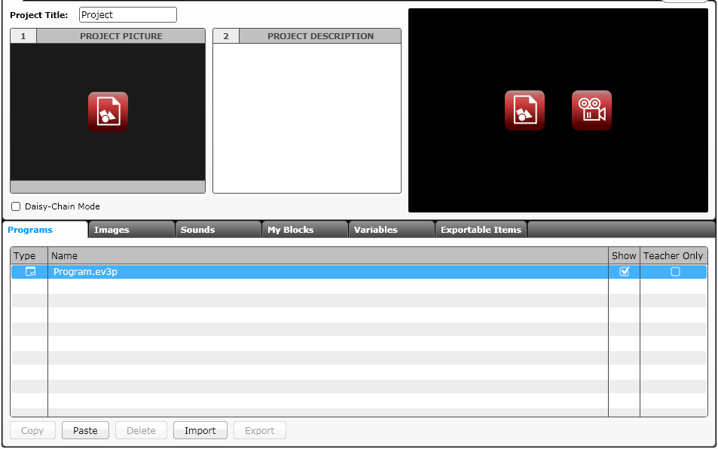
EV3 Software: Starting A new program
Create a Project
Opened Programs
Opened Projects
Create a Program
Project Properties
List of programs

Slide 8
PROJECTS VS. PROGRAMS
You will start by creating a PROJECT which has a .ev3 extension. You change the name of a project by using the Save Project As option from the File menu.
You will write many PROGRAMS as part of each PROJECT file. You change the name of a program within a project by doubling clicking on the program’s tab and typing in a new name.
Note: If there is an * next to the project name, you have made changes to the project and you have not yet saved yet.
There is a “x” next to project and program names. Clicking on it simply closes the file (it does not get deleted).
Here are some common file extensions in the EV3:
Programs (.ev3p)
Images (.rgf)
Sounds (.rsf)
Text (.rtf)
Projects (.ev3) – the only type of file you can open with the EV3 software
Import file (.ev3s) – can be imported by an EV3 project

Slide 9
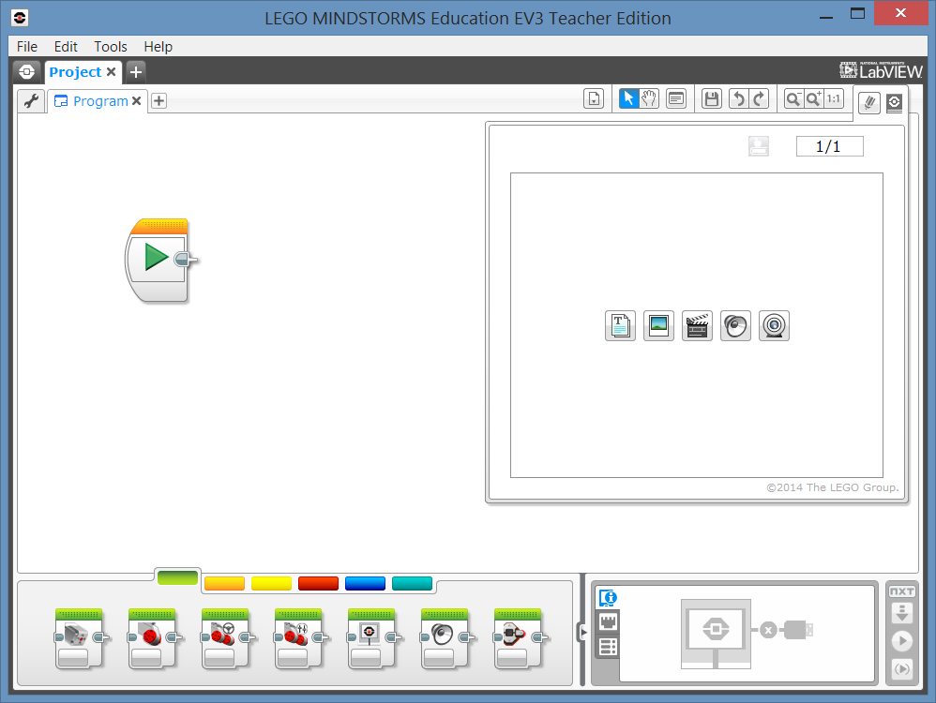
NAMING & SAVING YOUR WORK
Changing the Program Name
Double click on ”Program”
Saving your Project
Select File and “Save Project As”

Slide 10
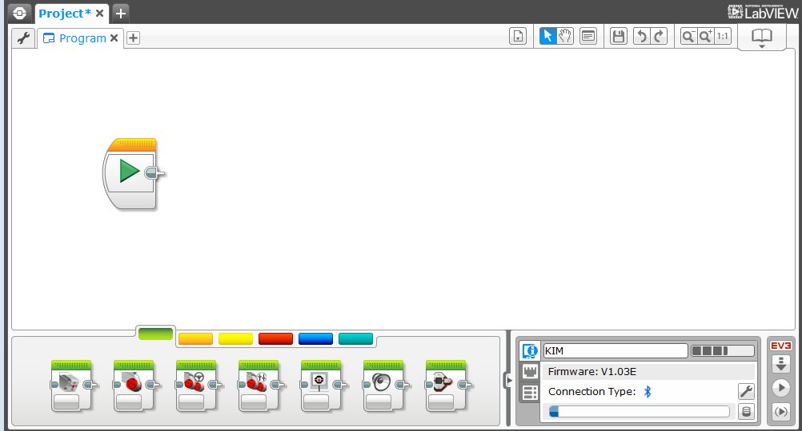
EV3 Software: Programming screen
Programming Area or Canvas
Programming Blocks in
6 Colored Tabs
Brick Status & Downloading

Slide 11

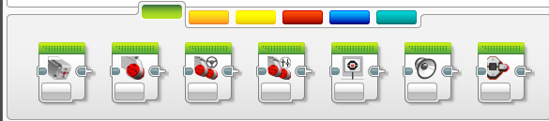
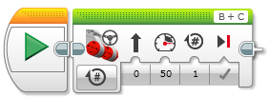
Adding Blocks To Your Program
STEP 1: Green Block Tab, Click and hold any block and drag to programming area
STEP 2: Drop next to the Start Block (green arrow)
(See animation)

Slide 12

Useful Icons
1
2
3
4
5
6
7
List Programs in Project: List of all programs in the project
Select: The cursor looks like an arrow and you can pick specific blocks or areas of the screen
Pan: The cursor looks like a hand. When you click and move the mouse, you can move through the program when it goes beyond one screen.
Comments: Click on this icon to create the comment box
Save Project: Save the current version of your project
Undo and Redo: Undo or redo the last actions
Zoom Out, Zoom In, and Reset Zoom: Use to decrease, increase or reset the magnification

Slide 13
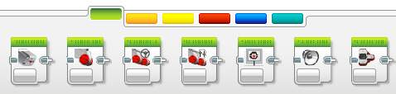
EV3 Blocks: Colored Tabs
ACTION BLOCKS
Move, Large & Medium Motor, Display…
FLOW BLOCKS
Start, Wait, Loop, Switch, Loop Interrupt
SENSOR BLOCKS
Brick Buttons, Gyro, Color, Ultrasonic
1
2
3
1
2
3
4
5
6
DATA OPERATIONS
Variables, Array, Logic, Math, Compare…
ADVANCED BLOCKS
Data Logging, Unregulated Motor…
MY BLOCKS
Custom Blocks you create
4
5
6

Slide 14
CREDITS
Author: Sanjay and Arvind Seshan
More lessons are available at www.ev3lessons.com
This work is licensed under a Creative Commons Attribution-NonCommercial-ShareAlike 4.0 International License.

