Slide 1
BEGINNER PROGRAMMING LESSON
NXT Light Sensor with NXT
Programmed in EV3-G

Slide 2
LESSON OBJECTIVEs
Learn how to use the NXT Light sensor with an NXT brick using EV3-G programming

Slide 3
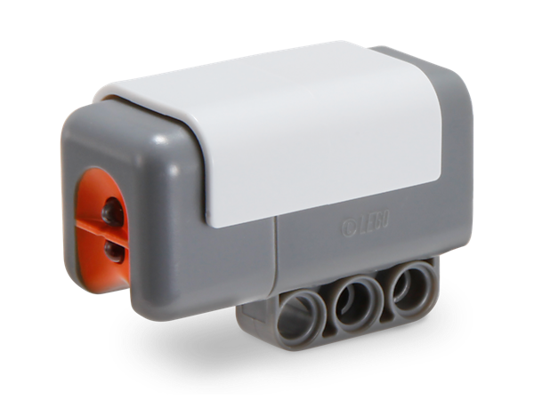
Using a light sensor with NXT in EV3-g
How can we make a light sensor work with the EV3 software and NXT brick?
Pretend it is a sound sensor (Beginner)
Use the Raw Sensor Block (Advanced)
This lesson will cover the beginner level

Slide 4
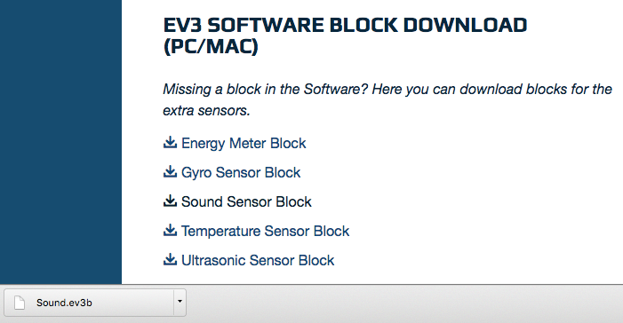
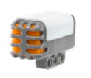

Downloading the Sound Block
The Sound Sensor Block is available for download on the LEGO.com site:
http://www.lego.com/en-us/mindstorms/downloads
Download the block using the “Importing Additional Blocks Lesson” in Beginner in EV3Lessons.com
Note: If you are using the EDU software, the block will already be in your palette

Slide 5
Using the light sensor with the sound sensor block
Once you install the sound sensor block, you can select the sound sensor for any loop, switch, or wait block.
The “sound” sensor has two settings:
In dB mode, it shines a red light and measures how much light is reflected. (Reflected light mode) A red light comes from the sensor whenever it is working in dB mode. White surfaces give a high (~70) reading. Black surfaces give a low (~20) reading.
In dBa mode, it looks for ambient light. (Ambient Light Mode) The red light will not be on.
Don’t worry about using a sound sensor in your program when you really have a light sensor connected. Everything works just fine.

Slide 6
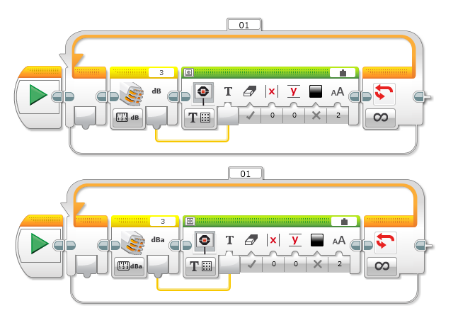
Example Usage: Reading the Light Sensor & Displaying
Reflected Light mode
Ambient Light mode

Slide 7
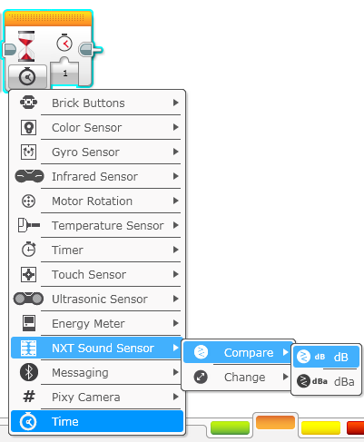
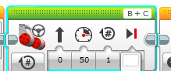
COLOR SENSOR CHALLENGE
Now that you know how to use the NXT Light sensor, can you use it to make the robot move up to a black line using the color sensor?
Step 1: Use Wait For NXT Sound Sensor (NXT Light)
Step 2: Use the NXT Sound Sensor in Compare dB mode
Step 3: To know what value to use, you will have to use Port View to determine what the NXT Light sensor reads for Black (refer to the ”Port View” Lesson in Beginner in EV3Lessons.com. Note that for the NXT, this is called “View → Light”)
Hint: You will use Move Steering (think about motor on and off) and Wait for “Color”

Slide 8
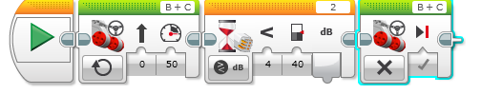
Color Sensor Challenge Solution
FINISH
Move Steering
Set to “ON”
Wait until Color is Black (threshold <40 determined using View)
Move Steering
Set to “OFF” with BRAKE
START

Slide 9
Using your NXT light sensor with other EV3 programs
When can we substitute a “sound” (really light) sensor for a color sensor in a program written for an EV3?
When the sensor only needs to tell light from dark.
When the colors to be told apart give reliably & consistently different readings.
Stop on a line, follow a line, and avoid a line are no problem. Following only green lines will be hard, maybe impossible.
Note: To learn how to use the NXT Light sensor to line follow, see the Line Following lesson on EV3Lesson.com

Slide 10
Notes for teachers/coaches
It’d be nice if the sound sensor block looked like the light sensor and were labeled as a light sensor, but the kids in my class adjusted to this quirk pretty easily. It was certainly easier to explain to novices than using raw values would have been. Installing the sound sensor block before class time will save on headaches.
Some other options, for those who would like to pursue them:
The “NXT light sensors in EV3 tutorial” at EV3lessons.com
Calibrating a light sensor (still uses the sound block) http://drpineda.ca/using-nxt-light-sensor-in-ev3.html
https://www.youtube.com/watch?v=I7Bqvk-uMLk&feature=youtu.be

Slide 11
Credits
This tutorial was created by Cathy Sarisky. Slides were modified and additional slides were added by Sanjay and Arvind Seshan.
More lessons are available at www.ev3lessons.com
This work is licensed under a Creative Commons Attribution-NonCommercial-ShareAlike 4.0 International License.

