Slide 1

BEGINNER PROGRAMMING LESSON
More Challenges

Slide 2
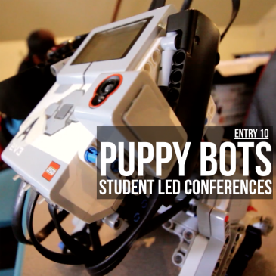
Challenges in this Lesson
Last year, we came across a really good set of videos by a robotics teacher in Texas.
He used EV3Lessons materials and combined them with his own project ideas.
This tutorial is a collection of challenges created by Thom Gibson at Headwaters School in Austin, Texas, USA
The challenges are reproduced here with his permission. Please credit Thom Gibson for the work.
For each challenge, Mr. Gibson provides a description of the requirements, a project rubric, as well as a project reflection sheet.
Links to videos from Mr. Gibson’s class have also been provided for inspiration
Image Credit: Thom Gibson

Slide 3
GOLD DIGGER PROJECT
Project Requirements
Find 3 pieces of randomly placed yellow-colored paper on a table using the color sensor, without falling off the table
Note from EV3Lessons: It is a good idea to test out if your colored paper is easily recognized by the color sensor. The closer the color is to LEGO colors, the better. We have found that rather than kids’ construction paper, thicker card stock with more vivid colors work better with the EV3 Color Sensor. You can use Port View to check the paper.
Videos:
https://youtu.be/8LnsCfJbRFY
https://youtu.be/_4kJwx6QzGU
Created by Thom Gibson (slightly modified by EV3Lessons)

Slide 4
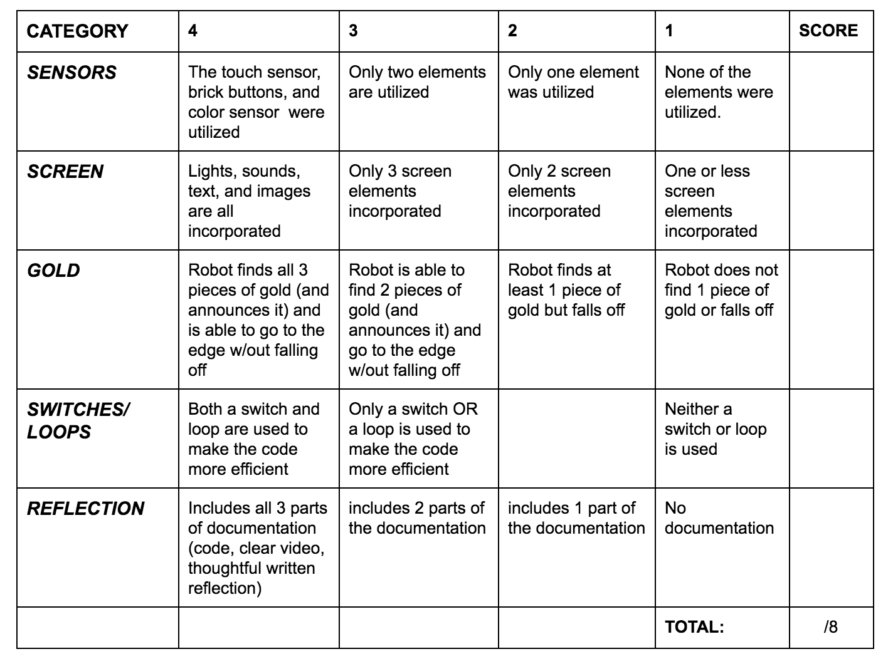
Gold DIGGER RUBRIC
/20
Created by Thom Gibson

Slide 5
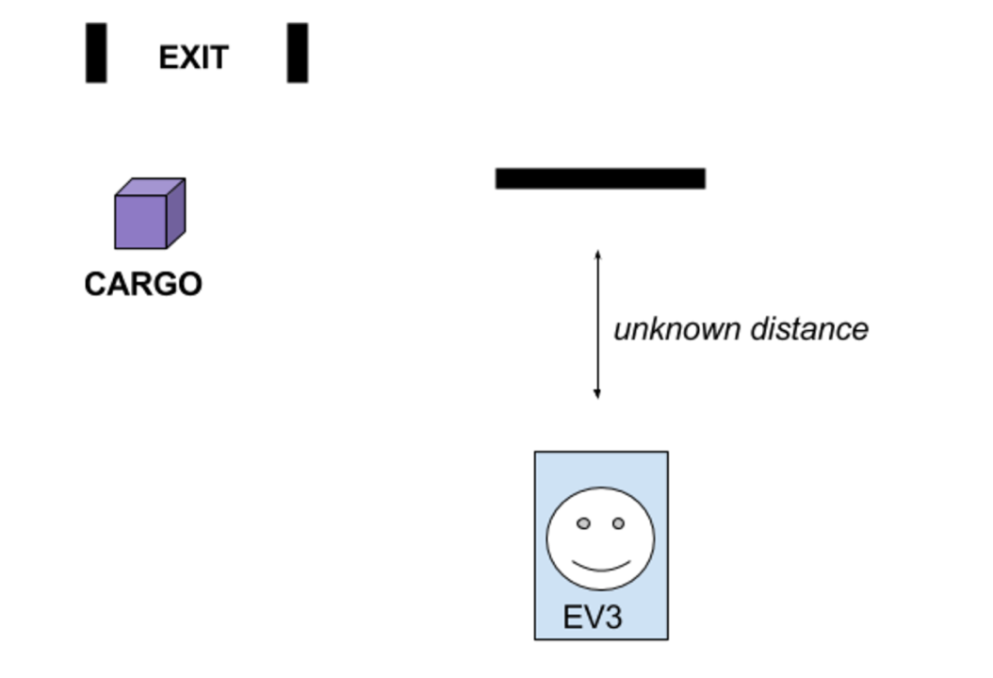
CARGO RESCUE PROJECT
After retrieving the gold in the previous challenge, you realize that you have dropped precious cargo that’s vital to the mission! You are able to scan the map and see where it is.
You know you will have to travel an unknown distance to a cliff wall, turn exactly 90 degrees to the left, travel an unknown distance forward to retrieve the cargo, and then turn exactly 90 degrees to the right to make you exit back to base camp.
Your rover is equipped with an Ultrasonic Sensor. (Gyro sensor is optional if you have not learnt how to use this sensor yet.)
Cliff
Start
Video: https://youtu.be/8ErF489RfhQ
Created by Thom Gibson (slightly modified slightly by EV3Lessons)

Slide 6
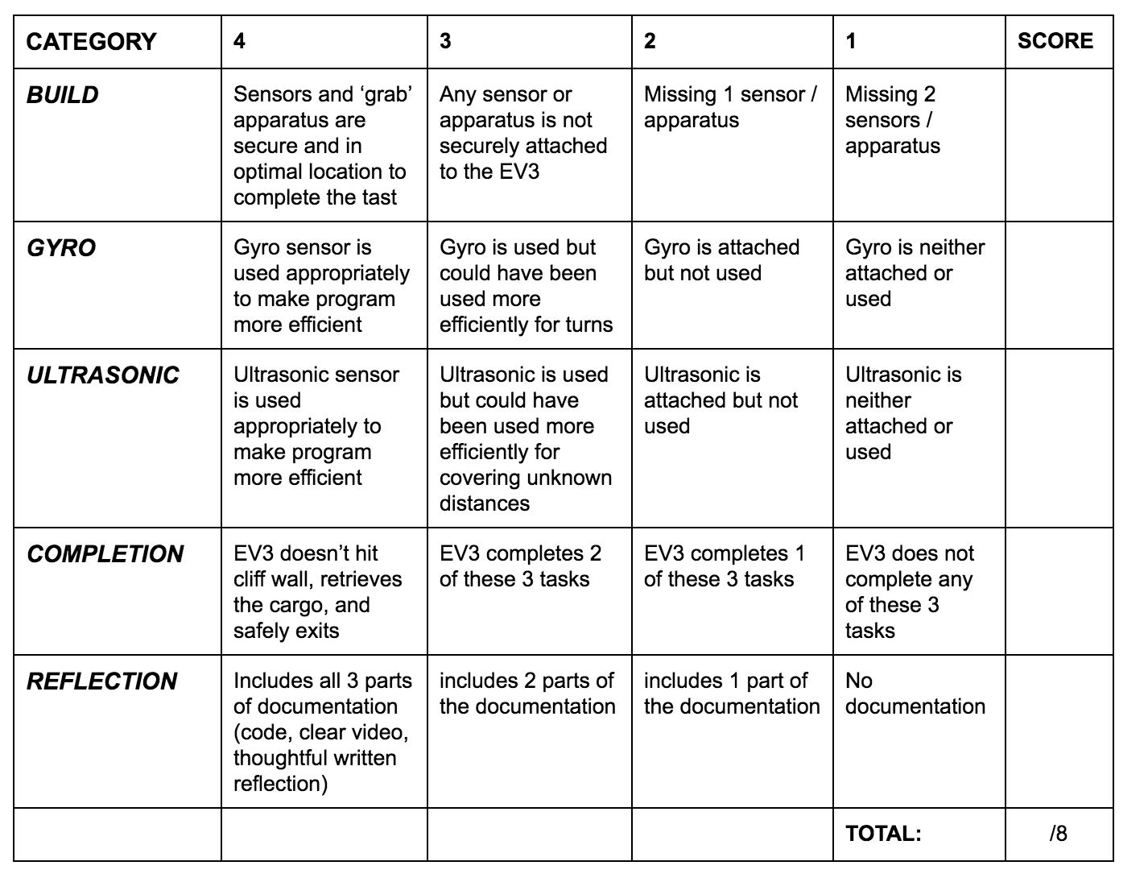
Cargo RESCUE RUBRICS
/20
Created by Thom Gibson

Slide 7
SENSORY PROJECT
Project Requirements
Ideas
Create a robot that uses each of the sensors at least once (touch, color, ultrasonic/infrared)
Use text on screen
Use brick sounds and lights
Use at least one brick button
Optional: If you have learnt how to use the Gyro sensor, add the gyro sensor
Create an obstacle course for your robot
Create an interactive game
Video: https://youtu.be/9dEupLZSI6s
Created by Thom Gibson (slightly modified by EV3Lessons)

Slide 8
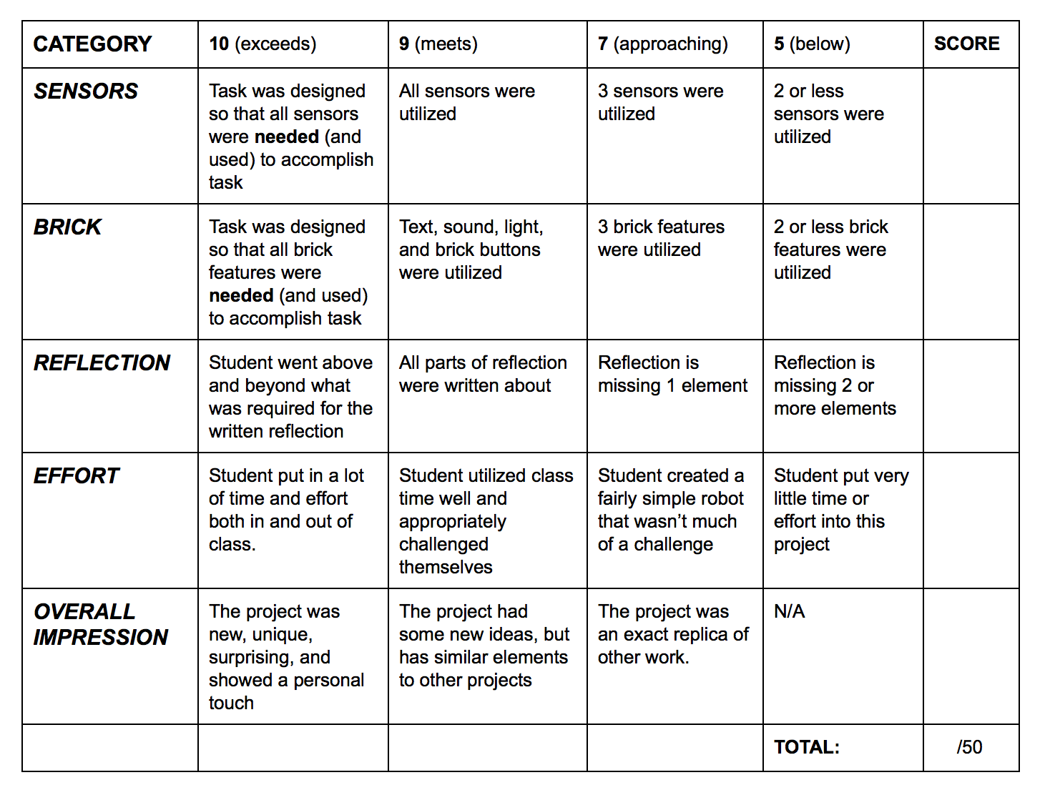
SENSORY PROJECT RUBRIC
Created by Thom Gibson

Slide 9
PROJECT REFECTION SHEET (FOR ALL PROJECTS)
1) What is the intended action for your robot (original plan)? Did your plan change in any way? Why or why not?
2) What challenges did you come across? Were there any that seemed too difficult to overcome in the time given?
3) Did you go through many iterations? (Provide video or other documentation of your robot failing)
4) Did you have any “aha” moments?
5) What parts of this project are you most proud of?
6) Include a screenshot of your code and a video of your robot in action
Created by Thom Gibson (slightly modified by EV3Lessons)

Slide 10
CREDITS
This challenges in this tutorial were created by Thom Gibson (https://thomgibson.com/)
The material was compiled and slightly modified by Sanjay Seshan and Arvind Seshan
More lessons are available at www.ev3lessons.com
This work is licensed under a Creative Commons Attribution-NonCommercial-ShareAlike 4.0 International License.

