Slide 1

BEGINNER PROGRAMMING LESSON
Picking Up and Moving an Object

Slide 2
Objectives
Learn how to program a robot to move an attachment arm – a powered attachment
Learn how to make useful attachments

Slide 3
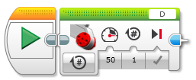
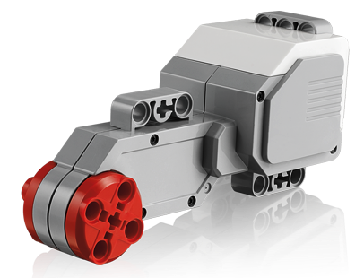
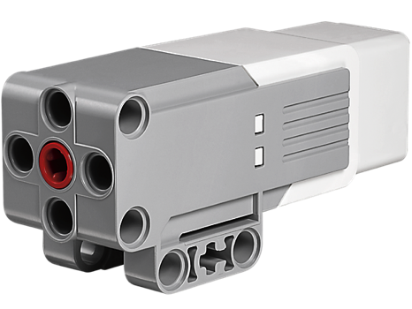
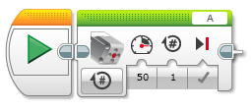
New Tool: Motor Blocks
You can use the Large EV3 Motor or the Medium EV3 Motor for attachment arms
Move Steering vs. Motor Block
For moving your wheels you should use a Move Steering Block that syncs both wheel motors (see Intermediate lesson called Move Blocks to learn about sync)
For moving your attachment your arm, you use either a Medium Motor Block or a Large Motor Block because you don’t need to sync your motors.
Large Motor Block
Medium Motor Block

Slide 4
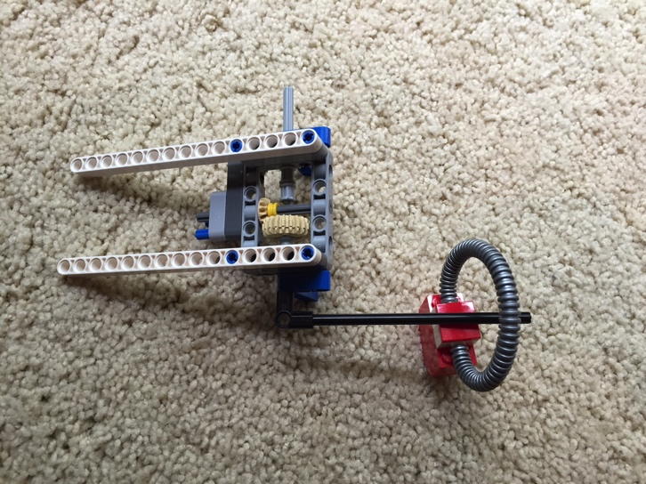
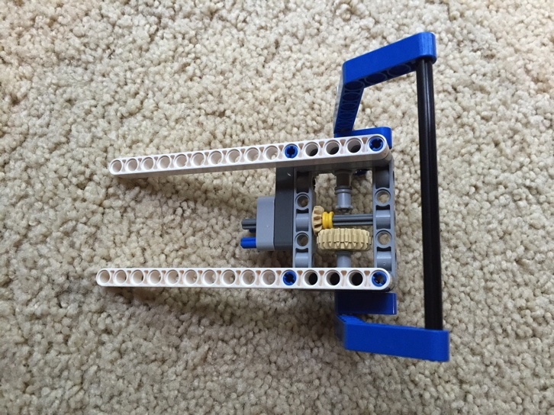
Using a Medium Motor
Attach a medium motor to Port A or a large motor to Port D as needed
This is a generic set-up for the EV3
Construct an attachment that can pick up or grab a hoop (object)
Look at the two examples on the right. They use the DroidBot’s SNAP attachment
DroidBot’s build instructions are available on the Robot Design page of EV3Lessons.com

Slide 5
Pick Up and Move Object Challenge
From the start line, move up to the black line
Pick up the object and bring it back to the start line
You can have the robot turn to come back or simply move backwards
You can make the object a cube to grab (as in the Core EV3 kit) or an item with a loop on top depending upon the pieces you have available.

Slide 6
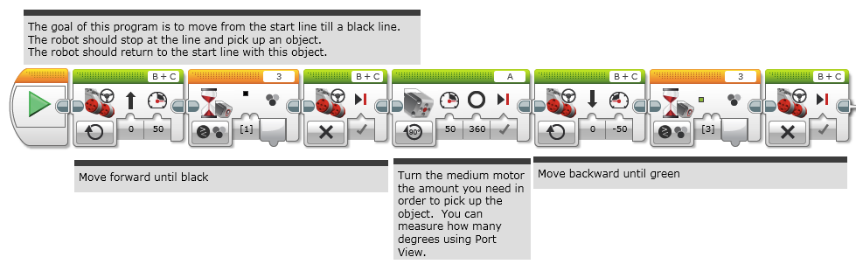
Challenge Solution

Slide 7


Trip to the Grocery Store
1. Start at Home and drive to the grocery store
2. Have your robot turn and backup/reverse into the parking space
3. Stop to pick up groceries
4. Return home using the short cut
2
1
3
4

Slide 8
Next Steps
Now that you know how to move an arm on a robot, can you move the arm while moving?
Check out the Parallel Beams lesson in Intermediate and Advanced
Refer to the Move Blocks Lesson in Intermediate to learn more about the differences between Move Steering and Motor Blocks

Slide 9
Credits
This tutorial was created by Sanjay Seshan and Arvind Seshan
More lessons at www.ev3lessons.com
This work is licensed under a Creative Commons Attribution-NonCommercial-ShareAlike 4.0 International License.

