Slide 1

BEGINNER PROGRAMMING LESSON
Brick Program

Slide 2
Lesson Objectives
Learn how to use brick program

Slide 3
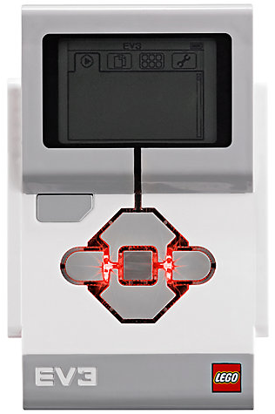
The “Brick” Buttons
1 = Back Undo Stop Program Turn robot off
2 = Center Button Select options Run Program Turn robot on
3 = Left, Right, Up, Down Navigate menus
1
3
3
2
3
3

Slide 4
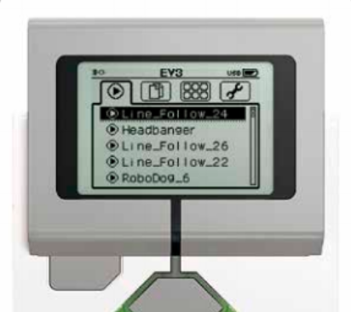
The “Brick” Screen
Tabs on Screen
Run Recent Find programs you ran recently
2. File Navigation Find all programs by project
Brick Apps Brick Program
4. Settings Bluetooth, Wifi, Volume
1
2
3
4

Slide 5
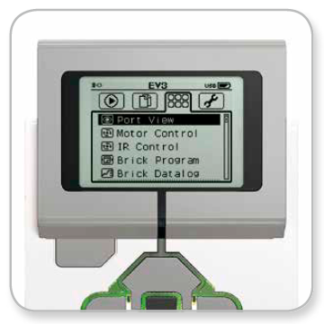
Where is Brick Program?
The third tab on the brick is called “Brick Apps”
The fourth item down is Brick Program
Image Credit: EV3 User Guide

Slide 6
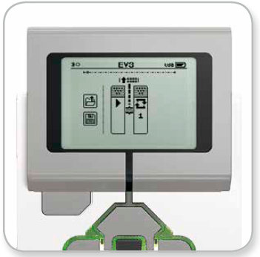
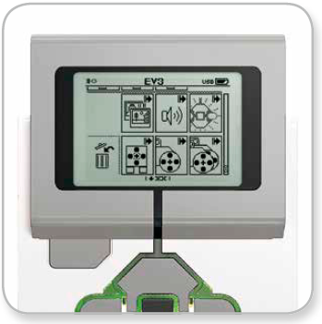
GETTING STARTED
Start Screen has a start block and a loop block. Press the Up button to add a block
Block Palette has all the blocks available. Navigate using Left, Right, Up, and Down buttons. Select with Center button
Image Credit: EV3 User Guide

Slide 7
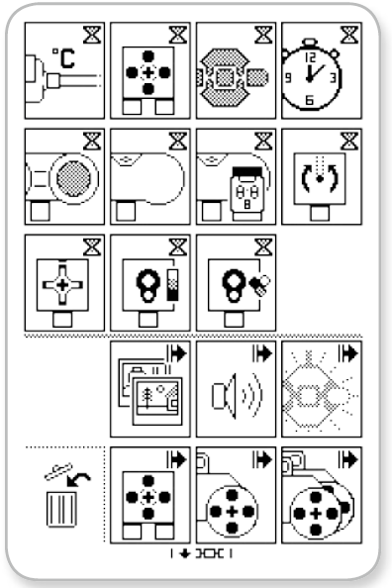
BLOCKS AVAILABLE
There are two types of commands:
Wait for (Hourglass Icons)
Action (Arrow Icons)
Trash Can deletes selected block
Image Credit: EV3 User Guide

Slide 8
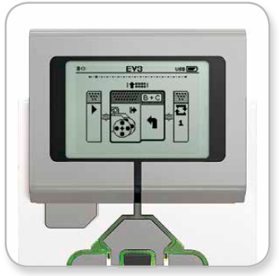
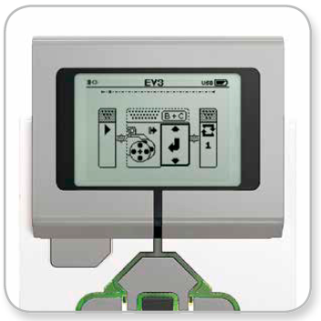
CHANGING PARAMETERS
To change a block’s parameters, make sure it is selected (in center of screen)
Press Center button to modify parameters for the block
Use Up/Down buttons to change value
Image Credit: EV3 User Guide

Slide 9
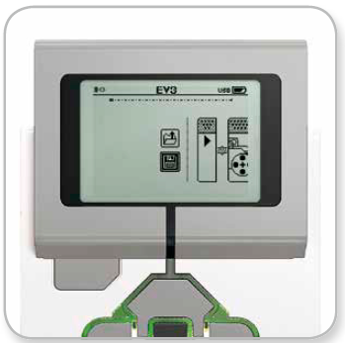
DELETE, SAVE, RUN
To delete, highlight the block, and press the Up button to go to the Block Palette and find the Trash Can icon.
To save, select Back button to return to the beginning of the program. Then select the Save icon to name and save the program
To run the program, use the Left button to get to the the Start block. Then press the Center button.
Image Credit: EV3 User Guide

Slide 10
DISCUSSION
Brick program can be useful for quick tests of your motors and sensors before you are ready to program
It can also be used in cases where computers are not available for students.

Slide 11
CHALLENGES
Challenge 1:
Use Brick Program to Move Until a Black Line.
Challenge 2:
Use Brick Program to Move Until the Ultrasonic is Less than 20cm. Say Stop before you stop moving.

Slide 12
CREDITS
Author: Sanjay and Arvind Seshan
More lessons are available at www.ev3lessons.com
This work is licensed under a Creative Commons Attribution-NonCommercial-ShareAlike 4.0 International License.

