Slide 1

BEGINNER PROGRAMMING LESSON
Sound Block

Slide 2
LESSON OBJECTIVES
Learn to use the Sound Block
Understand why the Sound Block can be useful in programming

Slide 3

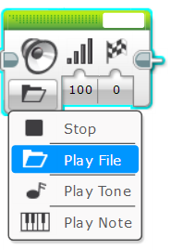
Sound Block
The Sound Block plays sounds to the EV3
You can play files, tones, and notes
Located in Green Tab

Slide 4

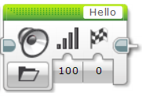
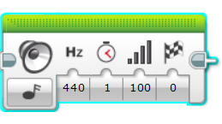
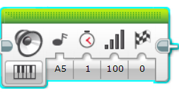
MORE ON Sound Blocks
Four Modes
Stop
Stop playing any sounds
Play File
Play a .rsf sound file
This is used for playing sounds (eg. Hello)
Play Tone
Play any music note (eg. D, D#)
Also plays custom frequencies via a data wire
Play Note
Play a key on a piano

Slide 5
Inputs
C
A
B
D
E
A
B
F
E
A
B
Volume of sound
Wait for the sound to finish before moving on
Sound file name
Frequency/Note of sound
Duration of sound
Piano note to play

Slide 6
Sound BLOCK CHALLENGE 1
Make a program that plays hello after you press the touch sensor
Hints:
You will have to use a wait block
You will have to use the sound block in File mode

Slide 7
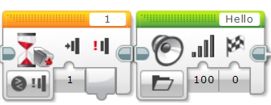
Challenge 1 solution
Wait for touch
Play Hello

Slide 8
Sound block CHALLENGE 2
Pick up your robot and place it on different colors. Check if the color sensor reads black. If so, have the robot say “black”. If the color sensor sees red, have the robot say “red”
For any other color, play a note of your choice for 0.01 seconds
Make sure that the sound waits for completion
Repeat this forever
Bonus Challenge: Can you the above while having the robot move? Have the robot drive over different colors to test your code

Slide 9
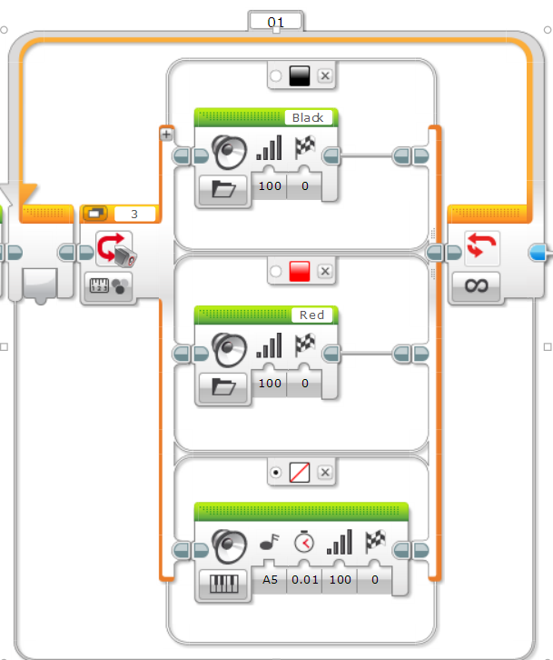
Challenge 2 Solution
Switch set to measure color
If Black, play Black
Loop forever
If Red, play Red
Set as default
Play a note for any other color

Slide 10
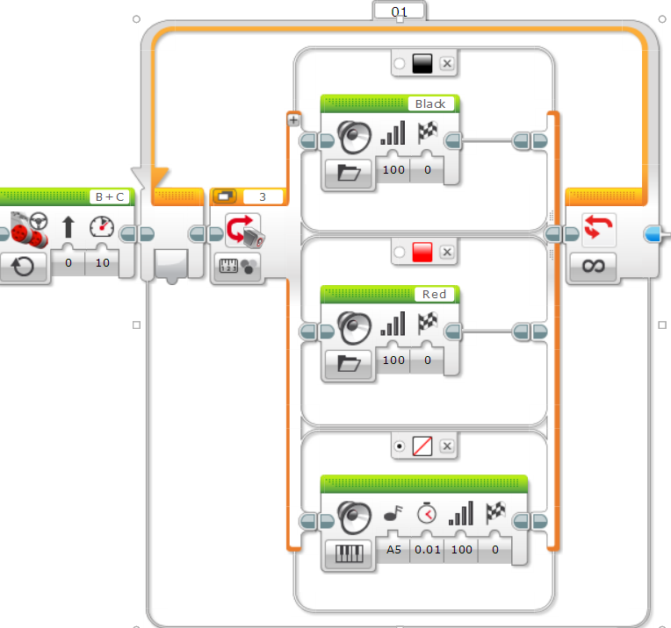
Challenge 2 Bonus Solution
Switch set to measure color
If Black, play Black
Loop forever
Move on at 10 power
If Red, play Red
Set as default
Play a note for any other color

Slide 11
Additional Challenges
Add more colors to the switch so that as the robot drives over additional colors, it say “green”, “blue”, “yellow”, etc.
Make the code stop after the robot detects 5 colored bands

Slide 12
Discussion Guide
Why might you want to know how to use the sound block?
You might want to know what part of the code you are at. See Debugging lesson in Intermediate
The sound block is a fun way to add emotion to your robot
You can use sounds to interact with the user in a game by saying “good job”, “game over”, etc.

Slide 13
CREDITS
This tutorial was created by Sanjay Seshan and Arvind Seshan
More lessons are available at www.ev3lessons.com
This work is licensed under a Creative Commons Attribution-NonCommercial-ShareAlike 4.0 International License.

