Slide 1

BEGINNER PROGRAMMING LESSON
Introduction to the NXT Sound Sensor

Slide 2
Lesson Objectives
Learn to use the NXT Sound Sensor with the EV3
Pre-requisites: Switches

Slide 3
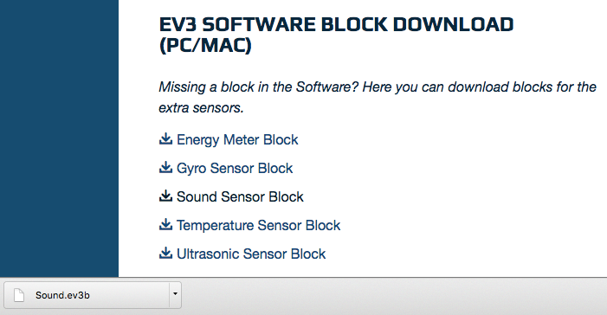
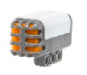

Downloading the Sound Block
The Sound Sensor Block is available for download on the LEGO.com site:
http://www.lego.com/en-us/mindstorms/downloads
Download the block using the Importing Additional Blocks Lesson in Beginner

Slide 4
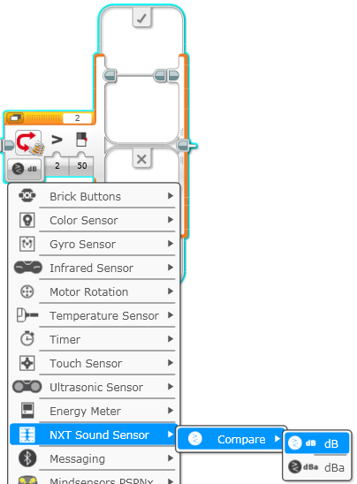
Switch - NXT Sound Sensor
Compare Mode
dB
Sound level, scaled to a percentage
dBa
Sound level, adjusted to approximate human ear sensitivity, and then scaled to a percentage
Source: EV3 Help Menu

Slide 5
Sound Sensor Challenge
Write a “Celebration” program where the robot moves faster or slower depending on how loud the sound is
Hint
Switch - NXT Sound Sensor Block will be used
You can use dB or dBa for this challenge

Slide 6
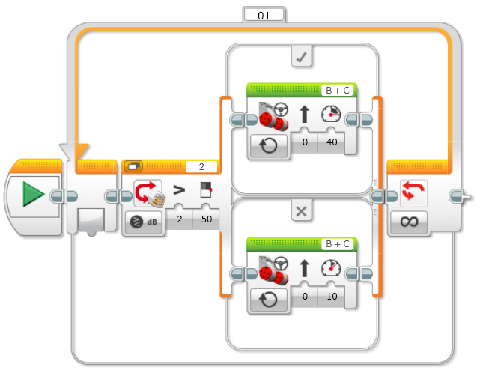
Challenge Solution
Move forward quickly when the sound level is high (>50)
Move forward slowly when the sound level is low (<50)

Slide 7
Credits
This tutorial was created by Sanjay Seshan and Arvind
More lessons are available at www.ev3lessons.com
This work is licensed under a Creative Commons Attribution-NonCommercial-ShareAlike 4.0 International License.

