Slide 1

BEGINNER PROGRAMMING LESSON
Ultrasonic Sensor

Slide 2
LESSON OBJECTIVES
Learn about the Ultrasonic Sensor
Learn how to use Wait Until Ultrasonic Block
Learn the difference between the Wait Until Ultrasonic Block and the Ultrasonic Block

Slide 3
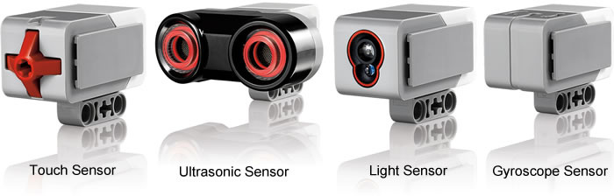
What is a sensor?
A sensor lets an EV3 program measure and collect data about is surroundings
The EV3 sensors include:
Color – measures color and darkness
Gyro – measures rotation of robot
Ultrasonic – measures distance to nearby surfaces
Touch – measures contact with surface
Infrared – measures IR remote’s signals
Infrared Sensor
Image from: http://www.ucalgary.ca/IOSTEM/files/IOSTEM/media_crop/44/public/sensors.jpg

Slide 4
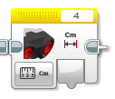
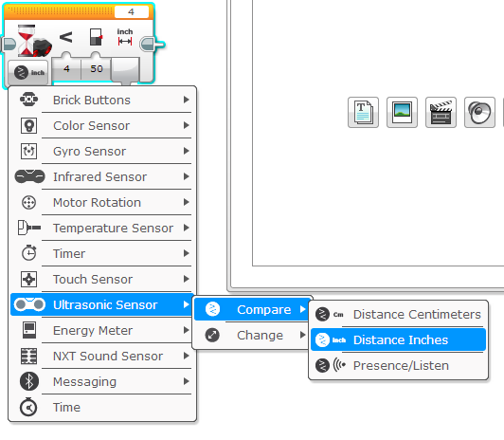
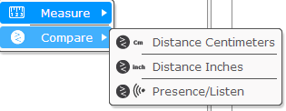
ULTRASONIC
An ultrasonic sensor measures distance.
You use it when you need to make sure you are a certain distance away from a target.
The distance can be measured in inches or centimeters.
To read the ultrasonic sensor, you use the Ultrasonic Block. To use the ultrasonic to do an action until a distance, you use “Wait Until”
Read Ultrasonic
VS.
Wait for Ultrasonic

Slide 5
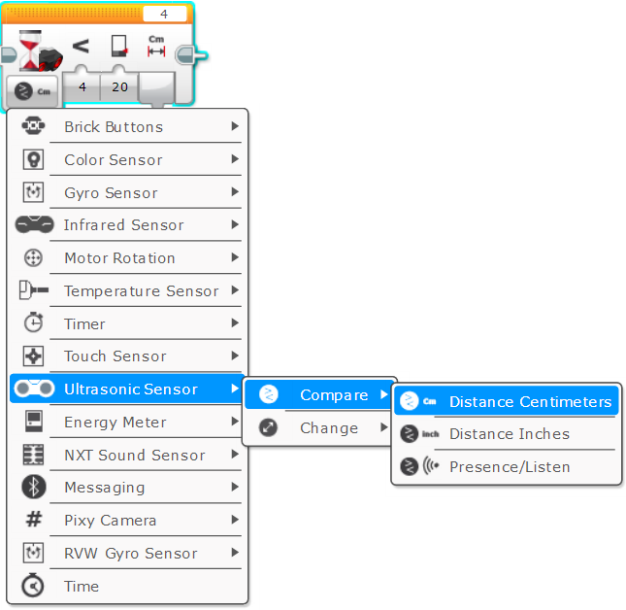
Ultrasonic CHALLENGE 1
Challenge: Make the robot move until it is 20cm away from the wall.
Step 1: Make a new program
Step 2: Set move to “on”
Step 3: Set wait block to use the Ultrasonic
Step 4: Set move block to “off”

Slide 6
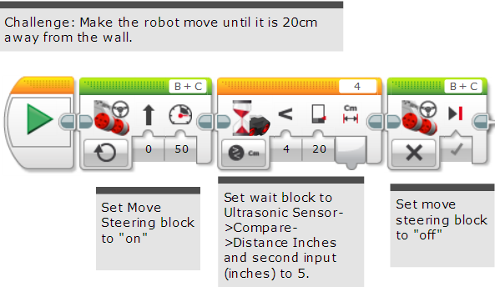
Challenge 1 solution

Slide 7
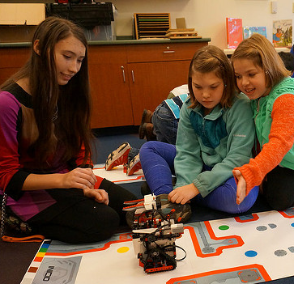
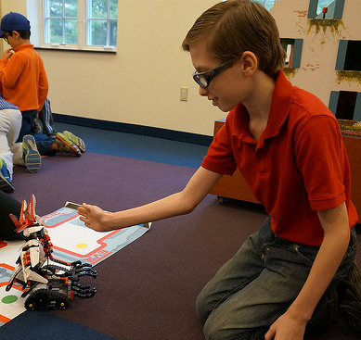
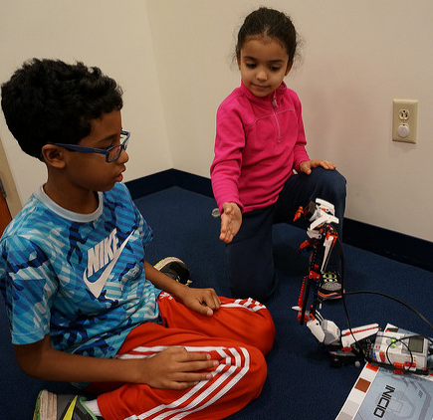
CHALLENGE 2: Use The Force To Control Your Robot!

Slide 8
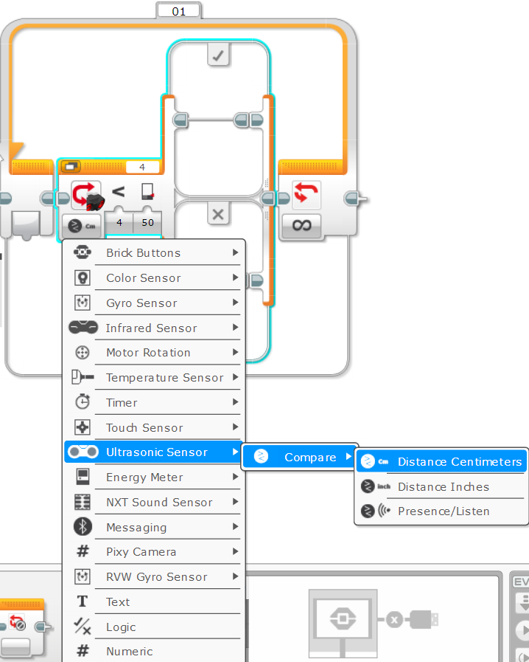
Challenge 2: PSEUDOCODE
If the robot is closer than 20cm away from your hand move backward, otherwise move forward.
Step 1: Drag a loop from the orange tab
Step 2: Drag a switch inside loop
Step 3: Set switch to Ultrasonic
Step 4: Set move steering block to ON with negative power and place in TRUE
Step 4: Set move steering block to ON with positive power and place in FALSE

Slide 9
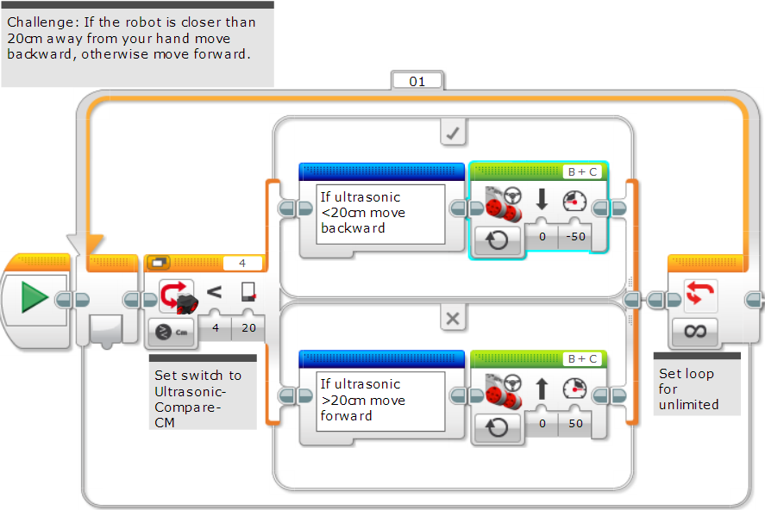
Challenge 2 solution

Slide 10
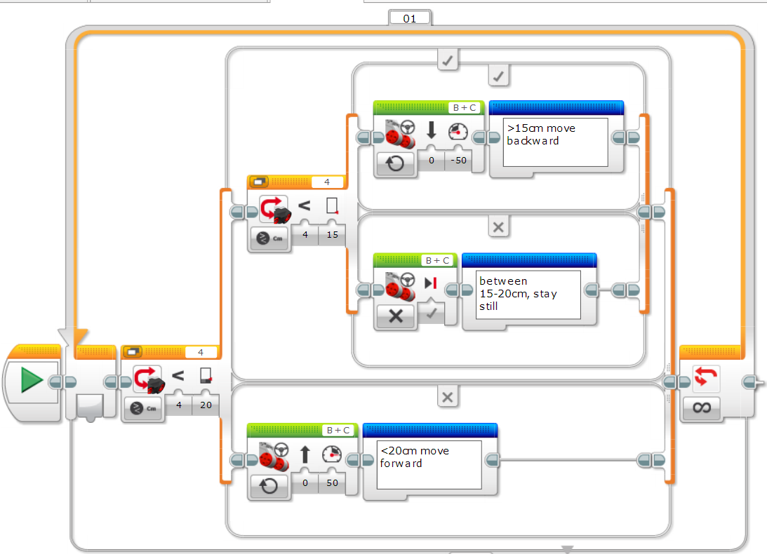
Learning To Master Your Force
The previous code kept the robot moving always. This version lets the robot rest if it is between 15-20 centimeters.

Slide 11
CREDITS
This tutorial was created by Sanjay Seshan and Arvind Seshan
More lessons are available at www.ev3lessons.com
This work is licensed under a Creative Commons Attribution-NonCommercial-ShareAlike 4.0 International License.

