Slide 1

Introduction to ev3dev: Setup

Slide 2
Objectives
Learn how to install ev3dev on an EV3
Learn to setup networking on ev3dev and connect to the ev3 using ssh
Prerequisites: none

Slide 3
Materials
EV3 brick
USB WIFI (Optional)
Micro SD card (2gb+ but smaller than 32gb)

Slide 4
What is ev3dev?
ev3dev is a Debian Linux-based operating system that runs on the LEGO® MINDSTORMS EV3
ev3dev allows you to program in different languages (eg. Python, c++)
ev3dev supports many USB and Bluetooth devices, like Wi-Fi dongles, keyboards, keypads, joysticks and cameras work too.

Slide 5
Step 1: Download ev3dev
Download the latest version of EV3dev for EV3 here (https://github.com/ev3dev/ev3dev/releases)
Unzip the file
Remember where you put the .img file

Slide 6
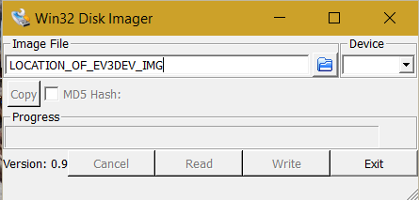
Step 2: Write Image (Windows)
Download win32diskimager
Insert the Micro SD card into the computer
Browse for the .img file you downloaded in win32diskimager
Write to the drive letter of your SD card (in device dropdown)
Accept all warnings

Slide 7
Step 2: Write Image (Mac OS X)
Open terminal from Application → Utilities
Run diskutil list
Now insert you SD card and run diskutil list again. The new entry (/dev/ID_OF_CARD) is your SD card. Remember the ID_OF_CARD
Run diskutil unmountDisk /dev/ID_OF_CARDs1
Unmount your SD card. If it has more than one partition, you will need to do this for each partition. (Listed as identifier when running diskutil list)
This is the dangerous part. If you pick the wrong device, you could wipe out your hard drive, so BE CAREFUL!.
Run sudo dd if=Location_OF_EV3DEV_IMG of=/dev/rID_OF_CARD bs=4m
REPLACE EVERY ID_OF_CARD WITH THE ACTUAL DISK ENTRY FOUND IN DISKUTIL LIST (EG. DISK1)

Slide 8
Step 2: Write Image (Linux)
Run df –h
Now insert you SD card and run df -h again.
See the a new entry eg.(/dev/sdb1)? That is your SD card. sdb is the actual device name and 1 is the partition number. Your actual device may be named something different.
Run sudo umount /dev/sdb1
You may have to run this more than once with a different number at the end if you have more than one partition
IMPORTANT: Note sdb is just an example id. Your actual device may be named something different.
Run sudo dd if=Location_OF_EV3DEV_IMG bs=4M of=/dev/sdb

Slide 9
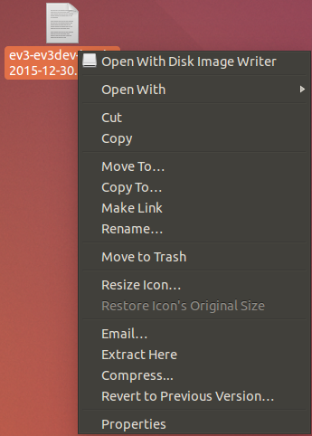
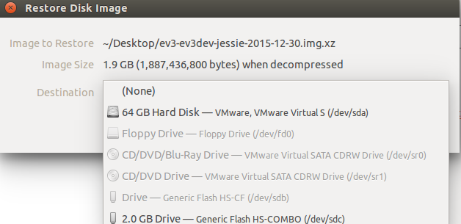
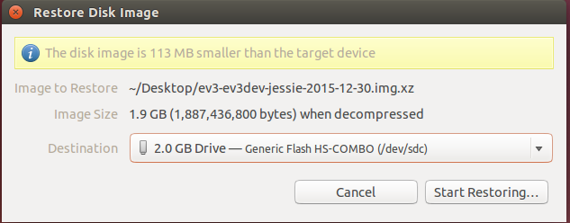
Step 2: Write Image (Ubuntu Linux)
Download the ev3dev image file ending with .xz instead of .zip (do not extract)
This is our micro SD card. (Yours will probably be different)

Slide 10
Step 3: Boot ev3dev
Put the SD Card in your EV3 and power it on.
At first, you will see the MINDSTORMS boot splash and the red LEDs will be on. This is immediately followed by the ev3dev boot splash and the LEDs changing to orange.
The button lights on the EV3 brick (LEDs) indicate SD card activity.

Slide 11
Step 4: Connect to the Internet
Insert the USB Wi-Fi dongle
Note that more than the standard LEGO specified Wi-Fi dongles should work
Navigate to Wireless and Networks using arrow keys on robot
Find Wi-Fi
Select Powered
Press Start Scan
Select a network that you recognize
Press connect
When you are prompted with a dialogue press the middle button
Type in the passcode
Select Accept then Accept on the other remaining dialogue
To connect to the Internet in another way (USB or Bluetooth) visit here

Slide 12
Step 5: SSH on Linux/Mac OS X
Launch terminal
Find the IP Address of your EV3 (On the top left of the EV3 screen)
In Terminal type ssh IP_Address_EV3 –l root
Replace IP_Address_EV3 with the value you found in step 2
The password is r00tme
root is the username
To change the password run sudo passwd
To make a new user run useradd NAME_OF_USER
Replace NAME_OF_USER with the username you want

Slide 13
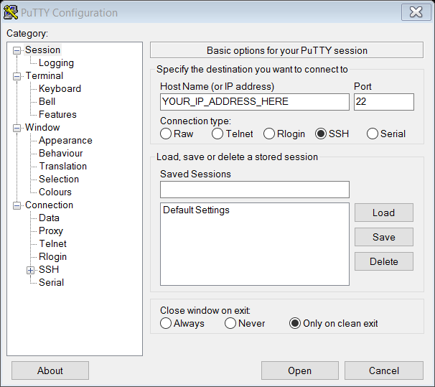
Step 5: SSH on Windows
Install Putty
Find the IP Address of your EV3 (On the top left of the EV3 screen)
Connect to the EV3:
Press open
root is the username
The password is r00tme
To change the password run sudo passwd
To make a new user run useradd NAME_OF_USER
Replace NAME_OF_USER with the username you want

Slide 14
CREDITS
This tutorial was created by Sanjay Seshan and Arvind Seshan from Droids Robotics.
More lessons are available at www.ev3lessons.com
Author’s Email: team@droidsrobotics.org
Credits: ev3dev.org
This work is licensed under a Creative Commons Attribution-NonCommercial-ShareAlike 4.0 International License.

