Slide 1

INTERMEDIATE PROGRAMMING LESSON
Brick buttons AS SENSORS

Slide 2
Lesson Objectives
Learn how to use your brick buttons as sensors
Prerequisites: Display Blocks

Slide 3

What are the Brick Buttons?
The Brick Buttons are the five buttons on the EV3 Brick (all buttons except the Back button)
They can be used as sensors to detect if a button has been pressed, to find out which button was pressed and to control your program
You can even use them to track if the button was pressed and then released in the past (like Bumped for the Touch Sensor)
Note: You cannot detect if two buttons are pressed at the same time
Wait Blocks, Switches, Loops and the Brick Buttons Programming Blocks all let you use the brick buttons as sensors

Slide 4
Challenge 1: Button Press & Debugging
CHALLENGE: Program your robot to move forward until a button is pressed. Just like in the beginner lessons that used sensors, you will use a Wait For block to complete this challenge.
A good use for such a program might be to help you debug. Adding a Wait For Button Press in your code helps you run parts of your code and check for errors.
STEP 1: Turn on motor in your Move Steering Block
STEP 2: Add a Wait For Button Press (Middle Button)
STEP 3: Stop Motors after the button is pressed.

Slide 5
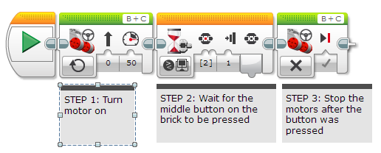
Challenge 1 Solution

Slide 6
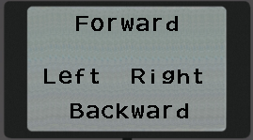
Challenge 2: Menu With Buttons
Create an onscreen menu using the brick buttons that does a different action based on which button is pressed. The actions to program are – go forward, backward, left and right
STEP 1: Use four Display Blocks to display the 4 actions on the screen so it will look like the image on the right
STEP 2: Add a Wait For button press
STEP 3: Add a Switch Block and based on which button is pressed, run the code for the four actions – left, right, forward, backward
STEP 4: Place all the above Blocks in a loop that runs forever

Slide 7
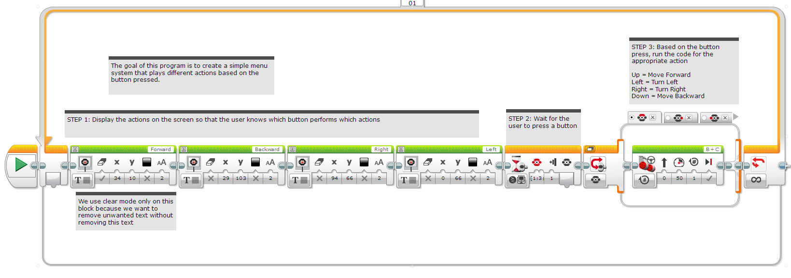
Challenge 2 Solution
Note that if the action in the switch block is very quick (like adding to a variable or displaying a sensor value), the above loop and selected action will run multiple times

Slide 8
CREDITS
This tutorial was created by Sanjay Seshan and Arvind Seshan
More lessons are available at www.ev3lessons.com
This work is licensed under a Creative Commons Attribution-NonCommercial-ShareAlike 4.0 International License.

